Slide 1



A CENTER FOR INTER-DISCIPLINARY RESEARCH
2018-19
TITLE
IMAGE CLASSIFICATION USING PYTHON
SUPERVISED BY
LOKESH KONJETI
GOKARAJU RANGARAJU
INSTITUTE OF ENGINEERING AND TECHNOLOGY
AUTONOMOUS

Slide 2
Advanced Academic Center
( A Center for Inter-Disciplinary Research )
This is to certify that the project titled
“ ------------------------------------’’
is a bonafide work carried out by the following students in partial fulfilment of the requirements for Advanced Academic Center intern, submitted to the chair, AAC during the academic year _______________________
Image classification using python
2019-2020
NAME | ROLL NO. | BRANCH
ARCHANA JAMINI | 18241A0475 | ECE
POTHULA SOWMYA | 18241A0498 | ECE
KAKARLAPUDI BHANU SRI | 18241A0477 | ECE
KADIYALA SAI PREMANVITHA | 18241A0476 | ECE
BOORLA NITHISHA | 18241A0465 | ECE
This work was not submitted or published earlier for any study
Dr ./Ms./Mr.
Dr.B.R.K.Reddy
Program Coordinator
Dr.Ramamurthy Suri
Associate Dean,AAC
Project Supervisor
i

Slide 3

ACKNOWLEDGEMENTS
We express our deep sense of gratitude to our respected Director , Gokaraju Rangaraju Institute of Engineering and Technology for permitting us to carry out this project and for the valuable guidance .
With immense pleasure, we express our deep sense of gratitude to our respected principal, for permitting us to carry out this project.
We are thankful to Associate Dean ,Advance Academic Centre for providing us appropriate ecosystem required to complete the project .
We are thankful to our project supervisor who spared valuable time and influenced novel ideas to guide us. We are indebted to all the above without whom we would not have completed the project.
ii

Slide 4
TABLES OF CONTENTS
Authorisation………………………………..i
Acknowledgments…………………………..ii
Abstract…………………………………......iii
1.Introduction……………………………….1-4
1.1 What is Artifical intelligence………….1
1.2 What are Neural networks…………….2-3
1.3 CNN(convolution neural network)……4
2.CNN………………………………………5-25
2.1 Nodes and layers……………………...5-14
2.2 Dataset………………………………..15-16
2.3 Code section…………………………16-24
3.Results……………………………………24-26
3.1 Output………………………………..24-25
3.2 Applications and usage……………….26

Slide 5
ABSTRACT
The field of machine learning has taken a dramatic twist in recent
times, with the rise of the Artificial Neural Network (ANN). These
biologically inspired computational models are able to far exceed the
performance of previous forms of artificial intelligence in common
machine learning tasks. One of the most impressive forms of ANN
architecture is that of the Convolutional Neural Network (CNN).
CNNs are primarily used to solve difficult image-driven pattern
recognition tasks and with their precise yet simple architecture, offers
a simplified method of getting started with ANNs. This document
provides a brief introduction to CNNs, discussing recently published
papers and newly formed techniques in developing these brilliantly
fantastic image recognition models. This introduction assumes you
are familiar with the fundamentals of ANNs and machine learning.
iii

Slide 6
ARTIFICAL INTILLIGENCE
In computer science, artificial intelligence (AI), sometimes called
machine intelligence, is intelligence demonstrated by machines,in contrast to
the natural intelligence displayed by humans.
Colloquially, the term "artificial intelligence" is often used to describe machines
(or computers) that mimic "cognitive" functions that humans associate with
the human mind, such as "learning“ and "problem solving".
Computer science defines AI research as the study of "intelligent agents": any
device that perceives its environment and takes actions that maximize its chance of
successfully achieving its goals.A more elaborate definition characterizes AI as “a
system’s ability to correctly interpret external data, to learn from such data, and to
use those learnings to achieve specific goals and tasks through flexible adaptation.”
Powerful Examples Of AI Applications:
1- Automated customer support 2- Healthcare
3- Smart cars and drones 4- Travel and navigation
5- Social media 6- Smart home devices
7- Creative arts 8- Security and surveillance
1

Slide 7
NEURAL NETWORK
A neural network is a series of algorithms that endeavors to recognize
underlying relationships in a set of data through a process that mimics the way
the human brain operates.
Neural networks can adapt to changing input; so the network generates the best
possible result without needing to redesign the output criteria. The concept of
neural networks, which has its roots in artificial intelligence, is swiftly gaining
popularity in the development of trading systems.
Basics of Neural Networks:
A neural network works similarly to the human brain’s neural network. A
“neuron” in a neural network is a mathematical function that collects and
classifies information according to a specific architecture. The network
bears a strong resemblance to statistical methods such as curve fitting and
regression analysis.
A neural network contains layers of interconnected nodes. Each node is a
perceptron and is similar to a multiple linear regression. The perceptron
feeds the signal produced by a multiple linear regression into an activation
function that may be nonlinear.
2

Slide 8
In a multi-layered perceptron (MLP), perceptrons are arranged in interconnected
layers. The input layer collects input patterns. The output layer has
classifications or output signals to which input patterns may map. For instance,
the patterns may comprise a list of quantities for technical indicators about a
security; potential outputs could be “buy,” “hold” or “sell.”.
Hidden layers fine-tune the input weightings until the neural network’s margin
of error is minimal. It is hypothesized that hidden layers extrapolate salient
features in the input data that have predictive power regarding the outputs. This
describes feature extraction, which accomplishes a utility similar to statistical
techniques such as principal component analysis.
Application of Neural Networks:
Neural networks are broadly used, with applications for financial operations,
enterprise planning, trading, business analytics and product maintenance. Neural
networks have also gained widespread adoption in business applications such as
forecasting and marketing research solutions
3

Slide 9
Convolution neural network
In deep learning, a convolutional neural network (CNN, or ConvNet) is a
class of deep neural networks, most commonly applied to analyzing visual
imagery.
CNN's are used to classify image data and predict the future outcome of
each of these image categories i.e If there are two categories Dogs and
Cats, One has to train a CNN on the given images of Dogs and Cats then the
goal is to create a convolutional neural network that learns on the image
data and uses this knowledge to predict the future images. Which means that
when a image of either a dog or a cat is passed to the algorithm then based
on the accquired knowledge it will predict weather the image is of a dog or a
cat.
A CNN is noting but a deep neural network, consisting of nodes, weights
and layers of the network that work as the neurons in the brain which in turn
make the algorithm function like a human brain to infer and learn from data.
4

Slide 10
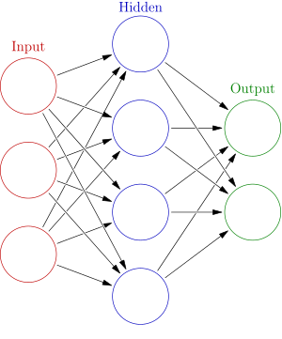
NODES
An artificial neural network is an interconnected group of nodes, inspired by a
simplification of neurons in a brain. Here, each circular node represents
an artificial neuron and an arrow represents a connection from the output of one
artificial neuron to the input of another.
A Node ,also called a neuron,is a computational unit that has one or more
weighted input connections,a transfer function that combines the input in some
way,and an output connections
Nodes are then oraganized into layers to comprise a network.In general ,we
cannot calculate the number of nodes to use per layer in an artifical neural
network.We must specify the number of nodes that we are using in a layer.
5

Slide 11
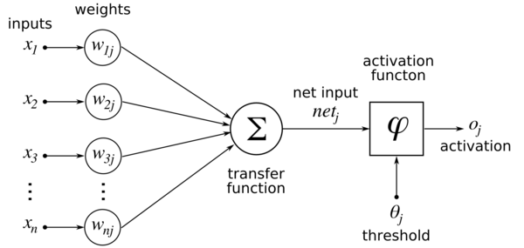
In a fully connected network each neuron will be associated with many
different weights. If there are n0 inputs (i.e. n0neurons in the previous layer) to
a layer with n1 neurons in a fully connected network, that layer will
have n0*n1 weights, not counting any bias term. Every edge you see represents
a different trainable weight
Convolutional layers are different in that they have a fixed number of weights
governed by the choice of filter size and number of filters, but independent of
the input size.
Connections in a artifical neural network:
Summation of our inputs multiplied with weights give us a
transfer function .These neural network forms layers in CNN
.
6

Slide 12
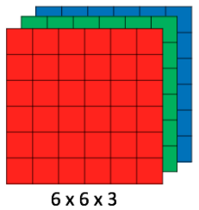
LAYERS IN CNN
CNN image classifications takes an input image, process it and classify it under
certain categories (Eg., Dog, Cat, Tiger, Lion). Computers sees an input image as
array of pixels and it depends on the image resolution. Based on the image
resolution, it will see h x w x d( h = Height, w = Width, d = Dimension ).
Eg., An image of 6 x 6 x 3 array of matrix of RGB (3 refers to RGB values) and
an image of 4 x 4 x 1 array of matrix of grayscale image.
Technically, deep learning CNN models to train and test, each input image will
pass it through a series of convolution layers with filters (Kernals), Pooling,
fully connected layers (FC) and apply Softmax function to classify an object
with probabilistic values between 0 and 1. The below figure is a complete flow
of CNN to process an input image and classifies the objects based on values.
7

Slide 13
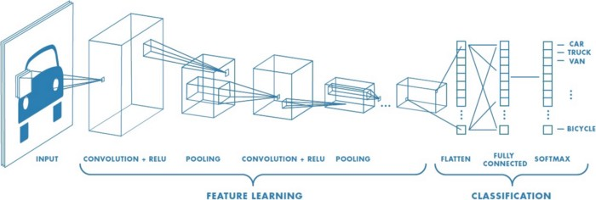
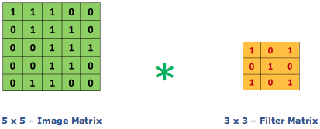
Neural network with many convolutional layers
Convolution Layer
Convolution is the first layer to extract features from an input image.
Convolution preserves the relationship between pixels by learning image
features using small squares of input data. It is a mathematical operation that
takes two inputs such as image matrix and a filter or kernal.
Consider a 5 x 5 whose image pixel values are 0, 1 and filter matrix 3 x 3 as
shown in below
Image matrix multiplies kernel or filter matrix
8

Slide 14
Then the convolution of 5 x 5 image matrix multiplies with 3 x 3 filter
matrix which is called “Feature Map” as output shown in below
The ouput of convolution layer acts as input for next layer, that is pooling layer
Pooling Layer:
Pooling layers section would reduce the number of parameters when the images
are too large. Spatial pooling also called subsampling or downsampling which
reduces the dimensionality of each map but retains the important information.
9

Slide 15
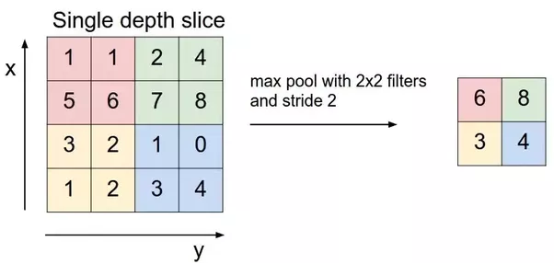
Spatial pooling can be of different types:
Max Pooling
Average Pooling
Sum Pooling
Max pooling take the largest element from the rectified feature map. Taking
the largest element could also take the average pooling. Sum of all elements in
the feature map call as sum pooling.
Fully Connected Layer
The layer we call as FC layer, we flattened our matrix into vector and feed it
into a fully connected layer like neural network.
10

Slide 16
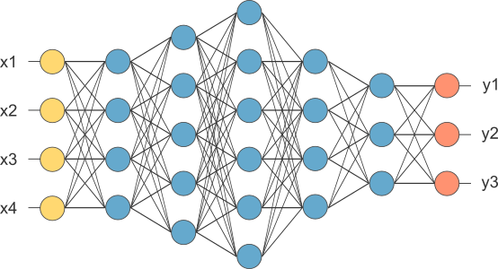
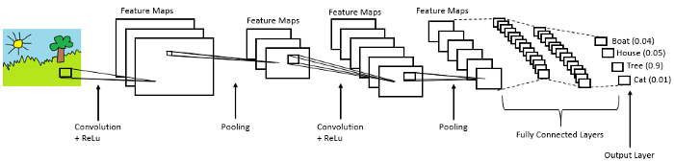
After pooling layer, flattened as FC layer
In the above diagram, feature map matrix will be converted as vector
(x1, x2, x3, …). With the fully connected layers, we combined these features
together to create a model. Finally, we have an activation function such as
softmax or sigmoid to classify the outputs as cat, dog, car, truck etc.,
Complete CNN architecture
11

Slide 17
Aaaa
ACTIVATION FUNCTION
Activation function decides, whether a neuron should be activated or not by
calculating weighted sum and further adding bias with it. The purpose of the
activation function is to introduce non-linearity into the output of a neuron.
Explanation :-
We know, neural network has neurons that work in correspondence of weight,
bias and their respective activation function. In a neural network, we would
update the weights and biases of the neurons on the basis of the error at the
output. This process is known as back-propagation. Activation functions make
the back-propagation possible since the gradients are supplied along with the
error to update the weights and biases.
A neural network without an activation function is essentially just a linear
regression model. The activation function does the non-linear
transformation to the input making it capable to learn and perform more
complex tasks. Activation functions classifies the outputs.
The activation function can be sigmoid function, relufunction, threshold
function,hyperbolic function,rectifier.
12

Slide 18
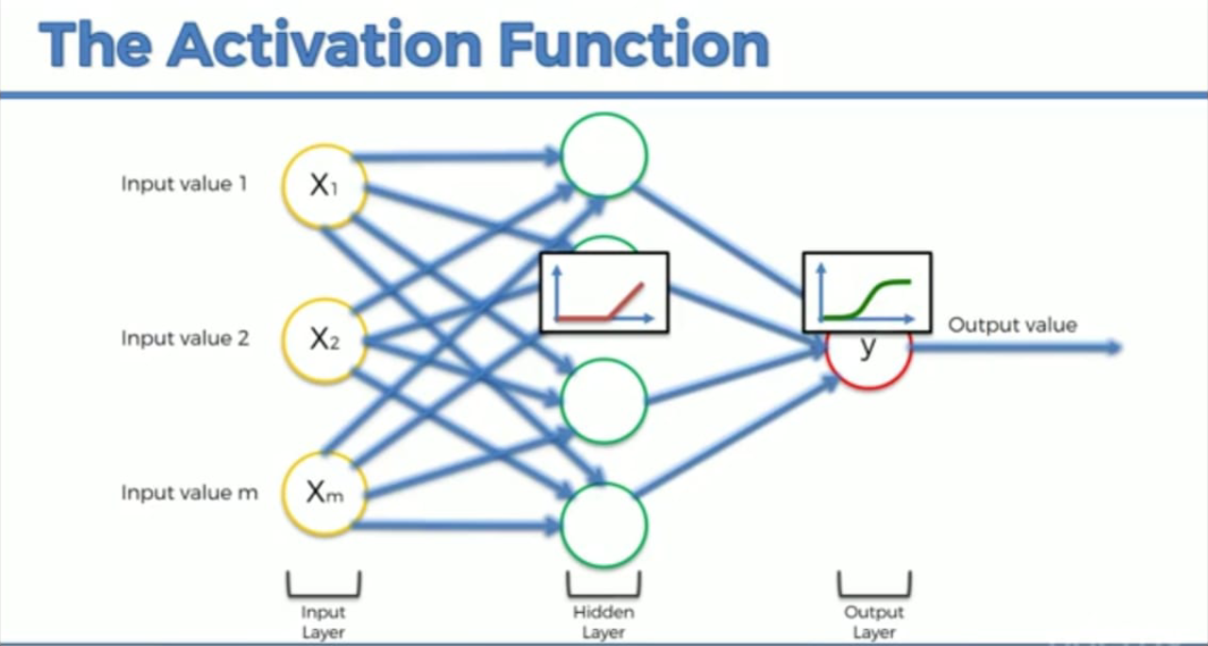
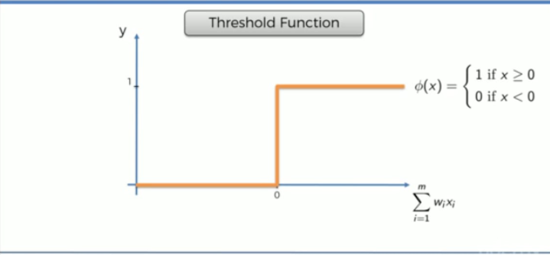
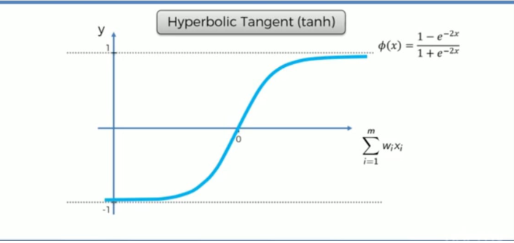
13

Slide 19
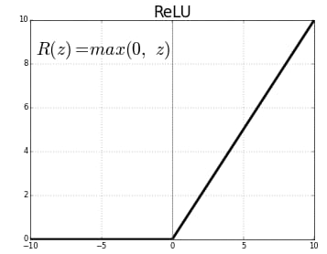
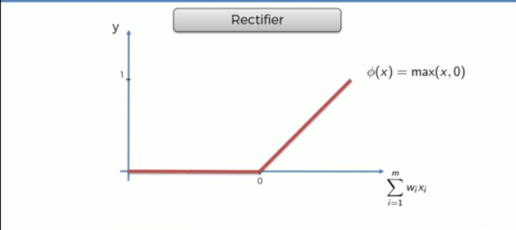
14

Slide 20
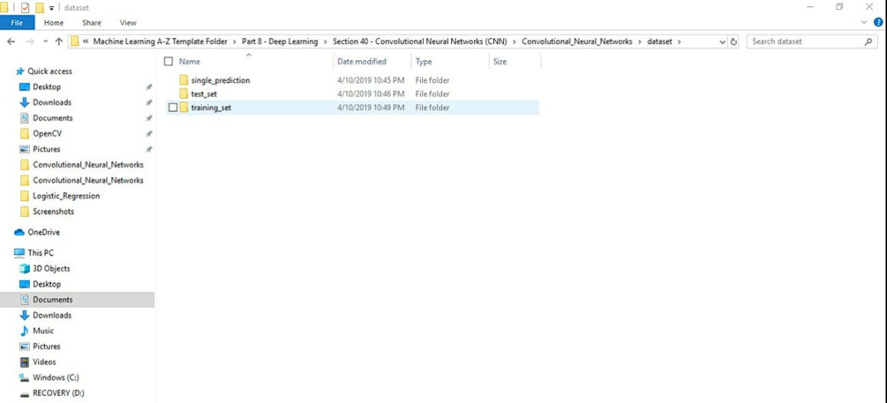
DATA SET
In this data set the data is divided into two types
Training data.
Testing data.
Training data, also called AI training data, training set, training dataset, or
learning set — is the information used to train an algorithm. The training
data includes both input data and the corresponding expected output. Based
on this “ground truth” data, the algorithm can learn how to apply
technologies such as neural networks, to learn and produce complex results,
so that it can make accurate decisions when later presented with new data.
Training data can be used for various machine learning algorithms, such as
sentiment analysis, natural language processing, and chatbot training.
Testing data, on the other hand, includes only input data, not the
corresponding expected output. The testing data is used to assess how well
your algorithm was trained, and to estimate model properties.
.
15

Slide 21
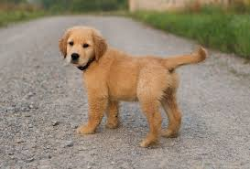

In this project we train 8000 images and we test 2000 images to predict
whether it is dog or a cat.
I3 CNN Algorithm
This section will be focusing on the code sections related to constructing
the algorithm.
3.1 Importing the libraries
The entire concept of Machine Learning is built upon the concept of Object
Oriented Programming hence we need to import the necessary packages
before starting the hard code the program. This list of necessary packages
and the python code to import these packages is given in the below code
snippet.
Fig 3.1 Importing the libraries
16

Slide 22
3.2 Initialising the CNN
When training a CNN from scratch, the filters elements of the layers are usually
initialised from a Gaussian distribution. This is random . Training is the
procedure of adjusting the values of these elements.
Fig 3.2 Initialising
Using a object classifier the class Sequential() is being accessed to initialize the
CNN, now one can use the methods from the class.
3.3 Convolution
Convolution is the first layer in the structure of the neural layers and it basically is
meant for compressing the image without loosing the attributes of the image. For a
normal image with around(1024x1024) pixel size it would normally take huge
computational power to train the neural network but to overcome that we need to
compress the image so as one can run and train the neural network on a daily used
computer and hence the technique of convolution is used.
The below code snippet shows the code necessary for that.
Fig 3.3 Convolution layer
17

Slide 23
3.4 Pooling
The pooling layer is about making the algorithm more robust to make sure
that it catches the attributes in an image what so ever the characteristics of the
image be.It is common to periodically insert a Pooling layer in-between
successive Conv layers in a CNN architecture. Its function is to progressively
reduce the spatial size of the representation to reduce the amount of
parameters and computation in the network, and hence to also control
overfitting.
Fig 3.4 Max Pooling
The MaxPooling function is used so as to get the maximum of the features of the
feature map from the previous convolution layer.
18

Slide 24
3.5 Adding another Convolution and Pooling layers set.
To increase the efficiency and make computation easy for a normal daily use
processor one can add another set of both the convolution and pooling layers.
Fig3.5 Second layer
3.6 Flattening
After adding the first and second layers the image is now converted to a smaller
matrix of values that gives the attributes of the image. This Flattening layer is
about converting this matrix into an array of the elements so as now the actual
learning layers of the full connection can be established
The below code snippet shows the code for converting matrix of attributes
into array of these features.
Fig3.6 Flattening layer
19

Slide 25
3.7 Full Connection
The input layer contains the vector of data that was created in the flattening step.
The features that we distilled throughout the previous steps are encoded in this
vector.
At this point, they are already sufficient for a fair degree of accuracy in recognizing
classes. We now want to take it to the next level in terms of complexity and
precision.
Fig 3.7 Full Connection
The Dense function has 128 output nodes and uses relu(rectifier) activation function.
The second Dense function has 1 output and uses sigmoid activation function.
3.8 Compiling the CNN
Once the Construction of the Neural Network is done , it should be compiled to
make sure that there is no ambiguity in the layers.
20

Slide 26
The below code snippet is used to compile the CNN.
Fig3.8 Compiling the CNN
3.9 Fitting the images
The given dataset has 8000 training images and 2000 testing images hence for a
neural network its not a very promising number, so we need to use some technique
which can generate images by rotating or zooming or changing the colour contrast
of the original images so that one can triple or quadruple the number of images to
make sure to feed enough images to the algorithm
Fig 3.9 Generating new images
21

Slide 27
The ImageDataGenerator class is used to generate these new images, using
the attributes rescale to rescale the size of the image to generate a different set
of images, sheer_range changes the color contrast to add in new images,
zoom_range zooms the image a bit to add in new images and horizontal_flip
to flip the image horizontally.
After generating the new images, the images are to be fitted to the algorithm
so that the algorithm can iterate through the images to find the relations and
gain knowledge based on these iterations.
The below code snippet shows the procedure to do that.
Fig 3.10 Fitting the images
training_set fits on training images and test_set fits on the testing set.
22

Slide 28
3.10 Training the CNN
Once the neural network is constructed and compiled without errors and then
images are fitted in accordance to training and testing data. The procedure for
training the model can be started, in this process the algorithm will iterate
through all the images for one iteration through all the images it is called one
Epoch and the number of epoch's can be hardcoded so that the algorithm will
iterate through the images and adjust the weights to gain knowledge.
The below code snippet shows the code for training the CNN
Fig 3.11 Training the CNN
23

Slide 29
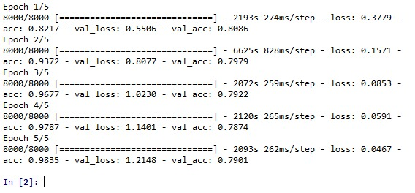
Fig 3.12 Training
3.11 Predicting the results
Once the model is trained then a single image can be passed to the algorithm
and the algorithm will predict the image.
For the given program it will predict weather the image is of a Dog or a Cat. If
this tested image is predicted correctly then the algorithm is ready.
24

Slide 30
The below code snippet will show the code for predicting the results
Fig3.13 Predictions
25

Slide 31
APPLICATIONS AND USAGES
Since digital image processing has very wide applications and almost all of
the technical fields are impacted by DIP, we will just discuss some of the
major applications of DIP.
Digital Image processing is not just limited to adjust the spatial resolution of
the everyday images captured by the camera. It is not just limited to increase
the brightness of the photo, e.t.c. Rather it is far more than that.
Applications of Digital Image Processing
Some of the major fields in which digital image processing is widely used
are mentioned below
Image sharpening and restoration
Medical field
Remote sensing
Transmission and encoding
Machine/Robot vision
Color processing
Pattern recognition
Video processing
Microscopic Image.
26

