Slide 1
DATA ANALYTICS PROJECT
Supermarket Sales Analysis & Business Intelligence Dashboard
Turning raw supermarket transaction data into actionable business intelligence through analysis, visualization, and dashboarding.
Project Focus
Core Deliverables
Transforming raw supermarket transaction data into actionable business intelligence through systematic analysis, visualization, and interactive dashboarding.
Cleaned & structured dataset
Exploratory Data Analysis (EDA)
Python visualizations
Interactive Power BI Dashboard
Business insights & recommendations

Slide 2
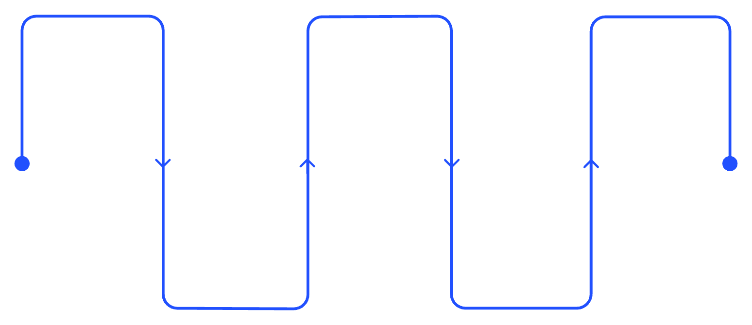
Project Overview
This project analyzes supermarket transaction data to understand sales performance, customer behavior, product category performance, and payment preferences — delivering a complete end-to-end analytics workflow.
Dataset
EDA
Power BI
Collect supermarket transactions
Explore trends and patterns
Build interactive dashboard
Data Cleaning
Visualization
Remove errors and standardize
Create clear charts
Each stage builds on the previous, ensuring data quality and analytical rigor before drawing conclusions or making business recommendations.

Slide 3






Problem Statement & Objectives
Problem Statement
Project Objectives
Raw supermarket transaction data is difficult to interpret directly. It does not clearly reveal high-performing product categories, customer purchasing patterns, payment preferences, or meaningful sales trends without structured analysis.
Analyze
Supermarket sales data systematically
Clean & Prepare
Dataset for reliable analysis
Perform EDA
Using Python (Pandas, Matplotlib, Seaborn)
Visualize
Create meaningful data visualizations
Dashboard
Develop an interactive Power BI dashboard
Recommend
Provide data-driven business recommendations

Slide 4
Dataset Description
Dataset Summary
Column Details
150
Column | Description
Invoice ID | Unique transaction identifier
Date | Date of transaction
Customer Type | Member or Visitor classification
Gender | Customer gender
Product Category | Category of purchased product
Unit Price | Price per unit (₹)
Quantity | Number of units purchased
Total Sales | Total transaction value (₹)
Payment Method | Cash, Card, or Digital payment
Records
Transaction rows
9
Columns
Feature attributes
Transaction-level supermarket sales information covering customer, product, and payment data.

Slide 5
Data Cleaning & Preparation
Cleaning Process
Cleaning Results
01
Final Records
Missing Values
Import Dataset
150 records × 9 columns retained after cleaning
0 missing values remaining after imputation
Loaded dataset using Pandas library
02
Inspect Structure
Duplicate Records
Output File
Reviewed rows, columns, and data types
0 duplicates found after deduplication check
cleaned_supermarket_sales.csv exported for analysis
03
Format Dates
Converted Date column to datetime format
04
Handle Missing Values
Replaced missing categorical values with "Unknown"
05
Validate Numerics
Checked Unit Price, Quantity, and Total Sales for invalid values
06
Remove Duplicates
Identified and removed duplicate records

Slide 6


Exploratory Data Analysis
Analysis Performed
Key Statistical Results
Descriptive Statistics
Structure Inspection
₹278.50
Mean, median, min, max for all numeric columns
Dataset shape, data types, and column overview
Avg. Total Sales
Per transaction average
Correlation Analysis
Category Analysis
Relationships between numeric variables
Product category, customer type, and payment method breakdowns
₹499.62
Max Total Sales
Outlier Detection
Highest single transaction
IQR method applied to Unit Price, Quantity, and Total Sales
5.57
Avg. Quantity
Units per transaction
₹28.76
Avg. Unit Price
Per unit average price
No significant outliers were found in Unit Price, Quantity, or Total Sales — confirming high data quality after cleaning.

Slide 7
Data Visualizations
Five key visualizations created from the cleaned dataset:
1. Total Sales by Product Category
2. Daily Sales Trend
3. Payment Method Distribution
Bar Chart
Line Chart
Pie Chart
4. Total Sales by Customer Type
5. Total Sales by Gender
Bar Chart
Bar Chart
[PLACEHOLDER FOR VISUALIZATION SCREENSHOTS] Insert your actual Python visualization screenshots here (Matplotlib/Seaborn charts)

Slide 8



Conclusion
This project successfully demonstrated an end-to-end Data Analytics workflow, transforming raw supermarket transaction data into meaningful visualizations, an interactive business intelligence dashboard, actionable insights, and data-driven recommendations.
Tools & Technologies Used
Python
Power BI
Git & GitHub
Data cleaning, EDA, and visualization (Pandas, Matplotlib, Seaborn)
Interactive dashboard development
Version control and project documentation
Data-driven decision making for business success

Slide 9
Key Insights & Business Recommendations
Key Insights
Recommendations
Vegetables generated the highest category sales: ₹8,918.92
Beverages generated the lowest category sales: ₹4,926.37
Maintain sufficient stock and promotions for high-performing categories (Vegetables, Dairy)
Use discounts and combo offers to improve lower-performing categories (Beverages, Bakery)
Members generated higher total sales (₹20,421.34) vs. Visitors (₹19,587.90)
Cash was the highest-contributing payment method: ₹14,797.44
Strengthen membership programs to encourage repeat purchases
Continue supporting popular payment methods while promoting digital payment options
Female customers generated higher sales (₹20,041.27) vs. Male customers (₹18,126.11)

Slide 10
Power BI Dashboard
An interactive Power BI dashboard was developed using the cleaned supermarket sales dataset.
KPI Cards
Dashboard Visuals
Total Sales by Product Category
Daily Sales Trend
Payment Method Distribution
Customer Type Distribution
Total Sales by Customer Type
Total Sales by Gender
Total Sales
Total Quantity
Total Orders
Interactive Slicers
Customer Type
Gender
Product Category
[PLACEHOLDER FOR POWER BI DASHBOARD SCREENSHOT] Insert your actual Power BI dashboard screenshot here

Slide 11

Data Visualizations
Five key visualizations were created from the cleaned dataset using Python (Matplotlib & Seaborn) to communicate sales patterns across categories, time, payment methods, and customer segments.
1
Total Sales by Product Category
Bar Chart — compares revenue contribution across all product categories
2
Daily Sales Trend
Line Chart — tracks sales fluctuations over the analysis period
3
Payment Method Distribution
Pie Chart — shows share of Cash, Card, and Digital payments
4
Sales by Customer Type
Bar Chart — compares Member vs. Visitor total sales
5
Sales by Gender
Bar Chart — compares Female vs. Male customer total sales
Insert your actual Python visualization screenshots (Matplotlib/Seaborn charts) in place of this placeholder section.

Slide 12

Power BI Dashboard
An interactive Power BI dashboard was developed using the cleaned supermarket sales dataset, enabling dynamic filtering and real-time exploration of key business metrics.
KPI Cards
Dashboard Visuals
Total Sales
Total Quantity
Total Sales by Product Category
Aggregate revenue across all transactions
Total units sold across all categories
Bar visual comparing category-level revenue
Daily Sales Trend
Total Orders
Line visual tracking sales over time
Count of all transaction records
Payment Method Distribution
Interactive Slicers
Pie visual showing payment share breakdown
Customer Type
Customer Type Distribution
Visual comparing Member vs. Visitor counts
Sales by Customer Type & Gender
Gender
Bar visuals for segment-level sales comparison
Insert your actual Power BI dashboard screenshot here in place of this placeholder.
Product Category

Slide 13
Key Insights & Business Recommendations
Key Insights
Business Recommendations
Dimension | Finding
Top Category | Vegetables — ₹8,918.92 in total sales
Lowest Category | Beverages — ₹4,926.37 in total sales
Customer Type | Members ₹20,421.34 vs. Visitors ₹19,587.90
Payment Method | Cash leads at ₹14,797.44 total contribution
Gender | Female ₹20,041.27 vs. Male ₹18,126.11
Stock & Promotions
Maintain sufficient inventory and run targeted promotions for high-performing categories — Vegetables and Dairy.
Boost Underperformers
Apply discounts and combo offers to improve sales in lower-performing categories — Beverages and Bakery.
Membership Programs
Strengthen loyalty programs to encourage repeat purchases and convert Visitors into Members.
Payment Strategy
Continue supporting Cash while actively promoting digital payment options to modernize the payment mix.

Slide 14



Conclusion
This project successfully demonstrated a complete end-to-end Data Analytics workflow — transforming raw supermarket transaction data into meaningful visualizations, an interactive business intelligence dashboard, actionable insights, and data-driven recommendations.
Raw Data
Cleaned Dataset
EDA & Visuals
Power BI
Tools & Technologies Used
Python
Power BI
Git & GitHub
Data cleaning, EDA, and visualization using Pandas, Matplotlib, and Seaborn
Interactive dashboard development with KPI cards, visuals, and slicers
Version control and project documentation throughout the workflow
Data-driven decision making for business success

