Slide 1

Udyam Digital
Professional offices first
A guided digital setup
for small businesses
Clinics, CA firms and
coaching centres
11.07%
Choose a suitable bundle and see the full bill.
Upload KYC documents, then track installation.
observed activation rate
NeverGiveUp / MNNIT Allahabad
₹10,695
lowest segment acquisition cost
7.36%
17.6 days
of 5,000 leads activate
average lead to activation
Source: supplied synthetic case data
01
Notes:
Sources: supplied Airtel_SYNC_Case.pdf, Appendix A1 and A2, and smb_leads.csv. All records are synthetic, Apr–Jun 2026. 368/5000=7.36%. Average lead-to-activation is 17.6168 days. Professional offices: 138/1247=11.07%, segment blended acquisition cost ₹10,695 (all segment lead costs / activations). Lowest observed segment CAC, not proof of causal superiority. Manufacturers convert at 12.80% but have 289 leads and CAC ₹15,324, versus 1,247 office leads. Choice balances economics and sample size. Quote bottleneck: 861 of 1,974 assessed leads accept a quote (43.6%). Prototype supports English and Hindi. Provider activation is simulated.

Slide 2
The competitive opportunity is a simpler journey
Bundled services and digital advice already exist. The buying journey still deserves focus.
Alternative | What the source establishes | Udyam’s design response
JioBusiness | Integrated connectivity and digital services, plus self-care for bills and requests. | Show product choices, tradeoffs and the full bill before the owner commits.
Vi ReadyForNext | Digital-readiness assessment, peer benchmarks and tailored recommendations. | Carry stated needs into a validated quote, KYC checks and saved order progress.
In the supplied case, only 861 of 1,974 assessed leads accept a quote.
JioBusiness source
Vi ReadyForNext source
Reviewed 9 Nov 2026. This is not a full audit of competitor workflows.
02
Notes:
Primary sources reviewed 9 November 2026: JioBusiness Solution https://www.jio.com/business/services/connectivity/jiobusiness-solution/ describes integrated enterprise voice, data and digital solutions and Digital Self-Care for plan/bill details and service requests. Vi Business https://www.myvi.in/business/blog/msme-assessment-for-business-digital-maturity-index describes readiness assessment, peer benchmarking and tailored solution recommendations. Design responses are our proposed positioning, not verified capability gaps. We do not claim competitors lack GenAI, KYC, checkout or order tracking, nor a proven price or speed advantage. Case baseline is fictional: a quote takes 3–5 days, and assessed-to-quote acceptance is 861/1974=43.6%; 1,113 leads leave this step.

Slide 3
Gemini advises. Catalogue rules decide.
Owners review the facts and retain control of the quote.
Consented, redacted needs only
Owner’s browser
Local application
Gemini API
English / Hindi
Editable needs and quote
Prices, eligibility, quantities
and product dependencies
Needs discovery and
product proposals
Local OCR
SQLite workspace
Mock registries
Document field extraction
Saved quotes and orders
GSTIN / Udyam fixtures
Documents stay local. AI cannot approve KYC. Provider activation is simulated.
03
Notes:
Architecture reflects the working prototype. Owner browser calls the Python server. Gemini uses structured requests for needs discovery and catalogue product proposals; implemented default model gemini-3.5-flash-lite. The cloud receives only the current redacted needs message and allowlisted sizing, goals and current-tool categories after separate AI consent. No uploaded images or registry records reach Gemini. Local validation calculates price and checks eligibility, dependencies, goal coverage and quantities. Local OCR extracts image fields. Mock GSTIN/Udyam CSVs support registry checks. SQLite stores the workspace and recorded order transitions. Diagram arrows show request and data-access directions; API responses return to the caller. Payment, e-sign, DigiLocker, messaging and real provider activation are unintegrated. Common-pattern redaction does not guarantee anonymity. Source: app.py, gemini.py, docs/ARCHITECTURE.md in repository https://github.com/aachintya/udyam-digital-airtel-sync-2026.

Slide 4
A clinic’s plan, with every charge visible
Eight staff, one location and a declared monthly budget of ₹6,000
Product | Why it fits | Monthly base
Fibre | Clinic connectivity | ₹1,499
Internet failover | Backup if fibre fails | ₹499
8 email users | A work account per staff member | ₹1,000
8 protected devices | Security for eight devices | ₹792
Subtotal | Before GST | ₹3,790
GST | 18% | ₹682.20
₹4,472.20
per month, including GST
₹1,770
one-time setup, including GST
₹6,242.20
first invoice, including setup
12-month minimum term
Illustrative quote, subject to serviceability. ₹1,527.80 budget headroom is not a measured saving.
04
Notes:
Source: supplied product_catalogue.csv and the actual Gemini-selected clinic quote. P02 fibre ₹1499 + P09 failover ₹499 + 8 P16 email users ×₹125 + 8 P20 devices ×₹99 =₹3790/month before GST. Estimated 18% GST=₹682.20. Total ₹4472.20/month. Setup ₹1770 including GST. First invoice ₹6242.20. Longest minimum term 12 months. Monthly budget headroom ₹6000−₹4472.20=₹1527.80. This is not a saving against an observed prior bill. Prices use catalogue minimums and remain subject to serviceability/commercial review. The owner can edit users and add-ons, download the quote and reserve the demo plan. The prototype collects no real payment and creates no commercial contract. Segment expansion examples are documented separately in BUSINESS_CASE.md.

Slide 5
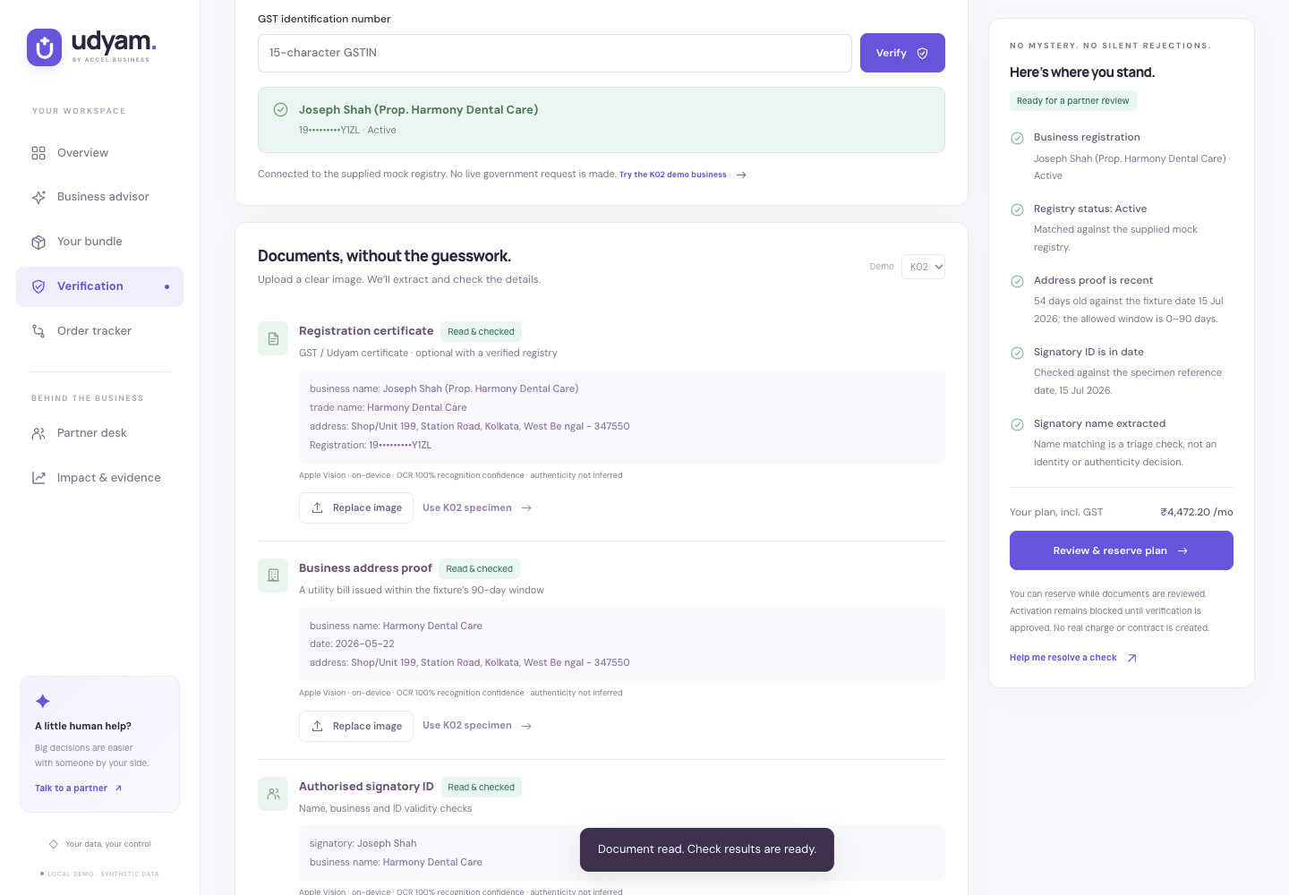
KYC shows the evidence that needs attention
Real local OCR supports review. Synthetic registry records make exceptions testable.
A clear reason for review
The cancelled K01 GST record surfaces a blocker. Matching K02 evidence restores readiness for partner review.
The owner controls consent
Separate AI and KYC permission. Temporary uploads. Workspace expiry after 24 hours of inactivity, with deletion on withdrawal.
05
Notes:
Source: actual verification route, local OCR pipeline and supplied 47 specimen images for 12 fictional applicants. The demo tests a cancelled K01 registration and successful matching K02 evidence. OCR reads images locally via Apple Vision with a Tesseract fallback. Mock registry status, extracted names, addresses and dates drive checks. OCR does not certify authenticity or legal compliance. Registry reference date is 15 July 2026 for the supplied fixtures. Images are deleted after extraction. Workspace records expire after 24 hours of inactivity; withdrawal deletes the local workspace. AI consent and document/KYC consent are separate. Production requires authenticated roles, encrypted storage, scanning, backup erasure and legal review. SQLite is not encrypted in this prototype. See the separate one-page privacy/security note.

Slide 6
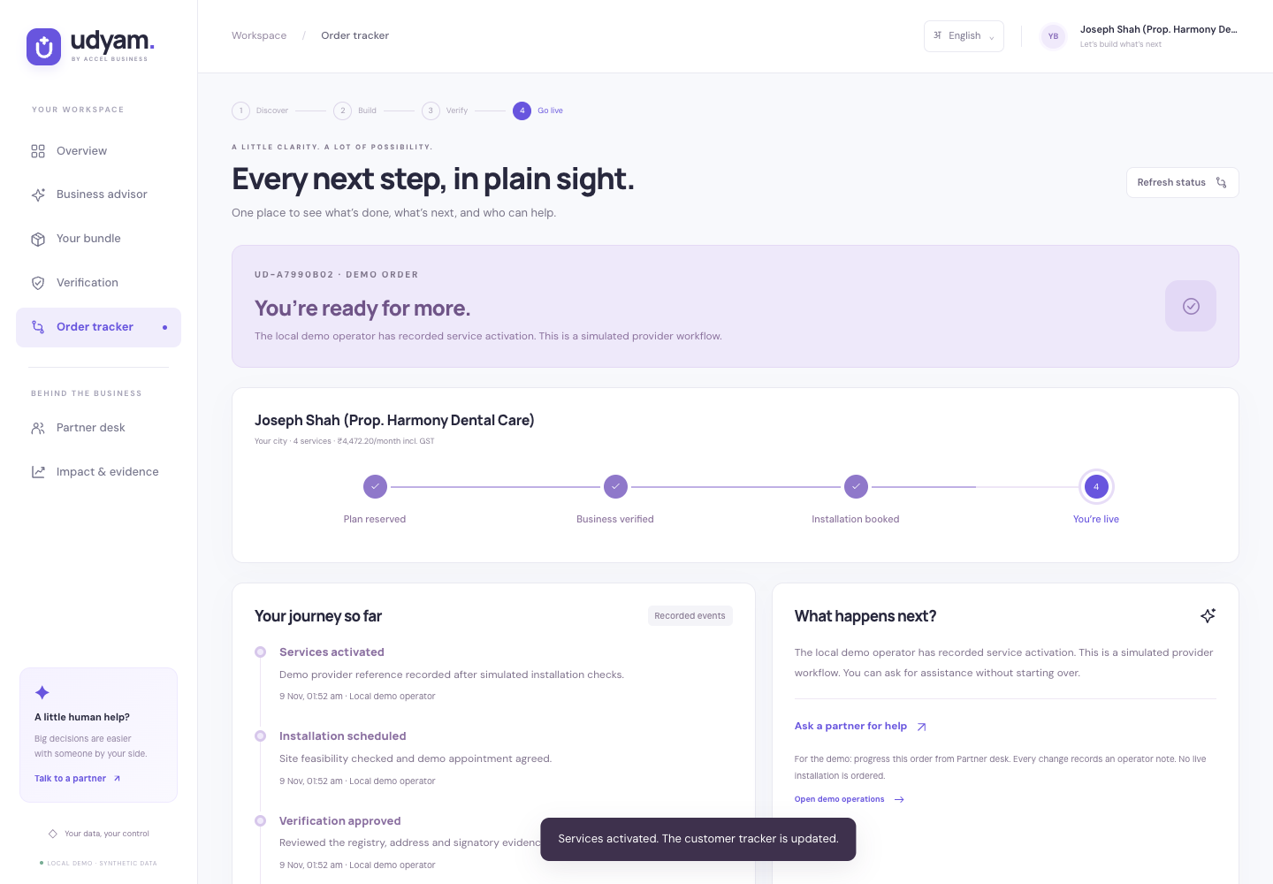
Partners finish the work with saved context
Owners can follow progress while partners resolve exceptions and arrange installation.
A proposed 12-week rollout
Phase | What must be ready
Weeks 1–2 | Validate catalogue rules and KYC exceptions.
Weeks 3–6 | Train partners and compare matched lead cohorts.
Weeks 7–12 | Connect providers and secure identity before expansion.
Each recorded action updates the same order history.
Launch gates: site serviceability, identity review, authenticated roles and encrypted storage.
06
Notes:
The prototype saves needs, quote, KYC status and operator notes in one order workspace. A partner reviews evidence, records an installation date and explicitly marks simulated completion, with a note at each transition. The owner tracker persists after reload. Existing field staff receive contextual handoffs and a lead desk with explainable priorities across 5,000 synthetic leads. Joint assisted/digital attribution is proposed to reduce channel conflict. Rollout phases are relative to a future pilot start and represent proposed work, not completed production integration. Key risks: poor serviceability, identity mismatch, data leakage and channel conflict. Gates: site checks, manual exception review, authenticated roles/encryption and joint attribution. Local operators share the owner session; production authentication and real provider activation are absent.

Slide 7
Pilot success must show up in activation
Overall case benchmarks. Pilot lift requires matched segment and channel cohorts.
Measure | Overall case | Proposed target
Lead-to-activation | 7.36% | 12%
Lead-to-activation time | 17.6 days | Under 7 days
Blended acquisition cost | ₹15,053 | Under ₹10,000
Status calls per activation | 3 | Under 1
Six-month churn | 15.2% | No worse than 15.2%
Portfolio scenario: 12% of 5,000 comparable leads gives 600 activations, up 232.
Targets are hypotheses. Margin and installation costs determine profit. Retention needs six-month follow-up.
Watch the 2:48 demo on Drive
View source code on GitHub
07
Notes:
Sources: synthetic smb_leads.csv and the supplied case. 368/5000=7.36%. CAC is all lead costs /368 activations=₹15053.37 rounded to ₹15053. Churn56/368=15.2%. Average lead-to-activation17.6168 days. Status-chase baseline3 from case. The slide uses overall-case benchmarks, not professional-office pilot baselines. Professional-office baseline conversion is11.07%, CAC₹10695 and average activation16.9 days. Establish pilot lift through matched segment/channel cohorts. Targets are proposed hypotheses, not observed improvements. At identical lead volume and comparable quality, 12%×5000=600 activations, 232 above368. Compare cohorts by segment/channel and monitor gross margin, install costs, commissions, complaints and retention. A 12-week acquisition pilot cannot establish six-month retention. Working proof: 45 automated checks previously passed, live Gemini discovery and proposals, actual local OCR, deterministic pricing checks and a recorded complete lifecycle with simulated activation. Narrated demo: https://drive.google.com/file/d/1kDy5QKG6w8ETujzBu6YHIMM5fdb2Mt4M/view?usp=sharing . User supplied this link; independent public access could not be verified through the web tool. Repository: https://github.com/aachintya/udyam-digital-airtel-sync-2026 . The demo is 168 seconds with subtitles and Gemini-generated male Indian English narration.

