Slide 1


Slide 2

ARCHR Intake

Slide 3
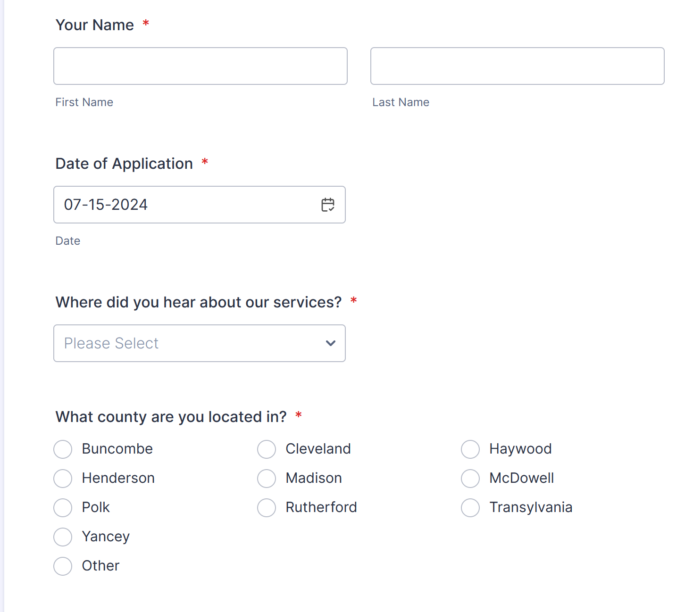
ARCHR Intake

Slide 4
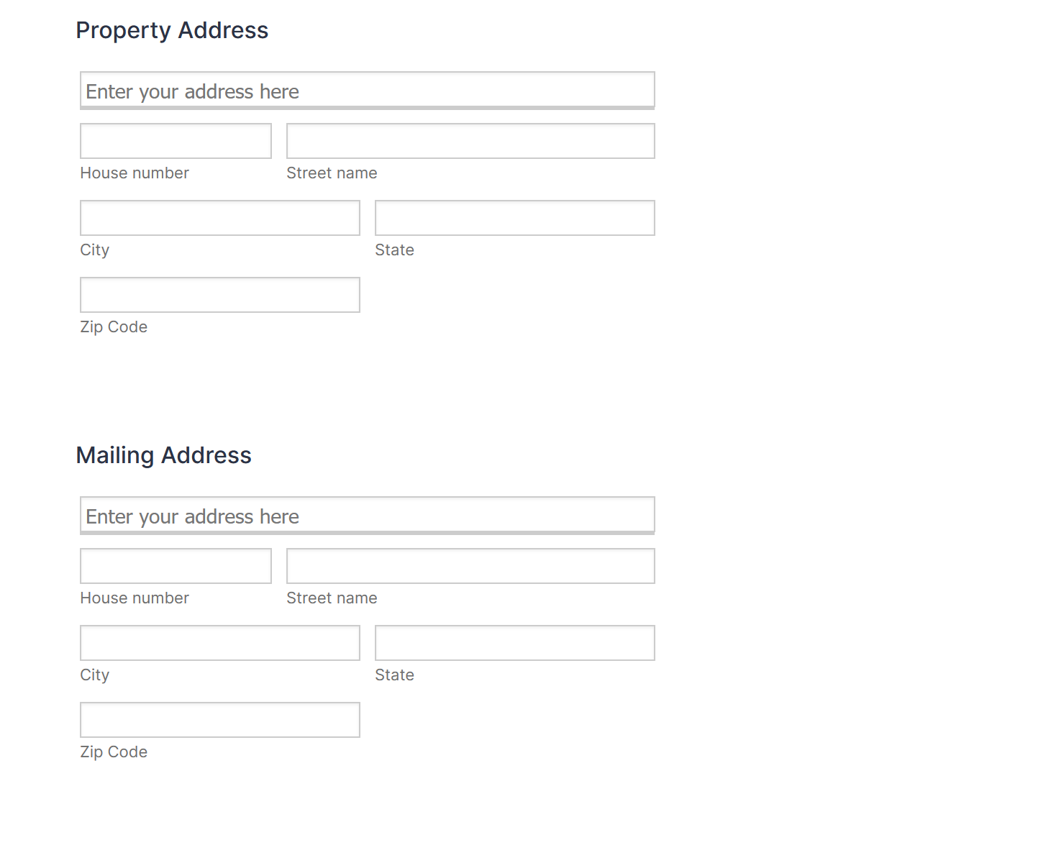
ARCHR Intake

Slide 5
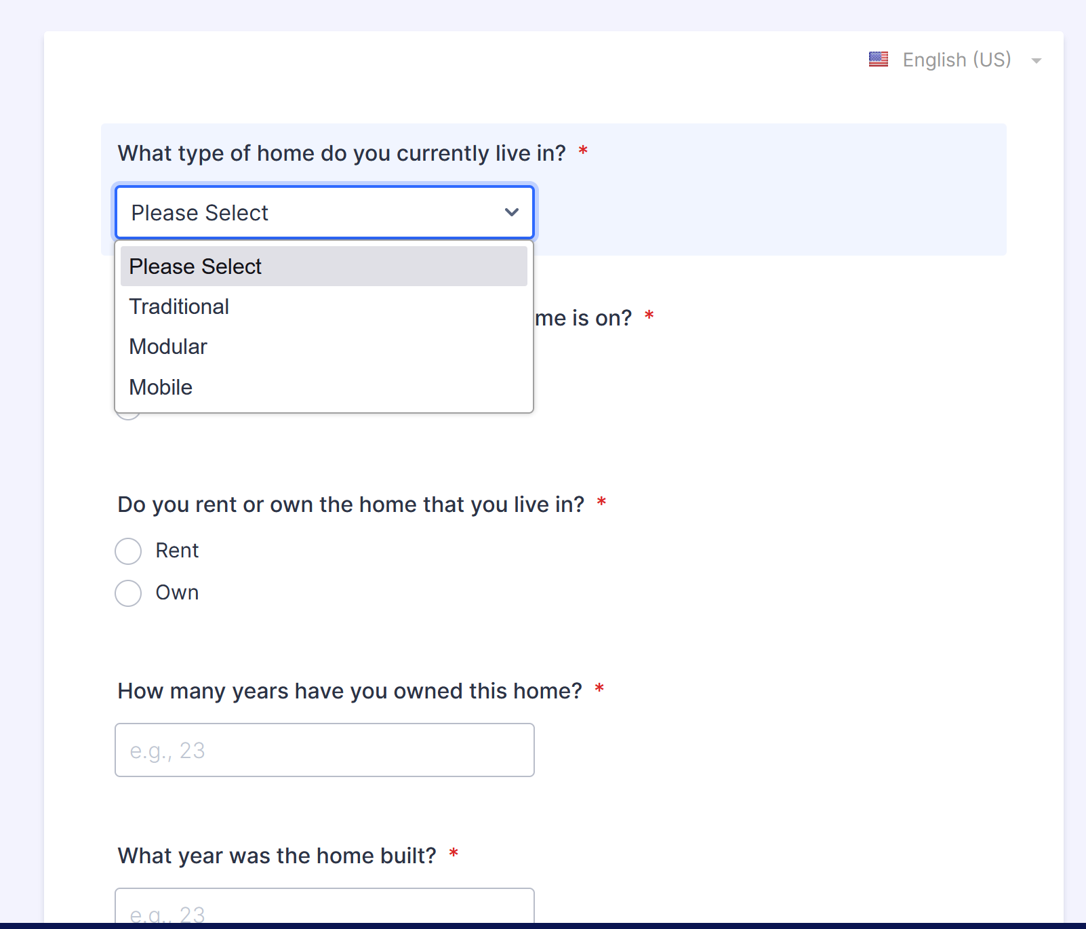
ARCHR Intake

Slide 6
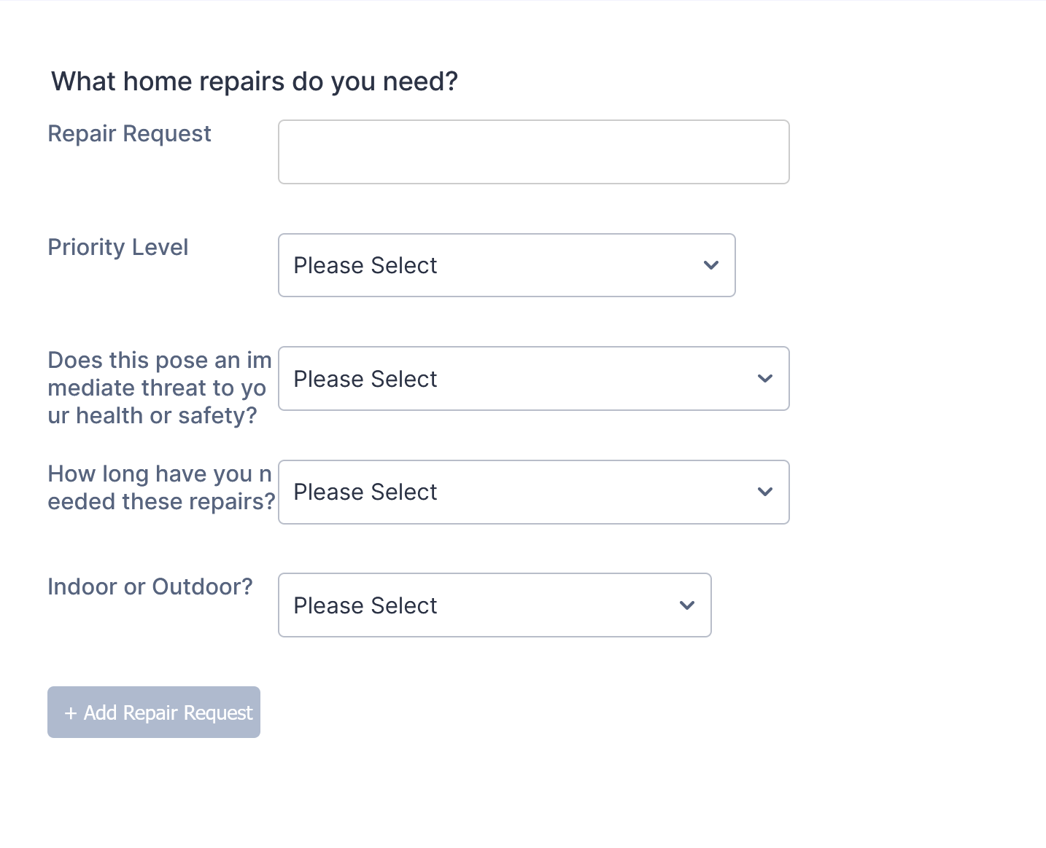
ARCHR Intake

Slide 7
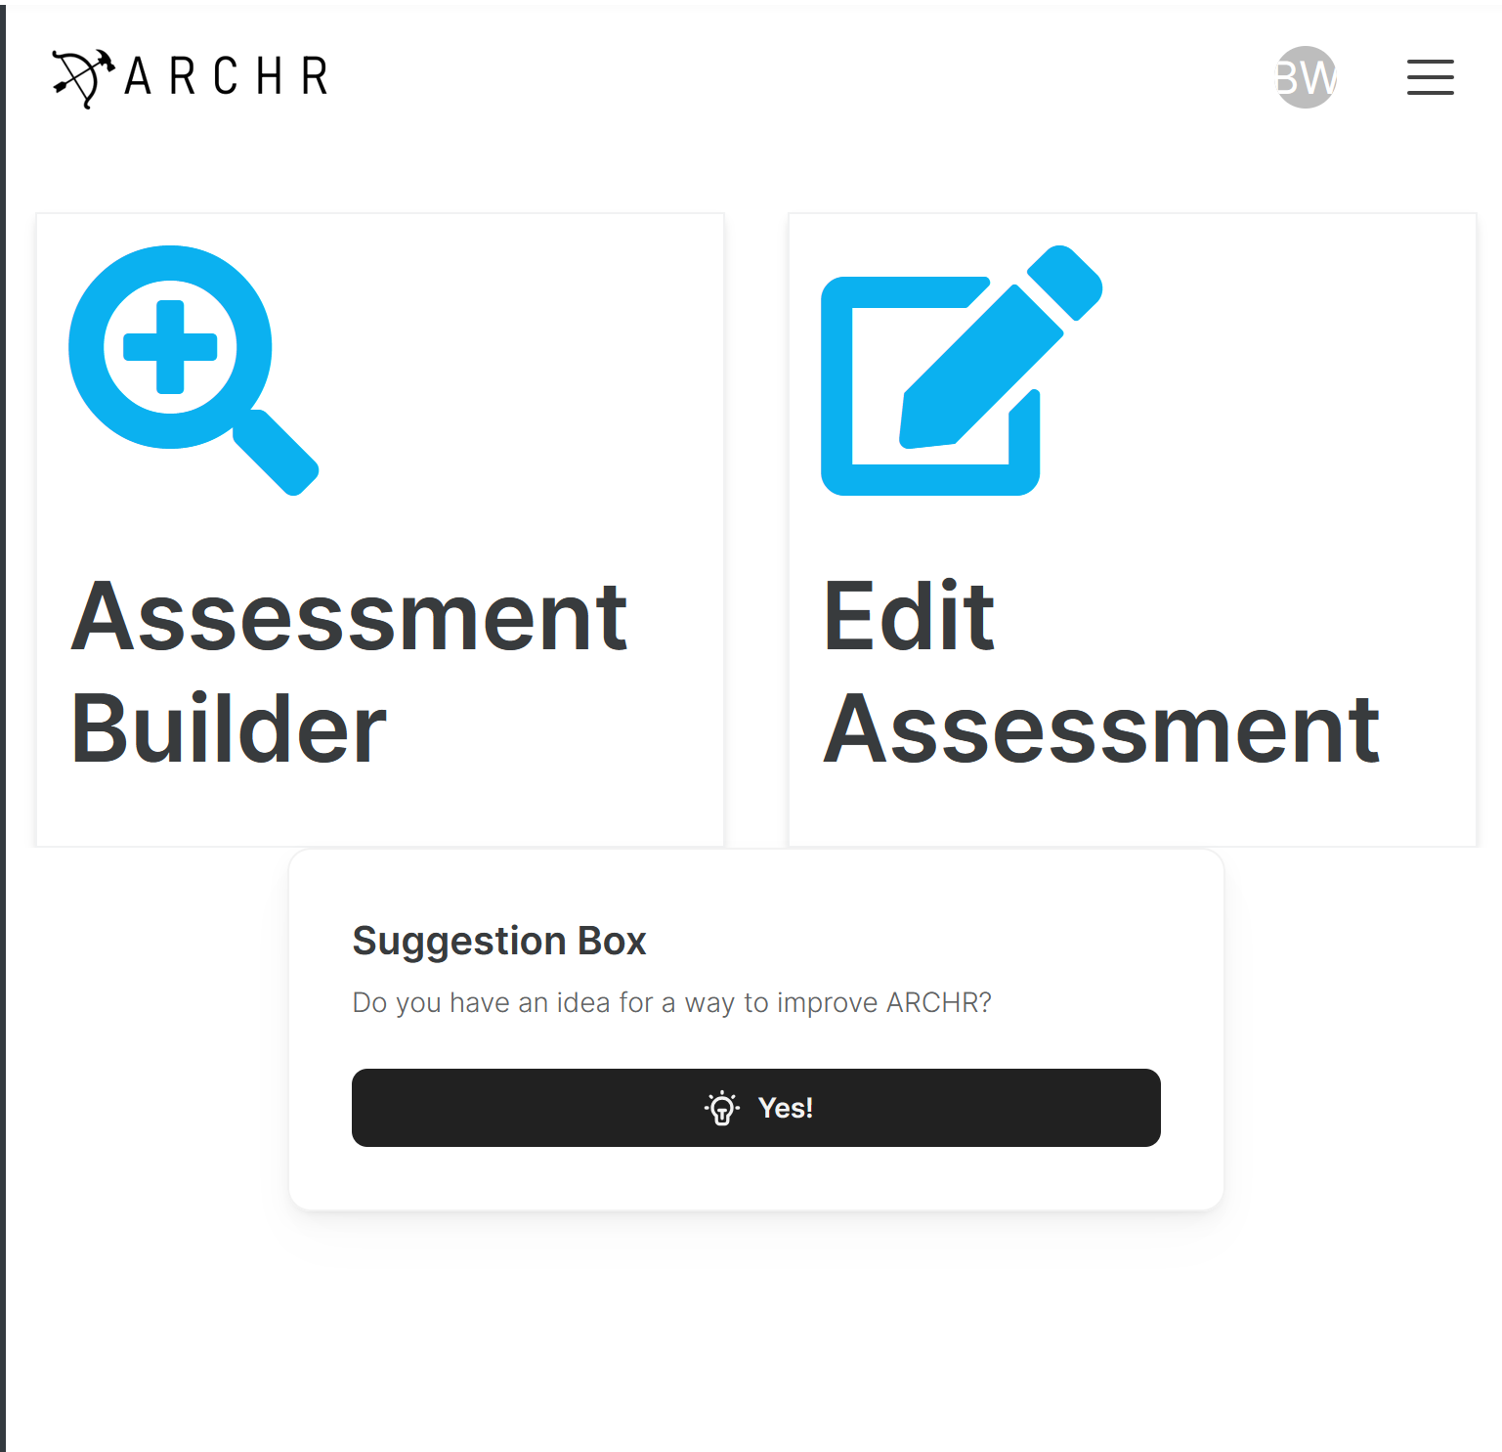
ARCHR Navigator

Slide 8
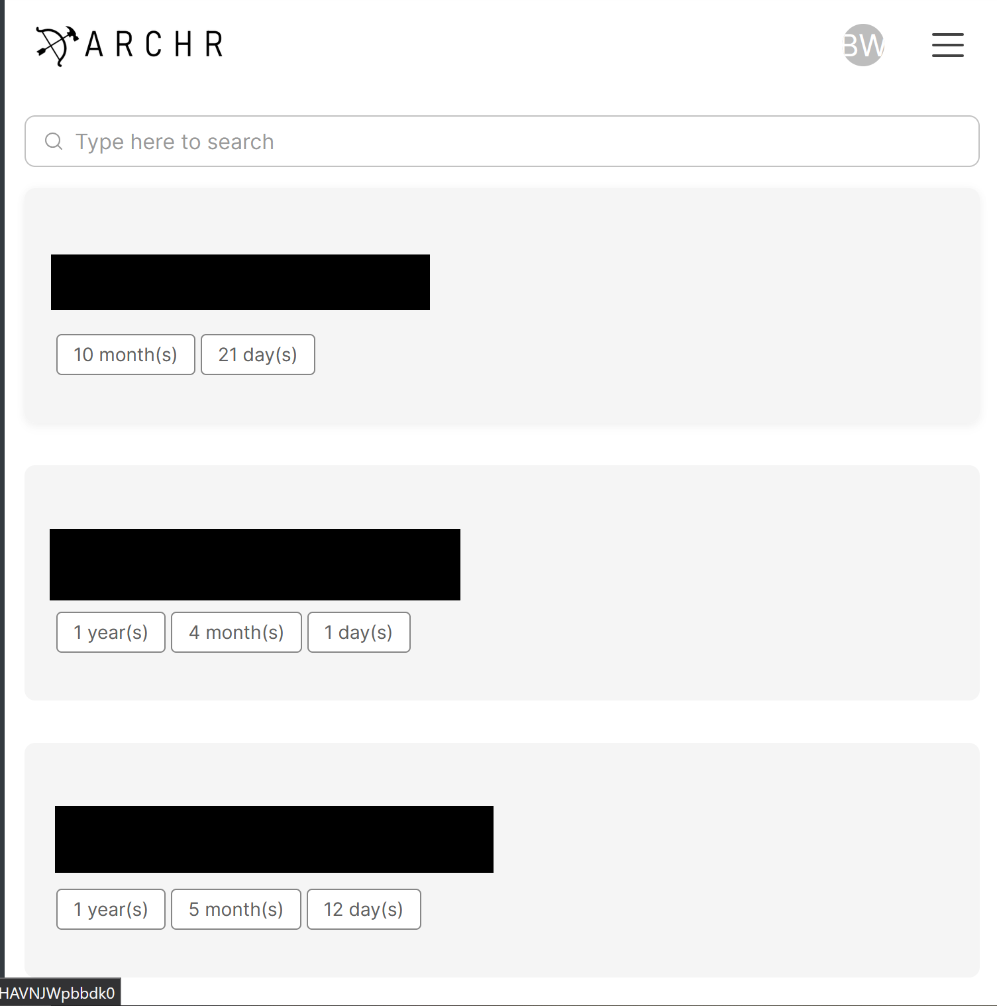
ARCHR Navigator

Slide 9
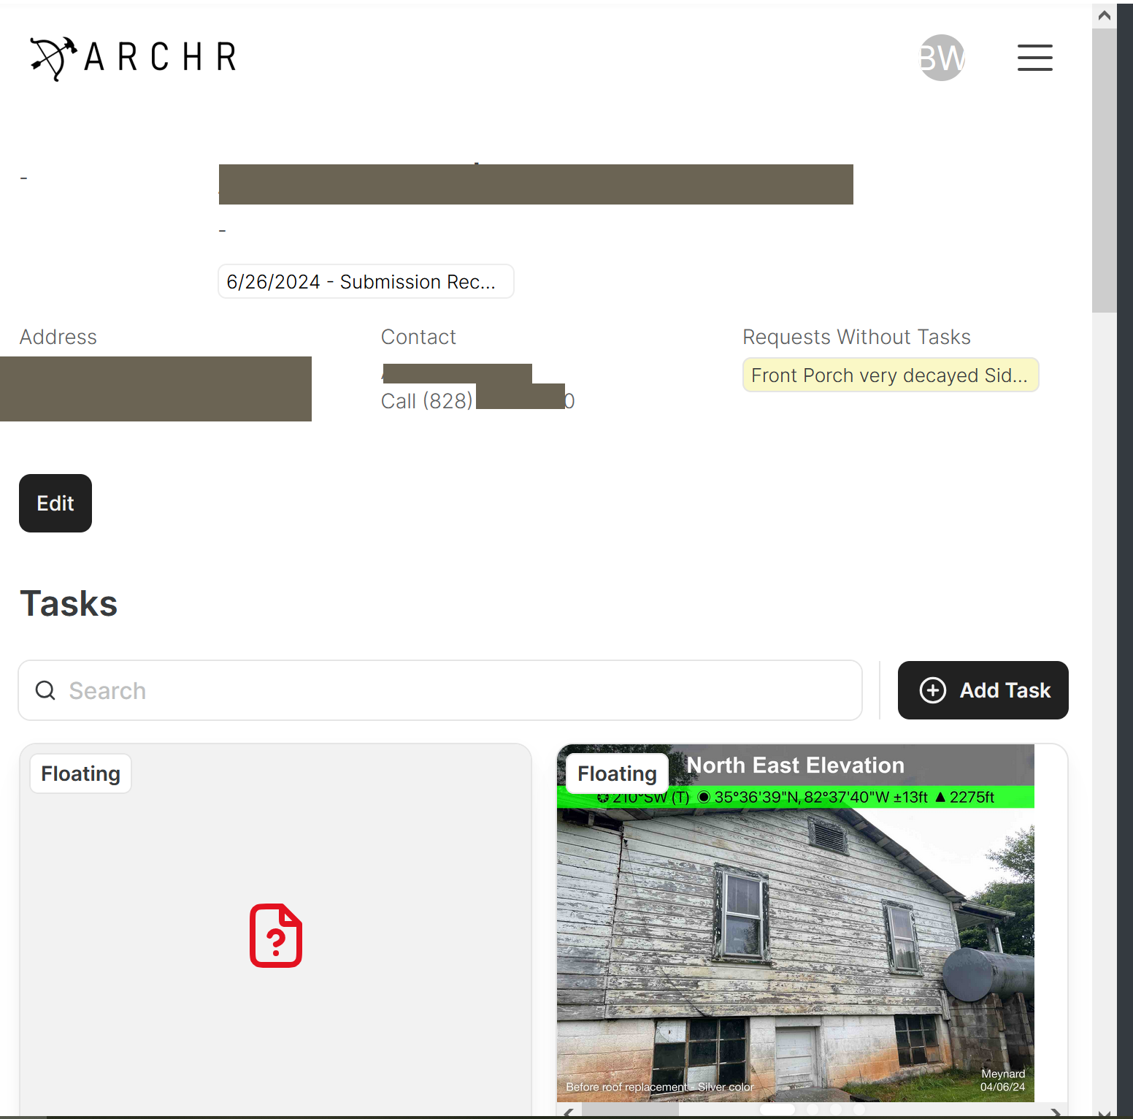
ARCHR Navigator

Slide 10
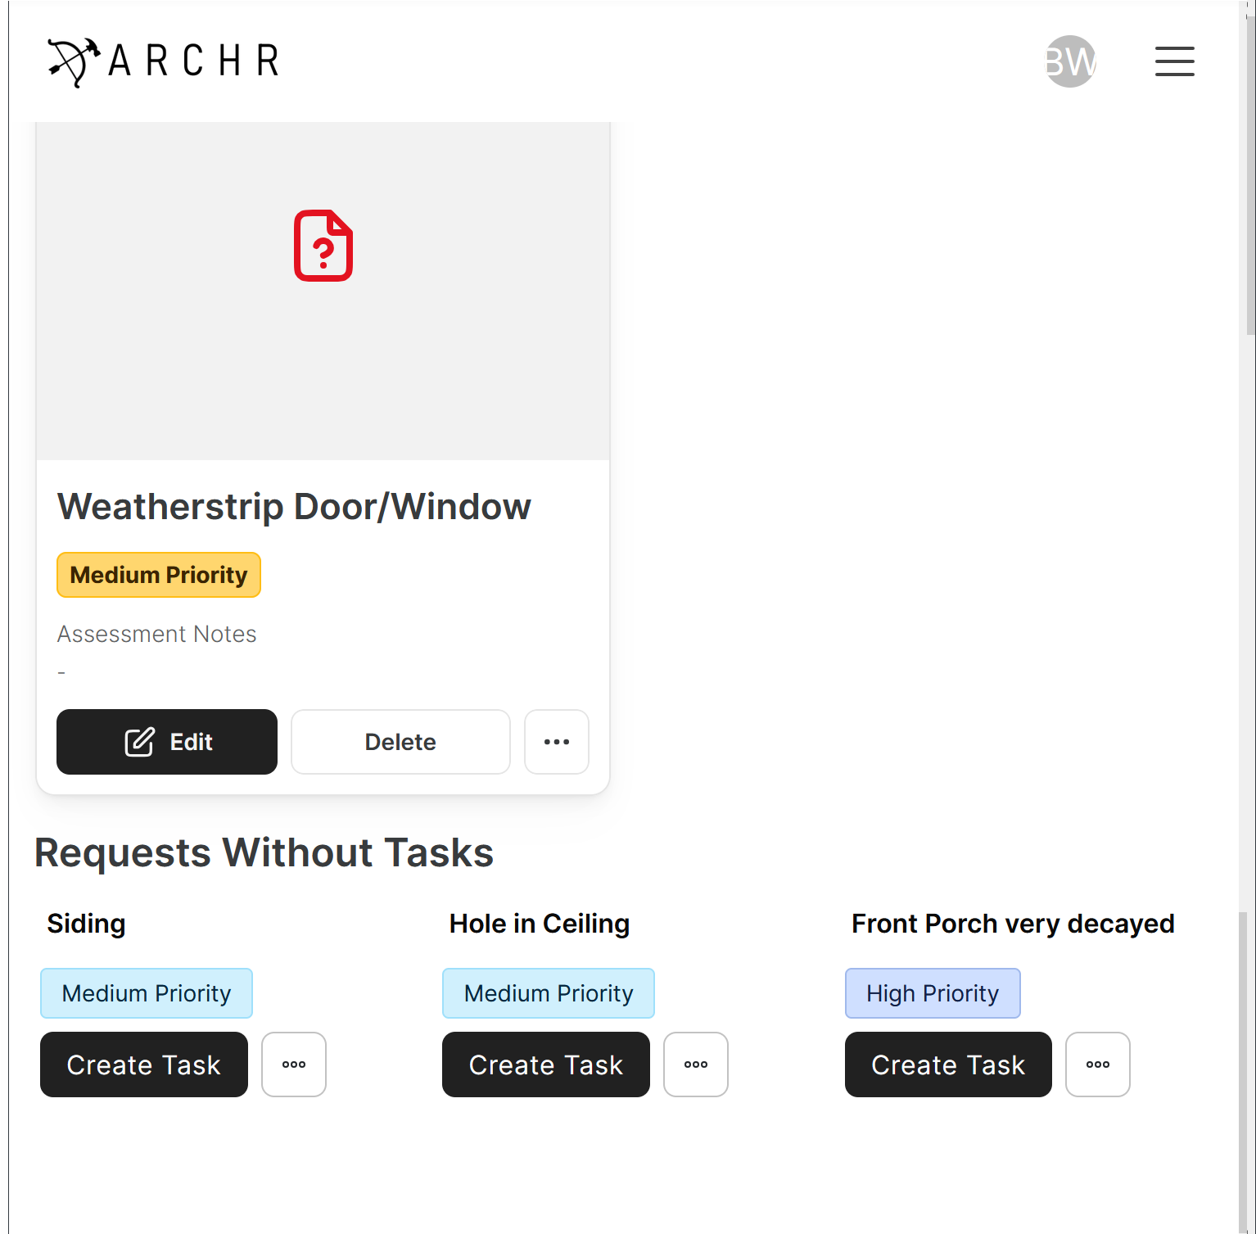
ARCHR Navigator

Slide 11
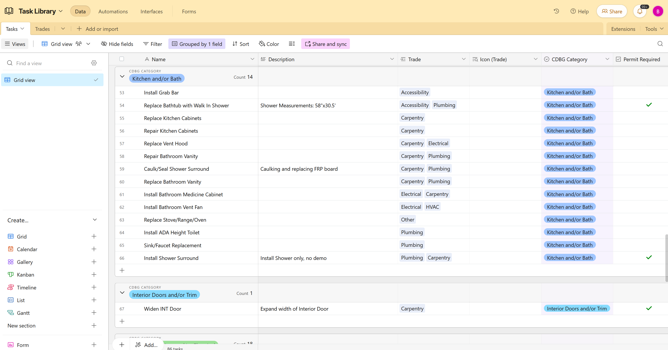
ARCHR Task Library

Slide 12
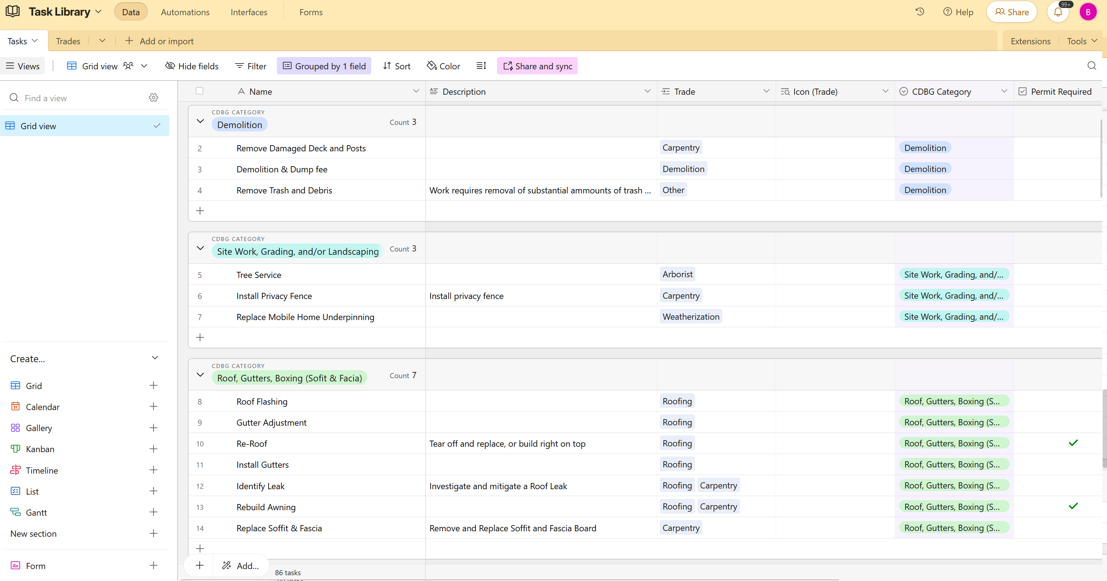
ARCHR Task Library

Slide 13
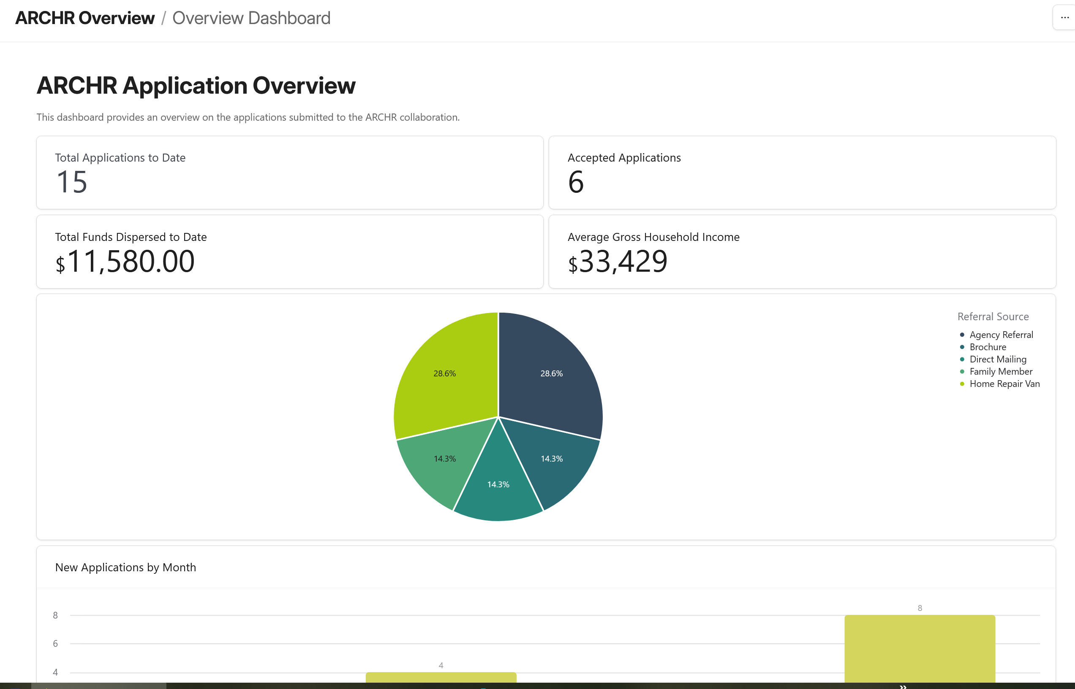
ARCHR Partner Org Interface

Slide 14
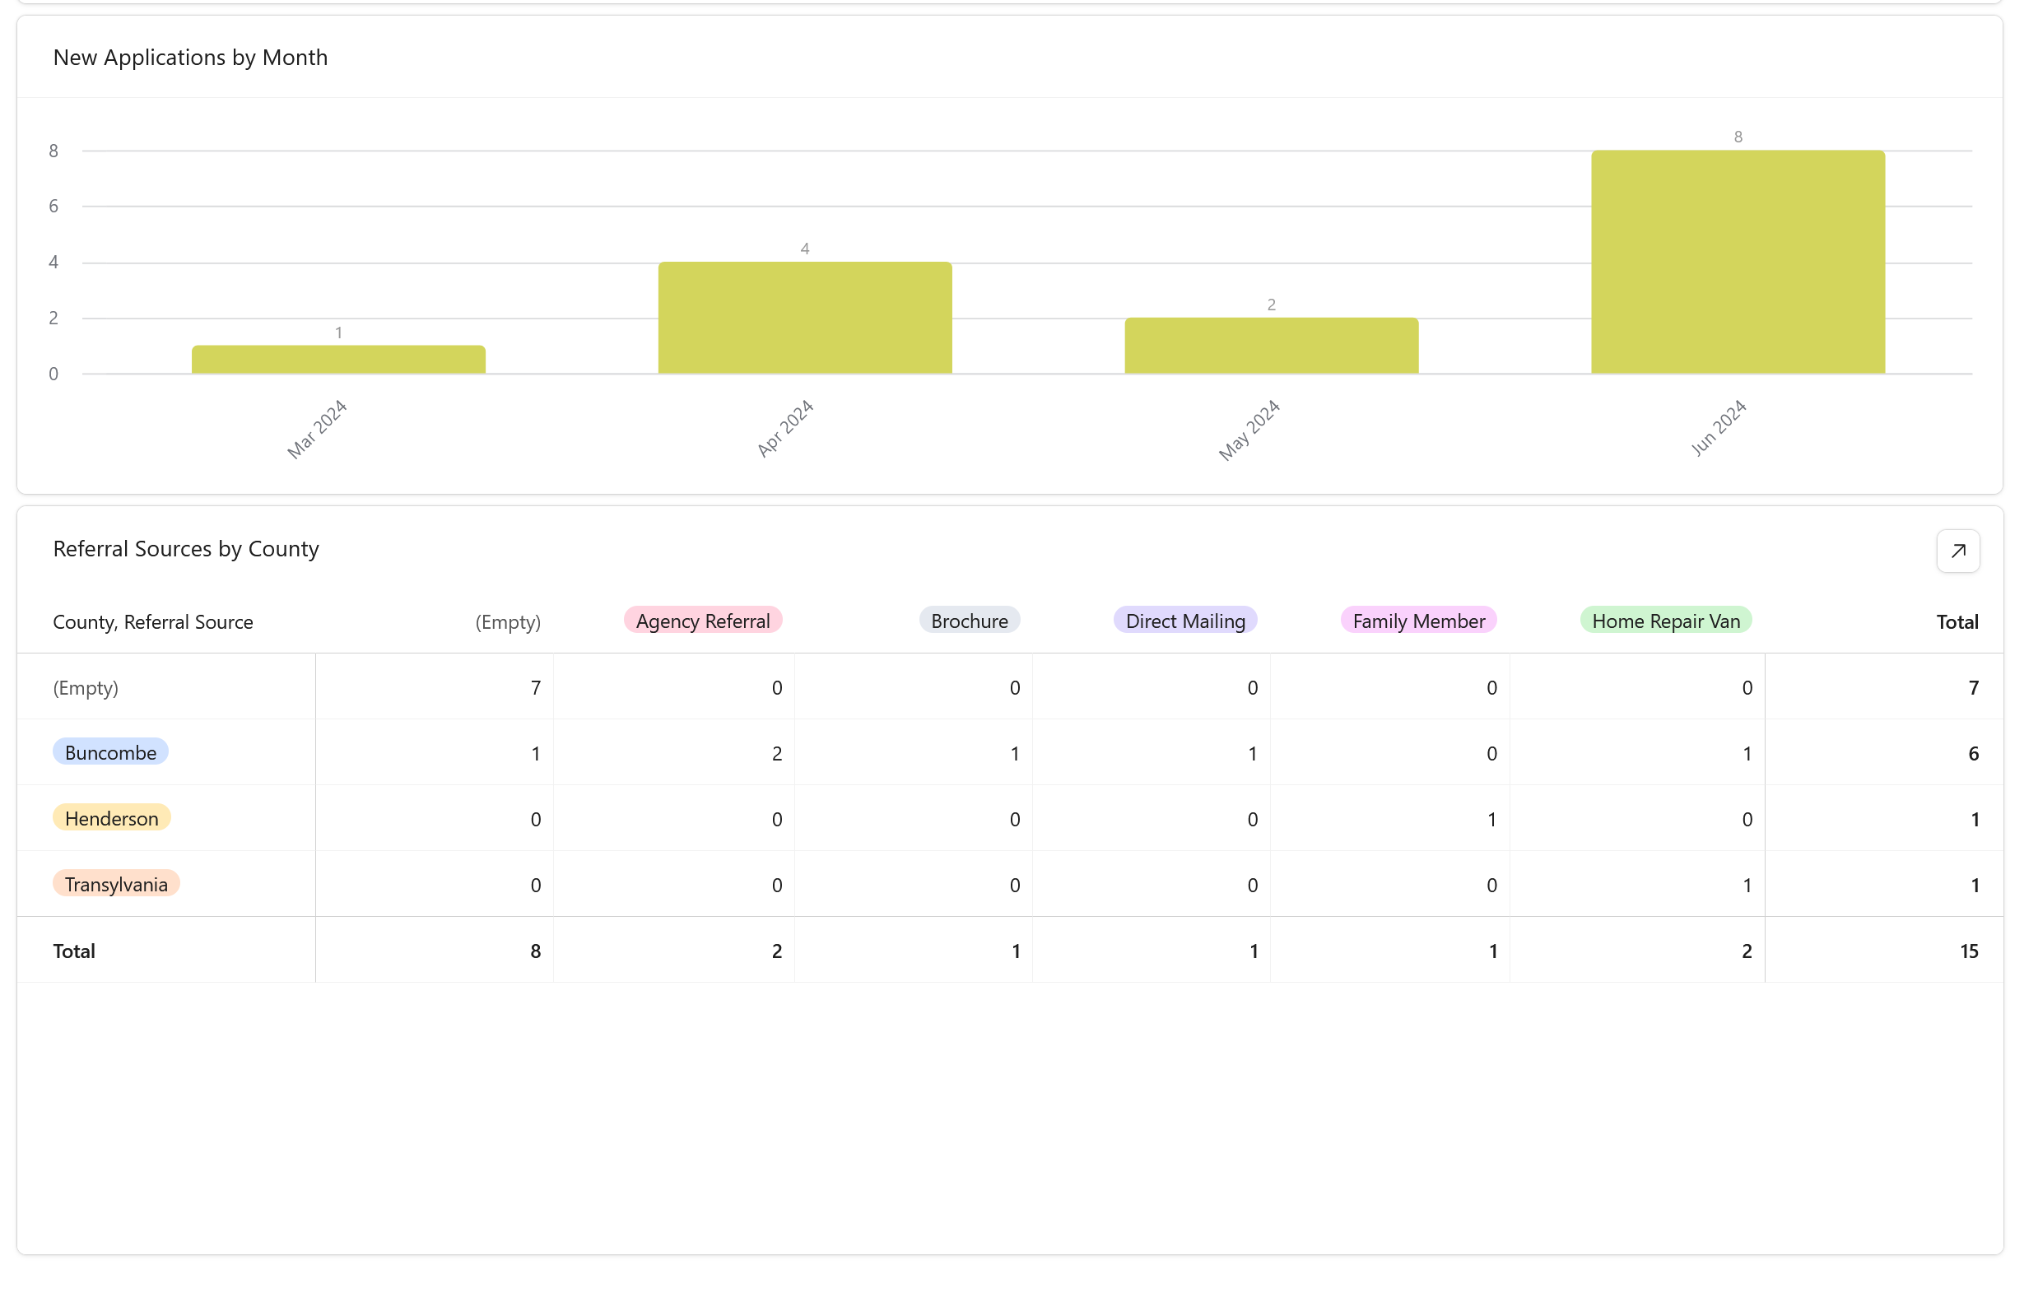
ARCHR Partner Org Interface

Slide 15
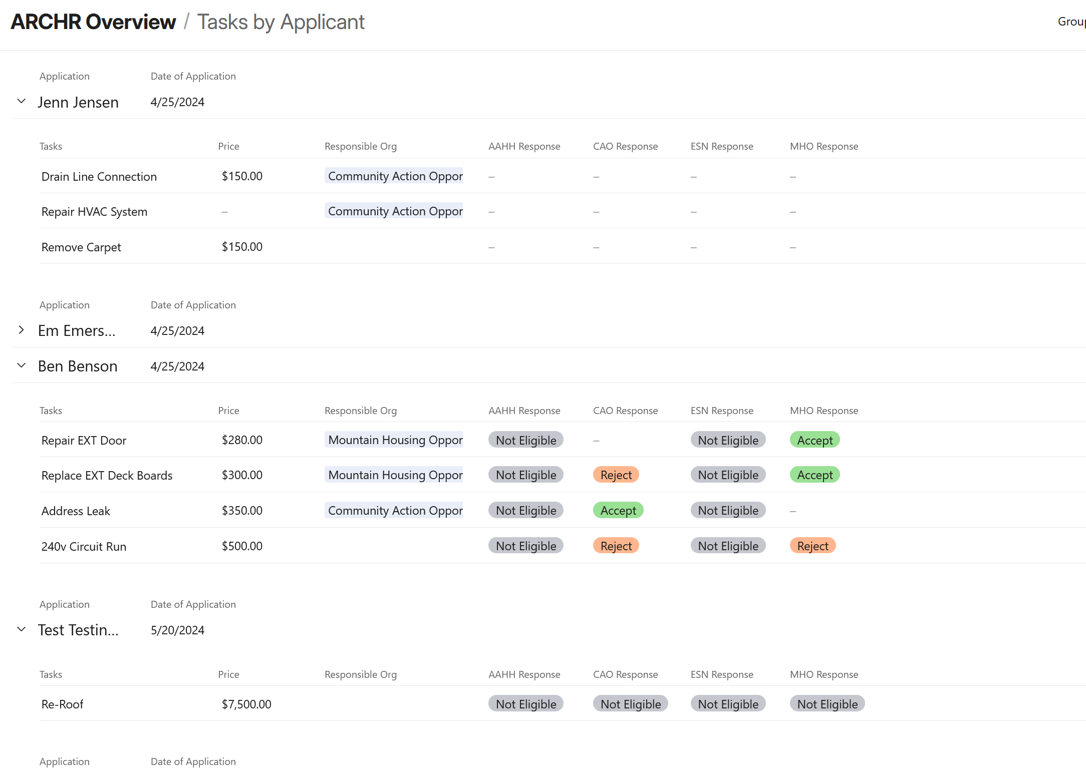
ARCHR Partner Org Interface

Slide 16
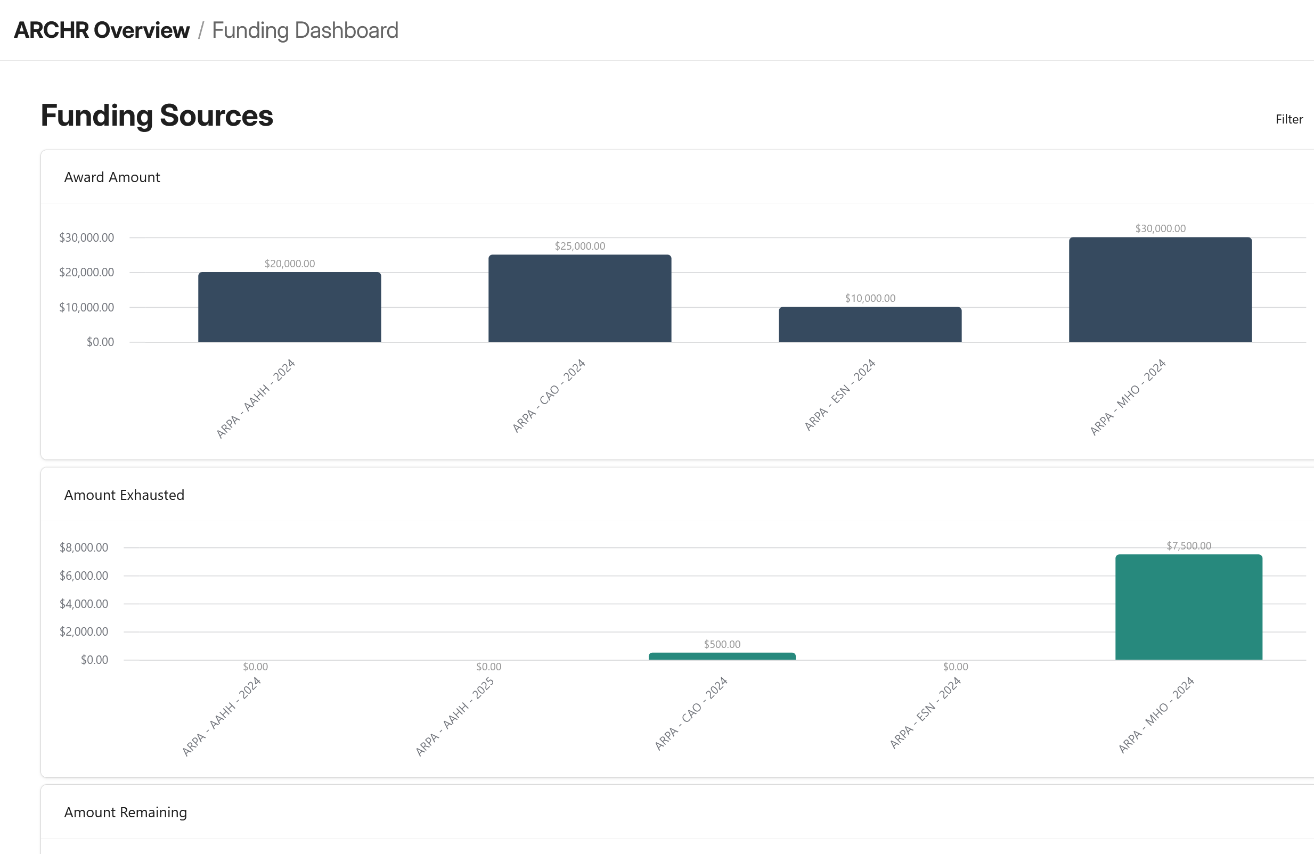
ARCHR Partner Org Interface

Slide 17
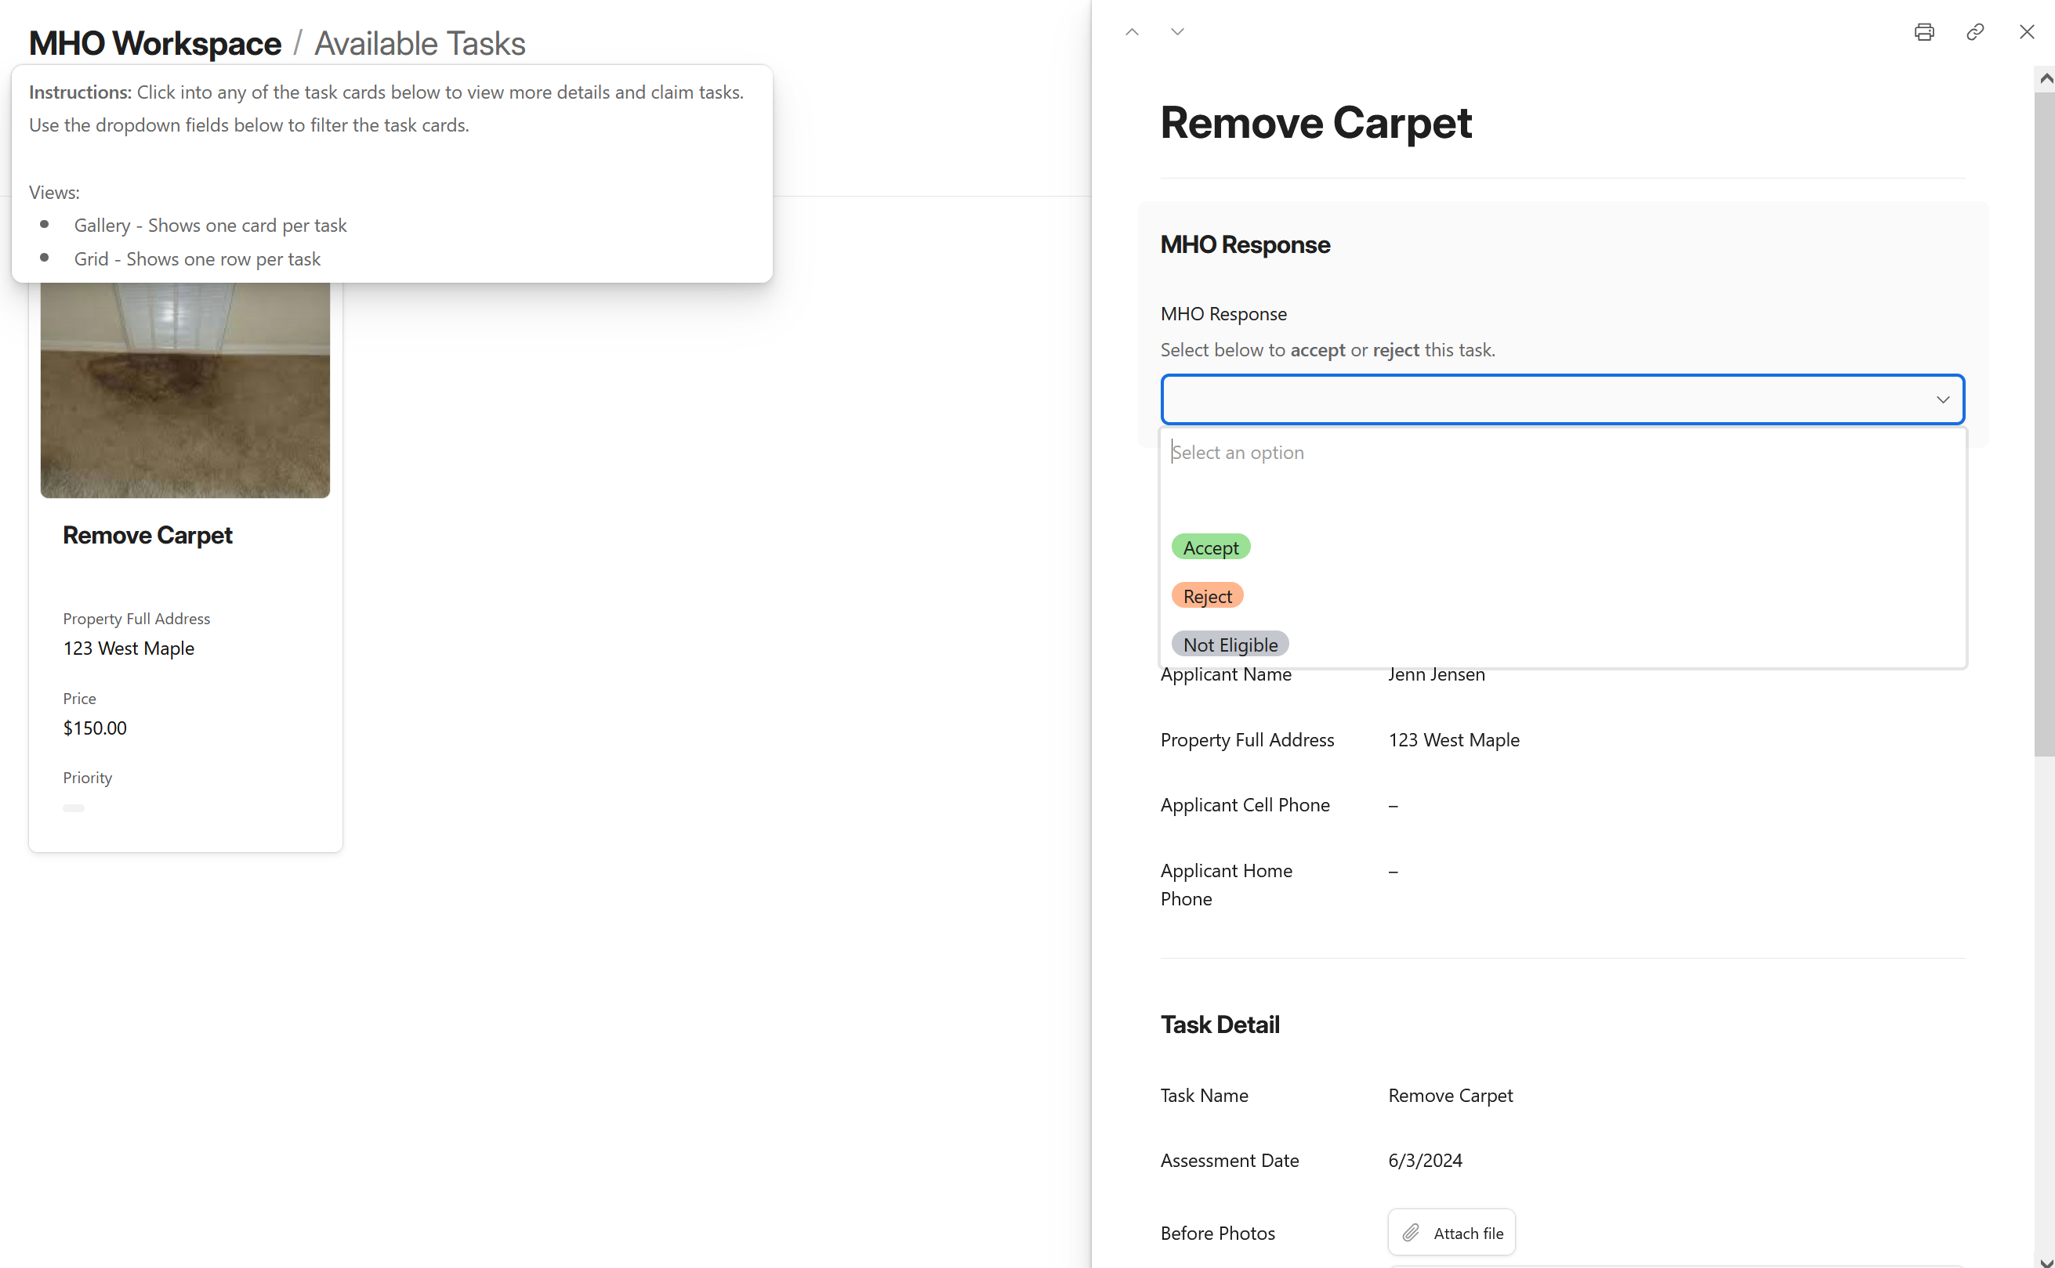
ARCHR Partner Org Interface

Slide 18
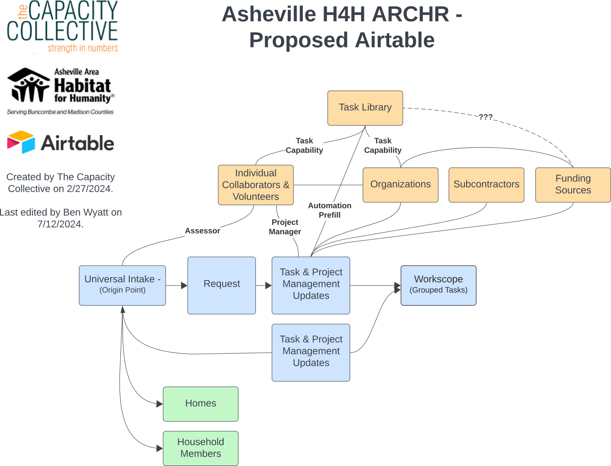

Slide 19

thecapacitycollective.org

