Slide 1
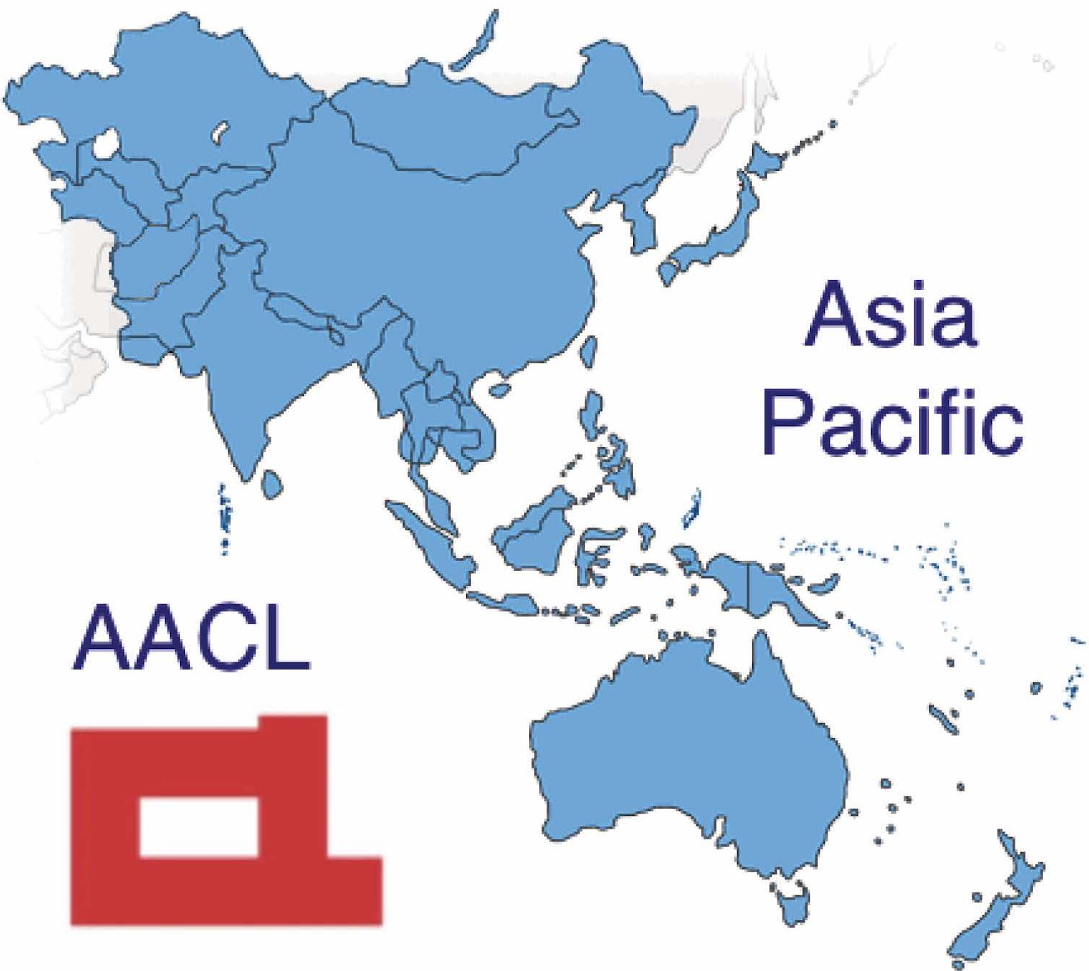

Asia
Pacific
AACL

