Slide 1
Introduction to Samba
Fabian Cooper & Aesia Cohen

Slide 2
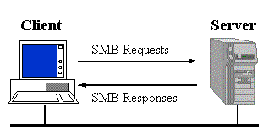
What is Samba?
Open-Source Software suite
File sharing
Printing services
Utilizes SMB and CIFS clients
Most often used for sharing between Linux and Windows systems.
Can be utilized for all systems

Slide 3
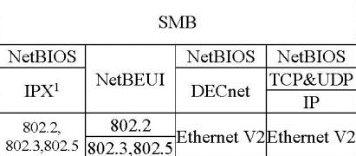
SMB: Server Message Block
Client Server/ Request-Response Protocol for share servers
Files, printers, serial ports, etc.
Exception being if there is a oplock; lock on file hosted on the server.
Clients connect using NetBIOS over TCP/IP

Slide 4
NetBIOS: Network Basic Input/Output System
A program that allows for communication on a LAN (local area network) connection.
Provides a message location and the name of the destination in the form of a NCB (Network Control Block).
Two Modes:
Session : Conversation between computers. Allows for large message handling and error detection/recovery
Datagram : Connectionless; messages sent independently and the application is responsible for error handling.

Slide 5
SMB: Security
Share Level:
All files are available to the client
Share can be password protected
User Level:
Applied to individual files
Users must log in and be authenticated
Common Issues:
TCP/IP environments aren’t usually sent outside of the originating subnet
Solution:
Microsoft introduced WINS (Windows Internet Name Service)
Introduction of CIFS

Slide 6
CIFS: Common Internet File System
File Sharing Protocol
Starts and ends a redirector connection to a shared resource at the server.
Namespace / File Manipulation Messages: Gain access to files to read and write to them.
Printer Messages: Send data to the print queue and get information about the print queue.
Other Messages: Write to mailslots and named pipes.

Slide 7
Samba: Prerequisite Setup
Before Opening VM:
Change inet address of VM’s
The CentOS7 inet address is set to 10.0.2.15 by default
Settings → Network → Attached to: Bridged Adapter
Once in the VM:
Remove the following File Locking files
>>rm -f
/etc/passwd.lock
/etc/group.lock
/etc/gshadow.lock
/etc/shadow.lock

Slide 8
Samba: Prerequisite Setup cont.
Switch to Root:
All commands in samba / smbclient require root access
Get NetBios name, Workgroup name, inet Address
>>ifconfig → inet address (enp0s3)
>>nmap <inet address> → NetBios and Workgroup names

Slide 9
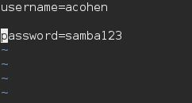
Samba: User Creations
Add a user to the samba database
>>smbpasswd –a <existing linux user>
>> touch /etc/samba/user.cred
>>vim /etc/samba/user.cred
Add the Following Lines:
>>username = <samba user>
>>password = <samba user

Slide 10
Samba: Share Folder Creation
Two Ways of Creating the Share Folder :
Use an Existing Directory
Pros: Faster to Implement
Cons: Change Permissions
Create a Directory
Pros: Share folder is secured to samba group users
Cons: More steps to implement

Slide 11
Samba: Configuration File
[global] Section:
Server-Wide Settings
Default Share Definitions
[homes] Section:
Unresolved share name is resolved here
User creation and password definition can be defined here
[printers] Section:
If share name resolution still is unresolved
Reads printer capabilities file (/etc/printcap)
[user defined share] Section:
Overrules [global] share defaults
Shared folder access permissions defined here
>>vim /etc/samba/smb.conf
[global]
…
…
[homes]
….
…
[printers]
…
…
[smbdemo]
…
>>testparm

Slide 12
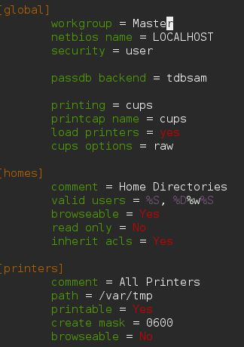
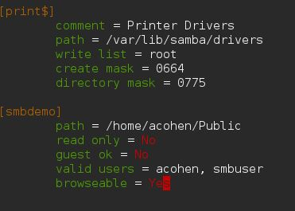
Samba: Basic Stand-Alone Server

Slide 13
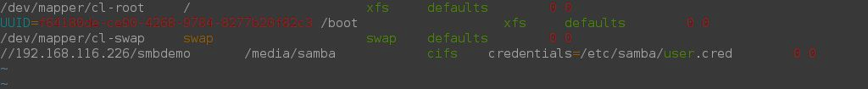
Samba: CIFS Integration
>>vim /etc/fstab
//<inet address>/<share folder> /media/samba cifs credentials=/etc/samba/user.cred 0 0
>>chmod 600 /etc/samba/user.cred
From Home
>>mkdir /media/samba
>>chmod 777 /media/samba

Slide 14
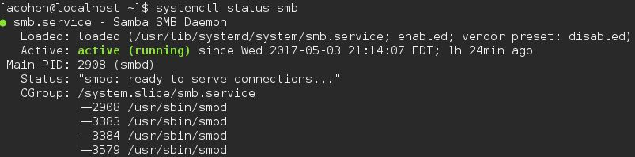
Starting the Samba Server
From the Server Host
>>systemctl enable smb
>>systemctl start smb
>>systemctl status smb
>>mount –t cifs //<inet address of server>/<share folder> -o username=<samba user> /media/samba
>>mount –a

Slide 15
Samba: Connecting to the SMB Server
From the Client
GUI:
Applications → Files → Connect to Server
>>Server Address : smb://<inet of server>/<sharefolder>
>>Username = <samba user>
>>Domain = SAMBA
>>Password = <samba user password>
>>Use text editors to edit files

Slide 16
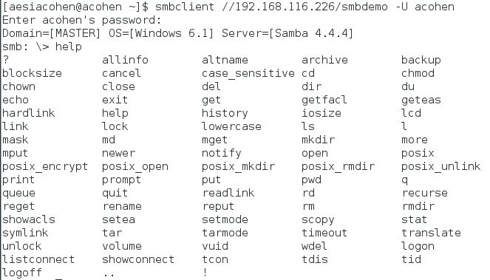
Samba: Connecting to the Server
From the Client cont.
Terminal
>>smbclient //<server inet address>/<share folder> -U <samba user>

Slide 17
Samba : smbclient
FTP-like client to access SMB/CIFS resources on servers
smbclient Functionality
Basic linux commands
Scripting capabilities
Print options
Backup options

Slide 18
Samba: smbclient Commands
Commands | Usage
lcd | Changes the current local directory to the one given.
get | Transfers a single file from the server host to the client
put | Copies a single file from the client to the server host
mget | Copies all files from the server host directory to the current client directory
mput | Copies all files from the current client directory to the server host
prompt | Turn on/off prompting when copying files
recurse | Turn on/of when copying directory and, if warranted, its content
Exit /Quit | Disconnect from the server

Slide 19
Works Cited
https://www.samba.org/samba/what_is_samba.html
https://www.samba.org/cifs/docs/what-is-smb.html#What_Is_SMB
http://searchnetworking.techtarget.com/definition/NetBIOS
https://technet.microsoft.com/en-us/library/cc939973.aspx
https://www.samba.org/samba/docs/using_samba/ch06.html
https://www.samba.org/samba/docs/using_samba/ch05.html

