Slide 1

Module 4: The Zombiola Simulation
By: Khiara MacElree, Quinn Thomas, Aesia Cohen

Slide 2
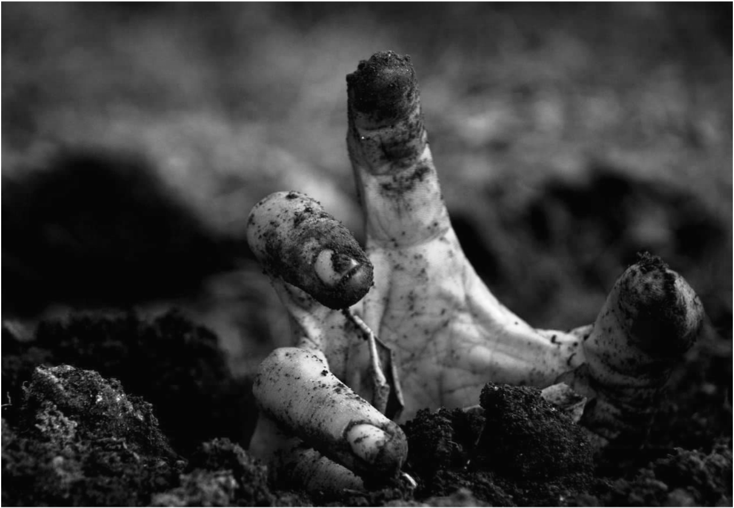
Requirements
Scenario:
After weeks of modeling and drafting, we were capable of creating a functioning program that simulates the survivability of the Susceptible researchers on the Zombiola Island
Design
Implementation
Verification
Overview

Slide 3

Requirements
Create UML Models that showed both the inheritance of the classes we would create and implement as well as how they would interact
Based on the UML models, create pseudo code for the class, helper functions, and main simulation
Implement the pseudo code into a working program.

Slide 4
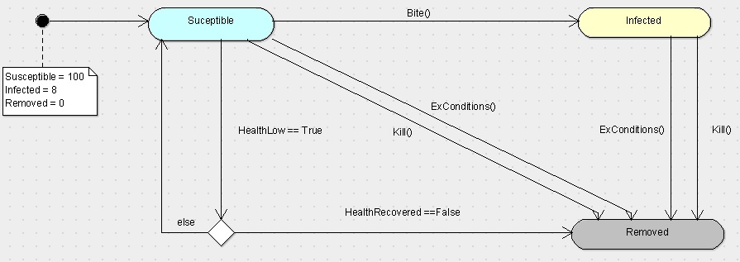
Design: State/Activity Model Recap Model Recap

Slide 5
Design:
Class Model

Slide 6
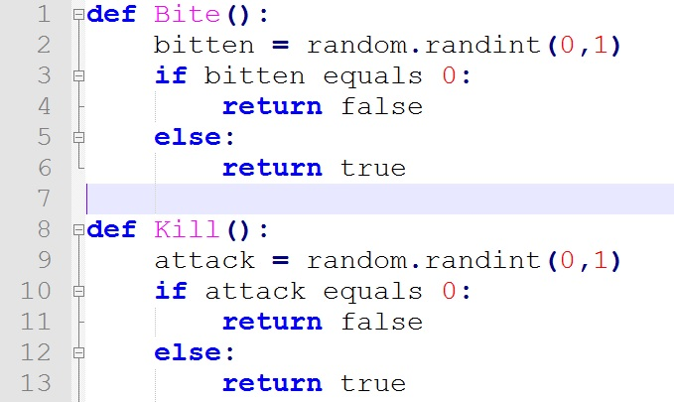
Design: Helper Functions Pseudo Code

Slide 7
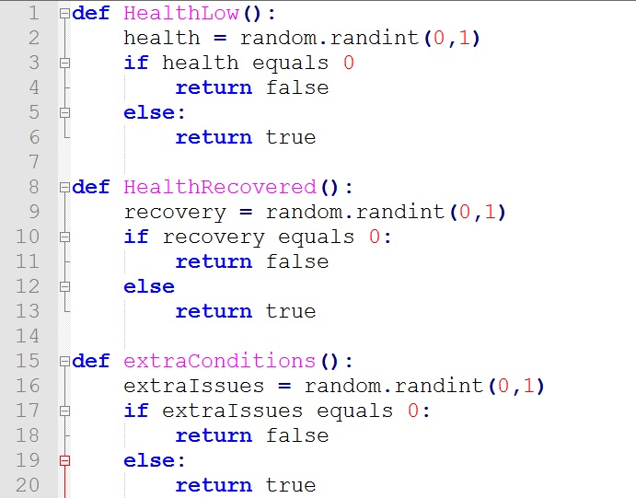
Design: Helper Functions Pseudo Code Cont.

Slide 8
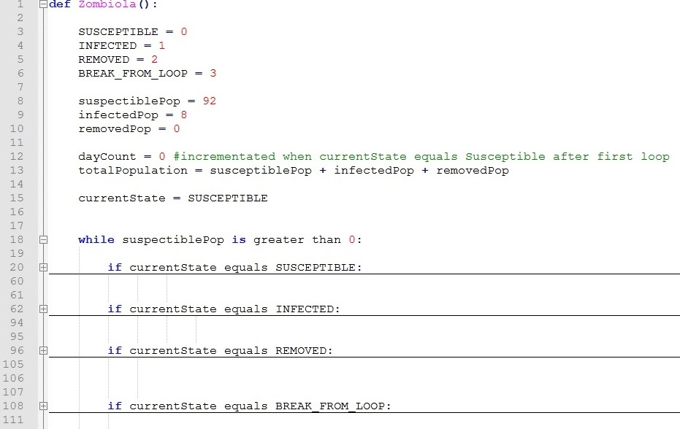
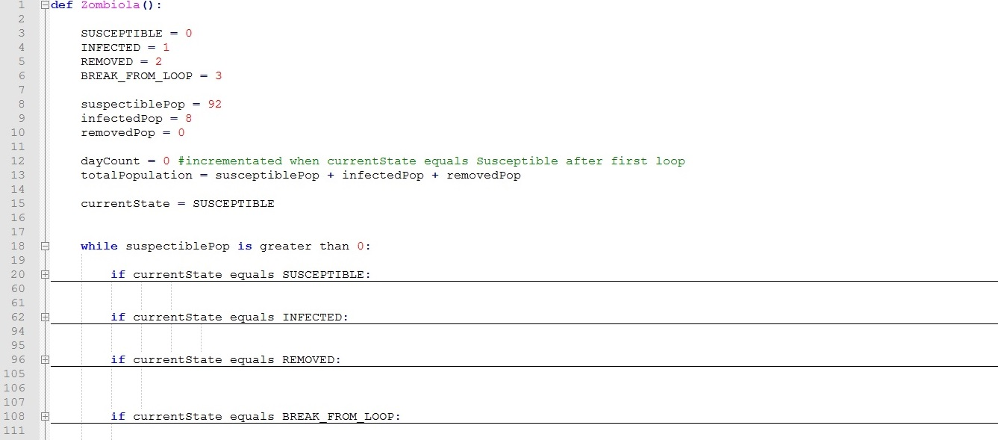
Design: Main Zombiola Pseudo Code

Slide 9
Implementation
Susceptible : Parent class
Infected : Child Class
Created lists as containers for the infected and susceptible class
Opted for Removed to be a variable
Kept the states in the program for organization

Slide 10
Zombiola Simulation Demonstration

Slide 11
Verification
Unit testing:
Running each state individually for any errors in syntax
populationCheck() method for constant debugging
System Test:
Ran the simulation for varying population counts

Slide 12
Overview
Challenges
Implementing classes and class objects into a state machine structure
Class syntax
Manipulating the containers
Accessing the object methods while they were in the container
Conclusion:
A class and the state machine structure make for clear and effective programming.

