Slide 1
Git 教學 – 進階
Cicilia Lee @ Pyladies
2018.12.23

Slide 2
Cicilia Lee 小西
資料科學家, AI chatbot
專長機器學習，自然語言處理
6年工作經驗，3.5 年 python 實作經驗
https://www.linkedin.com/in/cicilialee/

Slide 3
Outline
Remote branch
Git 操作流程與好習慣
分支命名與管理
團隊協作
Github功能介紹

Slide 4
Remote branch
Set SSH key at Github
Settings => SSH and GPG keys
https://help.github.com/articles/connecting-to-github-with-ssh/
Git clone 複製網路的程式碼
git branch –a
遠端分支: remotes/origin/*
git checkout <branch-on-server>
複製遠端分支

Slide 5
Git 操作流程與好習慣
(at master) git pull
Check out new code
Git checkout dev
<If someone merge to master >
git merge master
<Solve conflicts and commit>
<Start developing>
<commit when finished>
(at dev)git push

Slide 6
Solve conflicts
https://github.com/aacs0130/git_pyladies_tw
We have 2 roles to collaborate in this demo: fish and cat.
Please modify colors in order rainbow.txt

Slide 7
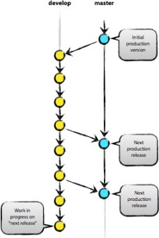
分支命名與管理-1/3
master
Develop
Features
Hotfix
Tags
Notes:
https://github.com/googleapis/dialogflow-python-client-v2/network

Slide 8
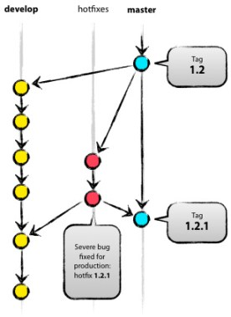
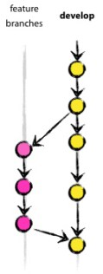
分支命名與管理-2/3
master
Develop
Features
Hotfix
Tags

Slide 9
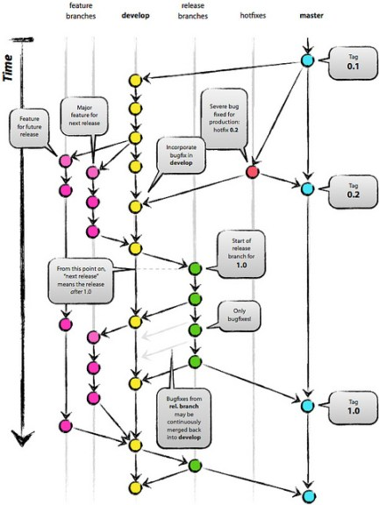
分支命名與管理-3/3
master
Develop
Features
Hotfix
Tags
Notes:
https://github.com/googleapis/dialogflow-python-client-v2/network

Slide 10
團隊協作 – 實際操作
https://github.com/aacs0130/git_pyladies_tw
設計同學1, 2, 3
截圖正確的狀況
寫好 code
設計步驟
什麼時候遇到 conflict

Slide 11
Github功能介紹
Code
Commit
branch
Issues
fix issue (demo)
Pull request (demo)
Insights
Dependency graph
Network
forks
Notes:
https://github.com/googleapis/dialogflow-python-client-v2/network

Slide 12
Q & A
https://github.com/aacs0130/git_pyladies_tw
https://www.linkedin.com/in/cicilialee/
Thank you

