Slide 1
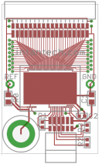
RHD2164 Headstage 1 Board
FR406 material, 0.036” thick, ENIG (immersion gold) plating (2 μm)
No through-hole components; only SMDs
0.550”
0.863”
actual size
0.1” hole in corner

Slide 2
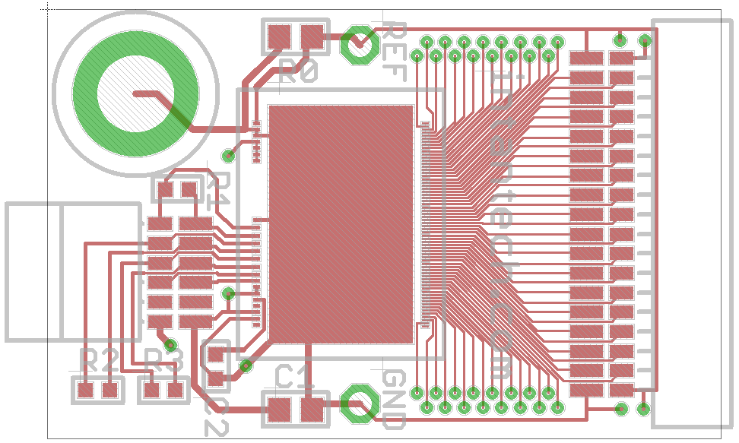
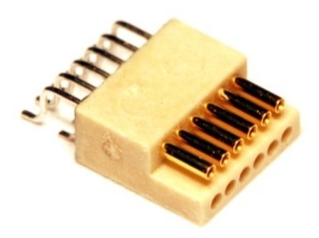
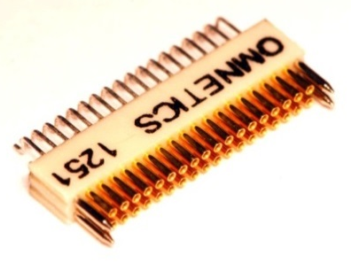
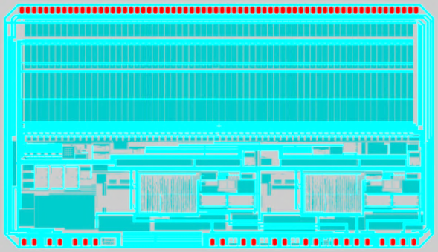
Top Components (9 total)
R1: 100 Ω (0201)
R0: 0 Ω (0402)
Omnetics A79025 connector
Omnetics A79623 connector
1 pad not bonded
RHD2164 bare die (7.3 mm x 4.2 mm, 0.20 mm thick)
85 total bondwires
3 pads not bonded
R2: 100 Ω (0201)
R3: 100 Ω (0201)
C2: 0.01 μF (0201)
C1: 0.1 μF (0402)

Slide 3
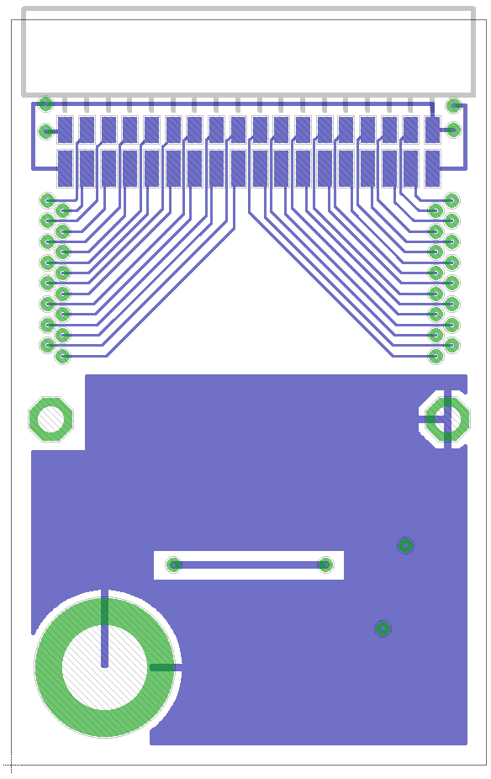
Bottom Components (1 total)
Omnetics A79025 connector

Slide 4
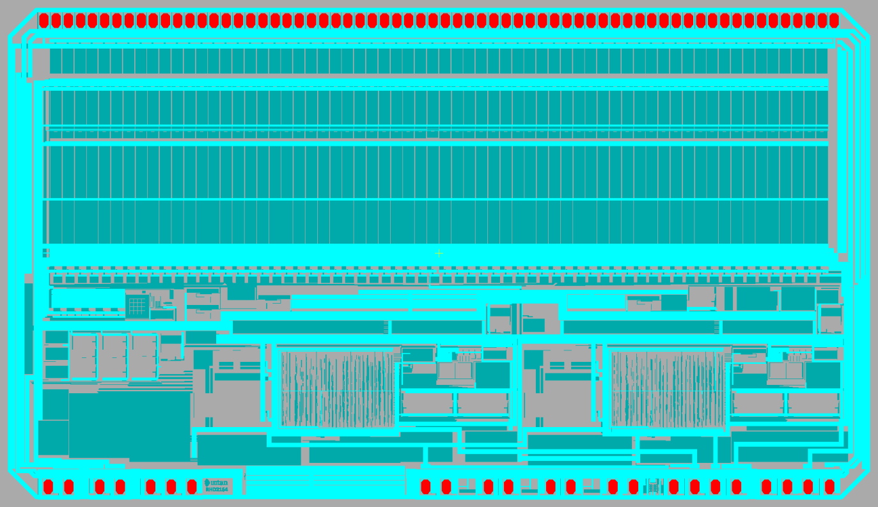
Intan Technologies RHD2164 Bare Die
Approximately 7.3 mm
Gray = approximate outline of die (may vary from die to die due to variations in sawing)
Yellow Cross = center of design (may not coincide precisely with center of die due to variations in sawing)
Approximately 4.2 mm
Blue, Green = top metal layers (highly visible)
Red = glass openings for bond pads
Each die is 0.20 mm (8 mils) thick

Slide 5

Bond Pad Dimensions
Bond pad metal: AlCu (99.5% aluminum, 0.5% copper)
72.0 μm
74.2 μm
116.0 μm
30.2 μm
Minimum bond pad pitch (center to center) on RHD2164: 101.6 μm (4.000 mil)

