Slide 1
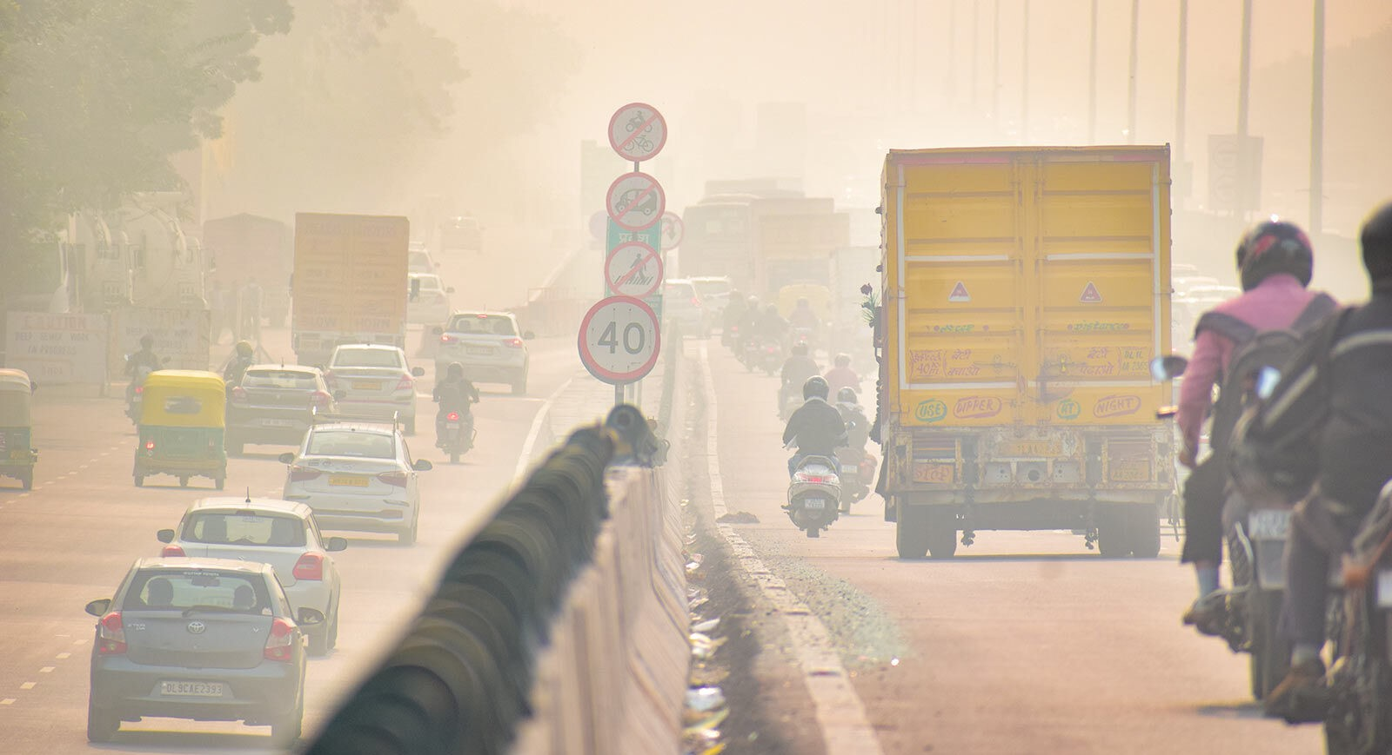
AIR QUALITY IN INDIA

Slide 2
TABLE OF CONTENTS
01
02
03
04
05
INTRODUCTION
DATASET
DESIGN
DATA ANALYSIS
RESULTS

Slide 3
INTRODUCTION
01

Slide 4
GOALS & STRATEGY
CONTENT
Our objective is to examine the air quality in India from 2015 to 2020 using the principles acquired in the Data Visualization course.
The dataset comprises information on air quality and the Air Quality Index (AQI) at both hourly and daily intervals from various stations in multiple cities across India
AQI POLLUTANTS
The AQI considers pollutants such as particulate matter (PM 10 and PM 2.5), ground-level ozone (O3), sulfur dioxide (SO2), nitrogen dioxide (NO2) and carbon monoxide (CO)

Slide 5
AIR QUALITY AND HEALTH ISSUES
The decline in air quality, arising from industrial activities and vehicle emissions, poses a substantial threat as highlighted by the Air Quality Index (AQI).
The close connection between air quality and public health is fundamental and cannot be emphasized enough.
There’s a strong correlation between exposure to poor air quality and a spectrum of health issues.

Slide 6
Increased pollution levels, including particulate matters and harmful gases, are associated with elevated risks of respiratory and cardiovascular diseases.
The significance of this issue compelled us to select the dataset about Air Quality in India, recognizing the profound impact that air quality has on public health.

Slide 7
DATASET
02
Some information

Slide 8
General information
The selected dataset contains information about the AQI (Air Quality Index) in a variety of stations in India. It is available in Kaggle platform at the following link: https://www.kaggle.com/datasets/rohanrao/air-quality-data-in-india/data.
In this dataset there are 5 tables, all used in the various graphs :
City_day, that contains daily collection of data for each city;
City_hour, that it’s similar to the first one but scheduled for hours;
Station_day, that contains daily collection of data for each station (represented by an ID);
Station_hour, that it’s similar to the table before but scheduled for hours;
Stations, that contains all the information about stations, such as name, city, status… ;

Slide 9
City involved
Ahmedabad
Aizawl
Amaravati
Amritsar
Bengaluru
Bhopa
Brajrajnagar
Chandigarh
Chennai
Coimbatore
Delhi
Ernakulam
Gurugram
Guwahati
Hyderabad
Jaipur
Jorapokhar
Kochi
Kolkata
Lucknow
Mumbai
Patna
Shillong
Talcher
Thiruvananthapuram
Visakhapatnam

Slide 10

Data cleaning
At first, we deleted the null values to avoid showing missing records but we realized that we were losing too much information so we decided to use the raw dataset to have a more complete overview.
For example, after applying data cleaning techniques to the dataset we had completely lost some information regarding Ahmedabad city.

Slide 11
DESIGN
03
Colours and typeface

Slide 12






Colours of AQI
GREEN
YELLOW
ORANGE
Good
Moderate
Unhealthy for sensitive people
RED
PURPLE
MAROON
Unhealthy
Very unhealthy
Hazardous

Slide 13
Design choices
Typeface
The typeface used is Arial, a sans serif
Background colors
Background images
The main color used is grey, that remind the pollution
In some cases it was more effective to add some images for highlights the graphs

Slide 14
DATA ANALYSIS
04

Slide 15
Through the use of Tableau, we have created dynamic visualizations that depict the fluctuating levels of pollutants, different AQIs, enabling a detailed understanding of the air quality landscape.

Slide 16
ROADMAP TO VISUALIZATIONS
Background:
Investigate different air pollutants and their sources.
Understand computation of the Air Quality Index (AQI).
Health impact
Select most relevant pollutants for study

Slide 17
Analysis:
Identify cities with the highest and lowest pollution levels
Trends in Air Quality Index (AQI) throughout the years
Investigate potential factors contributing to AQIs levels like population density, number of vehicles, industrial presence
Exploring monitoring stations
Examine more in depth specific pollutants

Slide 18
RESULTS
05

Slide 19
Some discoveries
POPULATION
BEHAVIOUR
MOST POLLUTED CITIES
Despite of what we think before, we find out that there is not a correlation between population and pollution as the butterfly graphs provide to show
Unexpected behaviour: big cities has high values of NOx during the night
The AQI level is worst during cold months
Ahmedabad
Brajrajnagar
Delhi
Patna
Lucknow

Slide 20
Challenges
MERGING THE DASHBOARDS
We didn’t find immediately the right solution to merge our work.
CHOOSE THE STORY
At the beginning we have too many ideas, so we have to choose one clear and defined path to follow
MOST EFFECTIVE GRAPHS
As it is the first time that we manage graphs and data, it was hard for us to immediately find the most effective way to visualize our data.

Slide 21
OUR TEAM
Claudia Luisa Crippa
Amelia Maria Acuna Rodriguez
Sergio Verga
Dias Karimov
Faezeh Azhir
Ludovica Rossetti

Slide 22
THANKS FOR YOUR ATTENTION!
If you want to check our work go to:
Hasta la VIZta project

