Slide 1
ECE 553: TESTING AND TESTABLE DESIGN OF DIGITAL SYSTEMS
Course Overview

Slide 2
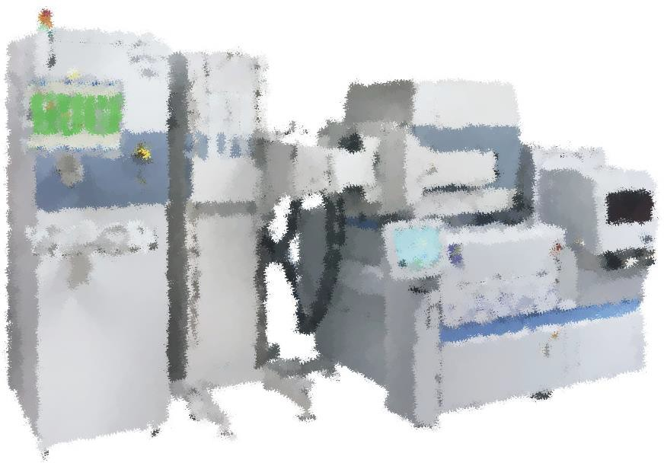
Outline
Course objective & roadmap
Notation & references
Acknowledgements
2

Slide 3
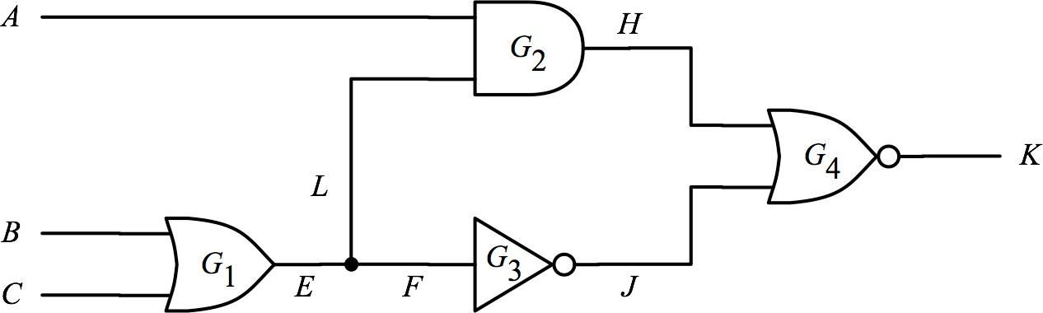
Course Objectives
You will learn
  What is VLSI testing
  Why is testing important
  How do we achieve good testing
  What are important issues in testing and their solutions
This course focuses on VLSI digital circuits
3

Slide 4
Course Roadmap (EDA Topics)
Fault Modeling
Logic Sim.
Fault Simulation
Testability
Comb. ATPG
Diagnosis
Seq. ATPG
Major topics
Side topics
4
Delay Test

Slide 5
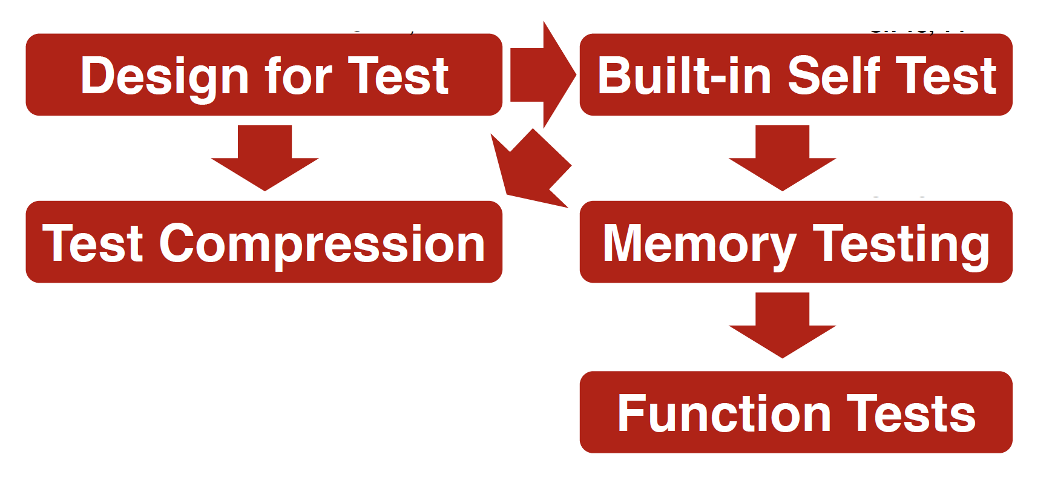
Course Roadmap (Design Topics)
5

Slide 6
Test in Semiconductor Pyramid
EDA
Logic Sim. Fault Sim. ATPG
Design
DFT
Boundary Scan BIST
Manufacture
Production Test Diagnosis Memory Test
6

Slide 7

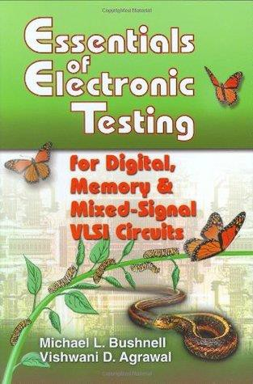
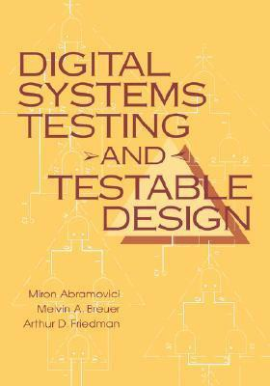
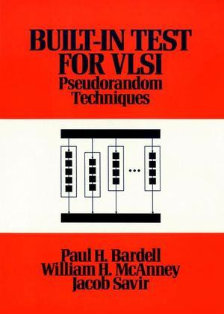
Reference Books
(WWW) L.T. Wang, C.W. Wu, and X. Wen, “VLSI Test Principles and Architectures”, Morgan Kaufmann, 2006.
(BA) M.L. Bushnell and V.D. Agrawal,“Essentials of electronic testing,”
Kluwer Academic Publishers, 2000.
(ABF) M. Abramovici, M. A. Breuer and A.D. Friedman, “Digital systems testing and testable design,” IEEE Press,1994
(BMS) P.H. Bardell, W.H. McAnney, J. Savior, “Built-in Test for VLSI:
Pseudorandom Techniques,” Wiely Interscience, 1987,
(WWW)
(BA)
7

Slide 8
Recommended Reading
Topics | WWW | BA
Introduction | 1.1, 1.2 | 1.4, 2.1, 3.2, 3.3
Logic Simulation | 3.2, 3.3 | 5.1 ~ 5.4
Fault Models | 1.3 | 4
Fault Collapsing | - | 4.5
Fault Simulation | 3.4 | 5.5, 5.6
Testability Measure | 2.2 | 6.1
Comb. ATPG | 4.1 ~ 4.4 | 7.5
Seq. ATPG | 4.5 | 8.2, 8.3
Delay Test | 4.10 | 12
Diagnosis | 7.2 | -
Design for Test (DFT) | 2.3 ~ 2.5, 10.2 | 14, 16
BIST | 5.3 ~ 5.5 | 15
Test Compression | 6 | -
Memory Testing | 8.2 | 9.5 ~ 9.7
8

Slide 9
Acknowledgements
Sources of course material:
  Emeritus Prof. Kewal Saluja , UW- Madison
  Prof. James Chien-Mo Li , NTU
  Prof. Vishwani Agrawal , Auburn University

