Slide 1
ECE 553: TESTING AND TESTABLE DESIGN OF DIGITAL SYSTEMS
General Introduction

Slide 2
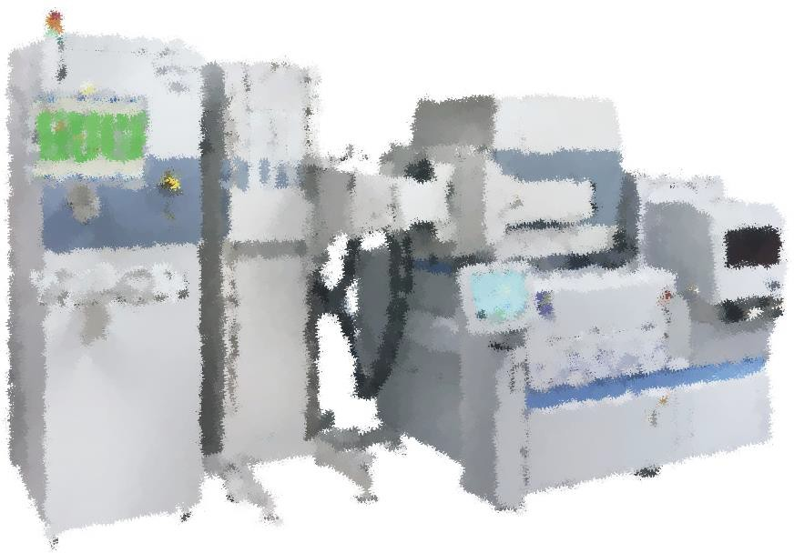
Outline
Introduction
  What is Testing
  Why is Testing Important
Types of Testing
Test Quality
Test Economics
Conclusions

Slide 3




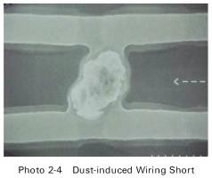
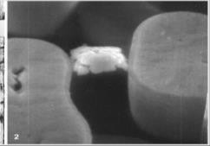


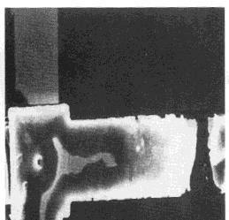
What is Testing?
Testing is process of determining whether a piece of hardware
  Functioning correctly (PASS) or defective (FAIL)
Why do we need to test Integrated Circuits (ICs)?
  Because defects occur in manufacturing process
Pass:
Manufacturing Process
Testing
Shippping
Defects
Fail: Reject
Testing is a Decision

Slide 4
Four Possible Outcomes
True pass and true reject are correct decision
Test escapes = defective chips that pass test
  also known as (aka.) under-testing
Yield loss = good chips that fail the tests
Goal of good testing: reduce both test escape and yield loss
  Trade off between test cost and test quality
 | Good IC | Defective IC
Pass tests | True PASS | Test Escapes (less is better)
Fail tests | Yield Loss (less is better) | True Reject
Notes:
Higher quality test means chips which pass the test are not defective. It does result in some good chips to fail the test and make the yield worse.
Higher quality means more cost.

Slide 5
Quiz
Q: Which of following is NOT IC testing?
A: Run SPICE simulation on amplifier design to check if output is correctly amplified
B: Apply analog signal to an ADC IC and check if output is correctly digitized
C: Apply two numbers to an adder IC and check if output number is correctly added
Notes:
Need physical IC so A is the answer.

Slide 6
Outline
Introduction
  What is Testing?
  Why is Testing Important?
Types of Testing
Test Quality
Test Economics
Conclusions

Slide 7
Stages of IC Product
Design
Debug
Verification
feedback
Fabrication
Good Testing is Key to Success
Prototype Test
Mass Production
pass test
good IC
Production Test
Customer
failing IC
returned IC
fail test
Diagnosis
diagnosed faults
Failure Analysis
Pictures of defects
feedback to design,
test & fab
& their root causes

Slide 8
Why is Testing Important?
1. Guarantee IC quality
  Reduces test escapes
2. Shorten Time to Market, for example by:
  Improve efficiency of production test
  Better diagnose defective IC to improve yield
3. Enhance Profit for example by:
  Fix defective chips if possible (like memory)
  Reduce yield loss
8

Slide 9



Testing is Everyone’s Responsibility
Fabrication
Yield improvement Systematic defect diag.
Physical Failure Analysis
Diagnosis
Test Engineer
Test cost reduction Test quality assurance
GOOD TESTING
Test Service
ATE maintenance
Test data analysis
EDA
Auto.Test Pat. Gen. Fault simulation
Design
Design for testability
Built-in self test
Reliability
Burn-in Accelerated life test
9

Slide 10
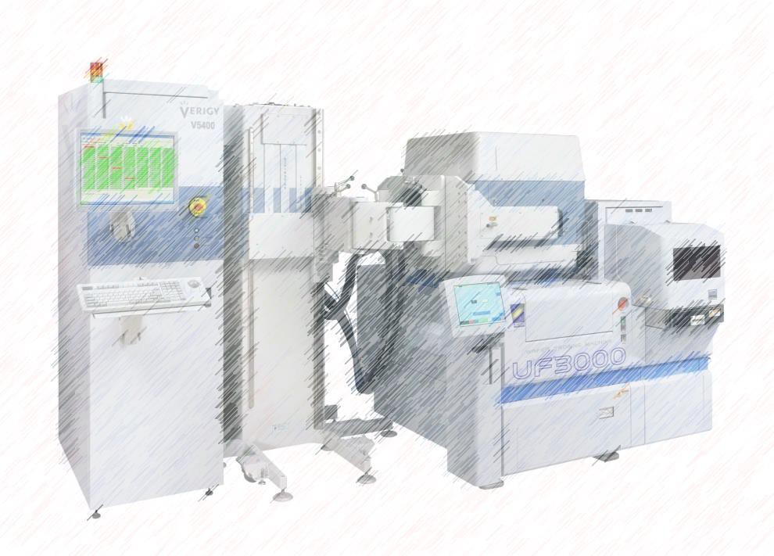
Introduction
What Is Testing
Types of Testing
Test Quality
Test Economics
Conclusions
10

Slide 11

Types of Testing
Testing (generally speaking)
Design Verification
Explicit Testing
Implicit Testing Or On-line Testing
don’t worry about names too much
Characterization Test
Production Test
Reliability Test
Diagnosis Test
Wafer Test
Package Test
System Test Burn-in Acc. Life test
Gross Test
DC parametric Test
AC parametric Test
Boolean Test
Delay Test
Functional Test
IDDQ, VLV
11

Slide 12
Types of Tests from A High-Level
(1) Design verification
Logic design errors, physical design errors
(2) Explicit testing : test for defects
  Mask problems, lithography problem
  Particles or scratches
  Bad manufacture recipe
Focus of class
(3) Implicit or online testing : test for failure due to external disturbance during normal operation
  Electromagnetic interference
  Alpha particles
  Power supply disturbance
Why so many types of tests?
Because There Are Many Different Problems!
12

Slide 13
Types of Testing
Testing (generally speaking)
Design Verification
Explicit Testing
Implicit Testing Or On-line Testing
Characterization Test
Production Test
Reliability Test
Diagnosis Test
Wafer Test
Package Test
System Test Burn-in Acc. Life test
Gross Test
DC parametric Test
AC parametric Test
Boolean Test
Delay Test
Functional Test
IDDQ, VLV
These Topics Are NOT in This Course

Slide 14
Design Verification
Verification
  Purpose : check if design correctly implements specified behavior
  Done before manufacture to catch design errors (bugs)
  Approaches: simulation, formal verification, …
Different from explicit testing
  Explicit testing’s purpose: check if IC is functioning correct or is defective
  Explicit testing done after manufacture to catch defects
  Approaches: apply test patterns by tester, …
design manufacture
Specifications description in sentences or codes
Design Code/Netlist/ layout
Silicon
IC chips
Physical devices
= ?
Verification
(for bugs)
= ?
Testing (for defects)

Slide 15
Implicit or Online Testing
Purpose
  Check IC output correctness during normal operation
Also known as:
  Concurrent Error Detection (CED)
  Online testing
Important for mission critical systems
  Airplanes, satellites, mainframe computers
Techniques (covered in courses related to fault-tolerant systems)
  Circuit level techniques
 Error Correction Code (ECC) protection of memory
  System level techniques
 Watch dog timer

Slide 16
Types of Testing
Testing (generally speaking)
Design Verification
Explicit Testing
Implicit Testing Or On-line Testing
don’t worry about names too much
According to purpose
Characterization Test
Production Test
Reliability Test
Diagnosis Test
According to stage
Wafer Test
Package Test
System Test Burn-in Acc. Life test
Gross Test
DC parametric Test
AC parametric Test
Boolean Test
Delay Test
Functional Test
IDDQ, VLV
According to test technique
16
Notes:
According to stages
Wafer test (aka. Wafer sort, wafer probe): on wafer
Package test (aka. Final test): after packaging
System test: in system

Slide 17
Types of Testing
Testing (generally speaking)
Design
Explicit Testing
Implicit Testing Or
don’t worry about names too much
Verification |  |  | On-line Testing
Characterization Test
Production Test
Reliability Test
Diagnosis Test
Wafer Test
Package Test
System Test Burn-in Acc. Life test
Gross Test
DC parametric Test
AC parametric Test
Boolean Test
Delay Test
Functional Test
IDDQ, VLV

Slide 18
Characterization Tests
Test a small amount of prototype ICs very thoroughly
  Test cost and test time are not big concerns
Purpose of characterization test
  1. Verify IC function is same as design (silicon debug)
  2. Confirm IC specifications under different test conditions
 Specifications: speed, VOH/VOL, rise/fall time …
 Conditions: VDD, Temperature …
  3. Characterization test helps develop test program for production test
 Determine Pass/Fail limits
Notes:
Determine pass/fail limits to ensure we have acceptable yield

Slide 19
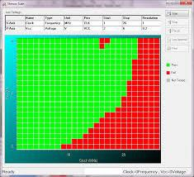
Shmoo Plot
Graphical display of CUT test results under different test conditions
Example: clock period (X-axis) vs. VDD (Y-axis)
  Green = PASS ; Red = FAIL
PASS
FAIL
VLSI Test 1.2 © N
Notes:
Shows results of characterization test
Very time consuming because each rectangle is a test so we need mxn different tests

Slide 20
Types of Testing
Testing (generally speaking)
Design Verification
Explicit Testing
Implicit Testing Or On-line Testing
don’t worry about names too much
Characterization Test
Production Test
Reliability Test
Diagnosis Test
Wafer Test
Package Test
System Test
Burn-in
Acc. Life test
Gross Test
DC parametric Test
AC parametric Test
Boolean Test
Delay Test
Functional Test
IDDQ, VLV

Slide 21
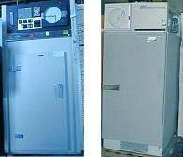

Reliability Tests
Burn-in
  Goal: screen out early-life failure
  Method: raised temperature and voltage for hours or days
 cook IC in oven!
  Very costly. Only applied to expensive IC such as CPU
Accelerated Life Test (ALT)
  Goal: estimate life time of IC to estimate wear-out
  Method: burn-in until IC is dead
  Only applied to some sampled ICs
Burn-in oven siliconfareast.com
Burn-in board
Notes:
Only to small sample because it is done until ICs are dead.
Reliability testing (type of explicit testing) : test for wear out
Electromigration
Corrosion

Slide 22
Bathtub Curve
IC’s failure rate* resembles a bathtub
  Early-life failure: fail early in life, due to reliability defects
  Wear out: normal life time, due to aging
Early-life failure period
Normal
lifetime
Wear-out
period
Failure rate
*Failure Rate = percentage of failures in a period of time
Time
~ 20 weeks
Burn-in
5 – 25 yrs
ALT
Notes:
High failure rate in first 20 weeks is due to ICs that escaped reliability test after production test.
Burn-in test help screen out the bad chips.
ALT: accelerated life test is needed to know the curve shape

Slide 23
Types of Testing
Testing (generally speaking)
Design Verification
Explicit Testing
Implicit Testing Or On-line Testing
don’t worry about names too much
Characterization Test
Production Test
Reliability Test
Diagnosis Test
Wafer Test
Package Test
System Test Burn-in Acc. Life test
Gross Test
DC parametric Test
AC parametric Test
Boolean Test
Delay Test
Functional Test
IDDQ, VLV
23

Slide 24
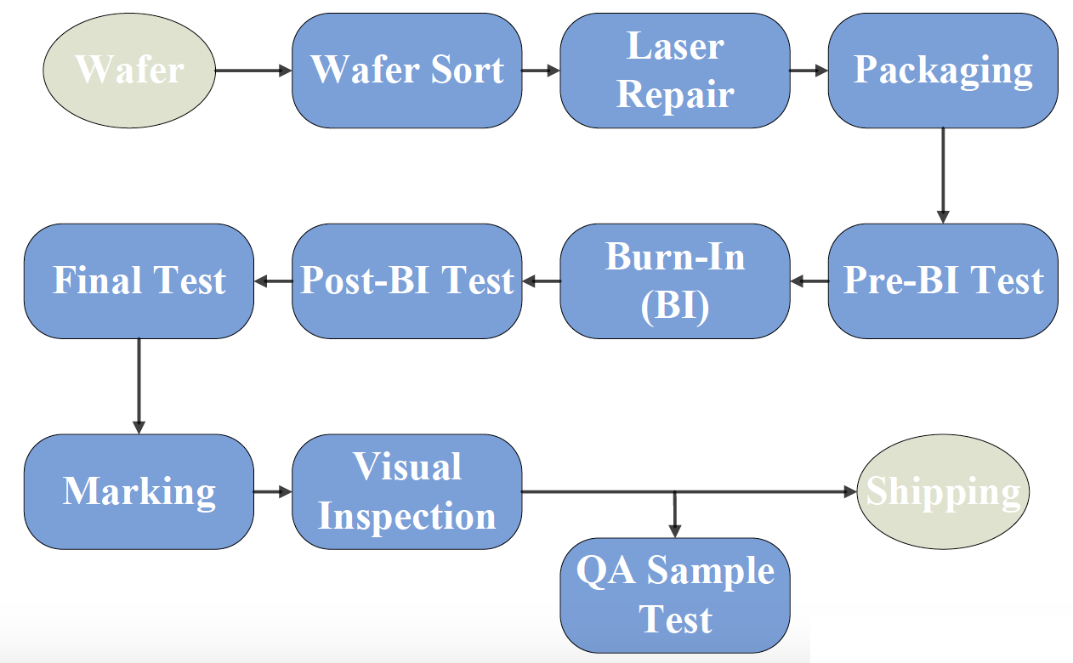
Production Tests
Purposes:
  1. Enforce quality requirements before selling to customers
  2. Sort parts for different specifications
 e.g. different speeds of CPU
Example: a typical production test flow
Wafer
Wafer Sort
Laser Repair
Packaging
Final Test
Post-BI Test
Burn-In (BI)
Pre-BI Test
Marking
Visual Inspection
Shipping
QA Sample Test
Notes:
We mark ICs according to speed
A small amount of sampled ICs will be tested to ensure quality

Slide 25
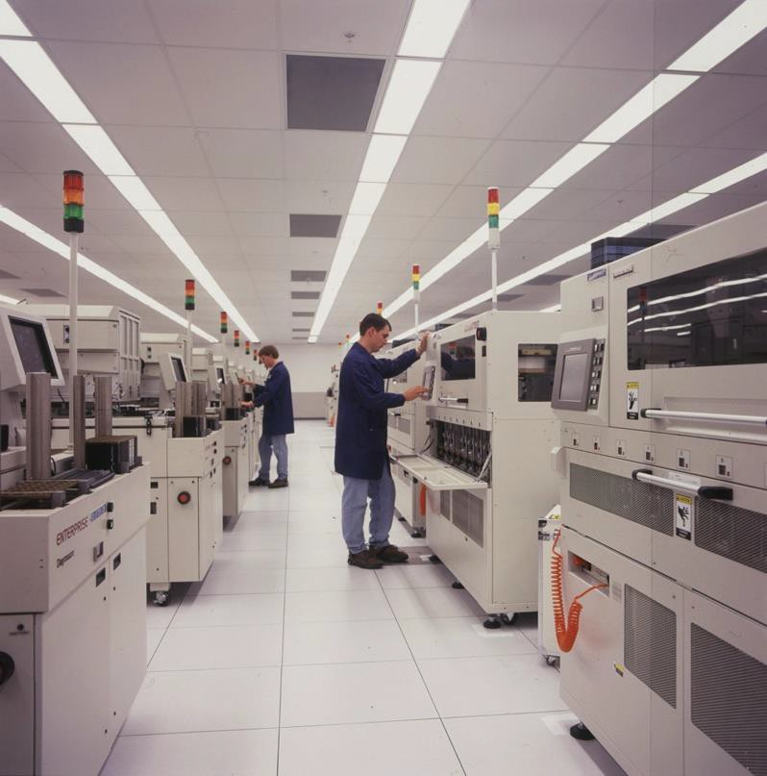
Production Test Floor
Yellow = Attention Needed
Green = PASS
Red = FAIL
Source: micron.com
VLSI Test 1.2 © Nati
Notes:
Many testers and handlers. CUT are inside the handlers.
3 color light indicates test status.

Slide 26
Types of Testing
Testing (generally speaking)
Design Verification
Explicit Testing
Implicit Testing Or On-line Testing
don’t worry about names too much
Characterization
Production Test
Reliability Test
Diagnosis Test
Test
Wafer Test
Package Test
System Test
Burn-in
Acc. Life test
Gross DC parametric Test Test
21
AC parametric Test
Boolean Test
Delay Test
Functional Test
IDDQ, VLV

Slide 27
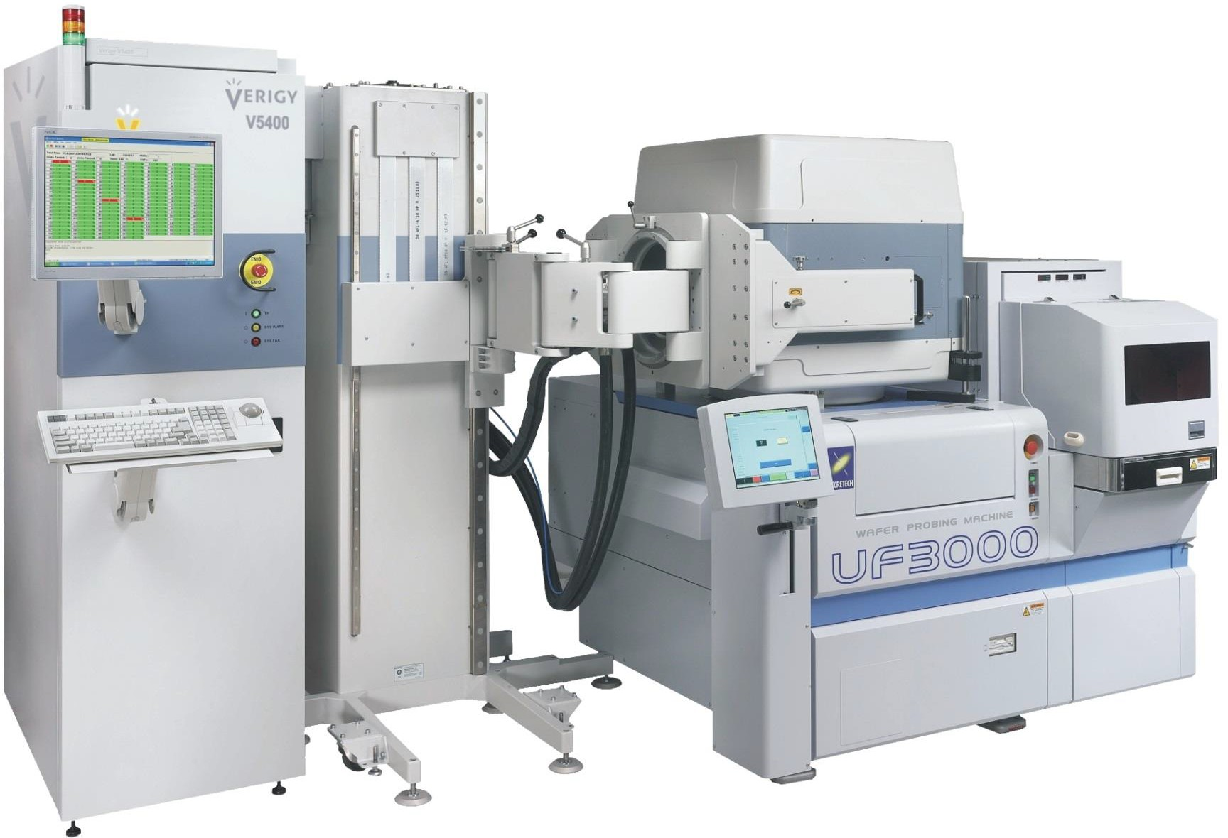
Wafer Test Setup
Source: Verigy.com
Test head
wafer and probe card
ATE
Probe station
Notes:
Test head is now facing down
Many wafers stored in the probe station and each time pass one.

Slide 28
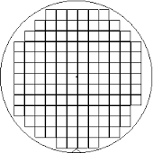
Wafer Sort / Map
Why we call it wafer sort?
Wafer map shows test results
  Dies are sorted into different Bins
Example:
  Bin #1: PASS ALL
  BIN #2: FAIL FUNCTION test
  BIN #3: FAIL IDDQ test
  BIN #4: FAIL DC parametric test
Wafer map very useful for
  pass/fail decision
  diagnosis
  yield improvement
Yield=Bin#1/total = 78/130=60%

Slide 29
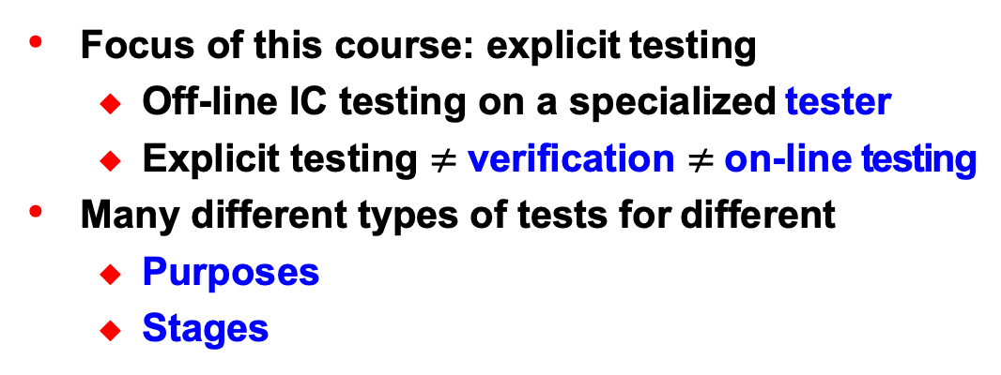
Summary
Focus of this course: explicit testing
  Off-line IC testing on a specialized tester
  Explicit testing $≠$verification $≠$on-line testing
Many different types of tests for different
  Purposes
  Stages
Techniques
Testing (generally speaking)
Design
Explicit Testing
Implicit Testing Or
Verification
On-line Testing
Characterization Test
Production Test
Reliability Test
Diagnosis Test
Wafer Test Package Test System Test
Burn-in
Acc. Life test
Gross | DC parametric | AC parametric | Boolean | Delay Test | Functional | IDDQ,
Test | Test | Test | Test |  | Test | VLV

