Slide 1
ECE 553: TESTING AND TESTABLE DESIGN OF DIGITAL SYSTEMS
General Introduction

Slide 2
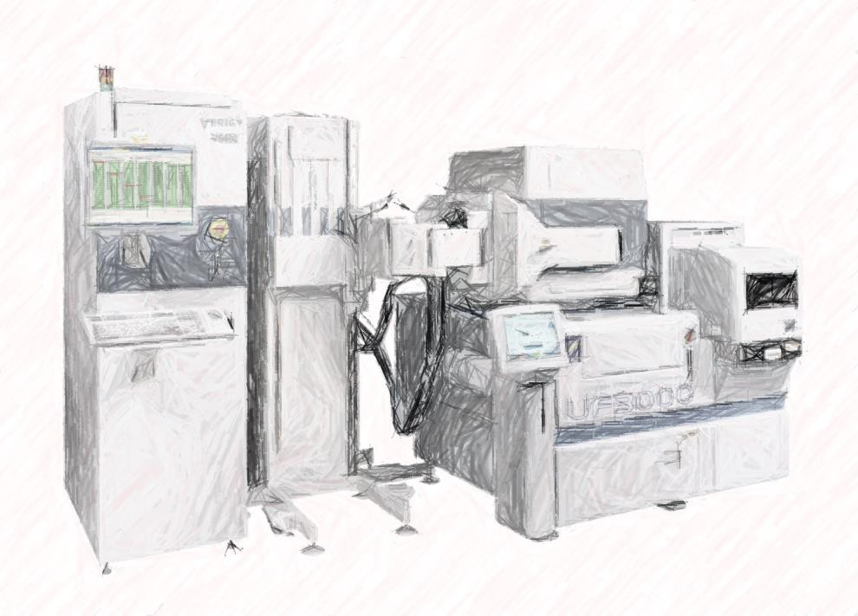
Introduction
What Is Testing
Types of Testing
Test Quality
  Defect per Million (DPM)
  Models to Predict DPM
  Models to Predict Yield
Test Economics
Conclusions
2

Slide 3


How to Measure Test Quality?
Defect Level (DL)
  Fraction of bad ICs passing the test (test escapes)
  Measured by Defective Parts per Million (DPM)
 < 200 DPM is acceptable for some IC
 >1,000 DPM is very bad for IC
Pass:
Manufacturing Process
Testing
Shipped Parts
 | Good IC | Bad IC
Pass | True PASS | Test Escapes (Defect Level)
Fail | Yield Loss | True Reject
Fail: Reject
Low DPM Means Good Test Quality
3

Slide 4
IC DPM → System DPM
If you think DPM= 1,000 (0.1%) is a sufficient level of defect, consider this case
A system has twenty ICs (each 1000 DPM), what is system DPM?
  No IC is defective for system to work correctly
 System DPM = 1-(1-0.001)²⁰ = 0.0198 = 2% = 20,000 DPM !
  If you sell a million system
 You have to fix 20,000 of them!
Low IC DPM is Very Important
4
Notes:
10^3/10^6=0.001=0.1%

Slide 5
Quiz
Q: (Cont’d from last slide)
20 ICs in a system.
Suppose we improve IC test quality to 200DPM What is system DPM?
A:
IC DPM$↑$ 5X, System DPM $↓$ 5X in this example
5
Notes:
200/10^6=0.0002=0.02%
1 – ( 1- 0.02%)^20 = 0.4%
From 2% (previous slide) to 0.4% is 5X improvement (lower) System DPM

Slide 6
Introduction
What Is Testing
Types of Testing
Test Quality
  Defect per Million (DPM)
  Models to Predict DPM
Measure Real DPM Is difficult. Can we predict it?
 Brown & Williams (IBM, 1981), Binomial distribution
 Agrawal (Bell Lab, 1982), ), Poisson distribution
Models for Yield
Test Economy
Conclusions
6

Slide 7
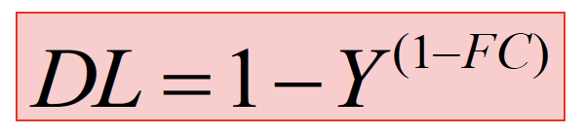
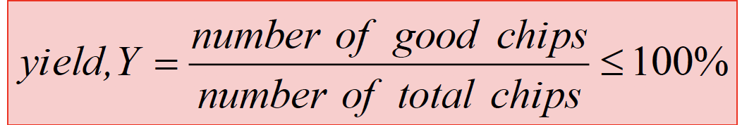
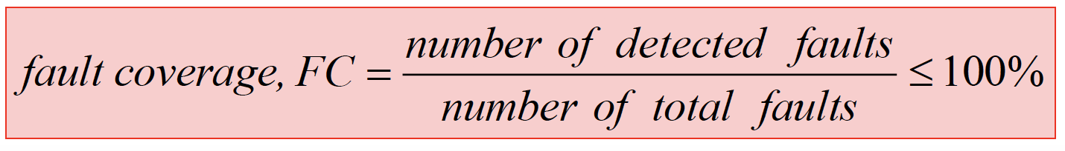
Brown & Williams Model [Williams 81]
Y=Yield, fraction of total manufactured IC that are estimated to be good
 High Y means good manufacturing quality
 Unknown parameter, estimated by fab. data or prediction
FC = Fault Coverage, fraction of detected faults
 High FC means good test quality
 Known parameter, from fault simulator and based on some considered fault models
7
Notes:
The Williams-Brown model formula relates the quality of the shipped products (Defect Level) to the quality of the manufacturing process (Yield) and the quality of the test suite (Fault Coverage)
1-FC = the blind spot that test fails to cover
Y^(1-FC) = probability of being genuinely good
Under this model, faults are assumed to be randomly and independently distributed. If the probability of the entire chip being defect-free is Y, then the probability that the untested fraction is defect-free scales exponentially with its size: Y^(1-FC)
The exponential nature of the formula means that if your manufacturing yield Y is poor, your fault coverage FC must be exceptionally high to keep defective parts from reaching customers.

Slide 8
B&W Proof
(simplified! Not required/just for your reference)
Assume each fault occurrence probability is q (uniform independent)
  Total t faults in an IC
  d out of t faults detected by this test → FC = d/t
Event A = an IC is good (no fault found)
  Prob(A) = probability that an IC is good → Prob(A)=(1-q)^{t}
  Y = fraction of IC that are good→ Y=Prob(A)
Event B = an IC pass the test
  Prob(B) = an IC free of d faults → Prob(B)=(1-q)^{d}
Event AB = an IC is good and pass test
◻Assume no overkill → Prob(AB) = Prob(A)
Quality Level (QL) = fraction of good IC passing the test
◻QL = Prob(A|B) = Prob(AB)/Prob(B) = (1-q)^{t-d} = (1-q)^{t(1-d/t)} = Y^{(1-FC)}
8
Notes:
Do not need to know and won’t discuss at class.

Slide 9
Quiz
Q1: Use B&W model.
Y=98%, FC=70%. DL=?
A:
Q2: If we add some design for testability (DFT) circuits to improves FC but harms yield a little we have Y=97%, FC=99%. DL=?
A:
_{DL = 1−Y} (1−FC)
DFT Very Important for DL Improvement
Notes:
Q1: 1 – 0.98^(1-0.7) = 6042 DPM
Q2: 1 - 0.97^(1-0.99) = 304 DPM

Slide 10
Introduction
What Is Testing
Types of Testing
Test Quality
  Defect per Million (DPM)
  Models to Predict DPM
 Brown & Williams (IBM, 1981), Binomial distribution
 Agrawal (Bell Lab, 1982), Poisson distribution
  Models for Yield
Test Economy
Conclusions

Slide 11
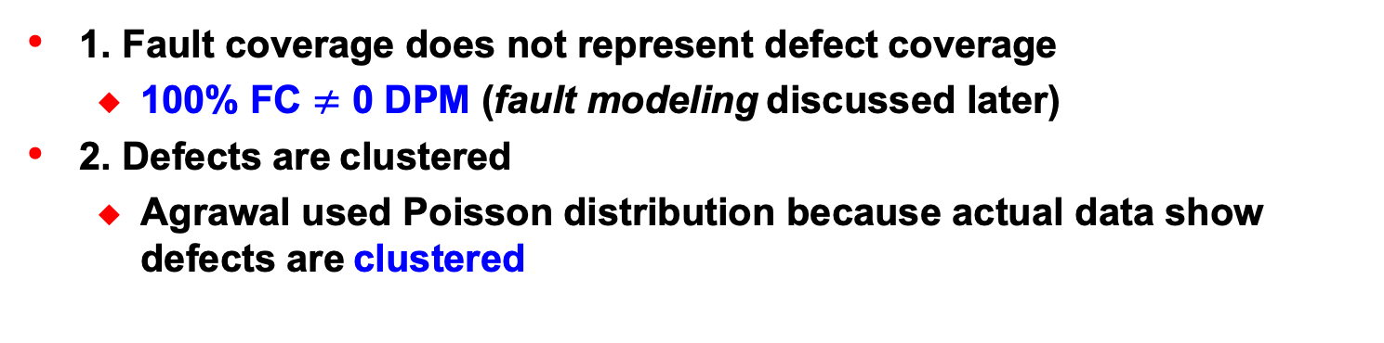
Why B&W Not Accurate?
1. Fault coverage does not represent defect coverage
  100% FC $≠$ 0 DPM (fault modeling discussed later)
2. Defects are clustered
  Agrawal used Poisson distribution because actual data show defects are clustered
?
t
d
?
Faults
Defects

Slide 12
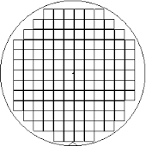
Agrawal Model [Agrawal 82]
(1 − FC)(1 − Y )e^{−(n−1) FC}
DL =
Y + (1 − FC)(1 − Y )e
−( n −1) FC
Actual data show defects are clustered
  n =average num. of defects on a bad die
We need two estimated parameters
  n: found from experiment
  Y: estimated from fab. or prediction
7 defects
3 bad die
n=7/3=2.3

Slide 13
Introduction
What Is Testing
Types of Testing
Test Quality
  Defect per Million (DPM)
  Models to Predict DPM
  Models for Yield
 Simple
 Critical Area
Test Economy
Conclusions
Measure Real Yield Is too late. Can we predict it?

Slide 14
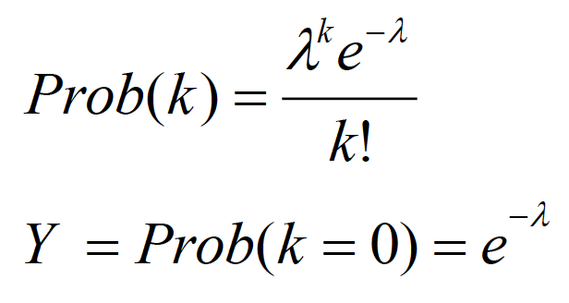
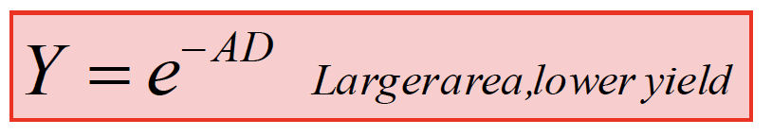

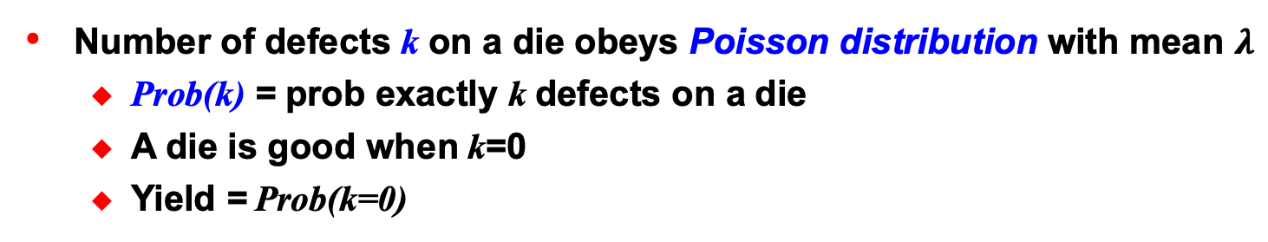
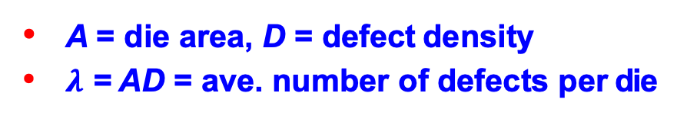
Yield Estimation (Simple)
Number of defects k on a die obeys Poisson distribution with mean $λ$
  Prob(k) = prob exactly k defects on a die
  A die is good when k=0
  Yield = Prob(k=0)
0.3
0.25
Poisson Distribution
$λ$=2
0.2
A = die area, D = defect density
$λ$ = AD = ave. number of defects per die
Prob(k)
0.15
0.1
0.05
0
0 1 2 3 4 5 6
k
Notes:
probability of a number of independent events occurring in a fixed time
Number of defects

Slide 15
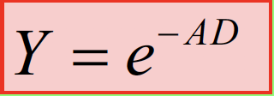
Quiz
Q: A=0.8cm², D=0.5/cm^{2.} What is yield?
A:
Notes:
Y = e^(- 0.8 x 0.5) = 67%

Slide 16
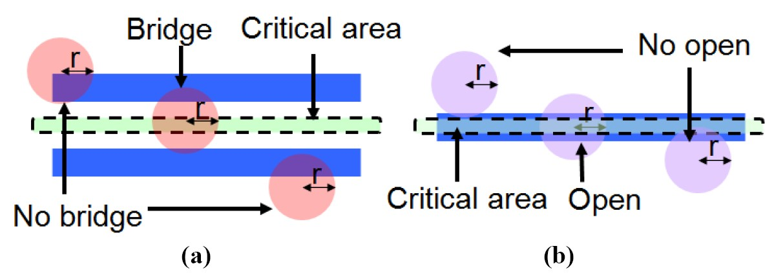
Critical Area , CA
Problem with Y=e^{-AD} model
  Some area NOT sensitive to defect. Use total area is pessimistic
Critical area, CA(r)
  Area where center of defect (radius r) lands to create a fault
Example:
  (a) bridging fault (b) open fault

Slide 17
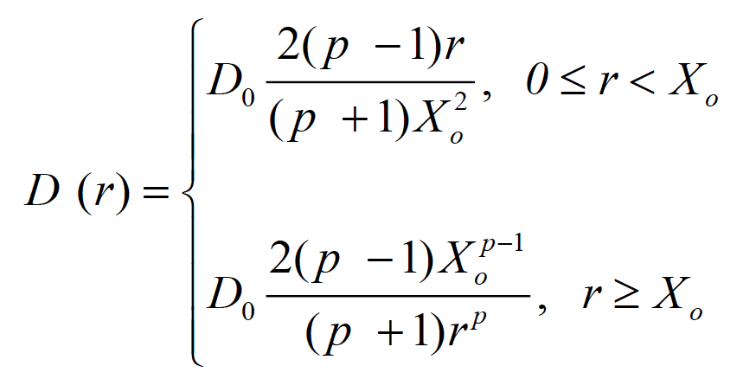
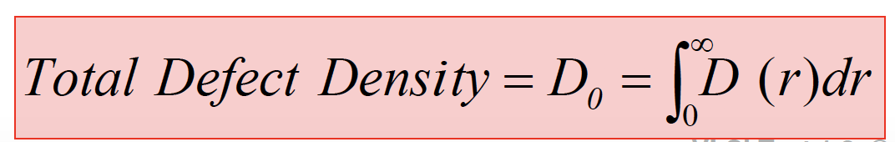
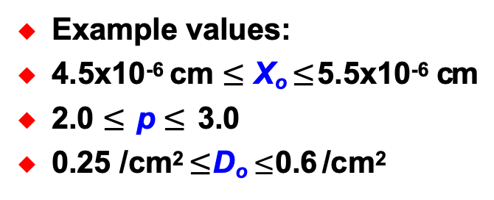
Defect Size and Density Distribution, DSDD
D(r) = defect density per unit defect radius r
Typical DSDD curve:
D(r)
D(r) is process dependent.
r
Example values:
4.5x10⁻⁶ cm $≤$ X_{o} $≤$ 5.5x10⁻⁶ cm
2.0 $≤$ p $≤$ 3.0
0.25 /cm² $≤$ D_{o} $≤$ 0.6 /cm²
X_{o}

Slide 18
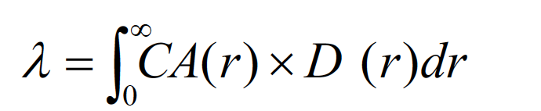
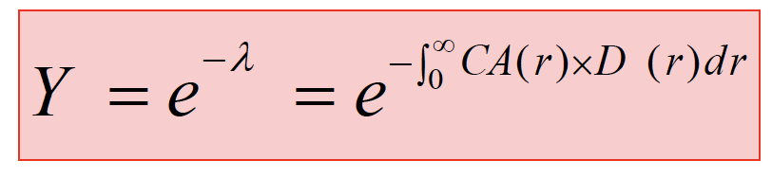
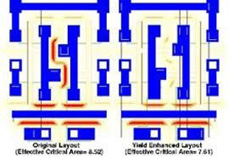
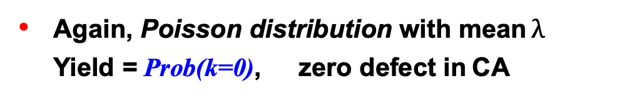
Yield Estimation (CA)
Expected number of defects per die landing in CA
◎
Again, Poisson distribution with mean $λ$
Yield = Prob(k=0), zero defect in CA
simple model
_{Y = e}− AD
Critical area analysis (CAA) is useful tool to estimate yield
  1. modify design for yield improvement
  2. extract bridging or open faults for ATPG
Notes:
CAA: simulating how random particle defects interact with a physical chip layout
random particle defects interact with a physical chip layout. By combining foundry defect density data with software models, CAA identifies the specific layout zones—the critical areas—where a particle of a given size will cause a functional failure, such as a short circuit (bridging) or an broken wire (open fault)
https://blogs.sw.siemens.com/calibre/2021/04/01/what-is-critical-area-analysis-and-why-should-i-care-2/
Traditional ATPG creates test vectors based on abstract logical assumptions, like the standard "stuck-at" fault model. CAA bridges the gap between physical reality and logical testing by locating exactly where physical defects are most likely to occur.

Slide 19
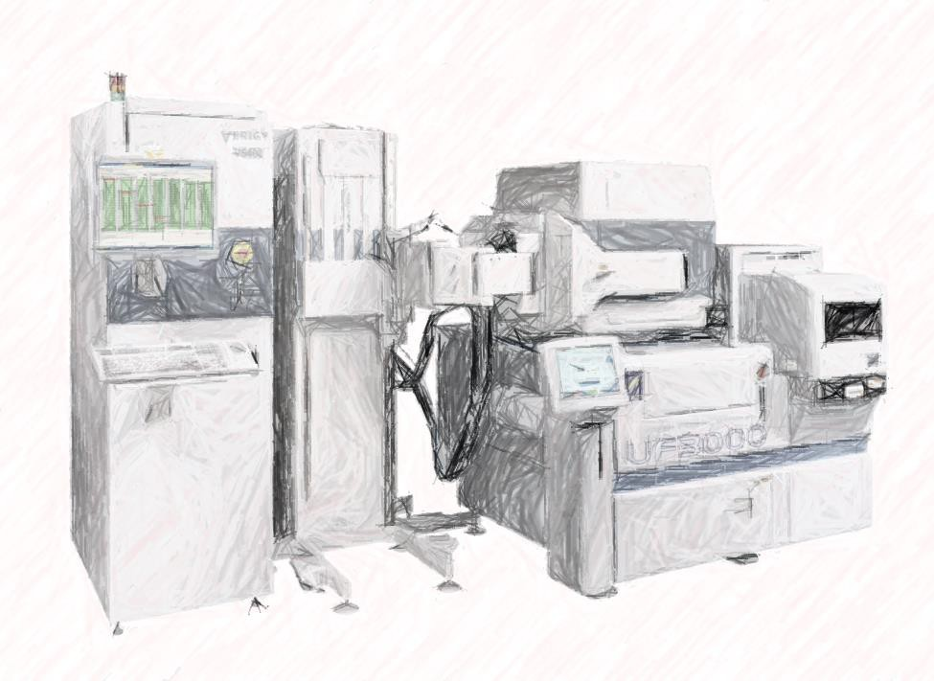
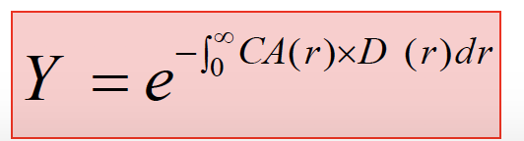
Summary
Test quality measured by Defect per Million (DPM)
Models for DPM
  Brown & Williams :
_{DL = 1−Y} (1−FC)
Agrawal
(1 − FC)(1 − Y )e^{−(n−1) FC}
DL =
Y + (1 − FC)(1 − Y )e
−( n −1) FC
Models for Yield
  Simple model
_{Y = e}− AD
Critical area

Slide 20
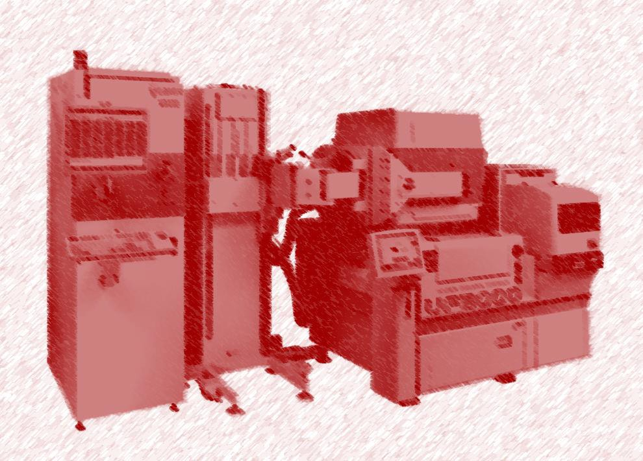
Introduction
What Is Testing
Types of Testing
Test Quality
Test Economics
  Why and Who Invests in Test?
 Global Semiconductor Industry
  How to Make Optimal Test Decision?
Conclusions
20

Slide 21
Why Invest in Testing?
Although testing is expensive
  Repair cost is even more expensive!
Rule of Tens [Davis 82]
1000
500
100
Cost per fault
(Dollars)
50
10
5
1
0.5
IC
Test
Board Test
System Test
Warranty Repair
21
Notes:
If not do IC testing well, board will be defective and will be thrown away, the cost for that is $5.
Component/IC Level ($0.50): Catching a fault (like a bridging or open circuit via CAA/ATPG) directly on the semiconductor wafer before packaging costs pennies.
System/Final Assembly Level ($50.00): If the board passes ICT and is built into the final chassis or product assembly, identifying the issue during system-level functional test spikes another 10x

Slide 22
15% Semiconductor Market Goes to Test
2019 (2025) global semiconductor market $412.3B ($795.6B) USD
  Out of which packaging and test is up to 15%
2019 (2025) Taiwan $86.3B ($ 209.1B) USD, ~21% (26.3%) of global market
  Fabless design $22.4B USD
  Manufacture $42.5B USD
Packaging $11.2B USD
Testing $5.0B ($7.14B) USD

Slide 23












Many Companies Invest Heavily in Test
IDM
Fabless/Foundry
EDA
ATPG
Fault Sim.
Design
BIST, DFT
Boundary Scan
Manufacture
Fabrication, Assembly, Test Physical Failure analysis
23
Notes:
IDM: Integrated Device Manufacturer: a semiconductor company that handles every single phase of the microchip creation process completely in-house
Design Houses

Slide 24
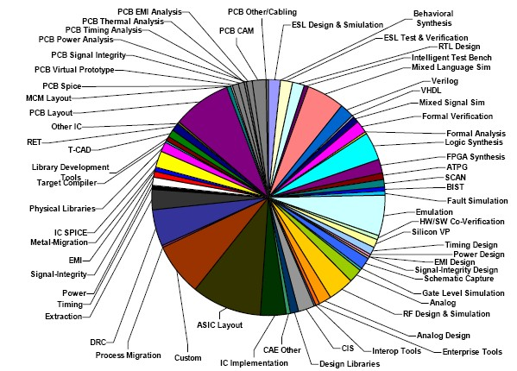
EDA Market by Tool
Test-related tools are about 5~10% EDA revenue in 2025
dataquest
2012
24
VLSI Test 1.4 © National Tai

Slide 25

Introduction
What Is Testing
Types of Testing
Test Quality
Test Economics
  Why and Who Invests in Test?
  How to Make Optimal Test Decision?
Conclusions
Test?
Repair?
25

Slide 26
How to Make Optimal Decision?
Optimal test not only technical issue, but also economics issue
  Trade off between test cost and repair cost
Different product has different optimal decision
  No single best decision for all products!
$
repair
cost
test cost
total = test
+ repair
Optimal
Test?
Repair?
Low test quality
High test quality
26

Slide 27
What Cost Can We Optimize?
EDA: ATPG, fault simulator …
  Typically 10K ~ 100K USD
Design: insert DFT/BIST circuitry
  Area/power/delay overhead about 5~10%
OSAT:
  Equipment
 Tester (Automatic Testing Equipment, ATE)
− Typically 0.5~3 M USD
 Handler, probe station, Burn-in oven
  Test application time (TAT)
 Around $50 to $300 USD per hour
 ASIC takes 2~3 seconds. CPU can be 0.5~1 minute
  Load board, probe card
 $1K ~ 20K USD
Many Decisions to Make
Notes:
Outsourced Semiconductor Assembly and Test

Slide 28
Case 1: DFT or Not?
Q1: Without DFT Y=98%, FC=70%. DL=? | _{DL = 1−Y} (1−FC)
A: 6,043 DPM Q2: With DFT Y=97%, FC=99%. DL=? A: 304 DPM
Technically, DFT Improves DPM But Is DFT Worth Doing Economically?

Slide 29
Case Study: DFT or Not? (Cont’d)
Q: Is it economical to insert DFT?
A: Yes. This is true for many products.
_{DL = 1−Y} (1−FC)
Although Y drops, DL improves significantly
Item | w/o DFT | with DFT
Total # of Dies | 1,000,000 | 900,000
Yield | 98% | 97%
FC fault coverage | 70% | 99%
_{DL =1-Y}(1-FC) | 6,043 DPM | 304 DPM
Sales = D x Y x $1 | 980,000 | 873,000
Repair cost = D x Y x DL x $100 | 592,163 | 26,587
Profit = S – R | 387,837 | 846,413
DFT Is Worth Doing!
Notes:
Fewer dies after DFT because design is larger

Slide 30
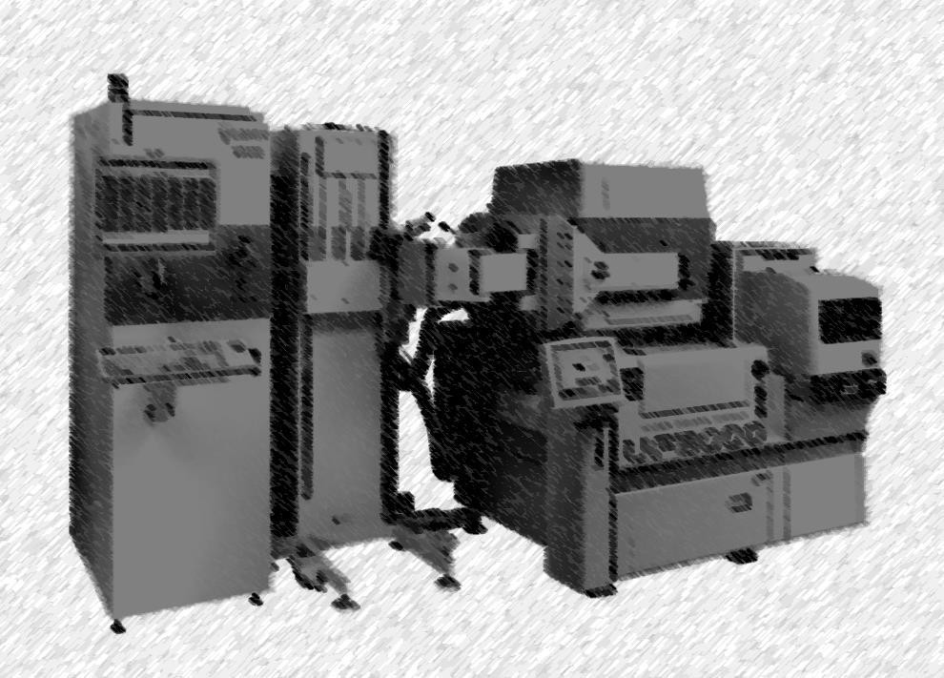
Introduction
What Is Testing
Types of Testing
Test Quality
Test Economy
Conclusions

Slide 31


Conclusions
WHY test?
  It is important to invest in test because of rule of ten
HOW to test?
  Optimal test not only technical issue, but also economics issue
  No single best test solution for all products!
WHO responsible?
  Testing is joint responsibility of everybody
Fab Production
PFA
TESTING
Test eng.
EEDDAA
Design
Reliability

Slide 32
References
[Agrawal 82] V. D. Agrawal, S. C. Seth, P. Agrawal, “Fault Coverage Requirement in Production Testing of LSI Circuits,” IEEE J. Solid- State Circuits, vol. SC-17, no. 1, pp. 57-61, Feb. 1982.
[Davis 82] B. Davis, The Economics of Automated Testing. McGraw- Hill: London, UK
[McCluskey 88] E.J. McCluskey ; F. Buelow, “IC quality and test transparency,” Int’l Test Conf., 1988.
[Williams 81] T. W. Williams, N. C. Brown, “Defect Level as a Function of Fault Coverage,” IEEE Trans. on Computers, vol. C-30, no. 12, pp. 987-988, Dec.1981.

