Slide 1
ECE 553: TESTING AND TESTABLE DESIGN OF DIGITAL SYSTEMS
Logic Simulation

Slide 2
Course Roadmap (EDA Topics)
Logic Sim.
Fault Modeling
Fault Simulation
Testability
Comb. ATPG
Diagnosis
Seq. ATPG
Delay Test
2

Slide 3
Why Am I Learning This?
Logic simulation is essential to verify:
  Design correctness
  ATPG patterns
Logic simulation is basic EDA tool for digital circuits
  Basic building block of many tools

Slide 4
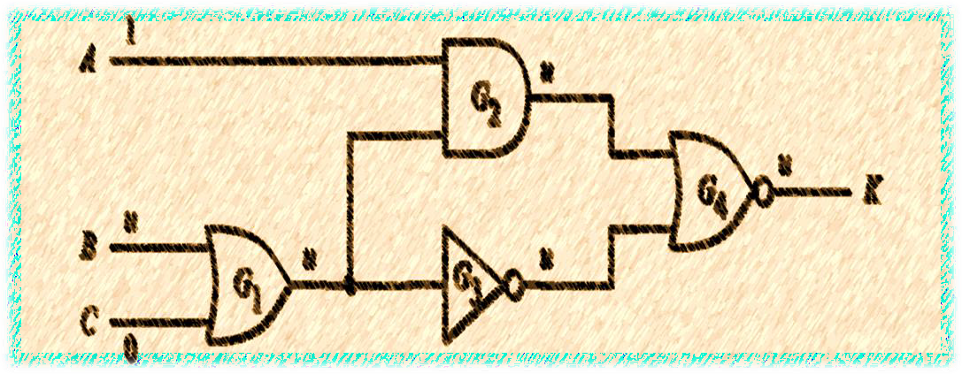
Logic Simulation
Introduction
Simulation Models
Logic Simulation Techniques
Issues of Logic Simulations

Slide 5
What Is Simulation?
Given input stimuli, models, and commands
  Run software to produce output responses
For digital circuits:
  Input stimuli are test patterns
  Models can be functional/logic/transistors (next slide)
Commands
Input Stimuli
Simulator
Responses
Models

Slide 6
Levels of Circuit Simulation
Functional/Behavior level
  Interconnect of modules (expressed in programming language)
  Good for architecture and functional verification
  Fast but inaccurate
  Example: C, System-C, Verilog (Register-Transfer-Level, RTL)
Logic level ⬅ our focus
  Interconnect of Boolean gates (aka. Gate-level netlist): AND, OR, NOT …
  Good for logic verification, test pattern generation
  Example: Verilog (gate-level)
Transistor level
  Interconnect of transistors
  Good for analog/mixed-signal and timing critical digital circuits
  Slow but accurate
  Example: SPICE
Mixed-level
  Mixed functional/logic/transistor levels
  Trade off CPU time and accuracy

Slide 7
Netlist Formats: Example
ISCAS format
ID = GATE_TYPE (INPUT1, …)
INPUT(G1)
INPUT(G2)
OUTPUT(G7)
G3 = NOT(G2)
G4 = NOT(G1)
G5 = AND(G1, G3)
G6 = AND(G2, G4)
G7 = OR(G5, G6)
Each line represents a signal ID which could be output pin of a gate, a primary input, or primary output
Example:
ID of primary input in 1st line is G1
ID of primary output in 3rd line is G7
G3 is ID of output pin of a NOT gate fed by signal G2
G5 is ID of output pin of AND gate fed by G2 and G4

Slide 8
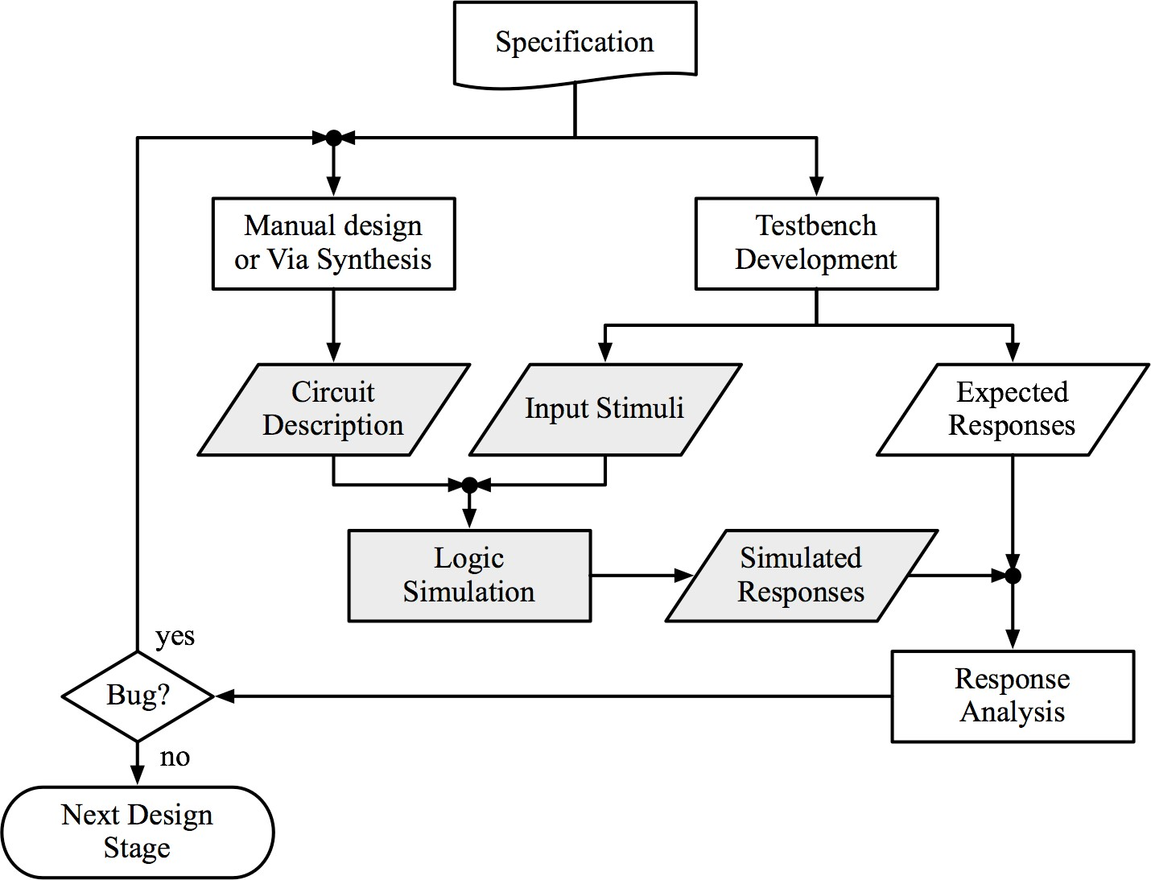
Verification by Simulation
(www Fig. 3.1)
Notes:
Testbench development involves writing code (usually in SystemVerilog using methodologies like UVM, or using VHDL/Python) to build a closed-loop verification environment.
During a simulation, testbench development provides the pipeline. The engineer writes a specific test case that outlines the input stimuli. The testbench takes those stimuli, formats them to fit the design's protocols, pushes them through the DUT, and verifies if the chip reacted correctly.

Slide 9
Summary
Introduction
  What is simulation?
 produce output based on given input stimuli and model
  Levels of simulation
 functional, logic, transistor, mixed
  Design verification by simulation

Slide 10
Logic Simulation
Introduction
Simulation Models
  Logic States
  Logic Gate Evaluation
Logic Simulation Techniques

Slide 11
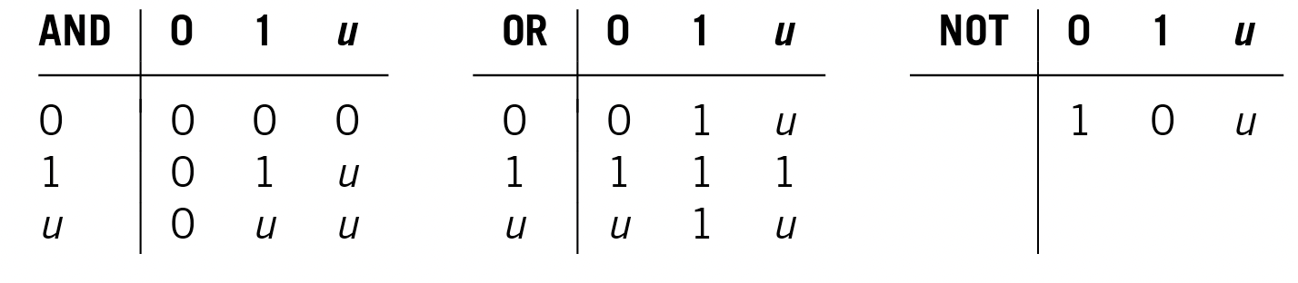
Logic States
Binary logic (0,1)
Three-valued logic (0,1, u) aka. Ternary logic [Eichelberger 65]
  u (mean unknown) is used when logic value cannot be determined during simulation
More States, More Accuracy, More CPU Time

Slide 12
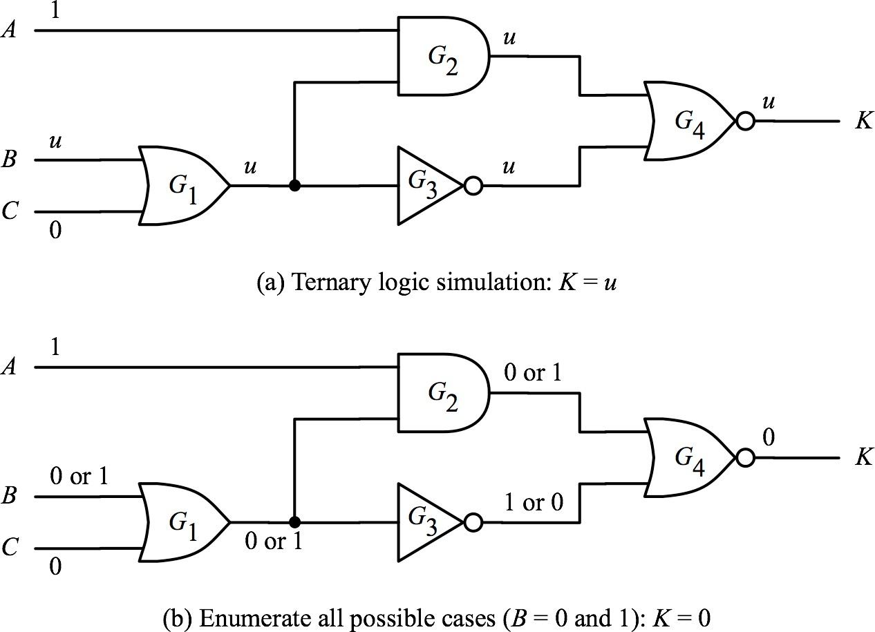
Ternary Logic Simulation
Problem: output K should be zero
A₁
F
A₂
We can do better in the bottom case: By enumerating all possible cases in (b), we can determine that K should be 0.
This example shows the limitation of using `u’ state. But (a) is faster than (b)

Slide 13
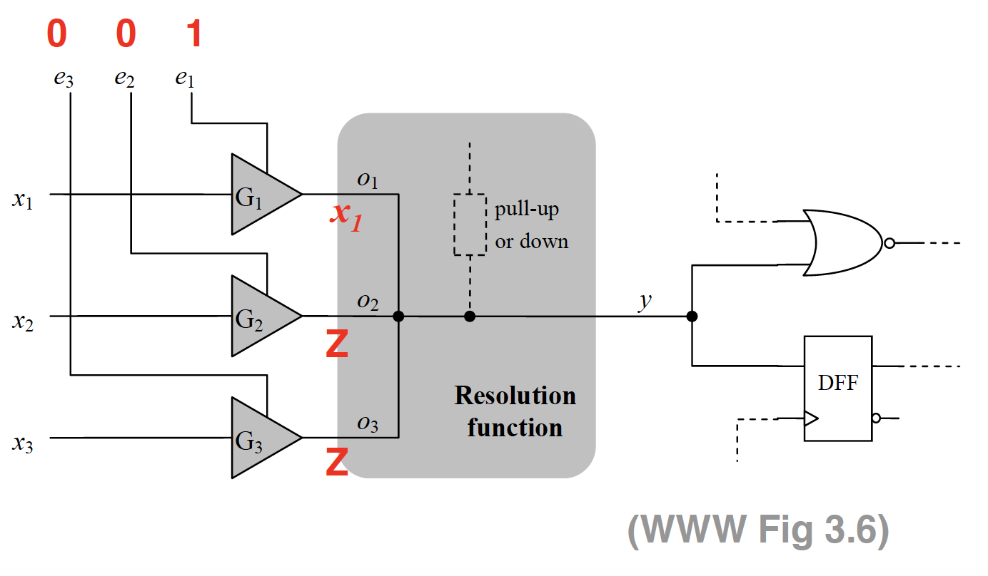
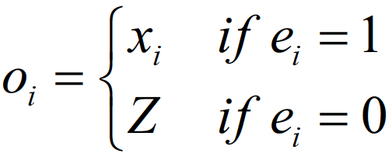
High Impedance State (Z)
  Note: do not confuse `u’ and `Z’
  Z = floating node without conducting path to VDD or GND
 aka. high impedance
Tri-state bus driver : Only one driver enabled at a time
  e₁,e₂, e₃ are one-hot signals
Notes:
The role of the Resolution Function is to determine the final, singular logic state of a shared net (or bus) when it is driven by multiple sources simultaneously.

Slide 14
Logic Simulation
Introduction
Simulation Models
  Logic States
  Logic Gate Evaluation
Logic Simulation Techniques

Slide 15
Gate Evaluation Using Truth Table
Determine output value based on a pre-stored truth table
Example: 3-valued logic truth table
Quiz:
What is size of truth table for n-input gate using 3 valued-logic?
A:
Practical implementation
  Break n-input gate into multiple 2-input gates
  Use for-loop to evaluate gate one by one
Notes:
A: 3^n
Instead of evaluating the whole 3^n table at once, the simulation algorithm runs a software for-loop to evaluate each of these small 2-input gates sequentially, one by one, until the final output is calculated. This changes the computational complexity from exponential 3^n to linear n-1 iterations).

Slide 16
Logic Simulation
Introduction
Simulation Models
Logic Simulation Techniques
  Compiled-code simulation
 Logic Optimization
 Logic Levelization
 Code Generation
  Event-driven simulation
  Parallel Simulation
25

Slide 17
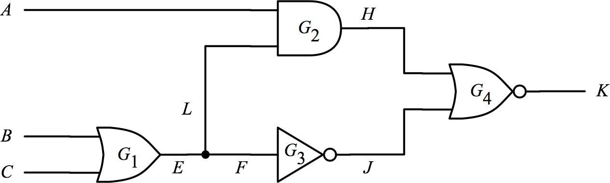
Compiled-Code Simulation
Translate circuit into sequence of codes
  Execute codes = run logic simulation
1
0
0
while{true} do
read(A,B,C);
E OR(B,C);
H AND(A,E);
NOT(E);
NOR(H,J);
end
E=OR(0,0)=0 H=AND(1,0)=0 J=NOT(0)=1 K=NOR(0,1)=0
26

Slide 18
Compiled-code Simulation Problems
1. Gate delay model not considered
2. Oblivious: forgets results in previous cycle
0→1 0
0
0
0
0
1
while{true} do
read(A,B,C);
E OR(B,C);
H AND(A,E);
NOT(E);
NOR(H,J);
end
Forget 1st cycle results.
Rerun all codes for 2nd cycle.
₁st ₂nd
32

Slide 19
Event-Driven Simulation [Ulrich 1965]
IDEA: evaluates a gate only if there is event(s) at its gate inputs
  Event is a signal value change (at time t)
  Gates with inputs changed are activated
Example:
  Event: A 0→1
  Activated gate: G₂
  Only evaluate 1 gate, instead of 4 gates
G₁, G₃, G₄
not evaluated again in 2nd cycle
0
0→1 0
0
0
0
1
33
Event-driven Faster than CC

Slide 20
Parallel Simulation
Simultaneously evaluate a gate with W patterns (determine W based on platform that the simulation software is running)
Example: W = 4 (WWW Fig 3.8)
  Consider only binary logic (no u or z)
  Speed up of 4 in this example, assuming 4 patterns can be simulated in parallel
1 | 0 | 0 | 1
1 | 0 | 0 | 1
1 | 0 | 0 | 0
1 | 1 | 1 | 0
0 | 1 | 1 | 0
0 | 0 | 1 | 0
1 | 1 | 1 | 0
0 | 0 | 0 | 1

Slide 21
Summary
Introduction
Simulation Models
Logic Simulation Techniques
  Compiled code simulation
  Event driven simulation
  Parallel Simulation
 Exploits bitwise operation to gain linear speed up

Slide 22
References
[Huffman 1957] D. A. Huffman, “Design and Use of Hazard-free Switching Networks,” J. ACM 4, pp.47, 1957.
[McCluskey 1962] E.J. McCluskey, “Transients in Combinational Logic Circuits,” Redundancy Techniques for Computing Systems, pp.9-46, Spartan Book, 1962.
[Ulrich 1965] Ulrich, “Time sequenced logical simulation based on circuit delay and selective tracing of active network paths”, ACM Nat’l Conference, pp.437-448, 1965.

