Slide 1
ECE 553: TESTING AND TESTABLE DESIGN OF DIGITAL SYSTEMS
Fault Modeling (1)

Slide 2
Course Roadmap (EDA Topics)
Logic Sim. Fault Modeling
Fault Simulation
Testability
Comb. ATPG
Diagnosis
Seq. ATPG
Delay Test
2

Slide 3
Why Am I Learning This?
Fault models quantify test quality
Fault models make test automation possible
“All models are wrong. But some are useful.”
(George Box)
3

Slide 4

Fault Modeling
Introduction
Fault Models
Fault Detection
Fault Coverage
Conclusions
4

Slide 5
Definitions
Defect
  Unintended physical difference between hardware implementation and its intended design
  Example: unwanted wire (short to ground)
Fault
  Representation of defects at abstracted logic level
  Example: b stuck at zero fault
1
1
Error
  Wrong output signal value
  Example: output = 0, when a=b=1
Failure
  Deviation from expected behavior
  Example: computer crash
1/0
good / error
Defect → Fault → Error → Failure
5

Slide 6
Examples of Defects
Material
  Bulk defect (cracks, crystal imperfections)
  Surface impurities
Wafer process
  Dust particle → Opens , shorts
  Gate oxide pinhole→ gate oxide shorts
  Bad ion implantation → transistor Vt shift
  Mask problem → Missing/extra wires, missing contacts/vias
  Lithography problem → Missing/extra wires, missing contacts/vias
  Poor etching → ill formed contacts, vias
  Careless handling → Oxide breakdown → gate oxide shorts
Package problem
  Careless handling → Oxide breakdown
Bad soldering → Contact degradation
Seal leaks
Aging (wear-out)
  Overstress → Oxide breakdown
  Electromigration → open, short
There are Many More Defects …
6

Slide 7
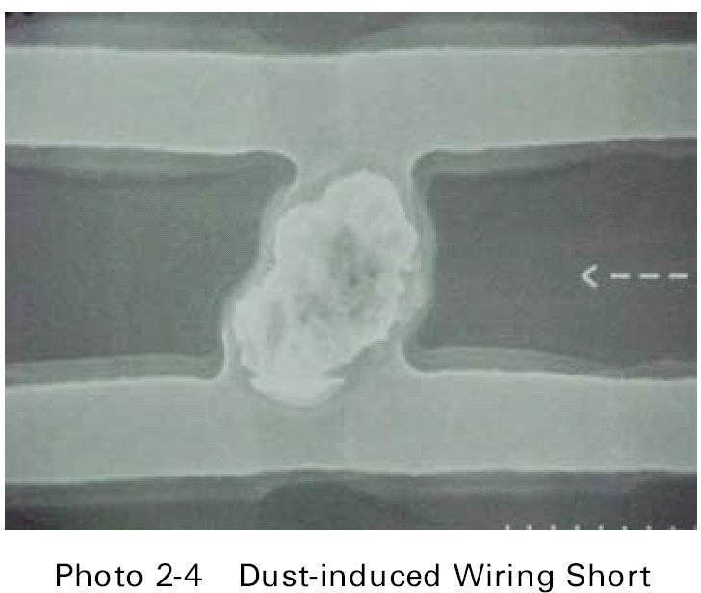
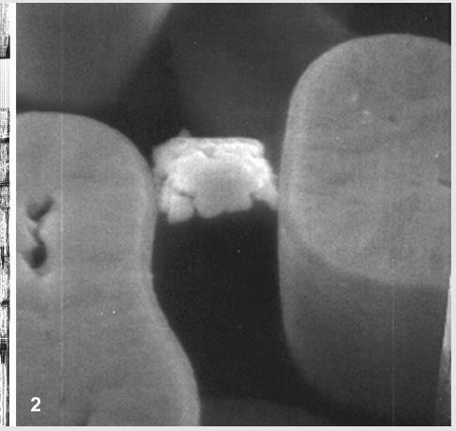
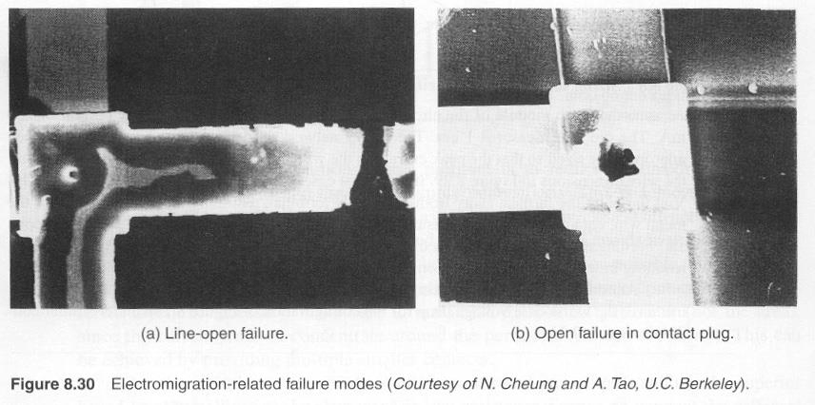

Photos of Defects
[Vallet IBM 1997]
[Nigh IBM 1998]
7

Slide 8
Random Defects, Systematic Defects
Random defects
  Caused by random factors such as particles, scratches, …
  No correlation across wafers, dies
Systematic defects
  Caused by deterministic factors such as mask, lithography, …
  Strong correlation across wafers, dies
8

Slide 9
What is Fault Modeling?
Representing defects at abstracted logic level
Higher level
Failure
Behavior
Error
I/O Signal
Fault
Logic
Physical
Defect
Lower level
Notes:
Defect modeling means representing fault as abstract logic level; important for IC testing

Slide 10
Why Fault Modeling?
1. Fault model quantify test quality
  Defects are hard to handle
 How many possible defects in a circuit ? Way too many
  Number of faults can be easily calculated in a circuit
2. Fault models make test automation possible
  Automatic test pattern generation (ATPG)
  Fault simulation
 evaluate test quality
  Automatic diagnosis
 locate defects
Automatic Tools Need Fault Model

Slide 11
Test Patterns and Test Sets
Test pattern, also known as (aka): Test Vector
  Input Boolean values to detect one or more faults
 Expected output often included (but not required)
Example: b stuck-at zero fault
 Test pattern a=1, b=1
Test Set = A set of test patterns
    Example: ab= {11, 00}
a
b
Test Length = Number of test patterns in a test set
  Example: ab= {11, 00}, TL=2
Shorter TL = Lower Test Cost

Slide 12
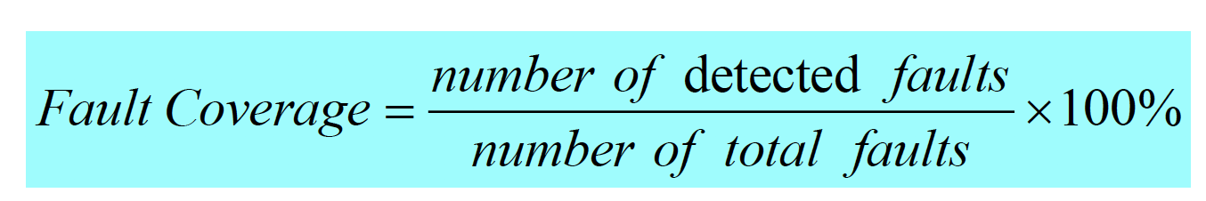
Fault Coverage (FC)
Between 0-100%
FC is most widely used as quantitative measure of test set quality
 Higher fault coverage implies more effective tests
  0-70% ➔ not good
  70-95% ➔ sometimes acceptable
− 95-100% ➔ good
(Standard depends on company and products)
In Brown & Williams model,
Defect Level = 1-Y ^{(1-FC)}
Higher FC results in Lower Defect Level

Slide 13
Quiz
You are asked to pick 2 patterns…
Suppose you picked {11, 00} for AND gate
  both output 1 and 0 functions are tested
a b
Q: What is single stuck-at fault (SSF) coverage? A:
c
Table: total six single stuck-at faults
Input | Fault-free Output | Faulty Output Value with SSF
a b |  | a/0 | a/1 | b/0 | b/1 | c/0 | c/1
0 0 | 0 | 0 | 0 | 0 | 0 | 0 | 1
1 1 | 1 | 0 | 1 | 0 | 1 | 0 | 1
*erroneous output values underlined
Notes:
a/0 detected by 11
a/1 not detected
b/0 detected by 11
b/1 not detected
c/0 detected by 11
c/0 not detected
c/1 detected by 00
Overall , 4 / 6 faults are detected → FC = 2/3

Slide 14
Summary
Fault modeling
  Fault models help to quantify and automate testing
  Defect → fault → error → failure
  Test length = number of test patterns
  Fault coverage = detected faults / total faults

Slide 15

Fault Modeling
Introduction
Fault Models
  Stuck-at fault (1961)
  Bridging fault (1973)
  Delay fault (1974)
  Transistor level fault
Fault Detection
Fault Coverage
Conclusions

Slide 16
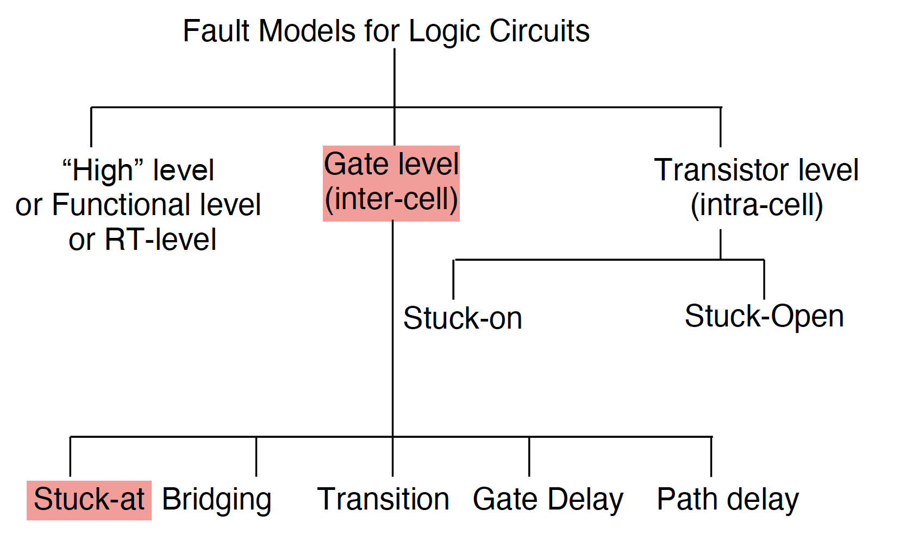
Classification of Fault Models

Slide 17
Single Stuck-at Fault Model
Single Stuck-at Fault (SSF) model [Galey 61]
  One signal line in Boolean network of logic gates is fixed to logic 0 or 1, independent of logic values on other signal lines
Notations: node x stuck-at fault
 x/0, x/1,
 x s@0, x s@1
 x SA0, x SA1
Number of faults is linear to circuit size
  2 faults (stuck-at one, stuck-at zero) per node
  2n SSF in a circuit of n nodes
Most commonly studied fault model
SSF is Scalable for Large Circuits

Slide 18
Single Stuck-at Fault Example
Example: SSF table of two input AND gate
  Total six faults: a/0, a/1, b/0, b/1, c/0, c/1
What’s the minimum test length for 100% SSF fault coverage?
Test set ab = {01,11,10} with length 3
  100% SSF fault coverage, detects all SSF
a b
c
Input | Fault-free Output | Faulty Output Value with SSF
a b |  | a/0 | a/1 | b/0 | b/1 | c/0 | c/1
0 0 | 0 | 0 | 0 | 0 | 0 | 0 | 1
0 1 | 0 | 0 | 1 | 0 | 0 | 0 | 1
1 1 | 1 | 0 | 1 | 0 | 1 | 0 | 1
1 0 | 0 | 0 | 0 | 0 | 1 | 0 | 1
*erroneous output values red/underlined

Slide 19
Quiz (Revisited)
You are asked to pick 2 patterns…
Q: Based on SSF model, which patterns do you pick ?
What is maximum fault coverage?
A:
a
c
b
Input | Fault-free Output | Faulty Output Value with SSF
a b |  | a/0 | a/1 | b/0 | b/1 | c/0 | c/1
0 0 | 0 | 0 | 0 | 0 | 0 | 0 | 1
0 1 | 0 | 0 | 1 | 0 | 0 | 0 | 1
1 1 | 1 | 0 | 1 | 0 | 1 | 0 | 1
1 0 | 0 | 0 | 0 | 0 | 1 | 0 | 1
Notes:
Pick 11 since it detects 3 faults , assuming 11 is picked, then pick 01 or 10 to cover 2 more faults , overall fault coverage (3+2) / 6 = 5/6

Slide 20
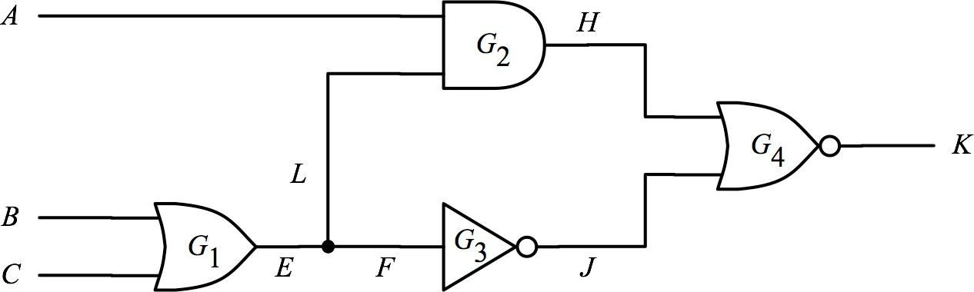

Fanout Stems and Branches
SSF on fanout stem not equivalent to SSF on fanout branches
  Faults on stems and faults on branches are counted separately
Example: E is fanout stem; L,F are fanout branches
  6 faults are not equivalent
Input |  |  | Output
A | B | C | good | E/0 | F/0 | L/0 | E/1 | F/1 | L/1
0 | 0 | 0 | 0 | 0 | 0 | 0 | 1 | 1 | 0
0 | 0 | 1 | 1 | 0 | 0 | 1 | 1 | 1 | 1
0 | 1 | 0 | 1 | 0 | 0 | 1 | 1 | 1 | 1
0 | 1 | 1 | 1 | 0 | 0 | 1 | 1 | 1 | 1
1 | 0 | 0 | 0 | 0 | 0 | 0 | 0 | 1 | 0
1 | 0 | 1 | 0 | 0 | 0 | 1 | 0 | 0 | 0
1 | 1 | 0 | 0 | 0 | 0 | 1 | 0 | 0 | 0
1 | 1 | 1 | 0 | 0 | 0 | 1 | 0 | 0 | 0
Stem Faults $≠$
Branch Faults

Slide 21
Quiz
Q: How many single stuck-at at faults in this circuit?
9 faults
14 faults
18 faults
Notes:
9 stems + branches → each s/0 or s/1 → total 18 faults

Slide 22
Multiple Stuck-at Faults
Multiple stuck-at fault (MSF) model
  More than one stuck at fault in a circuit simultaneously
Quiz
Q: how many multiple stuck-at faults in a circuit of n nodes? (do not include single stuck-at fault)
A:
Too may MSF, not scalable for large circuits
  Fortunately, SSF test set can detect many MSF
MSF Not Considered in Practice
Notes:
3^n total combinations (each node could be S@1 + S@0 + good → 3 possibilities)
3^n – 2n – 1 (2n for SSF - 1 for good circuit)

Slide 23
Fault Masking
Fault f₂ masks fault f₁ if
  A test for f₁ fails to detect f₁ in the presence of f₂
When a test fails to detect a fault it is supposed to detect
  We call it test invalidation
Fault masking rarely happens in practice
  Trouble more for diagnosis than for testing
Fault Masking Invalidates Tests
Fault Masking Makes Diagnosis Difficult
23

Slide 24
Fault Modeling
Fault Models
  Stuck-at fault
 Number of single stuck-at faults is linear to circuit size : 2n
 Multiple stuck-at faults are exponential in number
 Fault masking means two faults cancel each other
24

