Slide 1
ECE 553: TESTING AND TESTABLE DESIGN OF DIGITAL SYSTEMS
Fault Modeling (2)

Slide 2

Fault Modeling
Introduction
Fault Models
  Stuck-at fault (1961)
  Bridging fault (1973)
  Delay fault (1974)
  Transistor level fault
Fault Detection
Fault Coverage
Conclusions

Slide 3
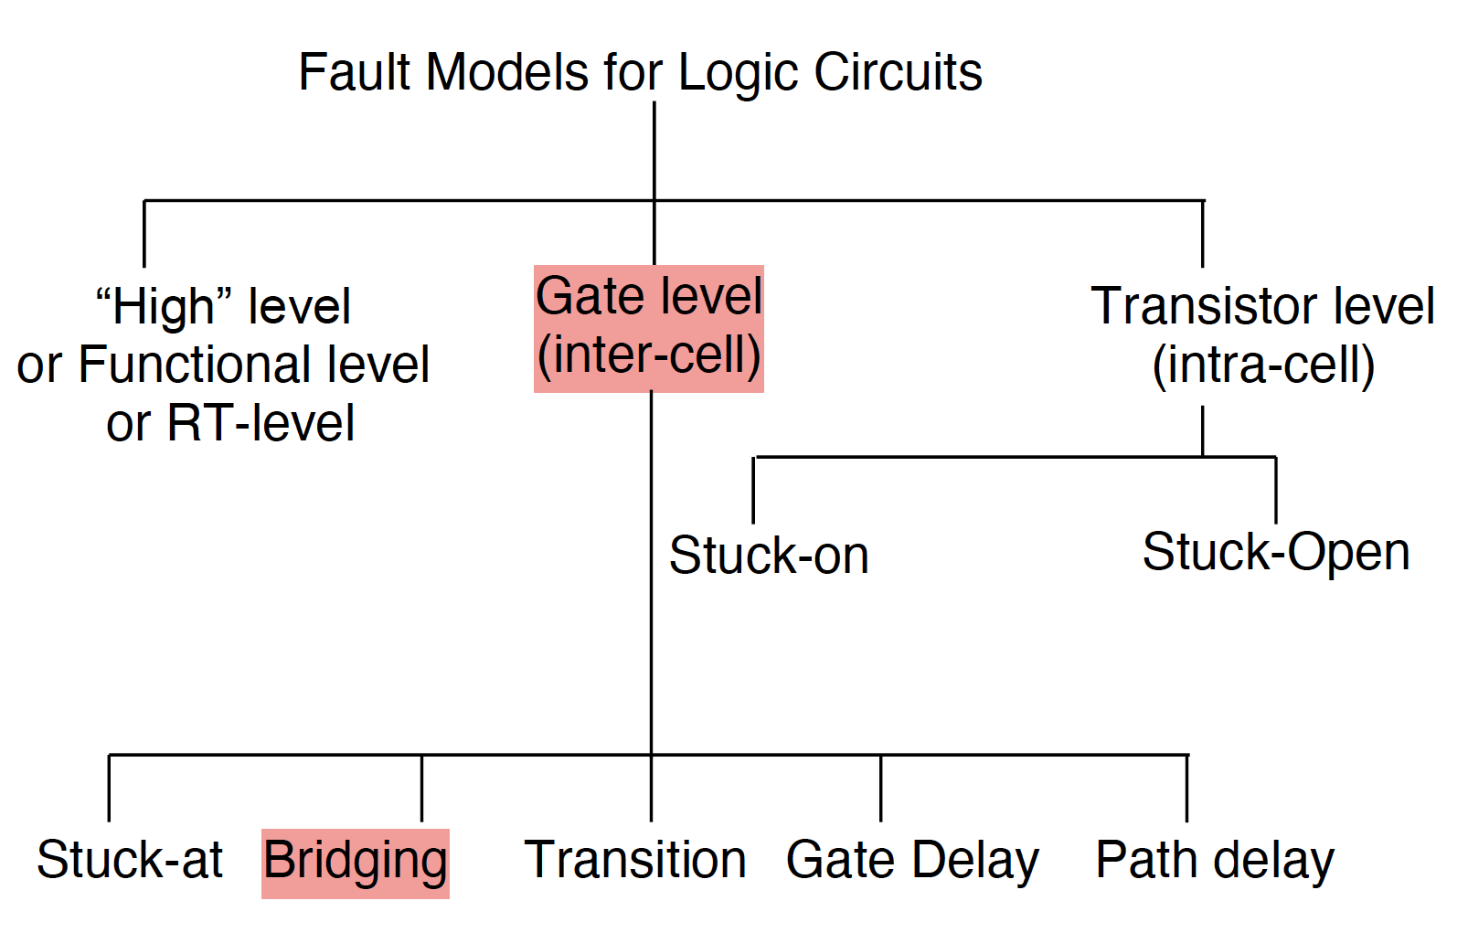
Classification of Fault Models

Slide 4

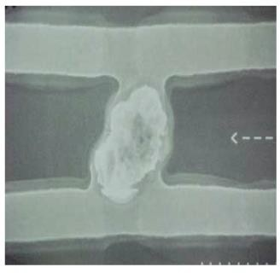

Bridging Faults (BF) [Williams 73][Friedman 74]
Definition:
  Two (or more) distinct logic signals unintended shorted together and create wired logic
CMP= Chemical Mechanical Polishing Picture source: Mentor graphics
Q: How many two-way BF in a circuit of n signals?
  Arbitrary choose two signals: C^{n}₂ = O(n²). too many!
  Need to identify pairs of neighbor signals from layout
 Fault extraction

Slide 5
Bridging Fault Models
Popular models for CMOS
  Wired-OR (1-dominant)
  Wired-AND (0-dominant)
  A-dominant
original a b | Wired-OR _{a}+ _{b}+ | Wired-AND _{a}+ _{b}+ | a-dominant _{a}+ _{b}+
0 0 | 0 0 | 0 0 | 0 0
0 1 | 1 1 | 0 0 | 0 0
1 0 | 1 1 | 0 0 | 1 1
1 1 | 1 1 | 1 1 | 1 1
wired-OR
f
a
a+
g
b
b+
f
a
g
b
f
a
a+
wired-AND
g
b
b+
Dashed Wired Logic Is Imaginary, not Real

Slide 6
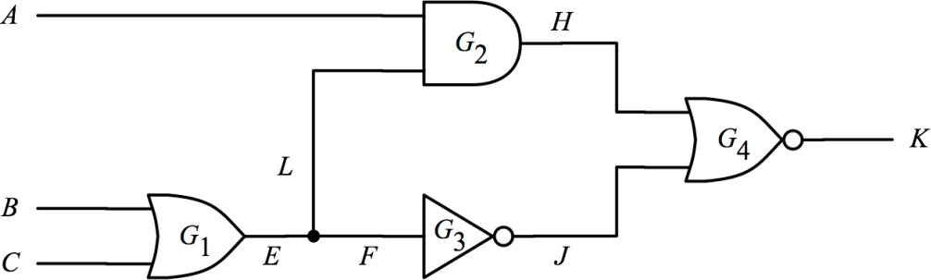
Different Models Need Different Patterns
Consider (A, B) bridging fault: : which patterns detect Wired-And and Wired-OR? How about A-dominant?
  Wired-AND, Wired-OR detected by 011, or 010
  A-dominant model detected only by 010
Inputs A B C | Fault-free Output | Wired- OR | Wired- AND | A- dominant
0 0 0 | 0 | 0 | 0 | 0
0 0 1 | 1 | 1 | 1 | 1
0 1 0 | 1 | 0 | 0 | 0
0 1 1 | 1 | 0 | 0 | 1
1 0 0 | 0 | 0 | 0 | 0
1 0 1 | 0 | 0 | 0 | 0
1 1 0 | 0 | 0 | 0 | 0
1 1 1 | 0 | 0 | 0 | 0

Slide 7


Feedback Bridging Faults
Type 1: creates memory
  Detected by test sequence 01→00
wired OR
z
x y
Inputs x y | Fault-free Output | Faulty Output
0 0 | 0 | unchanged
0 1 | 1 | 1
1 0 | 1 | 1
1 1 | 1 | 1
y
_{z}+
x
Type 2: creates oscillation
  “hard” detected by 10, or 11
  “potentially” detected by 00
wired OR
x
y
z
Inputs x y | Fault-free Output | Faulty Output
0 0 | 1 | oscillation
0 1 | 0 | 0
1 0 | 0 | 1
1 1 | 0 | 1
01010…
y=0
_{z}+
x=0
Notes:
Example why it cannot be detected
T1: 00 makes it feedback latch which makes the output “unchanged” whatever was the last state (it is not a 0)
T2: apply 10 or 11, output is 1 and can be detected
Potential detection will be discussed later

Slide 8
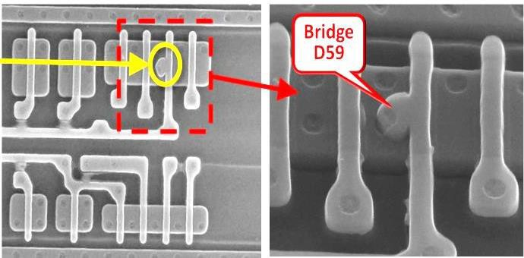
What are NOT Bridging Faults?
① BF does NOT consider shorts to power and ground
② BF does NOT consider defect resistance value
③ BF does NOT consider Intra-cell (intra-gate) defects
BF is gate-level, NOT transistor-level fault model
Intra-gate bridging defect is not a bridging fault
[Mentor graphics]
Notes:
Is really stuck-at fault
Defect resistance value (i.e., a resistance value for a line different than intended) is broader than bridging (when resistance = 0)
Anything within a gate is modeled using transistor-level fault

Slide 9

Summary
Bridging fault models for CMOS
  Wired-OR, wired-AND, A-dominant
Number of bridging faults is O(n²). too many!
  Needs fault extraction from layout
SSF test set may not be good enough to detect all BF
  Feedback BF may cause memory or oscillation
BF is permanent fault

Slide 10

Fault Modeling
Introduction
Fault Models
  Stuck-at fault (1961)
  Bridging fault (1973)
  Delay fault (1974)
 Path delay fault (PDF)
 Transition delay fault (TDF)
  Transistor level fault
Fault Detection
Fault Coverage
Conclusions

Slide 11
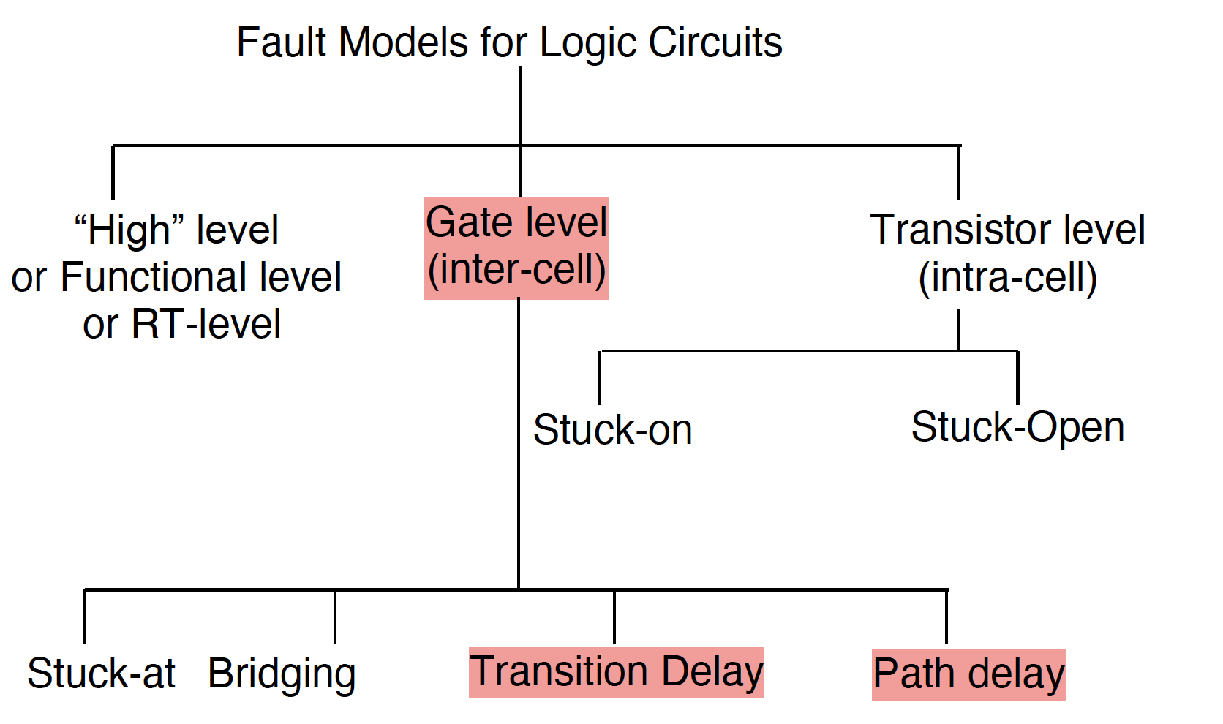
Classification of Fault Models

Slide 12
Some Defects Are Not Stuck-at
Some defects change circuit timing but not function
② Systematic defects: "process variation in V_{t}” slows down delay in all gates in a fabricated chip
① Random defects: "resistive open” causing poor contact at a specific location, slowing down signal when passing that location
Delay fault causes a circuit [Breuer 74]
  to fail to operate correctly at specified speed
  but produces correct output at slower speed
Delay Fault Models Are Needed

Slide 13
Two Delay Fault Models
Path Delay Fault (PDF) [Smith 85]
  Path delay of one faulty path > clock period
Transition Delay Fault, (TDF) [Barzilai 83] [Levendel 86]
  Path delay of all paths through a faulty node > clock period

Slide 14
Example
Clock period = 10.0ns
  good gate delay = 2.0ns
PDF (fault distributed along path)
  3.0 +2.6 +2.7 = 8.3 < 10 → pass
  3.0 +2.6 +2.7 +2.9 = 11.2 > 10 → fail
0→1
X
1→1
X
1→1
1→1 ^{________ X}
1→1 ^{____________ X}
0→1
TDF (lumped fault on interconnect = 9.0 ns)
  2.0+2.0+2.0+9.0=15.0 → fail
  2.0+2.0+2.0+9.0+2.0 = 17.0 → fail
1→1
1→1
1→1
1→1
X
PDF
TDF
Distributed
Lumped
Large fault size
Small fault size

Slide 15
Test Patterns for Delay Faults
Delay faults need two-pattern test
  As opposed to one-pattern test for stuck-at faults
A two-pattern test consists of
  V₁: initialize circuit state
  V₂: launch transition AND propagate fault effect to output
Control clock period T to determine if pass or fail at the primary output
T
0 0 ---
Pass
0
1
Fail
V₁
V₂
V₁
V₂
Delay Faults Require 2-pattern Test
Notes:
Test pattern should ensure a propagating transition at the output (through the path).
Test is done by applying a large-enough T (clock period) to detect the transition t the output and then gradually decrease T until the transition is not detected. Test is considered a pass if the desired clock period is within the range that the transition is detected.

Slide 16
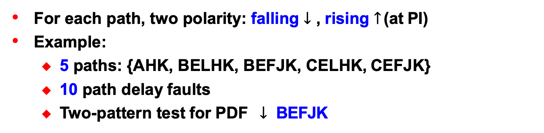
Path Delay Fault (PDF)
For each path, two polarity: falling $↓$ , rising $↑$ (at PI)
Example:
  5 paths: {AHK, BELHK, BEFJK, CELHK, CEFJK}
  10 path delay faults
  Two-pattern test for PDF $↓$ BEFJK
00 A
H
L
00
K
B
00 _{C}
E
F
J

Slide 17
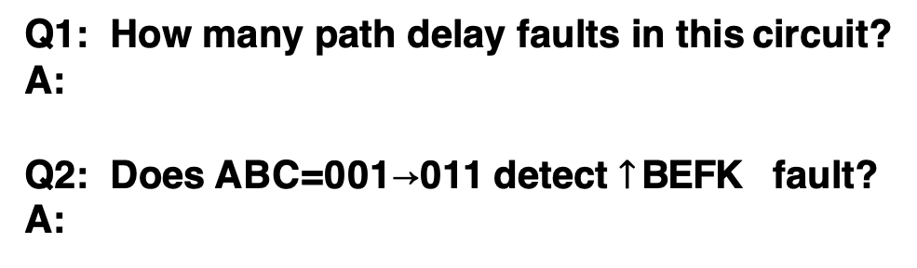
Quiz
Q1: How many path delay faults in this circuit?
A:
Q2: Does ABC=001→011 detect $↑$ BEFK fault?
A:
A B
G₁
K
G₂
G₄
E
F
G₃
C
17
Notes:
A is taking controlling value –> G1 =0 in both cycles
C is taking non-controlling value → G3 = B in both cycles
G4 has non-controlling value fed by G1 → K= output of G3 → transition is detected which means the two-cycle test can detect the path-delay fault

Slide 18
Fault Modeling
Introduction
Fault Models
  Stuck-at fault (1961)
  Bridging fault (1973)
  Delay fault (1974)
 Path delay fault (PDF)
 Transition delay fault (TDF)
  Transistor level fault
Fault Detection
Fault Coverage
Conclusions
18

Slide 19
Transition Delay Fault (TDF)
Each node has 2 TDFs: slow-to-rise (STR), slow-to-fall (STF)
  Example circuit below: total 9 nodes, 18 TDF
Two-pattern test for TDFs
  V₁: Initialization pattern: control initial value at fault site
 0 for STR fault, 1 for STF fault
  V₂: launch transition and propagate fault effect to output
     Detect SA0 for STR fault , SA1 for STF fault
A H
Q
K
STF
B _{X}
E G J
19

Slide 20
Experimental Results
Stuck-at
Delay
20%
0.5%
57%
7%
12%
3%
Bridge
Portion of failing chips
Covered by each test
[modified from Mentor Website]
20
Notes:
57% of chips are detected by any of the 3 tests
0.5% of chips are only detected by stuck-at tests
…
Overall, all tests are necessary but stuck-at test pretty good (not covered by stuck-at tests (20%+12%+3%)

Slide 21
Summary
Delay fault important for advanced technologies
Two popular delay fault models
  Path delay fault (PDF): two faults per path
 Rising, falling
  Transition delay fault (TDF): two faults per node
 STR, STF
 | Path Delay Fault | Transition Delay Fault
Number of faults (in terms of # nodes in circuit) | 🙁 worst-case exponential | ☺ linear
Fault size and distribution | ☺ small fault size ☺ distributed | 🙁 large fault size only 🙁 lumped
21
Notes:
Linear in number of nodes while exponential number of paths can be formed between nodes in worst-case
Trade off between model accuracy and complexity

