Slide 1
ECE 553: TESTING AND TESTABLE DESIGN OF DIGITAL SYSTEMS
Fault Modeling (3)

Slide 2
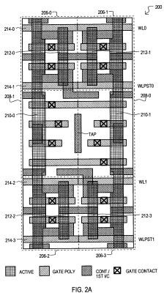
Fault Modeling
Introduction
Fault Models
  Stuck-at fault (1961)
  Bridging fault (1973)
  Delay fault (1974)
  Transistor-level fault
 Stuck-open (1978)
 Stuck-on
 Cell-aware (2009)
  Review
Fault Detection
Fault Coverage
Conclusions
X
2

Slide 3
Why Faulty NAND Has Memory ?
Stanford Murphy Experiment [Li 01]
  Sequence Dependency: Test result depends on test sequence
Example: NAND gate (fault is inside the NAND gate)
  Same test patterns {11, 01, 00}, but in different sequence
  Sequence 1 fails; Sequence 2 passes
  Is it A SA1 or not?
Sequence 1
A | B | ^{Out}good | ^{Out}faulty
1 | 1 | 0 | 0
0 | 1 | 1 | 0
0 | 0 | 1 | 1
?
A X-
A SA1 ?
B
Sequence 2
A | B | ^{Out}good | ^{Out}faulty
0 | 0 | 1 | 1
0 | 1 | 1 | 1
1 | 1 | 0 | 0
SSF Cannot Explain Seq. Dep.
Not A SA1 ??
3

Slide 4
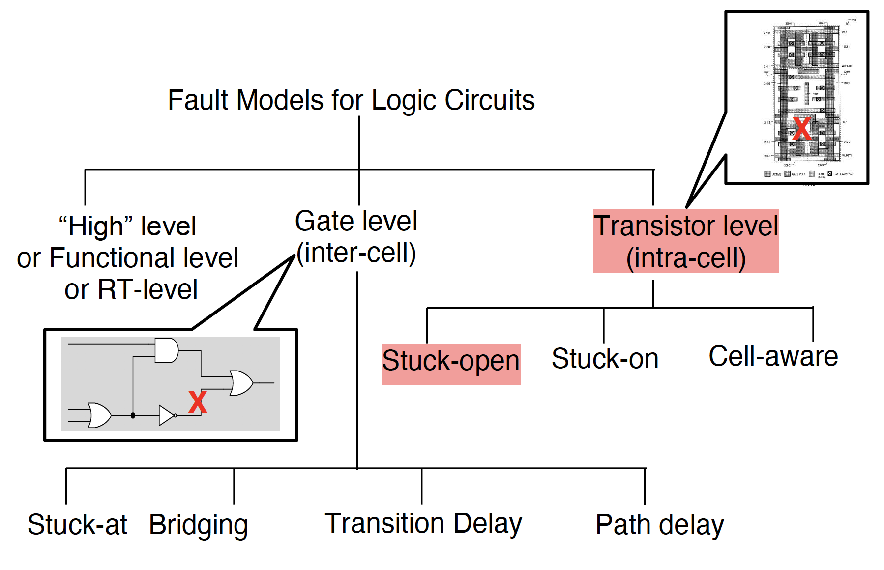
Classification of Fault Models
4

Slide 5
Stuck-open Fault [Wadsack 78]
Stuck-open (SOP) fault
Faulty transistor is always off
Example: NAND
  Consider 4 SOP faults: A_{P} B_{P} A_{N} B_{N}
VDD
B
P
A_{P}
OUT
A
A_{N}
B
B_{N}
Gnd
Input A B | Fault-free Output | Faulty Outputs Z = high impedance
 |  | A_{P} | A_{N} | B_{P} | B_{N}
0 0 | 1 | 1 | 1 | 1 | 1
0 1 | 1 | Z | 1 | 1 | 1
1 0 | 1 | 1 | 1 | Z | 1
1 1 | 0 | 0 | Z | 0 | Z
SOP Requires 2-pattern Test
5

Slide 6
Sequence Dependency
SOP Faulty circuit has memory (due to parasitic capacitor)
  Test results depend on sequence of test patterns
Example: A_{p} stuck-open fault,
  Same test patterns {11, 01, 00}, but different sequence
  Sequence 1 fails; Sequence 2 passes (test escape)
Sequence 1
A | B | ^{Out}good | ^{Out}faulty
1 | 1 | 0 | 0
0 | 1 | 1 | 0
0 | 0 | 1 | 1
FAIL:
Fault detected
A_{p}
B_{p}
Out
A
B
A_{N}
Sequence 2
A | B | ^{Out}good | ^{Out}faulty
0 | 0 | 1 | 1
0 | 1 | 1 | 1
1 | 1 | 0 | 0
B
N
PASS:
Fault undetected
(test escape)
6

Slide 7
Classification of Fault Models
Fault Models for Logic Circuits
“High” level
or Functional level
Gate level (inter-cell)
Transistor level (intra-cell)
or RT-level
Stuck-open
Stuck-on
Cell-aware
Stuck-at
Bridging
Transition Delay
Path delay

Slide 8
Stuck-On Fault
Faulty transistor is always on
  Form a conducting path between Vdd and Gnd in static state
Stuck-on fault may NOT be detected by Boolean testing
  Output logic values depend on relative impedance of transistors
Stuck-on fault can be detected by I_{DDQ} testing
  Apply test pattern
  Wait for a while
  Measure quiescent current from power supply
0
Conducting path
stuck-on fault

Slide 9
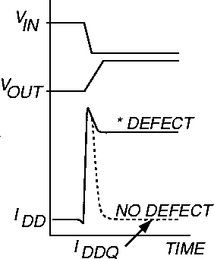
I_{DDQ} Testing [Mark 81]
Measure static power supply current, with test patterns applied
  I_{DD} = power supply current from V_{DD}
  Q = quiescent
Very commonly used in CMOS technology*
Example: NMOS stuck-on fault
*but I_{DDQ} less effective for new technologies due to leakage
^{I}DDQ
^{V}IN
NMOS
stuck-on fault

Slide 10
Classification of Fault Models
Fault Models for Logic Circuits
“High” level
or Functional level
Gate level (inter-cell)
Transistor level (intra-cell)
or RT-level
Stuck-open
Stuck-on
Cell-aware
Stuck-at
Bridging
Transition Delay
Path delay

Slide 11
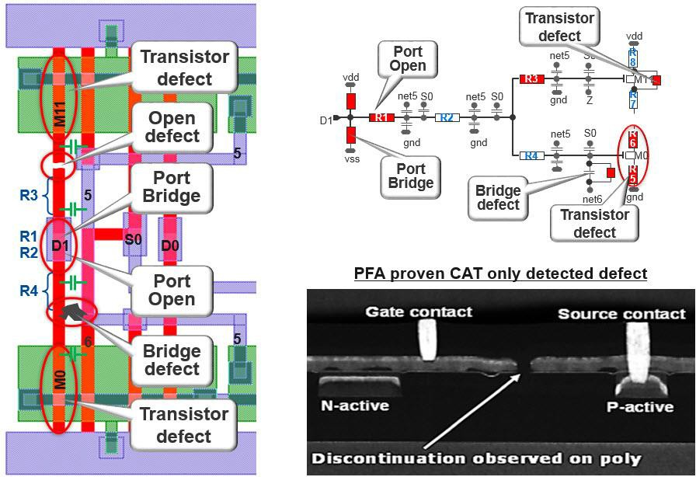
Cell-aware Test (CAT) [Hapke 09]
Consider different defects types inside cell: open, bridge, transistor
Need layout extraction and analog fault simulation
[Mentor website]
Notes:
Physical Failure Analysis
Only fails CAT

Slide 12
Fault Modeling
Introduction
Fault Models
  Stuck-at fault (1961)
  Bridging fault (1973)
  Delay fault (1974)
  Transistor-level fault (1978)
  Review
Fault Detection
Fault Coverage
Conclusion
X

Slide 13
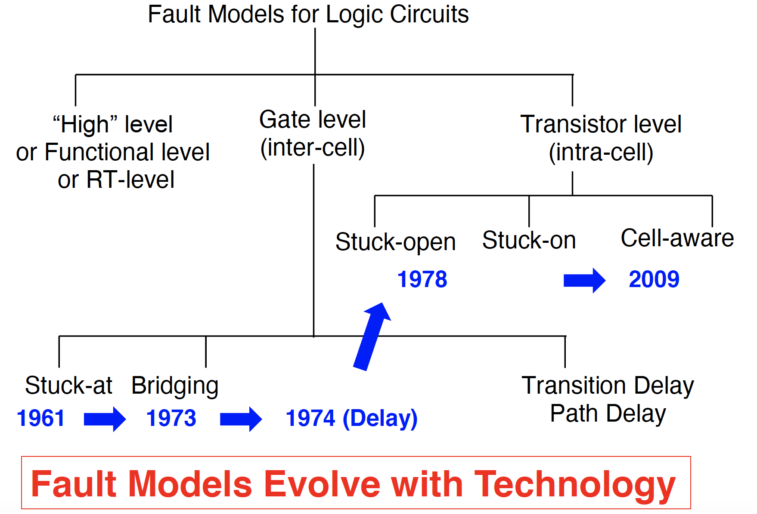
Classification of Fault Models

Slide 14
Summary
① Transistor stuck-open (SOP)
Sequence dependence: faulty comb. logic has memory
② Transistor stuck-on
I_{DDQ} testing
③ Cell-aware testing
layout extraction + analog fault simulation
Improved DPM but longer test
X
Fault models evolve with technology
  NO single best fault model for all circuits
  New fault models needed for future technologies!

Slide 15

Fault Modeling
Introduction
Fault Models
Fault Detection
Fault Coverage
Conclusions
15

Slide 16

Fault Detection
A test pattern detects a fault if
  output of faulty circuit $≠$ output of good circuit
a=0 b=0
0
1/0
test pattern (a,b,c,d) = (0,0,1,1) detects e stuck-at-0 fault
e
1/0
stuck-at-0 fault
f
c=1 d=1
notation 1/0:
good value=1; faulty value =0
16

Slide 17
Activation & Propagation
A fault is detected if two conditions are satisfied
  (1) Fault activation:
 different value at fault site (good is opposite of faulty value)
  (2) Fault effect propagation: (aka. error propagation)
 Propagate fault effect to any primary output
 A signal is sensitized if output changes when it changes
 A path of sensitized signals is called sensitized path
a=0 b=0
0
Fault activation: c=d=1
Fault site: e
Fault Effect Propagation: a=b=0
e is sensitized to output
e-f is sensitized path
1/0
SA0
e
f
c=1 d=1
1/0
Detection Requires (1) Activation & (2) Propagation
17

Slide 18
Fault Classes
Untestable faults = faults that cannot be provably detected by any test pattern (example next slide)
  aka redundant faults
  Proving untestable fault is NP-complete
Testable faults = faults that cannot be proven untestable
  Detected faults
  Undetected faults
  Potentially detected faults (discussed in fault simulation later)
  …
18
Notes:
* untestable faults is aka. undetectable faults
but very confusing so not used in lecture

Slide 19
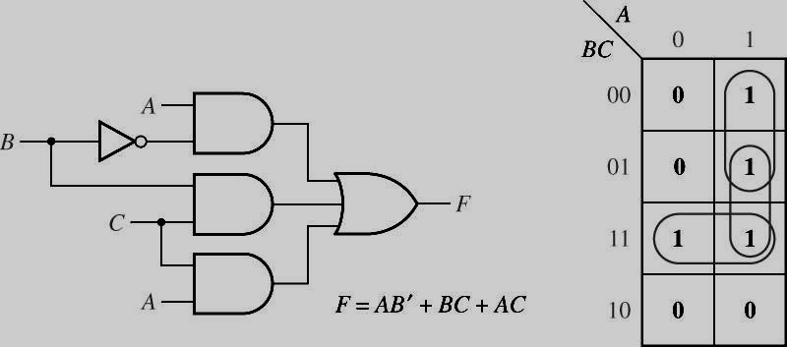
Untestable Faults
Hazard control circuitry
AB’ + BC + AC = AB’+BC
AC SA0 is untestable
Used for hazard prevention
[Roth, Fundamentals of Logic Design]
X
Error control circuitry
  A and A⁺ always produce same output
  ECC output SA0 is untestable
ECC
A
XOR
SA0
XOR
X
_{A}+
XOR
19
Notes:
A and A+ in ECC are identical
Output always 0 if no fault so checking for only SA0 is impossible (if other components not faulty)

Slide 20

Undetected Faults
Definition
  Faults that are testable but not detected by the given test set
Undetected faults happen due to ATPG runtime limitation
  Testable because cannot prove it to be untestable
  Cannot find test pattern, either because of runtime limitation
NOTE: do not confuse untestable faults with undetected faults
  Former: no test pattern exists (proven)
  Latter: no test pattern so far (may exist but not sure)
Untestable Faults $≠$ Undetected Faults
20

Slide 21
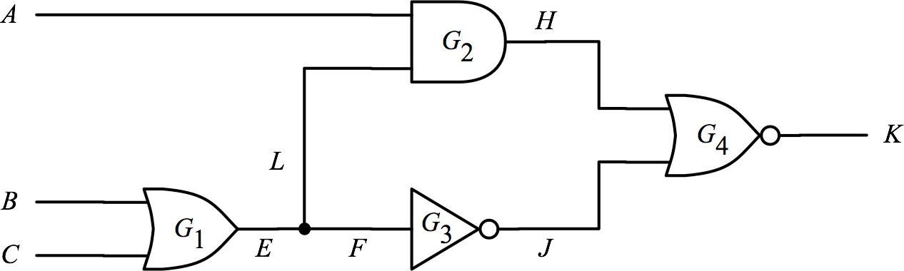
Quiz
Q1: Apply two patterns {000, 001}. Which fault (s) are undetected?
A:
Q2: Now consider all patterns. Which fault(s) are untestable?
A:
Input |  |  | Output
A | B | C | good | E/0 | F/0 | L/0 | E/1 | F/1 | L/1
0 | 0 | 0 | 0 | 0 | 0 | 0 | 1 | 1 | 0
0 | 0 | 1 | 1 | 0 | 0 | 1 | 1 | 1 | 1
0 | 1 | 0 | 1 | 0 | 0 | 1 | 1 | 1 | 1
0 | 1 | 1 | 1 | 0 | 0 | 1 | 1 | 1 | 1
1 | 0 | 0 | 0 | 0 | 0 | 0 | 0 | 1 | 0
1 | 0 | 1 | 0 | 0 | 0 | 1 | 0 | 0 | 0
1 | 1 | 0 | 0 | 0 | 0 | 1 | 0 | 0 | 0
1 | 1 | 1 | 0 | 0 | 0 | 1 | 0 | 0 | 0
Consider only six faults on EFL
VLSI
Test 3
Notes:
Detected faults: E/1, F/1, E/0, F/0
Untestable: L/1
Undetected: L/0 only (notice L/1 is untestable and should not be counted as undetected)

Slide 22

Fault Modeling
Introduction
Fault Models
Fault Detection
Fault Coverage
Conclusions

Slide 23
More Metrics
Fault coverage (FC): measure quality of test set
number of detected faults _{X 100%}
number of total faults
Test coverage : measure quality of test set for testable faults
number of detected faults _{X 100%}
number of testable faults
ATPG effectiveness : measure quality of ATPG algorithm
number of detected + untestable faults _{X 100%}
number of total faults
Notes:
ATPG generates faults that are detected and faults that are found to be untestable as its output

Slide 24
Quiz
Item | Number
Total Faults | 1,234
Detected faults | 1,000
Untestable faults | 230
Undetected faults | 4
Fault Coverage
Test Coverage
ATPG effectiveness
1,000/1,234
1,000/1,004
1,230/1,234
Notes:
We know beforehand how many faults should be tested (we feed this info to the ATPG tool)
The tool generates a test set and reports how many faults are detected by its generated test set.
The tool may also identify some faults as untestable and reports how many untestable faults it was able to find.
The 4 undetected faults may be untestable.

Slide 25
Revisit: DL =1-Y^{(1-FC)}
In practice, does 100% FC mean 0 DPM?
  NO! Fault coverage does NOT represent defect coverage
Total defects=?
Total faults
Detected defects=?
Detected
faults
Fault Coverage
Defect Coverage
=?

Slide 26

Defect → Faults
Sometimes, one defect can be modeled by more than one fault
defects
faults
Example:
  unwanted wire between b and ground
 b stuck-at zero SSF
 b slow-to-rise transition fault
 …
a b
G
f

Slide 27
Defect → Faults (2)
Sometimes, one defect cannot be well modeled by any fault
defects
faults
?
Examples:
  Fault masking (for multiple Stuck at Faults)
  …

Slide 28
Fault Modeling
Introduction
Fault Models
Fault Detection
Fault Coverage
Conclusions

Slide 29
Concluding Remarks
Fault model is very important for test automation
  Automatic test pattern generation
  Quantify quality of test patterns
Although many fault models, only a few used in practice
  Single stuck-at faults is applied for sure
  Transition delay faults may be applied
  Other fault models adopted according to product needs
NOTICE! Fault model can be deceiving
  Fault models do not always match behavior of defects
  100% fault coverage DOES NOT guarantee zero DPM

Slide 30
References
[Barzilai 83] Z. Barzilai and B. K. Rosen, “Comparison of AC Self-Testing Procedures,” IEEE Int’l Test Conf., pp.89-94, 1983.
[Breuer 74] M.A Breuer, “The Effects of Races, Delays and Delay Faults on Test Generation,” IEEE Trans. on
Computers, pp.1078-1092, 1974.
[Friedman 74] Friedman, Arthur D. "Diagnosis of short-circuit faults in combinational circuits." IEEE Transactions on Computers 100.7 (1974): 746-752.
[Galey 61] Galey, J. M., R. E. Norby, and J. P. Roth. "Techniques for the diagnosis of switching circuit failures." Proceedings of the 2nd Annual Symposium on Switching Circuit Theory and Logical Design (SWCT 1961). IEEE Computer Society, 1961.
[Hapke 09] F. Hapke, et al. "Defect-oriented cell-aware ATPG and fault simulation for industrial cell libraries and
designs." IEEE Int’l Test Conference, 2009.
[Hapke 14] F. Hapke, et al. “Cell-aware Test" IEEE Trans. on CAD, 2014.
[Levendel 86] Y. Levendel and P.R. Menon, “Transition Faults in Combinational Circuits: Input Transition Test Generation and Fault Simulation,” Int’l Symp. in Fault-tolerant Computing Systems, 1986.
[Li 01] JCM Li, CW Tseng, EJ McCluskey, “Testing for resistive opens and stuck opens,” Int’l Test Conf. 2001.
[Li 02] JCM Li, “Test and Diagnosis for Open Defects in digital CMOS IC,” PhD Thesis, Stanford Univ. 2002.
[Millman 88] S.D. Millman, McCluskey, “Detecting bridging faults with stuck-at test sets,” ITC 1988.
[Millman 89] S.D. Millman, McCluskey, “Detecting stuck-open faults with stuck-at test sets,” ITC 1989.
[Hughes 86] J Hughes and EJ McCluskey, “Multiple stuck-at fault coverage of single stuck-at fault test sets,” Int’l Test Conf., 1986.
[McCluskey 00] EJ McCluskey and CW Tseng, “Stuck-fault tests vs. actual defects, ” Int’l Test Conf., 2000.
[Smith 85] G.L. Smith, “Model for Delay Faults,” IEEE Int’l Test Conf., pp.342-349, 1985.
[Wadsack 78] RL Wadsack, “Fault modeling and logic simulation of CMOS and MOS integrated circuits” Bell System Technology, 1978.
[Williams 73] MJY Williams and JB Angell, "Enhancing testability of large-scale integrated circuits via test points and additional logic." IEEE Transactions on Computers 100.1 (1973): 46-60.
[Woodhall 87] BW Woodhall, BD Newman, AG Sammuli, “Empirical results on undetected CMOS stuck-open failures” Int’l Test Conf., 1987.

