Slide 1
ECE 553: TESTING AND TESTABLE DESIGN OF DIGITAL SYSTEMS
Fault Collapsing

Slide 2
Course Roadmap (EDA Topics)
Logic Sim.
Fault Modeling / Collapsing
Fault Simulation
Testability
Comb. ATPG
Diagnosis
Seq. ATPG
Delay Test
2

Slide 3
Fault Collapsing
Introduction
Equivalence Fault Collapsing
  Fanout-free circuits
  Circuits with fanout
Dominance Fault Collapsing
  Fanout-free circuits
  Circuits with fanout
Discussions
Conclusion

Slide 4
Introduction
Why Fault Collapsing?
  Reduces number of faults so that
 Speed up ATPG
 Shorten test set
How?
  Quickly find representative faults
  Use only those representative faults for ATPG
Requirement of fault collapsing algorithm
  Must be fast; otherwise, it is not worth doing
There are many different ways to do fault collapsing
  Obtaining the minimum solution is not so important
  As long as we do not miss any fault

Slide 5
Equivalent Faults
Faults f and g are functionally equivalent (or simply equivalent)
  if faulty outputs of them are identical for all test patterns
Example: A/0 B/0 and C/0 are all equivalent faults
  They belong to the same equivalent fault class
A
C
B
Input |  | Output
A | B | good | A/0 | C/0 | B/0 | A/1 | C/1 | B/1
0 | 0 | 0 | 0 | 0 | 0 | 0 | 1 | 0
0 | 1 | 0 | 0 | 0 | 0 | 1 | 1 | 0
1 | 0 | 0 | 0 | 0 | 0 | 0 | 1 | 1
1 | 1 | 1 | 0 | 0 | 0 | 1 | 1 | 1

Slide 6
Properties of Equivalence
Equivalence relationship is symmetric
  if fault f is equivalent to fault g, then fault g is equivalent to fault f
Equivalence relationship is also transitive
  if fault f is equivalent to fault g and fault g is equivalent to fault h,
then fault f is equivalent to fault h
Example
A
C
B
A/0 fault is equivalent to B/0 fault, which is also equivalent to C/0
fault. These three faults belong to the same equivalence class
Input |  | Output
A | B | good | A/0 | C/0 | B/0 | A/1 | C/1 | B/1
0 | 0 | 0 | 0 | 0 | 0 | 0 | 1 | 0
0 | 1 | 0 | 0 | 0 | 0 | 1 | 1 | 0
1 | 0 | 0 | 0 | 0 | 0 | 0 | 1 | 1
1 | 1 | 1 | 0 | 0 | 0 | 1 | 1 | 1

Slide 7
Equivalence Fault Collapsing, EFC
EFC reduces fault list using fault equivalence relationship
  Select one representative fault from every equivalent class
Example:
  Originally six faults per 2-input gate
  After EFC, only four faults per gate
  6→4
A/1
C/1
A/1
C/1
A/0 A/0
C/1
C/1
C/0
C/0
C/0
C/0
B/1 B/1
B/0
B/0
NOTE: EFC is not unique
  {A/0, A/1, B/1, C/1} is also EFC for AND gate

Slide 8
How to Perform EFC?
EFC can be performed by functional analysis or structure analysis
Functional analysis
  Apply all possible test patterns and fault simulate two faults
 If same faulty outputs , two faults are equivalent
  Exhaustive process which is time consuming
 2^{n} test patterns may be needed for an n-input circuit
Structure analysis
  Identify equivalent faults by circuit structure
  No test patterns applied
Many different structure analysis approaches
  We show a linear time structure analysis example
  Resulting equivalence collapsed fault list may not be minimal
 but good enough for most applications
Structure Analysis Is Enough for Most Applications

Slide 9
Gate Equivalence Rules for Structure Analysis
sa0
sa0
sa1
sa1
sa0 sa1
sa0 sa1
WIRE
sa0 sa1
sa0 sa1
AND
OR
sa0 sa1
sa0 sa1
sa0
sa1
NOT
sa0
sa1
sa0 sa1
sa0 sa1
sa0 sa1
sa0 sa1
sa0
NAND
NOR
sa1
sa0 sa1
sa0
sa0 sa1
sa1
sa0
FANOUT
sa1
Notes:
No equivalence in general case when there are branches (bottom-right image)

Slide 10
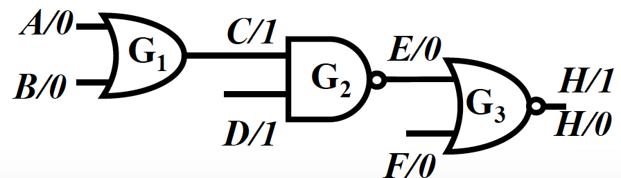
EFC on Fanout-free Circuits
Our EFC Rules (no need to memorize to solve a given problem!)
  (1) select both stuck-at one and zero faults for every primary output
  (2) select the “relevant” collapsed fault for each gate input
 relevant one is picking stuck-at non-controlling values based on gate type
Example
  Rule (1) : keep both H/0 and H/1 faults for primary output H
  Rule (2) : keep only one (relevant) fault for each gate input determined by the gate equivalency rules,
 A/0 and B/0 for OR gate G1 since 0 is non-controlling value
  Original 14 faults → 8 faults after EFC
  Why faults on the gate outputs are removed?
 gate G1 output stuck-at zero fault is equivalent to C/0 fault, which is equivalent to E/1, which is equivalent to H/0.
11

Slide 11
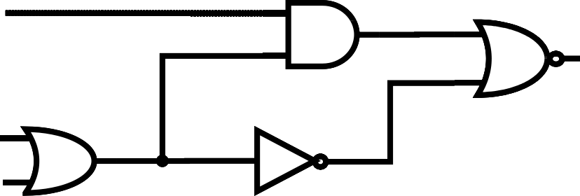
EFC on Circuits with Fanouts
Fanout stem faults are NOT
always equivalent to fanout branch faults
Example:
  E/0 is equivalent to F/0
 but not equivalent to L/0
A H
K
G
2
G₄
L
B C
J
G
1
E
F
G₃
*This functional analysis by building truth table using simulation is slow
Input |  |  | Output
A | B | C | good | E/0 | F/0 | L/0 | E/1 | F/1 | L/1
0 | 0 | 0 | 0 | 0 | 0 | 0 | 1 | 1 | 0
0 | 0 | 1 | 1 | 0 | 0 | 1 | 1 | 1 | 1
0 | 1 | 0 | 1 | 0 | 0 | 1 | 1 | 1 | 1
0 | 1 | 1 | 1 | 0 | 0 | 1 | 1 | 1 | 1
1 | 0 | 0 | 0 | 0 | 0 | 0 | 0 | 1 | 0
1 | 0 | 1 | 0 | 0 | 0 | 1 | 0 | 0 | 0
1 | 1 | 0 | 0 | 0 | 0 | 1 | 0 | 0 | 0
1 | 1 | 1 | 0 | 0 | 0 | 1 | 0 | 0 | 0
11

Slide 12
How to Handle Circuits w/ Fanouts?
Stem analysis using simulation for the fanout location (stem and its branches) is needed to determine equivalent faults
  However, stem analysis is time consuming
 not worth the time
 details skipped in this lecture
An approximate solution
  Partition circuit into independent fanout-free subcircuits (FFS)
  Every fanout stem treated as a primary output
 both s@1 s@0 faults are included on branches
 They are NOT collapsed
Treat each FFS partition independently
12

Slide 13
Example
2 partitions
Originally 18 faults, → after EFC 10 faults
A/1
H/0
K/0
K/1
G
2
G₄
L/1
E/0
G₁
J/0
B/0 C/0
F
E/1
G₃
NOTE:
  Inverter G₃ ignored
  because its input fault s@0 is always equivalent to its output s@1 fault
13

Slide 14
Problems of this Approach
Link between original (uncollapsed) faults and their corresponding collapsed faults is lost
Example:
  We do not calculate and store information about the equivalent faults
  For example {F/0, J/1, H/1, K/0} are equivalent but we don’t calculate or store this information for ATPG
However, link between the uncollapsed faults and collapsed faults are needed if we need to calculate the uncollapsed fault coverage
  Example: suppose a test detects 3 faults : A/1 K/0 and B/0
 Collapsed fault coverage is 3/10 = 30%
 But uncollapsed fault coverage is ?/18 = ?
A/1
H/0
G
K/0
K/1
2
G₄
L/1
E/0
G₁
E/1
J/0
B/0
C/0
F
14
G₃

Slide 15
Equivalence Example
sa0 sa1
Faults in blue
removed by
equivalence
collapsing
sa0 sa1
sa0 sa1
sa0 sa1
sa0 sa1
sa0 sa1
sa0 sa1
sa0 sa1
sa0 sa1
sa0 sa1
sa0 sa1
sa0 sa1
sa0 sa1
sa0 sa1
sa0 sa1
sa0 sa1
20
Collapse ratio = ----- = 0.625
32
Notes:
Study on your own

