Slide 1
ECE 553: TESTING AND TESTABLE DESIGN OF DIGITAL SYSTEMS
Fault Collapsing

Slide 2
Fault Collapsing
Introduction
Equivalence Fault Collapsing
  Fanout-free circuits
  Circuits with fanouts
Dominance Fault Collapsing
  Fanout-free circuits
  Circuits with fanouts
Checkpoint Theorem (1976)
Conclusion
2

Slide 3
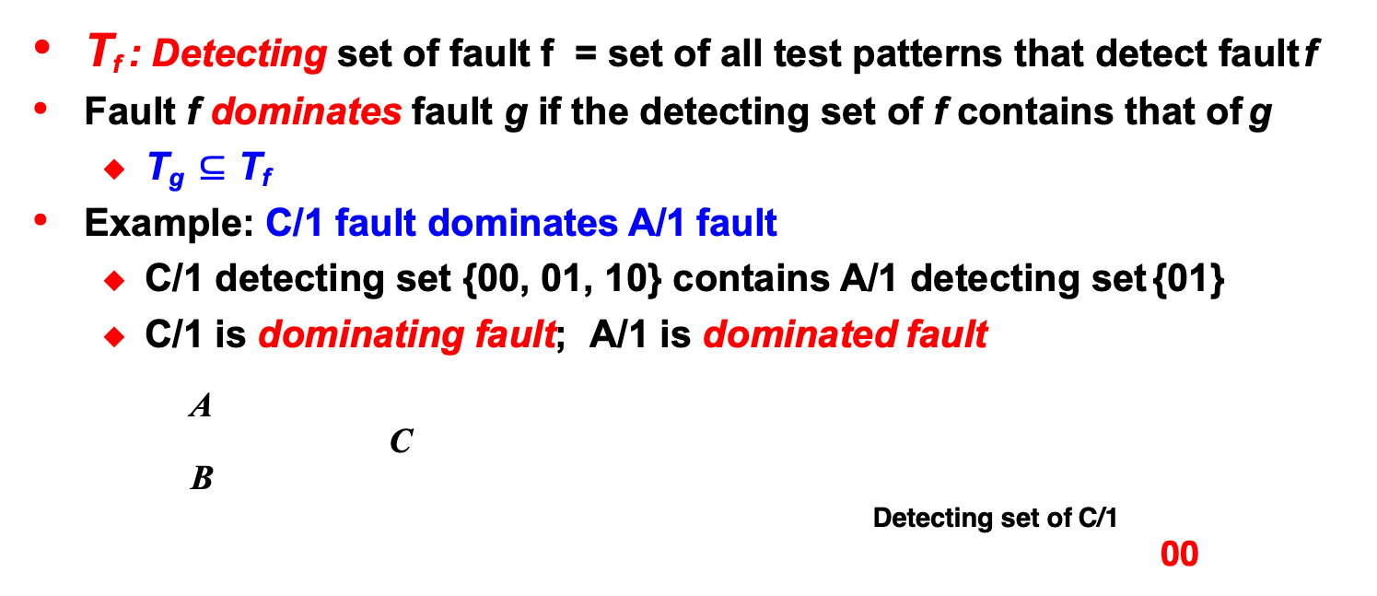
Fault Dominance
T_{f} : Detecting set of fault f = set of all test patterns that detect fault f
Fault f dominates fault g if the detecting set of f contains that of g
  T_{g} $⊆$T_{f}
Example: C/1 fault dominates A/1 fault
  C/1 detecting set {00, 01, 10} contains A/1 detecting set {01}
  C/1 is dominating fault; A/1 is dominated fault
A
C
B
Detecting set of C/1
00
Input |  | Output
A | B | good | A/0 | C/0 | B/0 | A/1 | C/1 | B/1
0 | 0 | 0 | 0 | 0 | 0 | 0 | 1 | 0
0 | 1 | 0 | 0 | 0 | 0 | 1 | 1 | 0
1 | 0 | 0 | 0 | 0 | 0 | 0 | 1 | 1
1 | 1 | 1 | 0 | 0 | 0 | 1 | 1 | 1
Detecting set of A/1
01
10
3

Slide 4
Quiz
Q: Is dominance relation symmetric?
if f dominates g, then g dominates f?
A:
Q: Is dominance relation transitive?
if f dominates g, and g dominates h, then f dominates h?
A:
4
Notes:
Not symmetric. Example of previous slide C/1 dominates A/1 but not the other way, based on the definition
But it is transitive

Slide 5
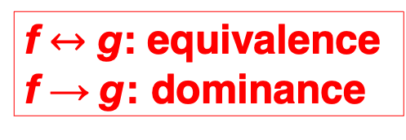
Dominance Fault Collapsing, DFC
DFC reduces fault list using fault dominance relation
  If a test pattern detects a dominated fault, then it must detect its
dominating fault. So dominating faults can be removed for ATPG
Example:
  C/1 fault can be removed. Additionally, A/0, B/0 also removed due to equivalence
  Minimum {A/1, B/1, C/0} 3 faults remains after DFC
Input |  | Output
A | B | Good | A/0 | C/0 | B/0 | A/1 | C/1 | B/1
0 | 0 | 0 | 0 | 0 | 0 | 0 | 1 | 0
0 | 1 | 0 | 0 | 0 | 0 | 1 | 1 | 0
1 | 0 | 0 | 0 | 0 | 0 | 0 | 1 | 1
1 | 1 | 1 | 0 | 0 | 0 | 1 | 1 | 1
X X
X X
X X
X X
X X
X X
blue SA0
red SA1
f $↔$ g: equivalence
f → g: dominance
Minimum 3 faults after DFC
5

Slide 6
DFC on Elementary Gates
2-input AND/OR/NAND/NOR elementary gates
  Originally 6 faults → 4 faults after EFC → 3 faults after DFC
For n-input elementary gate,
  n+1 stuck-at faults after DFC
A/1 A/0
C/1
XX
XX
XX
XX
XX
XX
XX
C/0
XX
XX
XX
XX
XX
B/1 B/0
A/1
A/1
C/1
X
A/0
A/0
X X
X X
X X
C/1
X
X X
X
X
B/1
C/0
C/0
B/1
B/0
B/0
blue SA0
red SA1
6

Slide 7
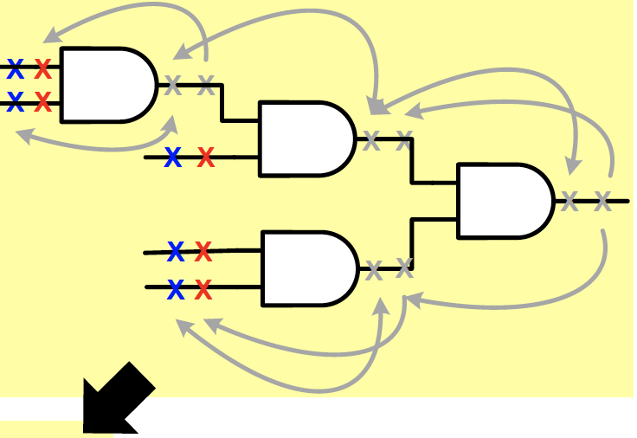
DFC on Fanout-free Circuits
X X
push to PI (move from right to left)
For EFC, remove SSF at gate output (determined when gate input is stuck at controlling value)
For DFC, remove the “other” SSF at gate output (determined when gate input is stuck at non-controlling value)
X X
X X
X X
X X
X X
X X
X X
X X
blue SA0 red SA1
X X
X X
all-PI gates reduce further
using EFC
For all-PI gate, reduce from 4 SSF at inputs to 3 SSFs (2 at gate inputs and 1 at gate output)
X X
X X
X X
X X
X X
X X
X X
7

Slide 8
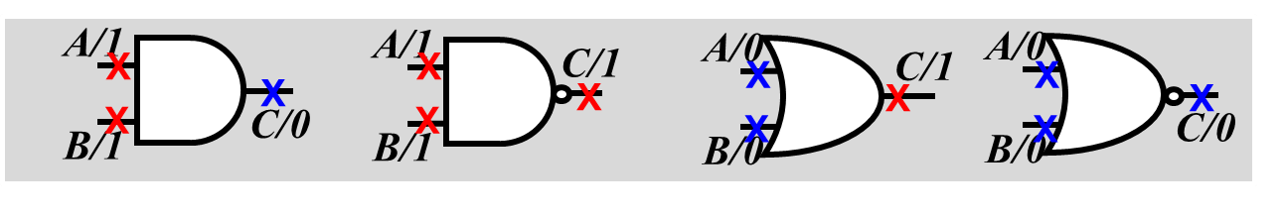
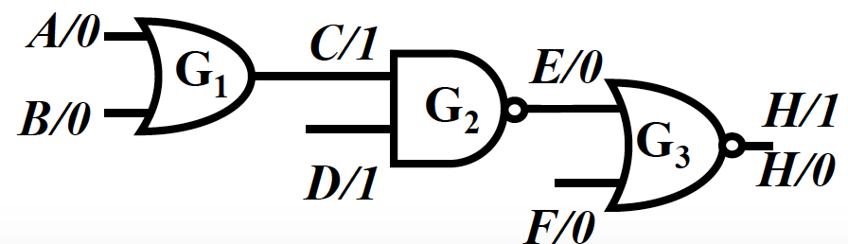
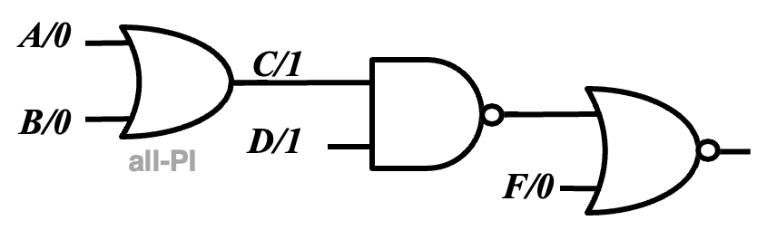
DFC Rules for Fanout-free Circuits
DFC Rules
one DFC collapsed fault for every primary input
one DFC collapsed fault for each all-PI gate output*
*all-PI gate = gate inputs are all PI
Example
  Original 14 faults → 8 faults after EFC → 5 faults after DFC
A/1
C/0
E/1
D/0
B/1
F/1
8

Slide 9
Fault Collapsing
Introduction
Equivalence Fault Collapsing
  Fanout-free circuits
  Fanout
Dominance Fault Collapsing
  Fanout-free circuits
  Circuits with fanout
Checkpoint Theorem
Conclusion
9

Slide 10
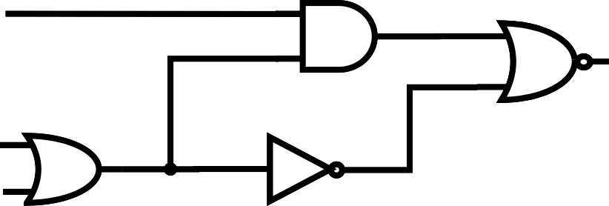
Fanout Stem and Branches
Fanout branch faults do NOT always dominate fanout stem faults
Example: F/1 fault dominates E/1. but L/1 fault does not dominate E/1
Stem analysis of fanout faults is time consuming
Input |  |  | Output
A | B | C | good | E/0 | F/0 | L/0 | E/1 | F/1 | L/1
0 | 0 | 0 | 0 | 0 | 0 | 0 | 1 | 1 | 0
0 | 0 | 1 | 1 | 0 | 0 | 1 | 1 | 1 | 1
0 | 1 | 0 | 1 | 0 | 0 | 1 | 1 | 1 | 1
0 | 1 | 1 | 1 | 0 | 0 | 1 | 1 | 1 | 1
1 | 0 | 0 | 0 | 0 | 0 | 0 | 0 | 1 | 0
1 | 0 | 1 | 0 | 0 | 0 | 1 | 0 | 0 | 0
1 | 1 | 0 | 0 | 0 | 0 | 1 | 0 | 0 | 0
1 | 1 | 1 | 0 | 0 | 0 | 1 | 0 | 0 | 0
A
H
K
G
2
G₄
L
B C
J
G
1
E
F
G₃
Hard to Analyze Dominance between Stem and Branches

Slide 11
How to Handle Circuits w/ Fanouts?
Approximate solution: Partition circuit into fanout-free subcircuits
  DFC each subcircuit independently
Example:
  J is considered input because inverter G₃ is ignored
  Original 18 faults, → after EFC 10 faults → after DFC 7 faults
  NOTE: this solution is NOT optimal
 J/0 is equivalent to F/1,which dominates E/1
A/1
H/0
G₄
G₂
K
L/1
J/0
B/0
E/1
F
G
1
G
3
C/0

Slide 12
Fault Collapsing
Introduction
Equivalence Fault Collapsing
  Fanout-free circuits
  Fanout
Dominance Fault Collapsing
  Fanout-free circuits
  Circuits with fanout
Checkpoint Theorem
Conclusion

Slide 13

Checkpoint Theorem [Breuer 76]
If a test detects all SSF on all checkpoints, this test detects all SSF in the circuit.
Checkpoints = primary inputs + fanout branches
Example:
  10 faults on checkpoints
  Originally 18 faults, after EFC 10 faults, after DFC 7 faults
A/0 A/1
G₂
L/0 L/1
G₄
B/0
B/1
C/0
C/1
G₁
G₃
F/0
F/1
|CHKPT| $≥$ |EFC| $≥$|DFC|

Slide 14
Fault Collapsing
Introduction
Equivalence Fault Collapsing
  Fanout-free circuits
  Fanout
Dominance Fault Collapsing
  Fanout-free circuits
  Circuits with fanout
Checkpoint Theorem
Conclusion

Slide 15

Example ATPG Report
CollapseRatio
 | Uncollapsed | Collapsed (typically EFC)
Total Faults | 1,234 | 800
Detected faults | 1,000 | 700
Untestable faults | 230 | 98
Aborted faults | 4 | 2
Fault Coverage | 1,000/1,234 | 700/800
number of collapsed faults number of uncollapsed faults
=
X100%
= ⁸⁰⁰ $≈$64.8%
1234
uncollapsed F.C.
₌ detected uncollapsed faults _{X 100%} total uncollapsed faults
Collapsed F.C.
₌ detected collapsed faults _{X 100%} total collapsed faults
Notes:
Test coverage in both cases remain roughly the same.
1000/(1234-230) ~ 700/(800-98) ~ 99.6%

Slide 16
Conclusions
Fault collapsing reduces size of fault list
  Speed up ATPG, Shorten test length
DFC Rules:
  (1) one fault on PI (2) one fault on output of all-PI gate
DFC is more aggressive than EFC
  FC of DFC is pessimistic
Checkpoint Theorem:
  Detecting all checkpoint faults is good enough
  Checkpoints are (1) PI, (2) fanout branches
Notes:
Fault coverage after dominance fault collapsing is considered pessimistic, not optimistic.
While it is a common intuition that collapsing faults might change the math in a favorable way, dominance fault collapsing actually removes faults that are easier to detect, leaving behind a fault list that is harder to test.

Slide 17
References
[Breuer 76] M. A. Breuer and A. D. Friedman, Diagnosis & Reliable Design of Digital Systems. Woodland Hills, CA: Computer Science Press, 1976.

