Slide 1
ECE 553: TESTING AND TESTABLE DESIGN OF DIGITAL SYSTEMS
Fault Simulation

Slide 2
Course Roadmap (EDA Topics)
Logic Sim. Fault Modeling
Fault Simulation
Testability
Comb. ATPG
Diagnosis
Seq. ATPG
2
Delay Test

Slide 3
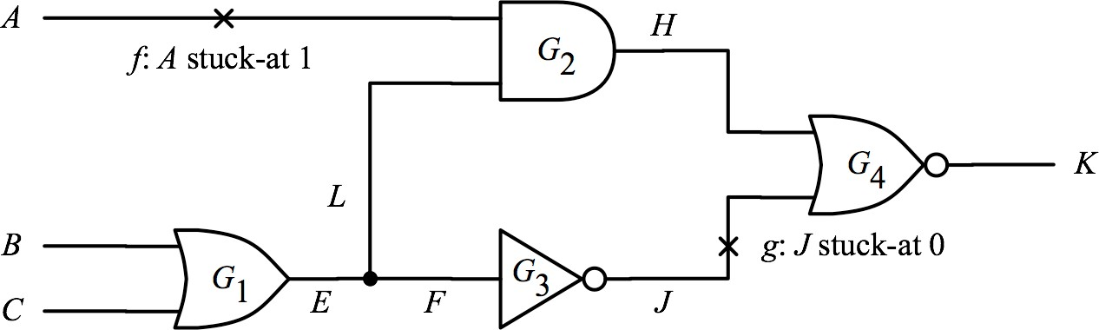
Motivating Problem
Apply 3 test patterns: P₁, P₂, P₃: {0,1,0} {0,0,1} {1,0,0}
  Your manager asks you : What is fault coverage?

Slide 4
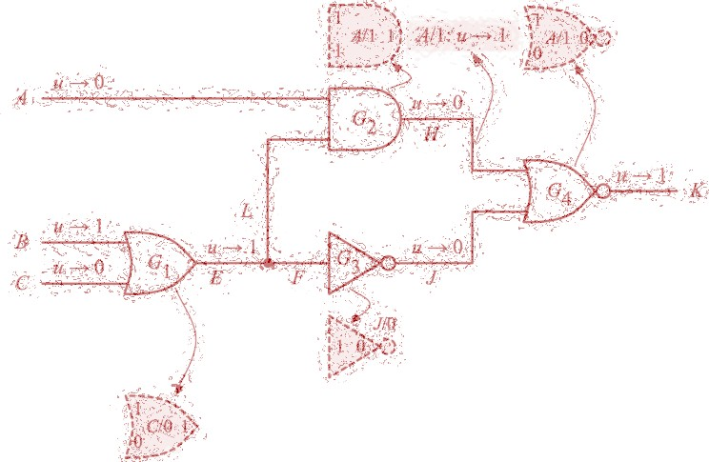
Fault Simulation
Introduction
Fault simulation techniques

Slide 5
What Is Fault Simulation?
Given:
  Circuit, fault model, test set
Determine:
  Output responses of faulty circuits
  Detected faults, Undetected faults
  Fault coverage
Commands
Input Stimuli (test set)
Fault Simulator
Good/Faulty Responses
Fault coverage
detected faults
Models (circuit, fault)

Slide 6
Applications of Fault Simulation
1. Evaluate quality of test sets (aka. Fault Grading)
  Determine fault coverage of a test set
2. Automatic Test Pattern Generation (ATPG)
  Identify detected faults and undetected faults
3. Diagnosis
  Generate fault dictionary
  Find fault responsible for failure
Therefore, fault simulators can be used as either
  Stand alone tool, or
 Fault grading
  Embedded tool
 ATPG
 Diagnosis

Slide 7
Fault Sim. Embedded in ATPG
After each test pattern generation
  Fault simulation
Fault dropping
  Remove detected faults from
fault list
  Prevent repeated test generation for detected faults
Pick a target
fault
Test pattern
generation
Fault Sim.
Yes
Fault Dropping
Any fault untried?
Fault Sim. Very Important for ATPG
No
Finish

Slide 8
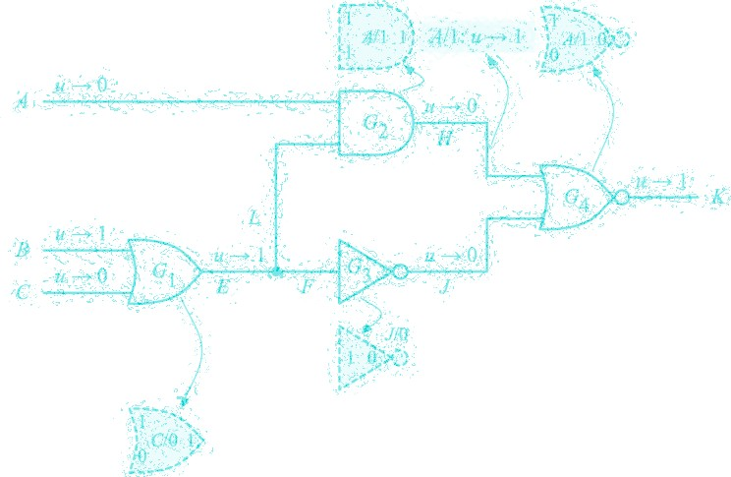
Fault Simulation
Introduction
Fault simulation techniques
  Serial fault simulation
  Parallel fault simulation (1965)
  PPSFP (1985)
  Deductive fault simulation (1972)

Slide 9
Serial Fault Simulation
Simple Idea: Run a fault-free logic simulation, store good outputs
  For every fault
 Modify good circuit (fault injection) to obtain a faulty circuit
 Run logic simulation on faulty circuit
 Compare faulty outputs with stored good outputs
− fault is detected if they are different
Advantages
  Easy to implement (regular logic simulator).
  Ability to simulate many fault models (stuck-at, delay, …)
Disadvantage
  Long CPU time

Slide 10
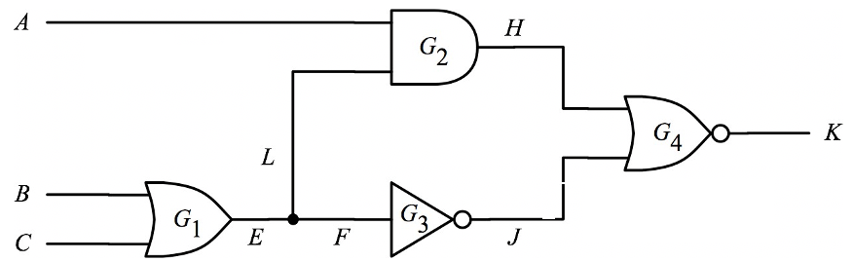
Quiz
fault | Det. by
A/1 | P₁
A/0 | -
B/1
B/0
C/1
C/0
E/1
E/0
F/1
F/0
H/1
H/0
J/1
J/0
K/1
K/0
L/1
L/0
Q: Apply 3 test patterns: P₁, P₂, P₃: {0,1,0} {0,0,1}
{1,0,0}. Please use serial fault simulation to determine fault coverage ? Consider all 18 faults.
A:
-
P₁
- P₂
- P₁
P₃ P₁ P₁
- P₁
P₃ P₃ P₁
-
-
Pat. | Input |  |  | Internal |  |  |  |  | Good Output
 | A | B | C | E | F | L | J | H | K
P₁ | 0 | 1 | 0 | 1 | 1 | 1 | 0 | 0 | 1
P₂ | 0 | 0 | 1 | 1 | 1 | 1 | 0 | 0 | 1
P₃ | 1 | 0 | 0 | 0 | 0 | 0 | 1 | 0 | 0
Notes:
Fault coverage 11/ 18
Slow process

Slide 11
Quiz
fault | Det. by
A/1 | P₁
A/0 | -
B/1
B/0
C/1
C/0
E/1
E/0
F/1
F/0
H/1
H/0
J/1
J/0
K/1
K/0
L/1
L/0
Q: Apply 3 test patterns: P₁, P₂, P₃: {0,1,0} {0,0,1}
{1,0,0}. Please use serial fault simulation to determine fault coverage ? Consider all 18 faults.
A:
-
P₁
- P₂
- P₁
P₃ P₁ P₁
- P₁
P₃ P₃ P₁
-
-
Pat. | Input |  |  | Internal |  |  |  |  | Output
 | A | B | C | E | F | L | J | H | K
P₁ | 0 | 1 | 0 | 1 | 1 | 1 | 0 | 0 | 1
P₂ | 0 | 0 | 1 | 1 | 1 | 1 | 0 | 0 | 1
P₃ | 1 | 0 | 0 | 0 | 0 | 0 | 1 | 0 | 0
Notes:
Fault coverage 11/ 18
Slow process

Slide 12
Complexity of Fault Simulation
Fault Simulation Complexity O(FxPxG)
  F: number of faults
  P: number of test patterns
  G: number of gates
Comparison
Logic simulation: O(G x P)
  ATPG: O(G x 2^{number_of_PI} x F)
ATPG > Fault Sim > Logic Sim
12

Slide 13
Fault Simulation
Introduction
Fault simulation techniques
  Serial fault simulation
  Parallel fault simulation (1965)
  PPSFP (1985) (parallel pattern)
  Deductive fault simulation (1972)
13

Slide 14
Two Types of Parallelism
Exploit parallelism of logic instructions (bit-wise operations)
  1. Parallelism in faults
 Parallel Fault Simulation [Seshu 65]
  2. Parallelism in patterns
 Parallel Pattern Single Fault Propagation, PPSFP
[Wacukauski 85]
14

Slide 15
Parallel Fault Simulation
[Seshu 65]
Run parallel logic simulation with W-1 faults (W determined by platform)
  one bit for fault-free circuit
  W-1 bits for faulty circuits assuming one fault in each circuit
(W-1) times faster than serial fault simulation (w/o fault dropping)
W bits
G | f₁ | f₂
…
fw-1
15

Slide 16
Example
Assume W=3
Fault free
Circuit with only fault a
Circuit with only fault b
fault a detected
fault b not detected
1 | 1 | 1
1 | 1 | 1
1 | 0 | 1
1
0
1
1 | 0 | 1
a sa0
0
0
1
1
1
1
b sa1
16

Slide 17
Fault Injection
Fault Injection = inserting fault(s) into circuit
Inserting a single fault is shown below
Control inputs of each fault should be set to activate it at the corresponding bit
a sa0
Non-faulty case
1 | 0 | 1
Control input
0 = SA0 fault injected
Quiz: how to insert SA1 fault? A:
17
VLSI Test 5.

Slide 18
Fault Injection
How would it work to parallel simulate for multiple single stuck-at fault, assuming one SSF present at a time?
  Modify circuit by injecting all the fault s
  The size of each control input is k for k-1 injected faults (k-1 fault value + 1 fault free value)
  Parallel simulate (at each gate) based on the k-bit vector of each of its fanins
18

Slide 19
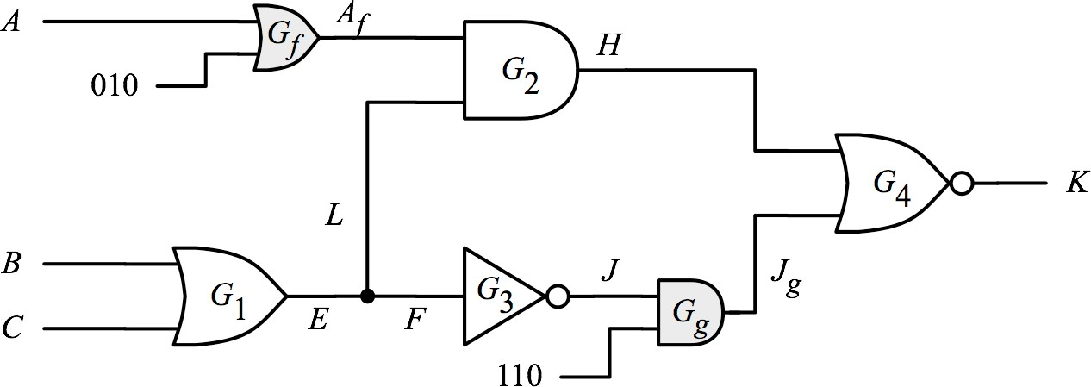
Quiz
A=SA1
Non-faulty
(non-controlling value)
J=SA0 (non-controlling value)
Q: Consider two faults: (A=SA1 , J=SA0). Use
parallel fault simulation on patterns
P₁= {010},
P₂= {001},
P₃= {100}.
A:
Circuit is drawn after fault injection (injected faults are shown in grey)
19
Notes:
Circuit is modified to inject two faults (A SA1 and J SA0) show in grey

Slide 20
Solution
0 | 0 | 0
0 | 1 | 0
0 | 1 | 0
P₁
1 0 1
Q: Consider two faults: (A=SA1 , J=SA0). Use
parallel fault simulation on patterns
P₁= {010},
P₂= {001},
P₃= {100}.
A:
P₁ P₂ detect f P₃ detects g
1 | 1 | 1
1 1 1
0 0 0
0 0 0
0 | 0 | 0
0 | 1 | 0
0 | 1 | 0
P₂
1 0 1
0 | 0 | 0
1 1 1
1 1 1
0 0 0
1 | 1 | 1
1 | 1 | 1
0 | 0 | 0
P₃
0 0 1
0 | 0 | 0
20
1 1 0
0 0 0
0 0 0

Slide 21
Fault Simulation
Introduction
Fault simulation techniques
  Serial fault simulation
  Parallel fault simulation (1965)
  PPSFP (1985) (parallel pattern)
  Deductive fault simulation (1972)
21

Slide 22
PPSFP: Parallel Pattern Single Fault Propagation
Procedure
  Step 0: run logic simulation, store good output O_{g}
  Step 1: Inject f₁ by creating an event at the fault site
  Step 2: Perform event-driven simulation, get output O_{f1}
 Compare O_{g} and O_{f1}
  Step 3. Create an event to undo fault effect of f₁
 Inject an event for next fault f₂
  Repeat step 2~3 until all faults simulated
W test patterns
Fault-free circuit
Out response O_{g}
W test patterns
W test patterns
f
X
f₁ X
2
f
’
1
Out response O_{f1}
Out response O_{f2}
22

Slide 23
PPSFP Example
Assume W=3
Fault-free circuit
  Fault-free output 111 stored
Pattern 1
Pattern 2
1 | 1 | 1
Pattern 3
1 | 0 | 1
1 | 0 | 0
1 | 0 | 0
1 | 1 | 1
0 | 1 | 1
1 | 0 | 0

Slide 24
Example- cont’d
One event created to inject fault a
  fault effects are then propagated
Good =
1 | 1 | 1
1 | 0 | 1
Fault a detected by P₁
0 | 0 | 0
0 | 0 | 0
0 | 1 | 1
no event
a sa0
0 | 1 | 1
1 | 0 | 0

Slide 25
Example – cont’d
Two events created:
  One event to restore fault a
  One event to inject fault b
Good =
1 | 1 | 1
1 | 0 | 1
Fault b not detected
1 | 0 | 0
Fault a restored
1 | 0 | 0
1 | 1 | 1
o
1 | 1 | 1
1 | 0 | 0
b sa1

Slide 26

Quiz
Q: Consider two faults: (f=SA1 , g=SA0). Use
PPSFP on patterns
P₁= {010},
P₂= {001},
P₃= {100}.
A:

Slide 27
Solution
0 | 0 | 1
0 | 0 | 1
0 | 0 | 0
Good
1 1 0
Q: Consider two faults: (f=SA1 , g=SA0). Use
PPSFP on patterns
P₁= {010},
P₂= {001},
P₃= {100}.
A:
P₁ P₂ detect f P₃ detects g
1 0 0
0 | 1 | 0
1 | 1 | 0
0 | 0 | 1
1 | 1 | 1
1 | 1 | 0
f
0 0 0
0 | 0 | 1
0 | 0 | 0
g
1 1 1
27
₀. ₀
2 ©
0
N

Slide 28






Comparison
Serial fault simulation: one fault, one pattern
Parallel fault simulation: multiple faults, one pattern
PPSFP: multiple patterns, one fault
 | P₁ | P₂ | P₃ | …
f₁
f₂
f₃
…
 | P₁ |  |  | P₂ |  |  | P₃ |  |  | …
f₁
f₂ |  | W-1 |  |  | W-1 |  |  | W-1
f₃
…
 | P₁ |  | P₂ | P₃ | …
f₁
 |  | W
f₂
 |  | W
f₃
 |  | W
…

Slide 29
Summary
Parallel fault simulation (parallel in fault)
  Run parallel logic simulation for W-1 faults
  Fault injection by circuit modification
Parallel Pattern Single fault Propagation (parallel in pattern)
  Run parallel logic simulation for W patterns

Slide 30
Fault Simulation
Introduction
Fault simulation techniques
  Serial fault simulation
  Parallel fault simulation (1965)
  PPSFP (1985)
  Deductive fault simulation (1972)

Slide 31
Deductive Fault Simulation
Procedure to apply one test pattern (P) at a time but consider a set of single-stuck-at faults (SSFs) in one shot
SSFs are given, e.g., for each line a stuck at fault opposite to its simulation value from P is assumed
For P, first perform a fault-free simulation
Gates are visited from PI to PO to create a "fault list" at (output of) each gate
  Fault list of a gate represents the set of all SSFs that are detected at the gate by P
  Creating the fault list of gate depends on the gate type, its input pin values (based on P), and fault lists at each of its input pins
The fault list at PO represents all faults that are detected by P
Uses logic deduction instead of simulation

Slide 32
Deductive Fault Simulation
a = 0 L_{a} = {a/1}
b = 1 L_{b} = {b/0}
d = 0
L_{d} = {a/1, c/1 , d/1}
c = 0
L_{c} = {a/1, c/1}
e = 0
L_{e} = {a/1, c/1 , e/1}
Pattern is ab=[01]
Assume SSFs: a/1, b/0, c/1, d/1, e/1
Detected faults are those in the fault lists of the POs
Eliminates per fault simulation

Slide 33
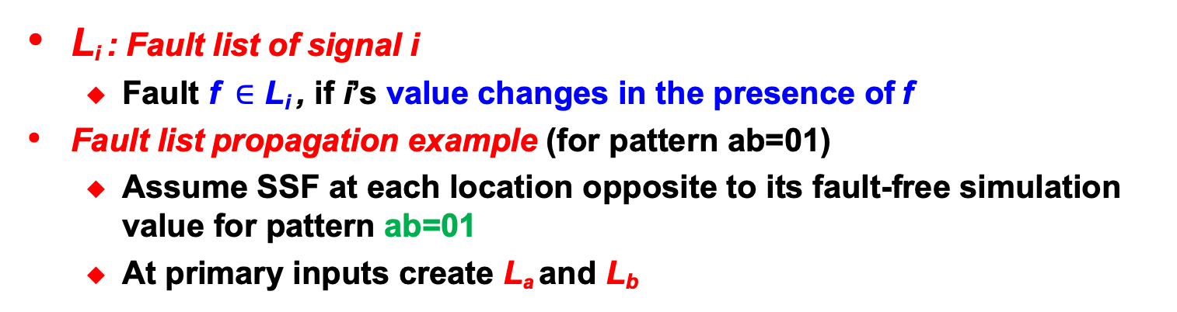
Deductive Fault Simulation [Armstrong 72]
L_{i} : Fault list of signal i
  Fault f$∈$ L_{i} , if i’s value changes in the presence of f
Fault list propagation example (for pattern ab=01)
  Assume SSF at each location opposite to its fault-free simulation value for pattern ab=01
  At primary inputs create L_{a} and L_{b}
a = 0
L_{a} = {a/1}
b = 1
L_{b} = {b/0}
d = 0
c = 0
e = 0
33

Slide 34
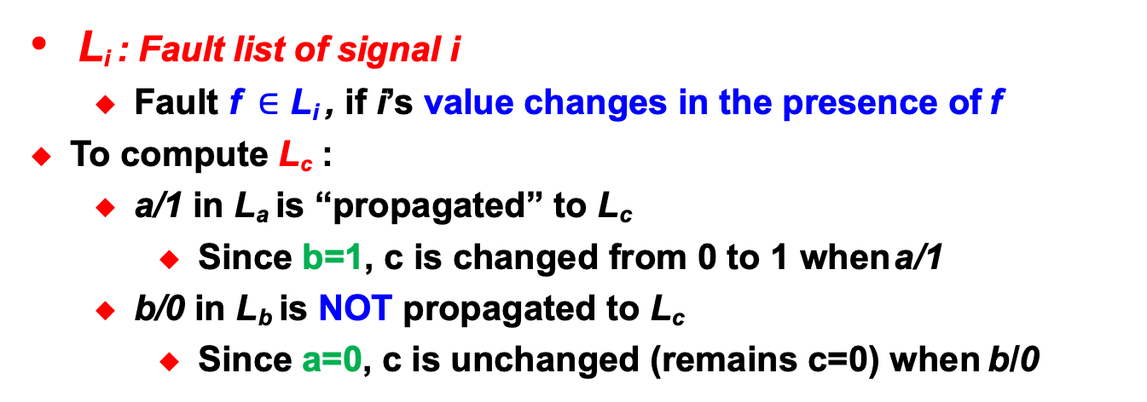
Deductive Fault Simulation [Armstrong 72]
L_{i} : Fault list of signal i
  Fault f$∈$ L_{i} , if i’s value changes in the presence of f
To compute L_{c} :
  a/1 in L_{a} is “propagated” to L_{c}
    Since b=1, c is changed from 0 to 1 when a/1
  b/0 in L_{b} is NOT propagated to L_{c}
    Since a=0, c is unchanged (remains c=0) when b/0
a = 0
L_{a} = {a/1}
b = 1
L_{b} = {b/0}
d = 0
c = 0
L_{c} = {a/1, c/1}
e = 0
34

Slide 35
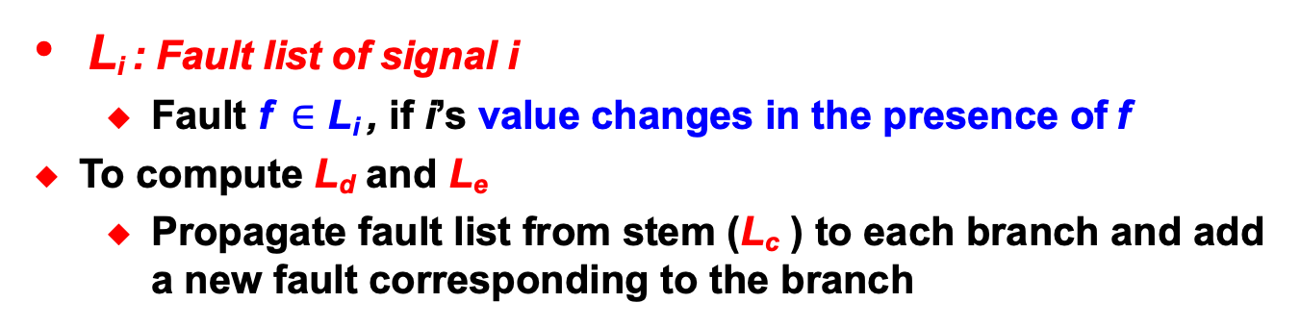
Deductive Fault Simulation [Armstrong 72]
L_{i} : Fault list of signal i
  Fault f$∈$ L_{i} , if i’s value changes in the presence of f
To compute L_{d} and L_{e}
  Propagate fault list from stem (L_{c} ) to each branch and add a new fault corresponding to the branch
a = 0
L_{a} = {a/1}
b = 1
L_{b} = {b/0}
d = 0
L_{d} = {a/1, c/1 , d/1}
c = 0
L_{c} = {a/1, c/1}
e = 0
L_{e} = {a/1, c/1 , e/1}
35

Slide 36
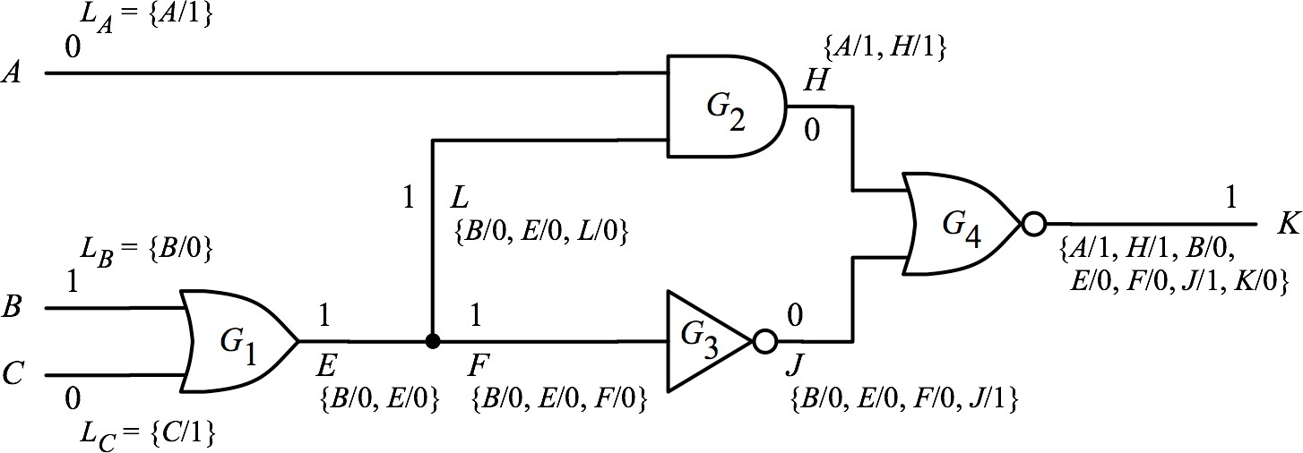
Example (P₁)
Assume 18 uncollapsed faults for pattern P1 : ABC=010
  From the 18 faults, only SSFs which are opposite of pattern value at each line are relevant (rest cannot be detected by P1) : for example, for A=0 only A/1 is relevant and A/0 cannot be detected
(WWW Fig 3.26)
7 faults are detected by P₁ ={010}
  Detected faults are dropped
  18-7=11 faults remains

Slide 37
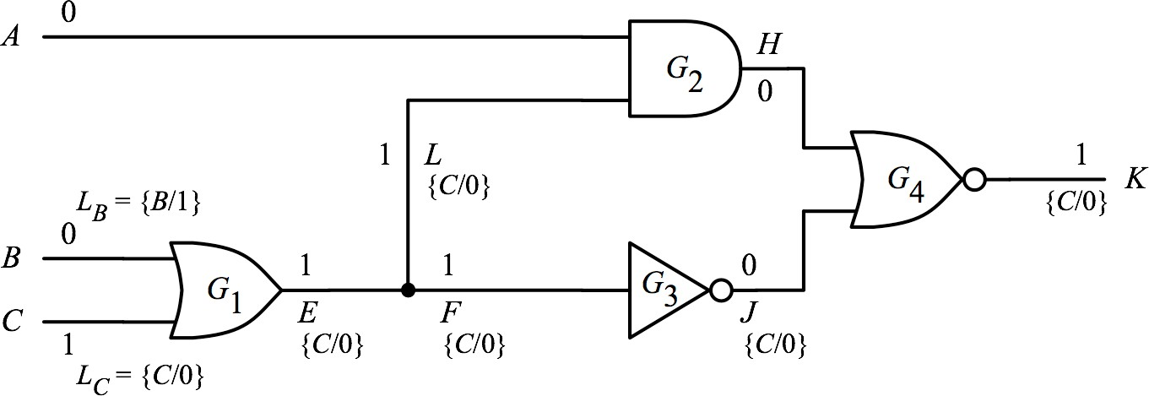
Example (P₂)
Detected by P₁: {A/1, H/1, B/0, E/0, F/0, J/1, K/0}, P2: ABC = 001
One more fault is detected by P₂ = {001}
  Q: why no A/1?
  Answer: it was detected by P₁ so it is dropped
11-1=10 faults remains
{C/0, L/0}

Slide 38
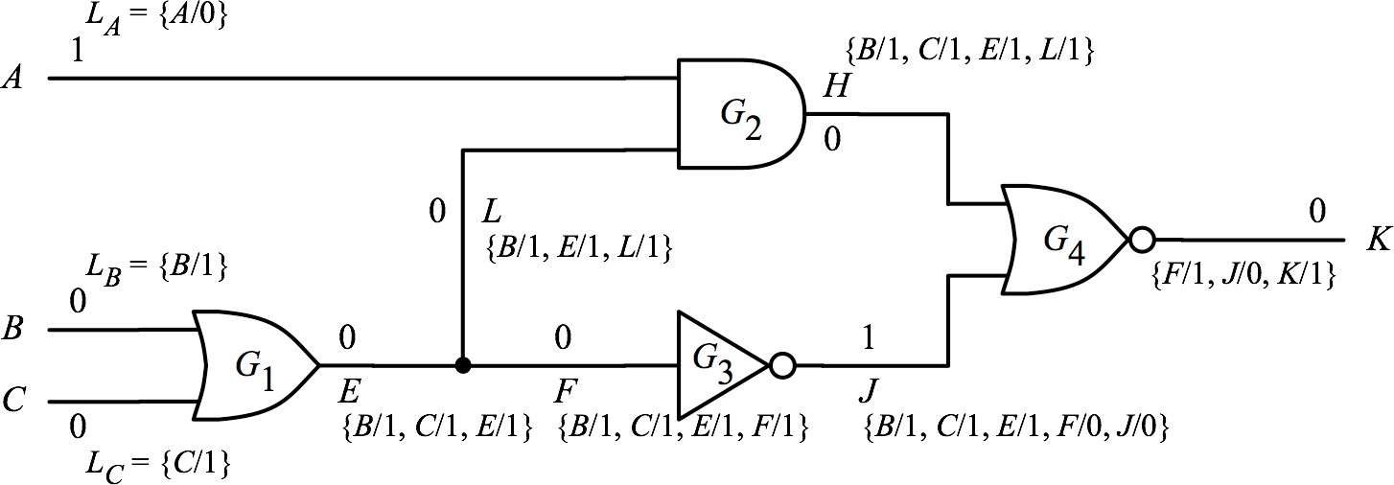
Example (P₃)
Detected so far: {A/1, H/1, B/0, E/0, F/0, J/1, K/0, C/0}, P3: ABC = 100
{B/1, C/1, E/1, L/1}
F/1
To determine L_{K}, visit each fault in each of the two fault lists:
  For a given fault such as B/1 in L_{H}
    B/1 in L_{H} → H changes from 0 to 1 in presence of B/1
    B/1 in L_{J} → J changes from 1 to 0 in presence of B/1
    H=1 and J=1 --> K=0 (due to B/1) which is same as K=0 (fault-free case) → B/1 does not propagate to L_{K}
38

Slide 39
Example (P₃)
Detected so far: {A/1, H/1, B/0, E/0, F/0, J/1, K/0, C/0}, P3: ABC = 100
{B/1, C/1, E/1, L/1}
F/1
To determine L_{K}, visit each fault in each of the two fault lists:
  For another fault such as F/1 in L_{J}
    F/1 is not in L_{H} → H remains 0 (non-controlling)
    F/1 is not in L_{J} → J changes from 1 to 0
    H=0, J=0 → K=1 (for F/1) which is different than K=0 (fault-free case) → F/1 propagates to L_{K}
39

Slide 40
Example (P₃)
Detected so far: {A/1, H/1, B/0, E/0, F/0, J/1, K/0, C/0}, P3: ABC = 100
Three more faults are detected by P₃ = {100}
10-3=7 faults remains undetected
{B/1, C/1, E/1, L/1}
F/1
(WWW Fig 3.28)
Fault Coverage = 11/18 = 61%
40

Slide 41
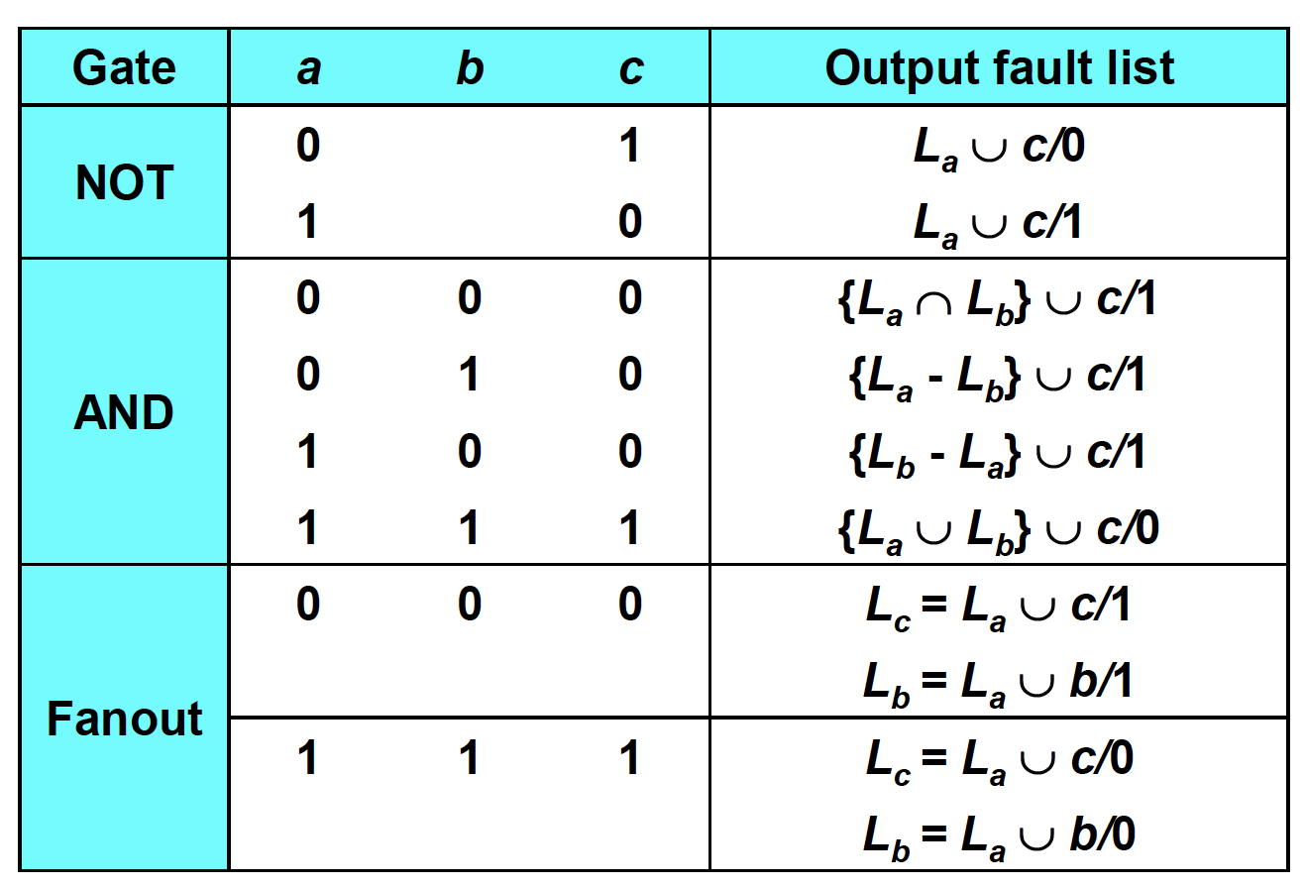


Fault List Propagation Rules
(no need to know)
a
c
a b
c
b
a
c
∩ = set intersection; ∪= set union ; A-B = remove (A∩B) from A
Notes:
Example: a=0 b=0 in AND → output fault list includes all faults that set a=1 (La) AND b=1 (Lb) at the same time (so intersection)
Example: a=0 b=1 in AND gate
Output fault list includes all faults that set a=1 (La) which are not setting b=0 (-Lb) .
Example: a=1 b=1 → output fault list includes all faults that set a=0 (La) AND/OR b=0 (Lb) (so union)

Slide 42
Summary
Idea: Use logic deduction instead of simulation
Advantages
  No loop of faults
Disadvantages
① Problem with calculating fault propagation lists
 Very complicated rules depending on situation
② Difficult memory management
 Memory requirement not predictable
 Many ∩ ∪ operations difficult for large designs
42

Slide 43
References
[Abramovici 1984] M. Abramovici, P. R. Menon, and D. T. Miller, “Critical Path Tracing: An Alternative to Fault Simulation,” IEEE Design and Test of Computers, 1984.
[Armstrong 1972] D. B. Armstrong, A deductive method for simulating faults in logic circuits, IEEE Trans. Comput., C-21(5), 464–471, 1972.
[Butler 1974] T. T. Butler, T. G. Hallin, J. J. Kulzer, and K. W. Johnson, LAMP: Application to switching system development, Bell System Tech. J., 53, 1535–1555, 1974.
[Cheng 1989] W. T. Cheng and M. L. Yu, Differential fault simulation: A fast method using minimal memory, in Proc. Des. Automat. Conf., June 1989, pp. 424–428.
[Jain 1985] S. K. Jain and V. D. Agrawal, Statistical fault analysis, IEEE Des. Test Comput., 2(1), 38–44, 1985.
[Seshu 1965] S. Sesuh and D. N. Freeman, On improved diagnosis program, IEEE Trans. Electron. Comput., EC-14(1), 76–79, 1965.
[Ulrich 1974] E. G. Ulrich and T. Baker, Concurrent simulation of nearly identical
digital networks, IEEE Trans. Comput., 7(4), 39–44, 1974.
[Waicukauski 1985] J. A. Waicukauski, E. B. Eichelberger, D. O. Forlenza, E. Lindbloom, and T. McCarthy, Fault simulation for structured VLSI, Proc. VLSI Syst. Des., 6(12), 20–32, 1985.
43

