Slide 1
ECE 553: TESTING AND TESTABLE DESIGN OF DIGITAL SYSTEMS
Testability Measures

Slide 2
Course Roadmap (EDA Topics)
Logic Sim. Fault Modeling
Fault Simulation
Testability
Comb. ATPG
Diagnosis
Seq. ATPG
Delay Test
2

Slide 3
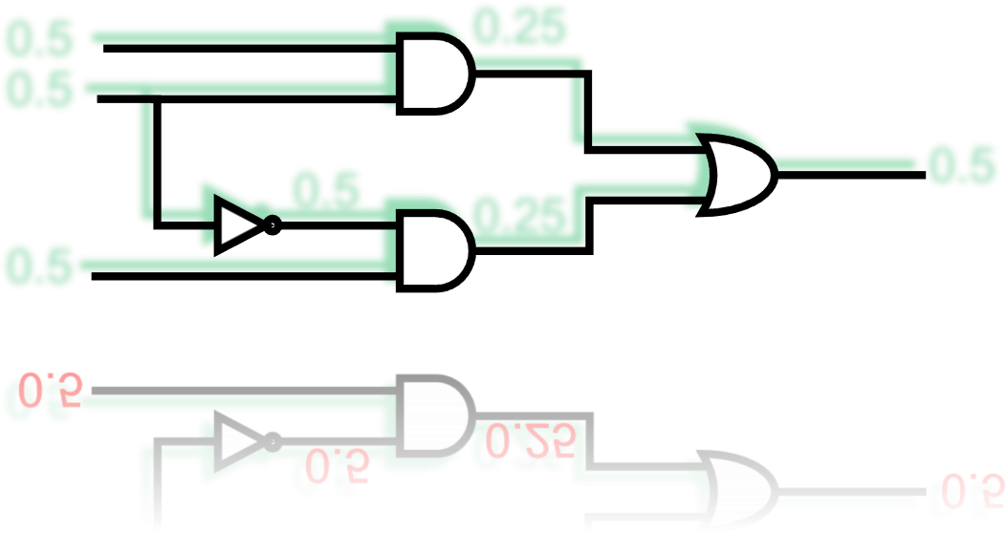
Testability Measure
Introduction
SCOAP (1979)
COP (1984)
0.5
0.5
0.25
0.5
0.5
0.25
0.5
3

Slide 4
Testability Measures
What is testability measure?
  Metric to measure degree of difficulty to test a circuit
Two important components:
  Controllability
 degree of difficulty to control a logic signal to 0 or 1
  Observability
 degree of difficulty to observe the logic value of a signal
Testability Measures Controllability and Observability
4

Slide 5
Testability Analysis
What is Testability Analysis?
  Calculate testability measures for a given circuit
Why testability analysis?
  1. Help ATPG make smart decision
  2. Insert DFT circuits to improve controllability and observability
When testability analysis?
  In preprocess stage of ATPG or DFT insertion
Requirements of testability analysis
  Should run very fast
  Sometimes, accuracy is not very important
5

Slide 6
Categories of Testability Analysis
1. Topology-based analysis
  Only analyzes structure of circuit. No test vectors are given.
  Example: SCOAP
2. Probability-based analysis
  Uses signal probability to estimate the testability. No test vectors are given but probability is specified for each PI.
  Example: COP
3. High-level analysis
  Performs testability analysis before synthesis
  Example: RTL testability analysis
6

Slide 7
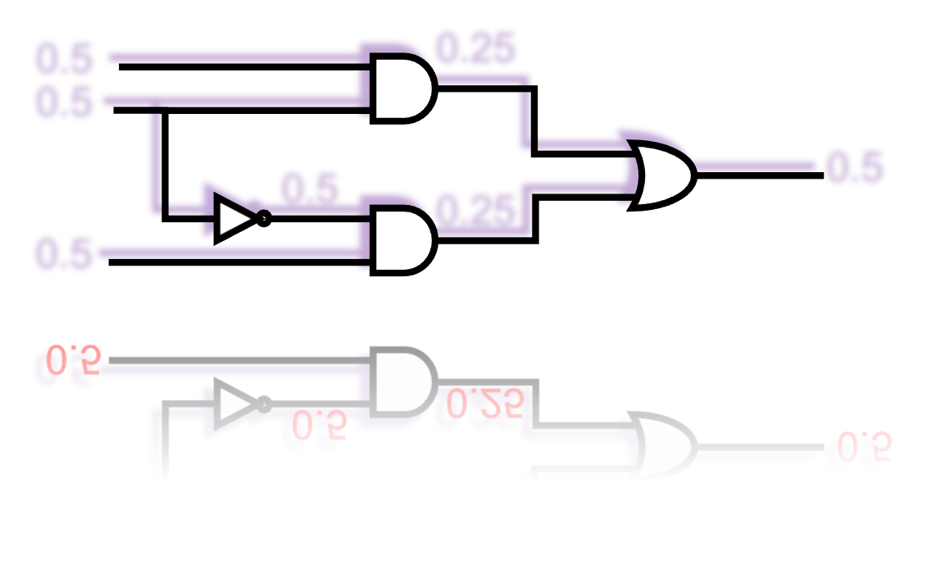
Testability Measure
Introduction
SCOAP (1979)
  Combinational
  Sequential
COP (1984)
0.5
0.5
0.25
0.5
0.5
0.25
0.5
7

Slide 8
SCOAP
[Goldstein 1979]
Sandia Controllability Observability Analysis Program*
SCOAP computes 6 numbers for each node N (i.e., node is output pin of a gate or a primary input)
*Sandia is name of research lab.
 | 0-controllability | 1-controllability | Observability
Combinational | CC⁰(N) | CC¹(N) | CO(N)
Sequential | SC⁰(N) | SC¹(N) | SO(N)

Slide 9
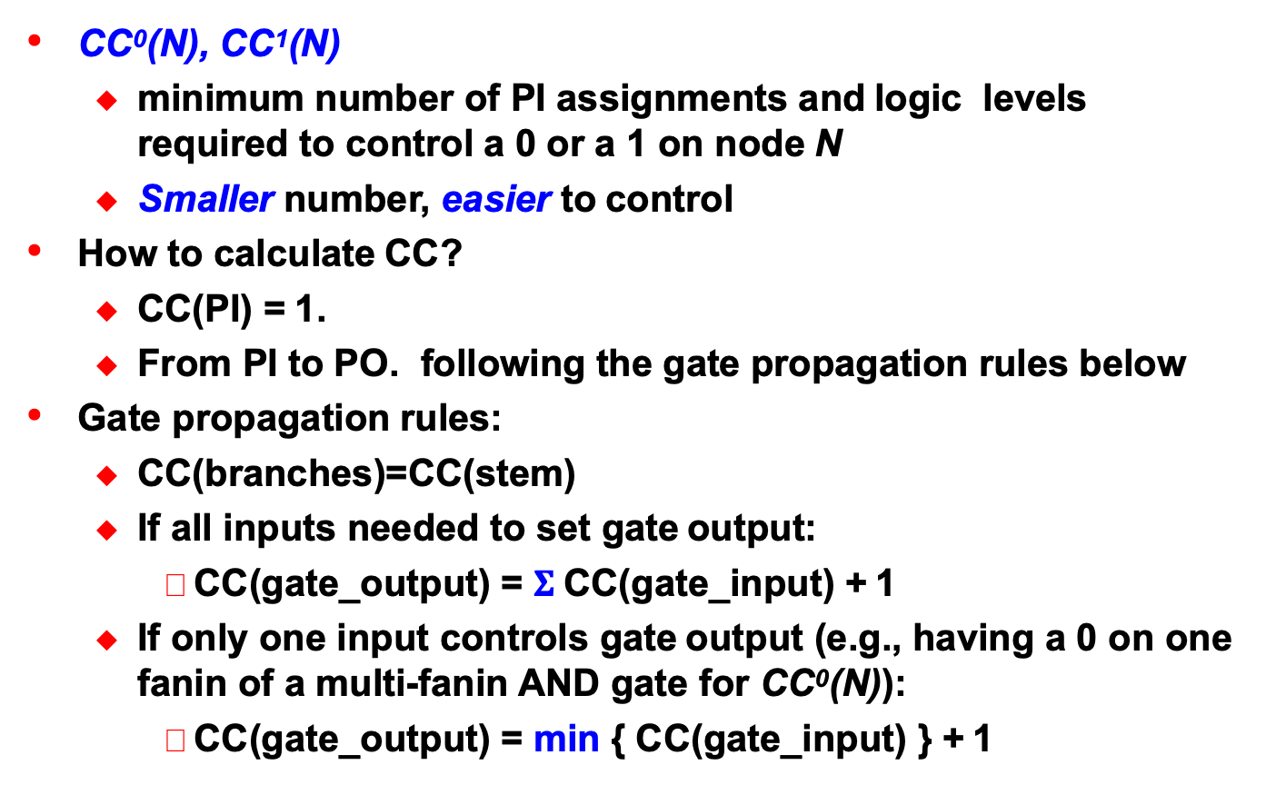
Combinational Controllability
CC⁰(N), CC¹(N)
  minimum number of PI assignments and logic levels required to control a 0 or a 1 on node N
  Smaller number, easier to control
How to calculate CC?
  CC(PI) = 1.
  From PI to PO. following the gate propagation rules below
Gate propagation rules:
  CC(branches)=CC(stem)
  If all inputs needed to set gate output:
 CC(gate_output) = $Σ$CC(gate_input) + 1
  If only one input controls gate output (e.g., having a 0 on one fanin of a multi-fanin AND gate for CC⁰(N)):
 CC(gate_output) = min { CC(gate_input) } + 1

Slide 10
CC⁰(N) & CC¹(N)
 |  |  |  | CC⁰(y) | CC¹(y)
Primary inputs |  |  |  | 1 | 1
 | x₁ x₂ |  | y | min[CC⁰(x₁),CC⁰(x₂)] + 1 | CC¹(x₁) + CC¹(x₂) + 1
 | x₁ x₂ |  | y | CC⁰(x₁) + CC⁰(x₂) + 1 | min[CC¹(x₁),CC¹(x₂)] + 1
 | x₁ x₂ |  | y | min[CC⁰(x₁) + CC⁰(x₂), CC¹(x₁) + CC¹(x₂)] + 1 | min[CC⁰(x₁) + CC¹(x₂), CC¹(x₁) + CC⁰(x₂)] + 1
 | x |  | y | CC¹(x) + 1 | CC⁰(x) + 1
x |  | y₁ y₂ |  | CC⁰(y₁) = CC⁰(y₂)= CC⁰(x) | CC¹(y₁) = CC¹(y₂)= CC¹(x)

Slide 11
An Example – Controllability
Forward: From PI to PO
CC⁰/CC¹
(BA Fig. 6.5)
1/1
2/6
a
4
1/1
3/5
1/1
b
5/7
6
x
1/1
1/1
2/7
2/2
5
y
1
2/7
3/5
3
z
1/1
2/2
3/5
3/5
c
2

Slide 12
Quiz
Q: how to control y to 0? How to control y to 1?
CC⁰/CC¹
1/1
1/1
2/6
a
4
1/1
3/5
1/1
b
5/7
6
x
1/1
2/7
1/1
2/7
2/2
5
y
1
2/7
3/5
3
z
1/1
2/2
3/5
3/5
c
2
Notes:
CC0 = 2 for y. This is by setting bh=0 and going through gate # 5. So 1 PI + 1 gate = 2 to compute CC0.
CC1=7 for y. It is obtained by a=0, b=1, c=0, going through gates # 1, #2, #3, #5 which gives 7 (3 PIs + 4 gates). The assignment was calculated by following the path on how CC1 was computed.

Slide 13
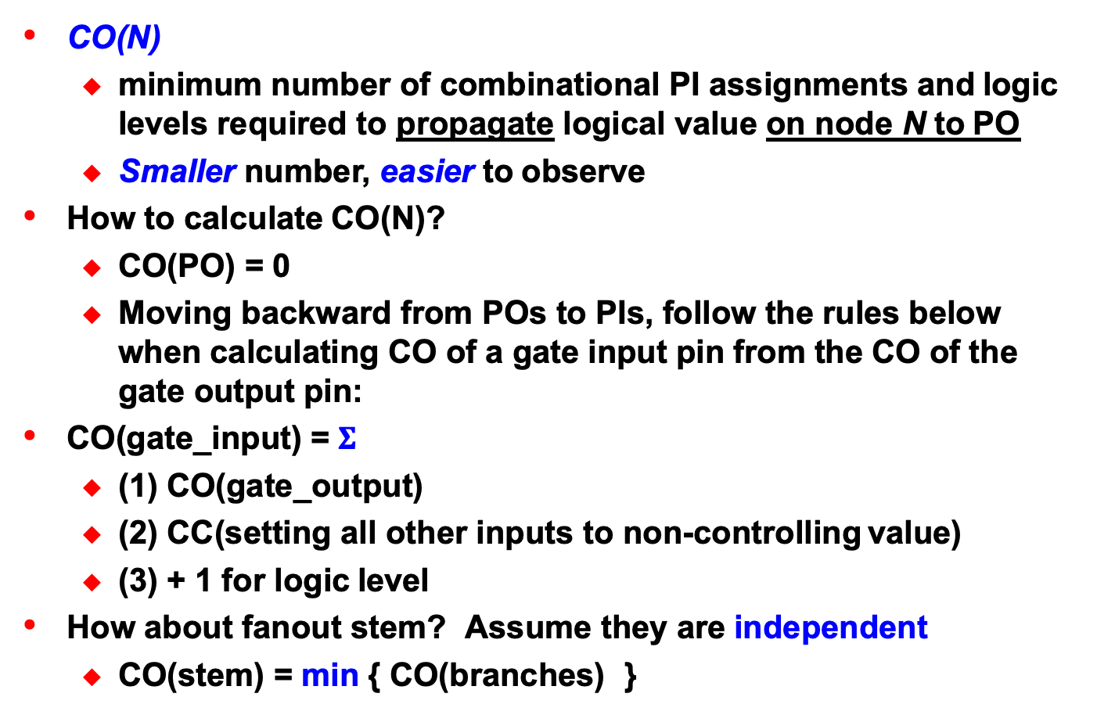
Combinational Observability
CO(N)
  minimum number of combinational PI assignments and logic levels required to propagate logical value on node N to PO
  Smaller number, easier to observe
How to calculate CO(N)?
  CO(PO) = 0
  Moving backward from POs to PIs, follow the rules below when calculating CO of a gate input pin from the CO of the gate output pin:
CO(gate_input) = $Σ$
  (1) CO(gate_output)
  (2) CC(setting all other inputs to non-controlling value)
  (3) + 1 for logic level
How about fanout stem? Assume they are independent
  CO(stem) = min { CO(branches) }

Slide 14
CO(N)
 |  | CO(x₁)
Primary outputs |  | 0
x₁ x₂ | y | CO(y) + CC¹(x₂) + 1
x₁ x₂ | y | CO(y) + CC⁰(x₂) + 1
x₁ x₂ | y | CO(y) + min[CC⁰(x₂) ,CC¹(x₂)] + 1
x₁ | y | CO(y) + 1
x₁ | y₁ y₂ | min[CO(y₁),CO(y₂)]

Slide 15
An Example – Observability
Backward: From PO to PI
CC0/CC1
8
1/1
1/1
a
4
2/6
4
1/1
8
3/5
3
6
6
b
1/1
5/7
6
x
4
2/7
0
1/1
3
6
2/7
1/1
0
2/2
2
5
y
1
0
2/7
0
3
0
3/5
2/2
3
z
c
3/5
3/5
1/1
3
2
4

Slide 16
Summary
Introduction
  Metric to measure degree of difficulty to test a circuit
  Helps 1. ATPG 2. DFT
SCOAP: Combinational
  CC⁰, CC¹, CO
0.5
0.5
0.25
0.5
0.5
0.25
0.5

