Slide 1
Going Viral: The Impact of County Health Department Social Media Accounts on COVID-19 Outcomes
Alexander Adams
PPOL683
December 6, 2021

Slide 2
Introduction
Major issues during COVID-19:
Lack of trust in institutions
Politicization of public health
Lack of clear communication on necessary steps
Lack of specificity to local contexts/community needs

Slide 3
Introduction
Original Project Intent:
Scrape tweets from major public health officials/departments/influencers
Perform text analysis
Report variation in text across spatial units
(and potentially over the course of the pandemic)

Slide 4
Introduction
3 major issues with this design:
1: Most county public health departments do not have twitter accounts!
2: No organized data set of accounts
3: Lots of uniformity in public health messaging at the local level

Slide 5
Introduction
Refocus project aims:
Does a county public health department even have a Twitter account (or Facebook account)?
Why? Potential proxy for:
Community engagement
Level of resources available
Also a vector of info transmission but not traditional media

Slide 6
Literature Review
53% of U.S. adults get at least some news from social media (Pew Research Center, 2020)
18-29 year olds in the U.S. prefer social media for news over other digital options.
Trust in local government is 20 points higher than trust in federal government (Kettl, 2020)
Users trust public health messaging more when it comes from organizations rather than individuals (Freberg, 2012)
Local government social media can be highly fragmented across different departments, allowing for greater flexibility and individual response (Zeemering, 2021)
Strongest overall predictor of COVID-19 outcomes is partisanship
Counties where Trump did better in 2020 had higher case rates/death rates starting in summer 2020 (Morris, 2020)
Study of geotracking data from cellphones (n = 15M) found counties where Hillary Clinton did better in 2016 had 14% more social distancing during March-May 2020 (Gollwitzer et al., 2020)
Not going to focus on or address this further during this presentation

Slide 7
Theory
CPHDs are closer to daily life than state or federal departments
Public health messengers (e.g. Anthony Fauci, Rochelle Walensky) could be polarized/polarizing
Local messengers could have stronger ties to the local community
Increased trust in local public health guidance
Social media = increasingly effective at reaching large numbers of people
Esp. younger people
Also increasingly a dominant source of/vector for information
Viable communication channel on par with TV/Newspapers

Slide 8
Question
Do counties in the United States whose CPHDs have Facebook or Twitter accounts have different COVID-19 outcomes than counties whose CPHDs do not have such accounts?

Slide 9
Hypothesis
Counties where the CPHD has Facebook or Twitter accounts will have better COVID-19 outcomes than counties where the CPHD does not have Facebook or Twitter accounts.

Slide 10
Prediction
If this hypothesis is correct, then counties with CPHD social media accounts should have lower rates of COVID-19 cases and deaths and higher rates of vaccination than those without CPHD social media accounts.

Slide 11
Test
Current Test: OLS Linear Regression
Future Implementation: Examination of Spatial Autocorrelation

Slide 12
Methods
Data on public health department social media accounts does not exist
Solution: manual collection
For Twitter:
Record binary variable (1/0 present/not present)
Record Twitter handle
For Facebook:
Record binary variable (1/0 present/not present)
Some departments are grouped into multi-county districts

Slide 13
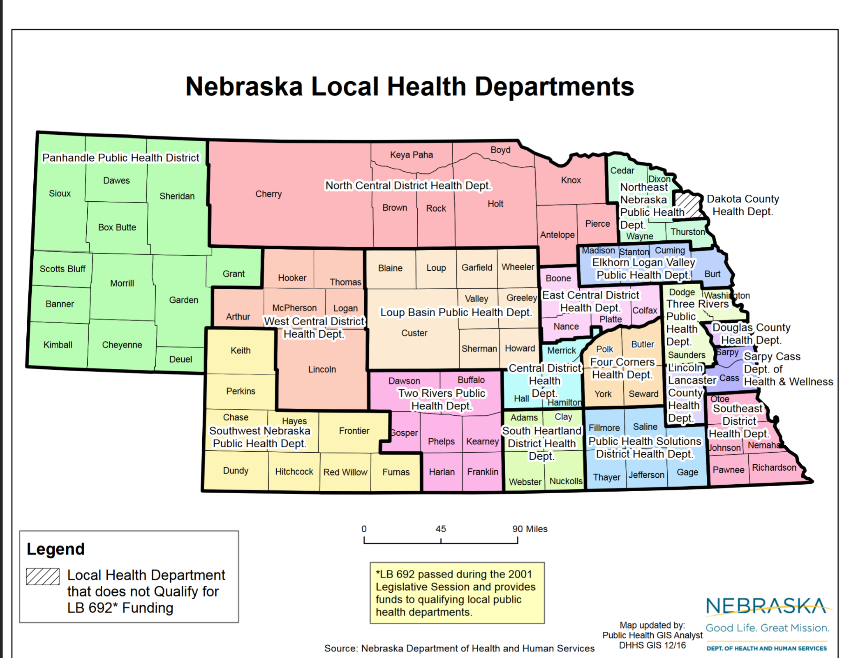

Slide 14
Methods
Use `twint` library for Python to scrape all gathered Twitter handles
For each handle, scrape most recent tweet
Use date of tweet to create two binary variables
twitter_active_COVID
1/0, active after 2020-03-10
twitter_active_last60
1/0, active within last 60 days

Slide 15
Data
Observations are at the county/county-equivalent level
3,143 counties in the 50 U.S. states + D.C.
Variables include:
Presence of CPHD Facebook/Twitter
Population
COVID-19 Cases/Deaths adjusted for population
% Population which completed COVID-19 vaccination sequence
% Population Received >=1 COVID-19 vaccination dose
Racial makeup of each county

Slide 16
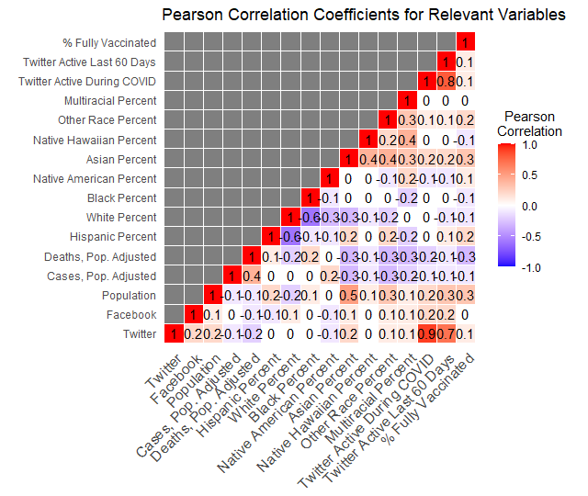
Results

Slide 17
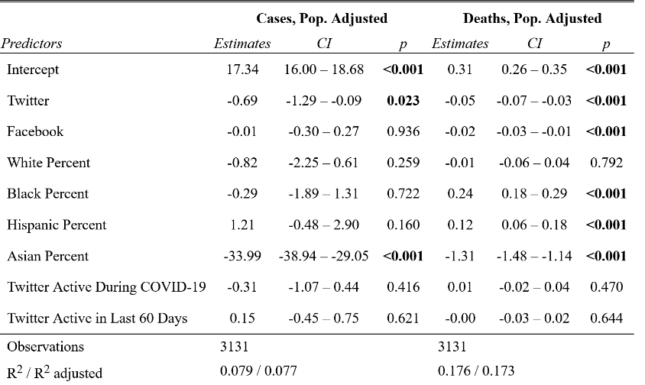
Regression Output (All units are percents)

Slide 18
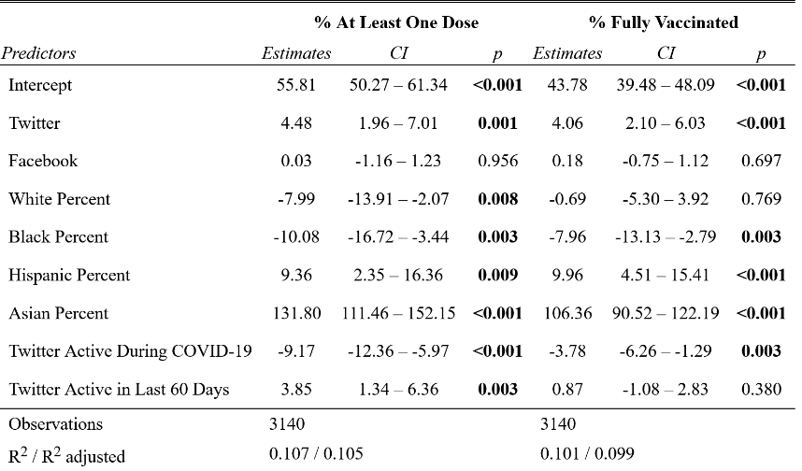
Regression Output (All units are percents)

Slide 19
Results
Across three most important COVID-19 metrics:
Cases
Deaths
Vaccination Rates
Facebook: Estimated effect not statistically significant or substantively significant
Twitter: Estimated effect is statistically significant, potentially substantively significant

Slide 20
Results
For all dependent variables:
R² <= 0.18
Other unexplored factors explain significant parts of variance
Most significant effects are for vaccination
All else ==, CPHD having a Twitter account (regardless of activity) associated w/ 4-4.5% increase in vaxxed % of county population
Why?

Slide 21
Discussion
Impact of local government social media on public health is likely small
# of counties with:
Facebook: 2,100
Twitter: 871
Potential drawbacks of health department social media:
County communications can be fragmented
Other accounts (general gov’t account, mayor’s accounts, etc) might have more followers

Slide 22
Discussion
Weird effect estimate for “Twitter Active During COVID-19”
Sign is negative for vaccinations
CPHD twitter accounts which have been active since COVID-19 was declared a pandemic are associated with a decrease in vaccination rates?

Slide 23
Conclusions
CPHDs having Facebook accounts does not seem to affect COVID-19 outcomes along any dimension
CPHDs having Twitter accounts may have a small effect on COVID-19 outcomes, particularly regarding vaccination
Large amounts of unexplained variation in COVID-19 data

Slide 24
Next Steps
Gather data on social media engagement
Do departments which get more likes/retweets/replies or which have more followers see effects on COVID-19 outcomes?
Enrich facebook data to gather comparable detail on activity (long-term work)
Find and incorporate COVID-19 data on age, to check effects across generational divides

