Slide 1
NSF REU — OPTICS & PHOTONICS | SUMMER 2026
Predicting Lattice Stiffness with
Graph Neural Networks
A fast, defect-aware alternative to finite element simulation for architected lattice materials
Alexander Adams
Dept. of Mechanical Engineering & Materials Science, University of Pittsburgh
Advisor: Dr. Xing Liu
Dept. of Mechanical & Industrial Engineering, New Jersey Institute of Technology
Notes:
Title slide. Introduce project, myself, and my advisor. Keep it to about 15 seconds.

Slide 2

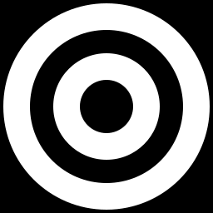
Problem, Significance & Goals
The Problem
ADVANCED MATERIALS: THE MONEY BEHIND THE MATH
Theory assumes perfectly periodic lattices. Manufacturing reality introduces strut-diameter variation, missing struts, and node misalignment — so classical models fail to predict real stiffness and fracture behavior.
$1.2T+
Global advanced materials market (2023)
Project Goal
$110–133B → $205–313B
Build a graph neural network that predicts lattice stiffness directly from imperfect, real-world geometry — fast enough for iterative design, accurate enough to trust in place of full simulation.
Architected composites & lattice materials, 2024 → 2032–34 (~8–9% CAGR)
30–50% / 40%+
Why it matters: no matter the field — aerospace, energy, medicine, defense — performance eventually hits a ceiling set by materials. Better material optimization raises that ceiling everywhere at once.
Stiffness-to-weight gain over foams / possible weight reduction from lattice design
Notes:
Frame the problem, then pivot to the size of the prize: cite the $1.2T+ advanced materials market and the faster-growing lattice/composites segment. Land the line: materials set the ceiling for every field.

Slide 3


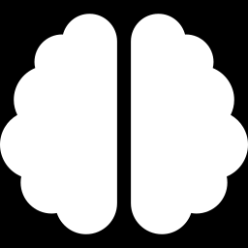
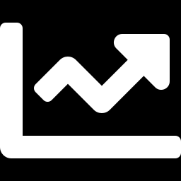
Research Approach
A graph neural network learns directly on lattice geometry — no meshing, no billions of degrees of freedom
Lattice Geometry
▸
Graph Construction
▸
GCN Model
▸
Predicted Stiffness
Node positions,
connectivity, boundary
conditions
Weighted edges,
rich node + graph-level
features
Message passing over
graph structure learns
stiffness response
Fast surrogate for
full FE simulation
Iterative Pipeline Development
Weighted graph edges
Richer node features
Graph-level features
Target normalization
Architecture search (GCN-2/3, GraphSAGE, GIN)
Multi-seed validation
Each step keeps Adam optimization + the same train/validation/test split fixed, so gains are attributable to representation, not tuning noise.
Notes:
Walk through the pipeline left to right, then point out the six representation upgrades tested this summer. Emphasize this is a controlled, additive research process.

Slide 4
Results
Representation upgrades — not optimizer tuning — drove the accuracy gain
R²: 0.9148 → 0.9456
Baseline vs. best multi-seed configuration
RMSE: 0.00382 → 0.00288 (−24%)
Validated Across 5 Seeds
Test R² range: 0.934 – 0.955
Adam remains the strongest optimizer — AdamW and SGD variants underperform
GCN-3 modestly outperforms GCN-2; GraphSAGE and GIN did not improve results
Open question: out-of-distribution (prediction-set) generalization still trails held-out test accuracy — the focus of ongoing work.
Notes:
Point at the chart: each bar is a confirmed, multi-seed-validated gain. Baseline R2 0.9148 to 0.9456 with 24% RMSE reduction. All gains from feature engineering, not optimizer swaps.

Slide 5


Discussion & Future Work
Where this stands
THE BIGGER PICTURE
A fast, defect-aware GCN surrogate now predicts lattice stiffness at 0.95 test R² — replacing costly FE simulation and enabling rapid design iteration across defective, real-world lattice geometries.
Materials set the ceiling for aerospace, energy, medicine, and defense alike. Faster, defect-aware design tools push that ceiling higher — across a $1.2T+ market moving toward $200–300B+ in architected materials alone.
Next steps
Multi-seed validation of Huber-loss objective for tail-seed stability
Stabilize residual GCN-3 to close the out-of-distribution gap
Extend beyond stiffness to failure-mode / fracture prediction
ACKNOWLEDGEMENT
Dr. Xing Liu
Dept. of Mechanical & Industrial Engineering, NJIT
NSF REU Site: Optics & Photonics
New Jersey Institute of Technology, Summer 2026
Notes:
Close by restating the significance in one sentence, thank Dr. Liu and the REU program, and stop — leave time for questions.

