Slide 1
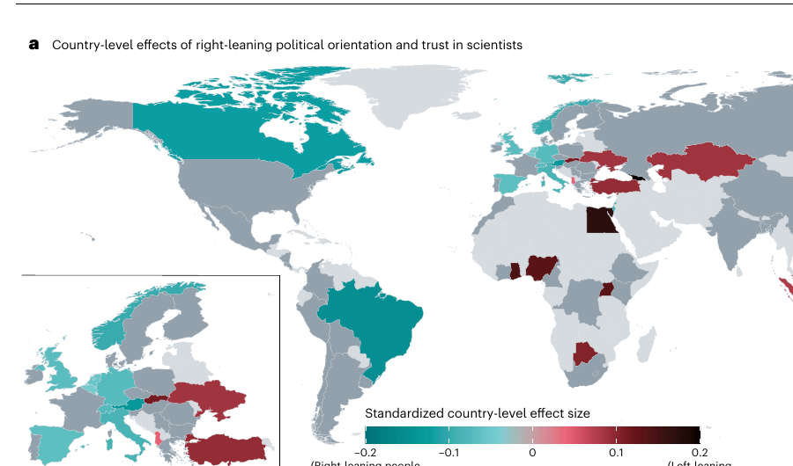
Successful statistical study
Trust in Scientists
and Their Role in Society
A presentation on a large-scale statistical study across 68 countries
71,922
68
2025
survey respondents
countries
journal article
Group Presentation • Statistics
Nature Human Behaviour

Slide 2
Roadmap aligned to the rubric
The deck follows the presentation checklist step-by-step.
1
Study overview
What was studied and why it matters
Central question
Is there really a global “crisis of trust” in scientists after COVID-19 and amid debates over misinformation, policy, and expertise?
2
Statistical methods
Survey design, weighting, indices, correlations, regression, t-tests
3
Evidence & visuals
Graphs, maps, confidence intervals, and summary comparisons
4
Findings & takeaways
How the analysis supports the conclusions
Answer preview: the study finds moderate-to-high trust overall, but meaningful variation by country and group.
5
Software spotlight
R / RStudio features, applications, limitations, and demo
Source: Nature Human Behaviour (2025), “Trust in scientists and their role in society across 68 countries,” doi:10.1038/s41562-024-02090-5
02

Slide 3
Study overview
A preregistered, global survey measured trust in scientists and expectations for science in society.
What the article studied
• How much people trust scientists across countries.
• Which demographic, ideological, and attitudinal factors relate to trust.
• Whether people think scientists should communicate with the public and influence policy.
• Which research priorities the public wants scientists to focus on.
71,922
68
37
final respondents
countries / territories
languages in survey
79%
12
of global population covered by surveyed countries
trust items across 4 dimensions
Design details
Cross-sectional online survey, collected Nov. 2022–Aug. 2023, with quota samples weighted by age, gender, education, and country sample size.
Source: Nature Human Behaviour (2025), “Trust in scientists and their role in society across 68 countries,” doi:10.1038/s41562-024-02090-5
03

Slide 4
Statistical tools used in the study
The article combines careful survey measurement with inferential statistics.
Preregistration + pretest
Weighted survey estimates
Trust index
Research questions, hypotheses, and analysis plan were specified before full analysis.
Quota samples were adjusted to represent national age, gender, and education distributions.
12 items measured competence, integrity, benevolence, and openness; reliability was high.
Multilevel regression
Confidence intervals + p-values
Paired t-tests
Random-intercept models estimated correlates of trust while accounting for country clustering.
Uncertainty and statistical significance were shown for estimates and comparisons.
Compared desired vs. perceived research priorities within respondents.
Why this matters: the statistical methods turn thousands of individual responses into interpretable estimates, uncertainty ranges, and country-level comparisons.
Source: Nature Human Behaviour (2025), “Trust in scientists and their role in society across 68 countries,” doi:10.1038/s41562-024-02090-5
04

Slide 5
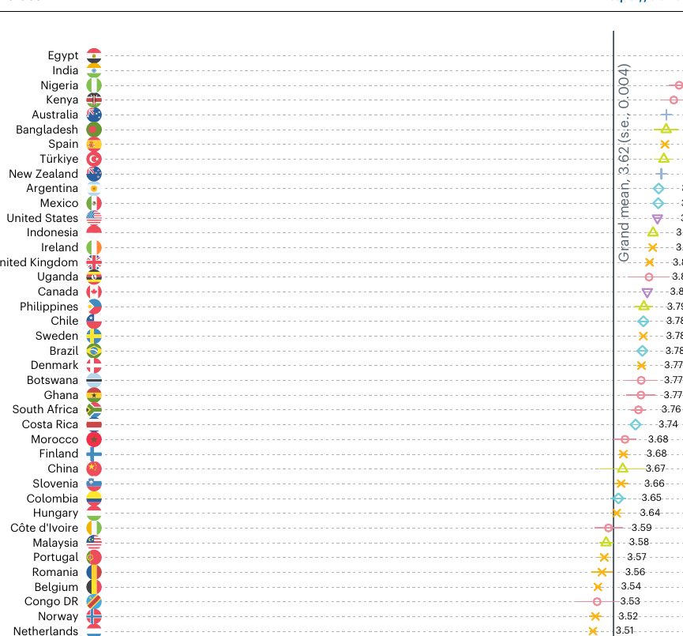
Finding 1: global trust is moderately high
Weighted country means challenge the narrative of a widespread trust crisis.
Main reading of the graph
3.62
No surveyed country had low average trust in scientists. Countries varied, but the global center of the distribution remained above the neutral midpoint.
weighted global mean trust on a 1–5 scale
• Dots show each country’s weighted mean trust score.
• Horizontal bars show standard errors, giving uncertainty around each estimate.
• The vertical line marks the overall grand mean.
Conclusion supported: the data do not support a broad global collapse of trust in scientists.
Fig. 1: Weighted means and standard errors by country.
Source: Nature Human Behaviour (2025), “Trust in scientists and their role in society across 68 countries,” doi:10.1038/s41562-024-02090-5
05

Slide 6
How the first graph informs the conclusion
Weighted summaries + uncertainty estimates make the country comparison meaningful.
1
2
3
4
5
Raw survey responses
Index construction
Post-stratification weighting
Country means + SEs
Inference
Individuals answer trust questions on 1–5 scales.
12 trust items combine into one reliable trust score.
Responses are adjusted to match national age, gender, and education.
Each country gets a weighted mean with standard error.
Compare countries and see whether means fall below neutral trust.
Example interpretation
Key statistical idea
A mean above 3 means average trust is above the neutral midpoint. The study reports a grand mean of 3.62, so the summary statistic directly supports the claim that trust is moderate-to-high overall.
The plot is descriptive, but not “just descriptive”: weights and standard errors make it an evidence-based comparison rather than a simple average of whoever responded.
Source: Nature Human Behaviour (2025), “Trust in scientists and their role in society across 68 countries,” doi:10.1038/s41562-024-02090-5
06

Slide 7
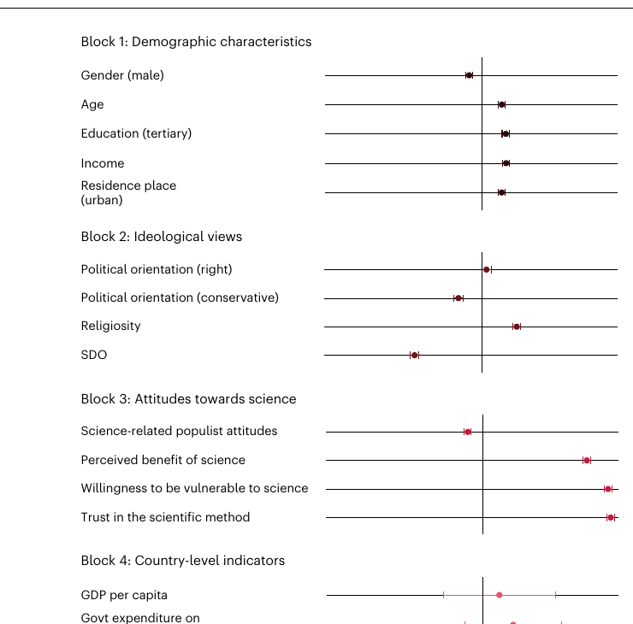
Finding 2: attitudes explain more than demographics
Regression estimates show which variables move with trust after accounting for country clustering.
How to read this forest plot
• Dots to the right of zero are positively associated with trust.
• Dots to the left of zero are negatively associated with trust.
• Intervals that do not cross zero are statistically significant at the study’s threshold.
Strong positive links
Trust in scientific methods
Perceived benefit of science
Negative links
Social dominance orientation
Conservatism
Science-populist attitudes
Conclusion supported
Trust is not explained mainly by simple demographics. The larger relationships are about people’s attitudes toward science, perceptions of benefit, and ideology.
Fig. 2: Standardized multilevel regression estimates with 95% confidence intervals.
Source: Nature Human Behaviour (2025), “Trust in scientists and their role in society across 68 countries,” doi:10.1038/s41562-024-02090-5
07

Slide 8
Finding 3: political patterns are not universal
Country-level maps show that politics relates to trust differently depending on context.
What the maps add
• A single global average can hide national differences.
• Some countries show lower trust among right-leaning or conservative groups.
• Other countries show the opposite or no statistically clear relationship.
Statistical technique
Random slopes by country let the relationship between political orientation and trust vary instead of forcing one universal effect.
Fig. 3: Country-level effects of political orientation on trust in scientists.
Source: Nature Human Behaviour (2025), “Trust in scientists and their role in society across 68 countries,” doi:10.1038/s41562-024-02090-5
08

Slide 9
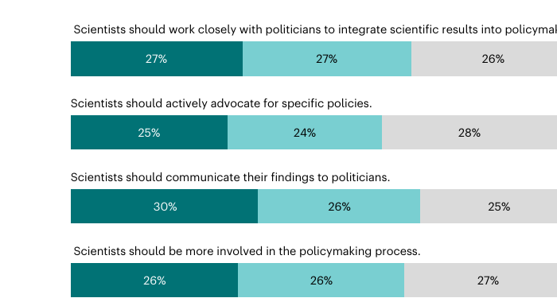
Finding 4: people want scientists to communicate
Stacked bars summarize agreement about scientists’ public and policy role.
83%
The strongest consensus item is public communication, not necessarily direct advocacy.
agree scientists should communicate science with the general public
Method: diverging stacked bar chart
• Shows the full distribution, not just an average.
• Separates agreement, midpoint, and disagreement.
• Makes it easy to see where consensus is strongest.
Fig. 4: Weighted response probabilities for normative perceptions.
Conclusion supported: high trust also connects to support for scientists engaging more with society and policymaking.
Source: Nature Human Behaviour (2025), “Trust in scientists and their role in society across 68 countries,” doi:10.1038/s41562-024-02090-5
09

Slide 10
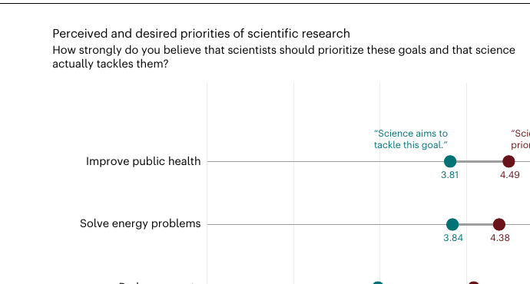
Finding 5: the public sees a priority gap
Paired comparisons reveal mismatch between desired priorities and perceived scientific focus.
Largest gap
1.11
Respondents wanted scientists to prioritize poverty reduction more than they perceived science currently does.
point gap for poverty reduction
How the statistics inform the finding
The study compared each person’s desired priority rating with their perceived current priority rating. Significant paired t-tests show the gaps are unlikely to be random noise.
Fig. 5: Perceived vs. desired research priorities; paired t-tests assess differences.
Takeaway: trust may increase when scientific institutions listen to public priorities and communicate ongoing work on issues people care about.
Source: Nature Human Behaviour (2025), “Trust in scientists and their role in society across 68 countries,” doi:10.1038/s41562-024-02090-5
10

Slide 11
Conclusions, limitations, and our takeaways
The evidence is reassuring overall, but it still points to communication challenges.
Main conclusions
Limitations to mention
• There is no widespread global lack of trust in scientists.
• Distrust among even a minority can still affect policy and public behavior.
• People strongly support scientists communicating with the public.
• Perceived openness is lower than competence, so transparency matters.
• Online surveys can underrepresent people without reliable internet access.
• Some countries used English/French despite other common local languages.
• The survey used a broad Western-style definition of “science.”
• Cross-country measurement is difficult because words and scales can translate imperfectly.
Our takeaway
The study is a strong example of statistics being used to test a popular claim. Instead of relying on headlines about a “trust crisis,” the authors measured trust systematically, estimated uncertainty, and checked patterns across many countries.
Source: Nature Human Behaviour (2025), “Trust in scientists and their role in society across 68 countries,” doi:10.1038/s41562-024-02090-5
11

Slide 12
Statistical software spotlight: R + RStudio
R is a free, open-source environment designed for statistical computing and graphics.
What can it do?
Best features
R
• Clean and transform raw data.
• Run statistical tests, regressions, and simulations.
• Create publication-quality graphs.
• Build reproducible reports and dashboards.
• Huge package ecosystem: tidyverse, ggplot2, lme4, survey, Shiny.
• Code-based workflow makes analysis reproducible.
• RStudio makes scripts, plots, data, and files easier to manage.
Applications
Limitations
Public health • polling • market research • sports analytics • finance • machine learning • academic research
Steeper learning curve than spreadsheet tools; memory limits on very large data; code quality depends on the user documenting and organizing scripts.
Source: Nature Human Behaviour (2025), “Trust in scientists and their role in society across 68 countries,” doi:10.1038/s41562-024-02090-5
12

Slide 13
R demo: recreate a priority-gap analysis
A small case study using the article’s mean ratings from Figure 5.
Input data frame
Example R code
Goal
Perceived
Desired
Gap
library(tidyverse)
priorities <- tibble(
goal = c("Public health", "Energy",
"Poverty", "Defense tech"),
perceived = c(3.81, 3.84, 2.98, 3.79),
desired = c(4.49, 4.38, 4.09, 3.10)
) %>%
mutate(gap = desired - perceived)
priorities %>% arrange(desc(abs(gap)))
Public health
3.81
4.49
0.68
Energy problems
3.84
4.38
0.54
Reduce poverty
2.98
4.09
1.11
Defense/military tech
3.79
3.10
-0.69
Output interpretation
In class demo idea
• The largest absolute gap is poverty reduction: desired priority is much higher than perceived current focus.
• Defense/military technology is the only negative gap: people perceive more focus than they want.
• The same workflow can be extended to all countries, demographic subgroups, and uncertainty intervals.
Run the code, change the means, and watch how the ranked gaps update. This demonstrates reproducible data analysis in a simple way.
Source: Nature Human Behaviour (2025), “Trust in scientists and their role in society across 68 countries,” doi:10.1038/s41562-024-02090-5
13

Slide 14
Final wrap-up
Statistics helped the authors test a public claim with evidence.
What this study shows about statistical analysis
• Good measurement matters: a 12-item scale is stronger than one vague question.
• Weighting matters: survey data need adjustment to represent target populations.
• Visualization matters: different graphs answer different questions.
• Modeling matters: regression helps separate small demographic effects from stronger attitudinal effects.
Rubric completion check
• Study summary included
• Statistical tools explained
• Graphs and charts interpreted
• Conclusions and takeaways stated
• R software introduced with demo
Discussion question
If scientists want to increase trust, should they focus more on transparency, public communication, or matching research priorities to public concerns?
Source: Nature Human Behaviour (2025), “Trust in scientists and their role in society across 68 countries,” doi:10.1038/s41562-024-02090-5
14

