Slide 1
Simplified Use-Case of Graph Neural Networks (GNNs) Predicting Synthetic Lattice Stability
June 9th 2026
Alexander Adamsª and Dr. Xing Liu^{b}
ª Department of Mechanical Engineering and Materials Science, University of Pittsburgh, Pittsburgh, PA 15260
^{b} Department of Mechanical and Industrial Engineering, New Jersey Institute of Technology, Newark, NJ 07102

Slide 2
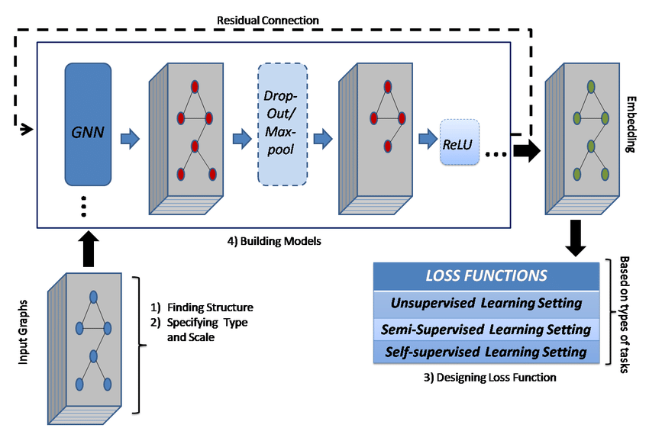
Background

Slide 3
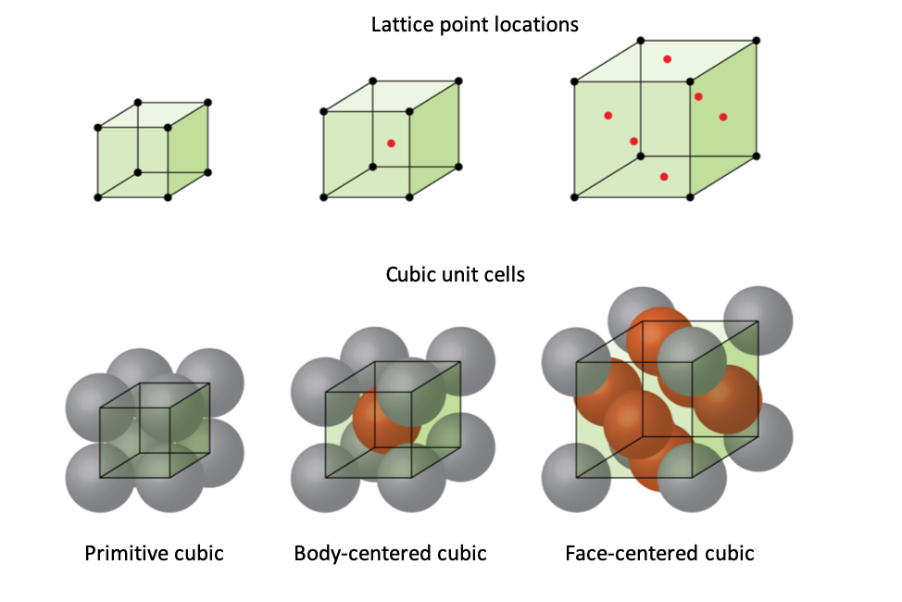
Step 1: Synthetic Data Generation
Created 100 cubic lattice structures
• Sizes: 2×2×2 to 4×4×4 atoms
• Node features: Atom types (0 or 1)
• Edge features: Bond strengths (0.7-1.0)
Stability labels computed from:
• Average node degree (connectivity)
• Average bond strength (quality)
• Graph connectivity (integrity)
• Added noise
Stability labels were computed from average degree, mean bond strength, connectivity, and added noise.
Notes:
Berkache et al. (2022) used micropolar continuum theory to derive analytical scaling laws for hexagonal, triangular, and kagome lattices. Shaikeea et al. (2022): fracture in 3D octet-truss metamaterials depends on T-stress AND Kᴵ, not Kᴵ alone. Standard testing protocols developed for continua are fundamentally inadequate.
Fleck, Deshpande & Ashby (2010) show fracture toughness Kᴵᴶ ∝ ρ̄ᵈ via full lattice simulations.

Slide 4
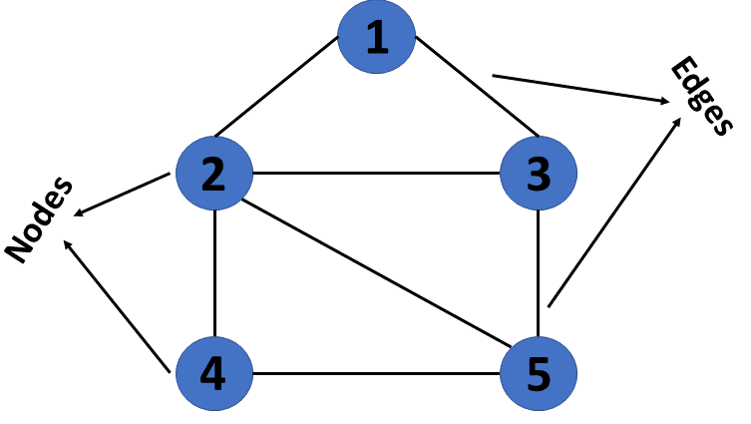
Data Characteristics
Graph Structure Statistics:
• Average nodes per structure: ~33.29
• Average edges per structure: ~70.86
• Stability range: [0.644, 0.960]
• Size counts: 2×2×2: 37, 3×3×3: 27, 4×4×4: 36
Train/Validation/Test Split:
• Training: 70 samples (70%)
• Validation: 15 samples (15%)
• Testing: 15 samples (15%)
Batch Processing: 8 samples per batch

Slide 5
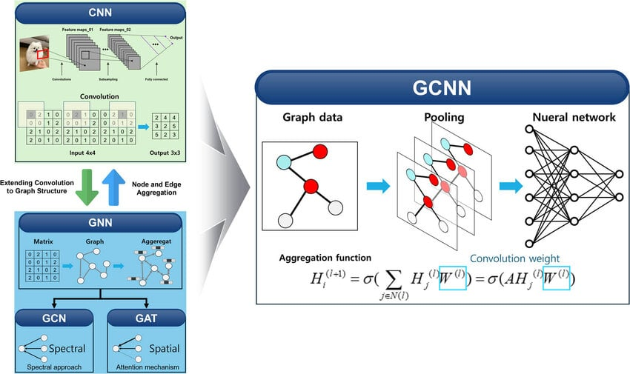
Step 2: GCN Architecture
Model Design:
Node features: atom type + normalized degree (2 dims)
Edge weights: bond strength
Graph summary features: node count, edge count, avg degree, mean bond strength, connectivity
3 GCN layers + global mean pooling + MLP head + direct residual path from graph summary features
Total Parameters:
15,463

Slide 6
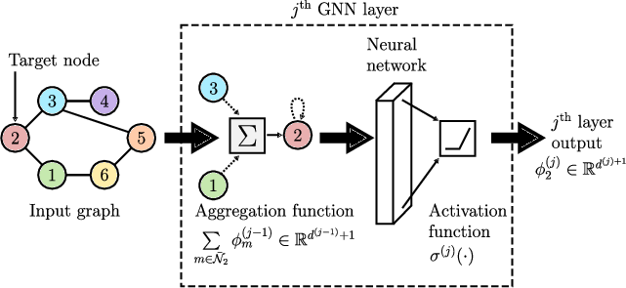
GNN Forward Pass
Notes:
Node Features (atom types) → [GCN Layer 1: aggregate 1-hop neighbors] → [GCN Layer 2: aggregate 2-hop neighbors] → [GCN Layer 3: aggregate 3-hop neighbors] → [Global Mean Pooling: graph-level representation] → [MLP Head: 64→32→16→1 dimensions] → Stability Prediction (0-1)

Slide 7
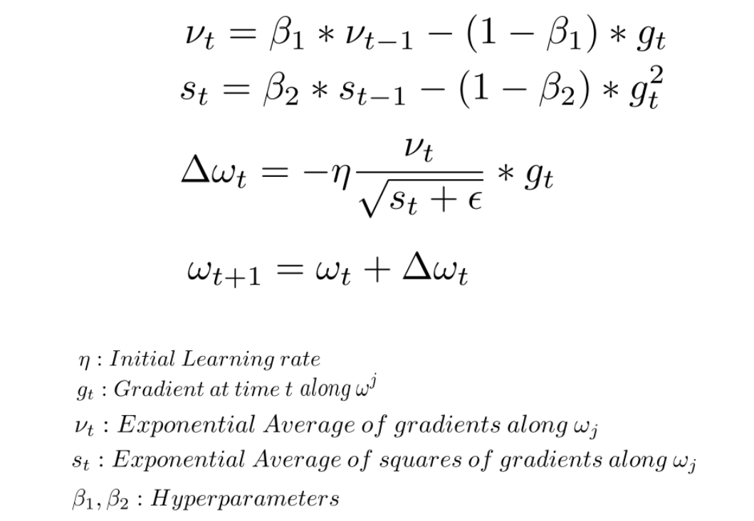
Step 3: Training the Model
Optimization Setup:
• Optimizer: Adam (learning rate 0.001)
• Loss Function: Mean Squared Error (MSE)
• Early Stopping: patience = 15 epochs
• Max Epochs: 100
→ Best run stopped at epoch 47 via early stopping
Training Process:
1. Forward pass through batch
2. Compute MSE loss
3. Backward pass (compute gradients)
4. Update weights
5. Validate on validation set
Notes:
Best model automatically saved during training

Slide 8
Step 4: Results & Performance
Metric | Target | Achieved | Status | Notes
R² Score | — | 0.675 | Pass | Test R²: 0.675448
MAE | < 0.12 | 0.037175 | Pass | Test MAE: 0.037175
RMSE | — | 0.048447 | Pass | Test RMSE: 0.048447
Training Time | — | ~20 s on CPU ~10 sec (GPU) | — | Fast GPU inference
Model Quality Assessment
Stable convergence on small noisy data
Good fit, some range compression at extremes
Test MSE: 0.002347

Slide 9
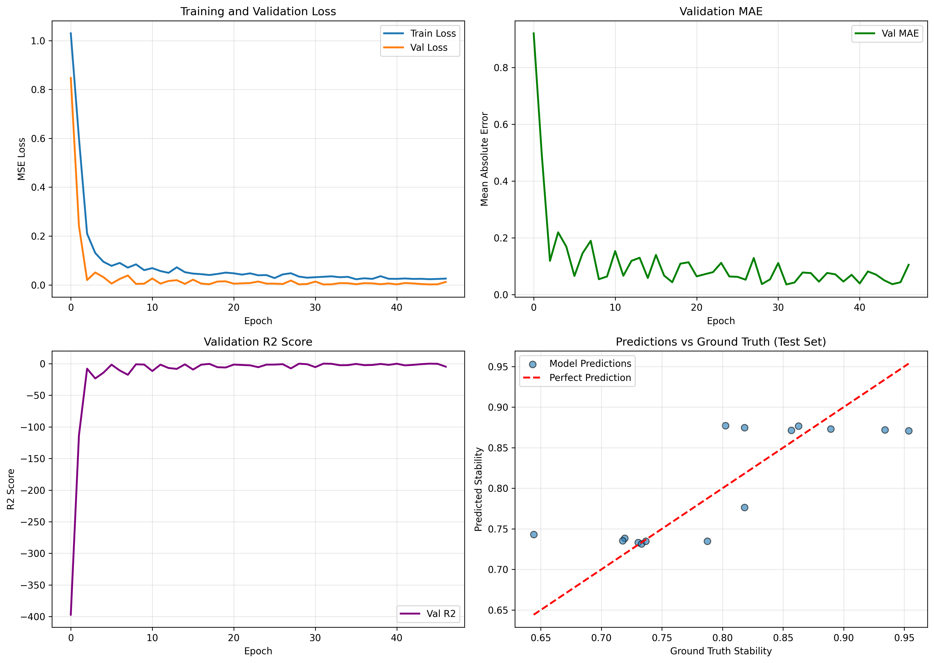
Training Visualization
Notes:
📊 Four Key Plots Generated:
1. Loss Curves: Train vs validation loss
→ Shows convergence and overfitting patterns
2. MAE Progression: Validation mean absolute error
→ Steady decrease indicates learning
3. R² Score: Validation goodness of fit
→ Increases toward 1.0 (excellent fit)
4. Predictions vs Ground Truth: Scatter plot
→ Points near diagonal = accurate predictions
📁 All plots saved to: results/training_results.png

Slide 10
What the Model Learned
1. Message Passing:
The model captures the main stability trend from graph structure and bond quality
2. Prediction Range:
Predictions are strongest in the mid-range
3. Remaining Limitations:
Model still underpredicts some high-stability samples and overpredicts the lowest-stability sample
4. Key Takeaway:
This shows why scatter plots are necessary alongside scalar metrics

Slide 11
Connection to NSF-REU Research
Mock Project Characteristics:
• Synthetic cubic lattices
• Random atom types
• Arbitrary stability labels
• 100 samples
Real Project Characteristics:
• Real crystal structures (ICSD, Materials Project)
• DFT-computed properties
• Actual material strength measurements
• Thousands of samples
Core concepts, techniques, and pipeline directly transfer
Key Lesson for Real REU Workflow:
Architecture-feature alignment matters: the model improved only after explicitly using graph-level structural summaries and edge-weight information
Notes:
Core concepts, techniques, and pipeline directly transfer
Data Representation:
✓ Graph representation
✓ Node features
✓ Edge features
✓ Batch processing
Model Architecture:
✓ GCN layers
✓ Message passing
✓ Global pooling
✓ MLP head
Training Methodology:
✓ Data splitting
✓ Validation strategy
✓ Early stopping
✓ Hyperparameter tuning
Evaluation:
✓ Multi-metric evaluation
✓ Error analysis
✓ Visualization
✓ Interpretation

Slide 12
Key Learnings Demonstrated
GNN Fundamentals:
• Graph representation of materials
• Message passing mechanism
• Permutation invariance
Implementation Skills:
• PyTorch model building
• PyTorch Geometric workflows
• Training loop design
ML Best Practices:
• Data pipeline design
• Validation strategies
• Hyperparameter tuning
• Model debugging and calibration analysis
• Feature engineering for graph data
• Importance of checking prediction scatter, not just MAE/RMSE
Domain Knowledge:
• Materials as graphs
• Structure-property relationships

Slide 13
Next Steps
Review and understand the code in legacy codebase (so far)
Experiment with hyperparameters (if access to legacy codebase is given)
Try generating different lattice types with random asperities in Abaqus

