Slide 1
Simplified Use-Case of Graph Neural Networks (GNNs) for Predicting Synthetic Lattice Stability
June 9th 2026
Alexander Adams
Department of Mechanical Engineering and Materials Science, University of Pittsburgh, Pittsburgh, PA 15260
Notes:
Predicting the Mechanical Properties of Complex Lattice Metamaterials Using Graph Neural Networks

Slide 2
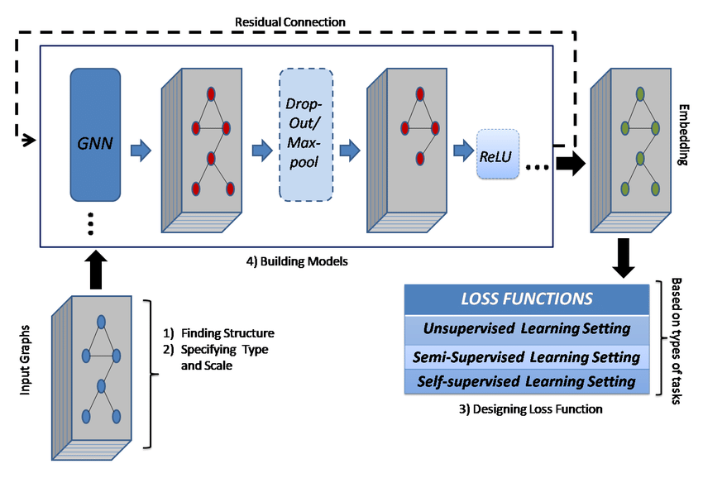
Background
Notes:
- Step 3 is "Designing a Loss Function" — a loss function is essentially the model's score of how wrong it is. After every prediction, the model checks its answer against the real answer, and the loss function measures the gap. The goal of training is to shrink that gap over time. There are different types depending on how much labeled data you have — but for this project we used a supervised approach, meaning every sample had a known correct answer.
- Step 4 is "Building the Model" — this is the actual GNN architecture. The data flows through several layers (the stacked gray blocks), where at each layer the model learns to combine information from neighboring nodes. Dropout and MaxPool are regularization and compression steps — they help the model generalize rather than just memorize the training data. ReLU is an activation function — it's a simple math operation that lets the network learn nonlinear patterns instead of just fitting a straight line.
- The "Residual Connection" (the dashed arrow looping around the outside) is a shortcut that lets the original input signal bypass the middle layers and reconnect later. This helps the model retain information that might get distorted as it passes through many layers.
- The final output on the right is an "Embedding" — a compressed numerical representation of the whole graph that captures its key structural features, which then gets fed into a final prediction layer.

Slide 3
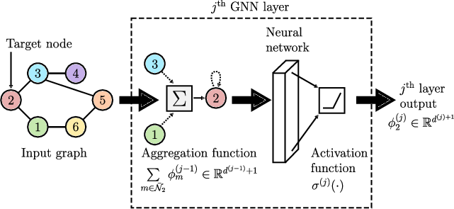
GNN Forward Pass
Notes:
Aggregation Function — Node 2 looks at its immediate neighbors (nodes 1, 3, and itself). It collects, or "aggregates," their feature vectors — basically their numerical descriptions — and sums them up. This is the core idea of message passing: every node gathers information from the nodes around it. The mathematical notation at the bottom (the summation symbol with subscript m) just means "sum over all neighbors."
- Neural Network — That combined neighborhood information gets passed through a small neural network, which is just a series of matrix multiplications and transformations. Think of it as a learned filter that decides what features are important.
- Activation Function σ — This is applied after the neural network step. It introduces nonlinearity — without it, no matter how many layers you stack, the whole thing collapses into a single linear equation and can't learn complex patterns. Common choices are ReLU (sets negatives to zero) or others depending on the task.
- Output — The result is a new, updated feature vector for node 2, now enriched with information from its local neighborhood. In our model we run this process across 3 layers, which means each node ends up "seeing" information from nodes up to 3 hops away.

Slide 4
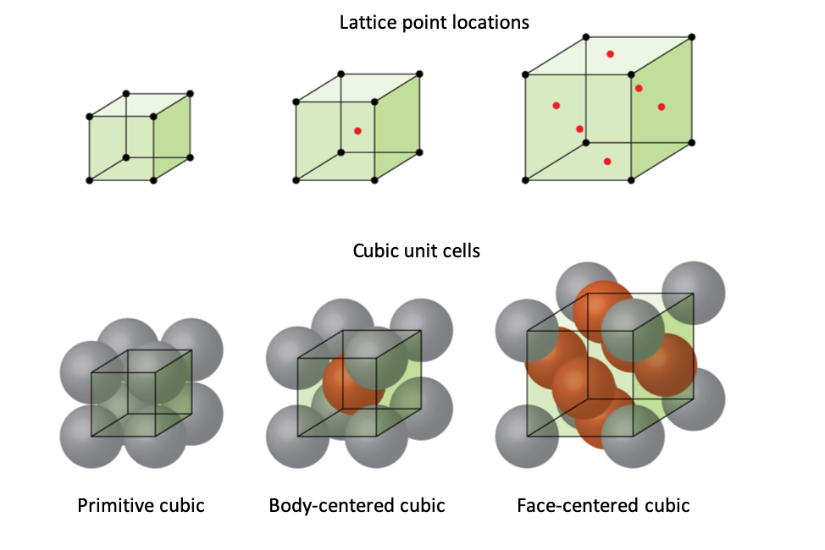
Step 1: Synthetic Data Generation
Created 100 cubic lattice structures
• Sizes: 2×2×2 to 4×4×4 atoms
• Node features: Atom types (0 or 1)
• Edge features: Bond strengths (0.7-1.0)
Stability labels computed from:
• Average node degree (connectivity)
• Average bond strength (quality)
• Graph connectivity (integrity)
• Added noise
Stability labels were computed from average degree, mean bond strength, connectivity, and added noise.
Notes:
The "stability label" is the target number I want the model to learn to predict. It's a single score computed from four factors: how well-connected the atoms are on average, how strong the bonds are on average, whether the graph is fully connected without isolated atoms, and a small amount of added noise

Slide 5
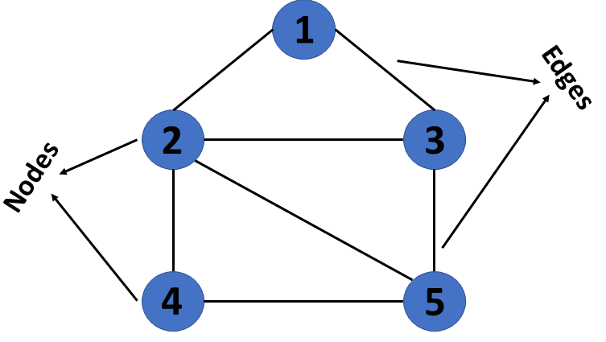
Data Characteristics
Graph Structure Statistics:
• Average nodes per structure: ~33.29
• Average edges per structure: ~70.86
• Stability range: [0.644, 0.960]
• Size counts: 2×2×2: 37, 3×3×3: 27, 4×4×4: 36
Train/Validation/Test Split:
• Training: 70 samples (70%)
• Validation: 15 samples (15%)
• Testing: 15 samples (15%)
Batch Processing:
8 samples per batch
Notes:
Training set (70 samples): this is what the model actually learns from.
- Validation set (15 samples): used during training to monitor whether the model is improving or starting to overfit. "Overfitting" means the model memorizes the training data instead of learning generalizable patterns — like a student who memorizes answers without understanding the concepts.
- Test set (15 samples): held out completely until the very end. This is the true report card — data the model has never seen, used to evaluate real-world performance. "Batch processing" means rather than feeding all 70 training samples at once, the model processes 8 at a time. This is computationally more efficient and also adds a bit of randomness that helps training.

Slide 6
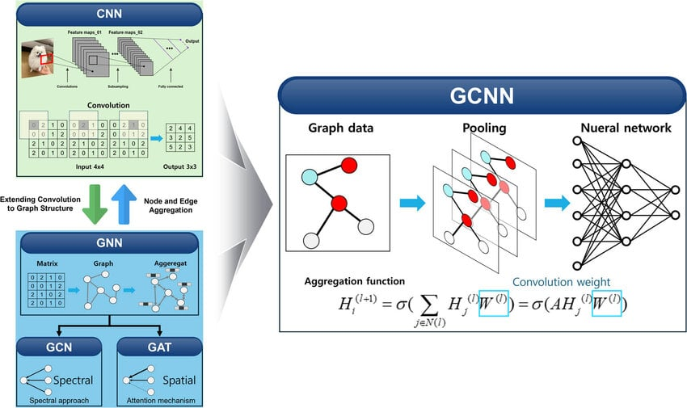
Step 2: GCN Architecture
Model Design:
Node features: atom type + normalized degree (2 dims)
Edge weights: bond strength
Graph summary features: node count, edge count, avg degree, mean bond strength, connectivity
3 GCN layers + global mean pooling + MLP head + direct residual path from graph summary features
Total Parameters:
15,463
Notes:
The "convolutional" part is borrowed from image-processing AI, where a filter slides across an image to detect patterns. In a GCN, that same idea is applied to graphs: each layer "convolves" information from neighboring atoms to update each atom's representation. The model takes two types of input for each structure: - Node-level features: each atom's type and how connected it is relative to others (normalized degree). - Edge-level features: the bond strength between each pair of connected atoms. - Graph-level summary features: five global statistics describing the whole structure — total atom count, total bond count, average connectivity, average bond strength, and whether the graph is fully connected. The architecture has 3 GCN layers that do the neighborhood aggregation, followed by "global mean pooling" which averages all atom embeddings into a single graph-level vector, and an "MLP head" — a small standard neural network — that takes that vector and outputs the final stability number. There's also a "residual path" that bypasses the GCN layers entirely and feeds the graph-level summary features directly into the final prediction. This was a key design decision — the model's accuracy noticeably improved once I added those global features as a direct shortcut. Total parameters is 15,463 — that's the number of internal numbers the model learns during training. By comparison, large AI models like GPT have hundreds of billions of parameters. This is a very small, efficient model.

Slide 7
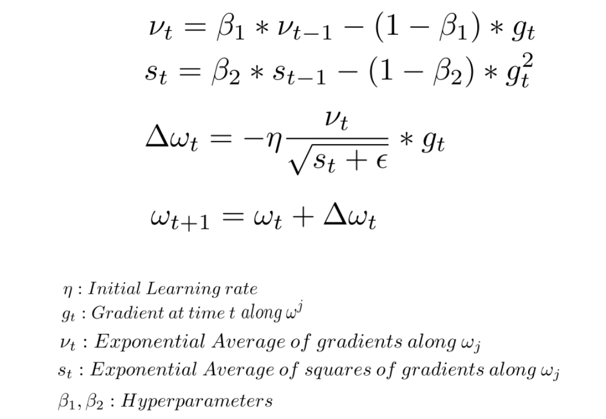
Step 3: Training the Model
Optimization Setup:
• Optimizer: Adam (learning rate 0.001)
• Loss Function: Mean Squared Error (MSE)
• Early Stopping: patience = 15 epochs
• Max Epochs: 100
Best run stopped at epoch 47 via early stopping
Training Process:
1. Forward pass through batch
2. Compute MSE loss
3. Backward pass (compute gradients)
4. Update weights
5. Validate on validation set
Notes:
Adaptive moment estimation-It adapts the learning rate — how big of a step the model takes when updating — individually for each parameter based on how that parameter has been changing
1. Forward pass — feed a batch of 8 structures through the model to get predictions. 2. Compute loss — measure how wrong those predictions are. 3. Backward pass — use calculus (backpropagation) to compute how much each parameter contributed to the error. 4. Update weights — nudge every parameter slightly in the direction that reduces the error. 5. Validate — check performance on the 15 validation samples without updating anything.

Slide 8
Step 4: Results & Performance
Metric | Target | Achieved | Status | Notes
R² Score | — | 0.675 | Pass | Test R²: 0.675448
MAE | < 0.12 | 0.037175 | Pass | Test MAE: 0.037175
RMSE | — | 0.048447 | Pass | Test RMSE: 0.048447
Training Time | — | ~20 s on CPU ~10 sec (GPU) | — | Fast GPU inference
Model Quality Assessment
Stable convergence on small noisy data
Good fit, some range compression at extremes
Test MSE: 0.002347

Slide 9
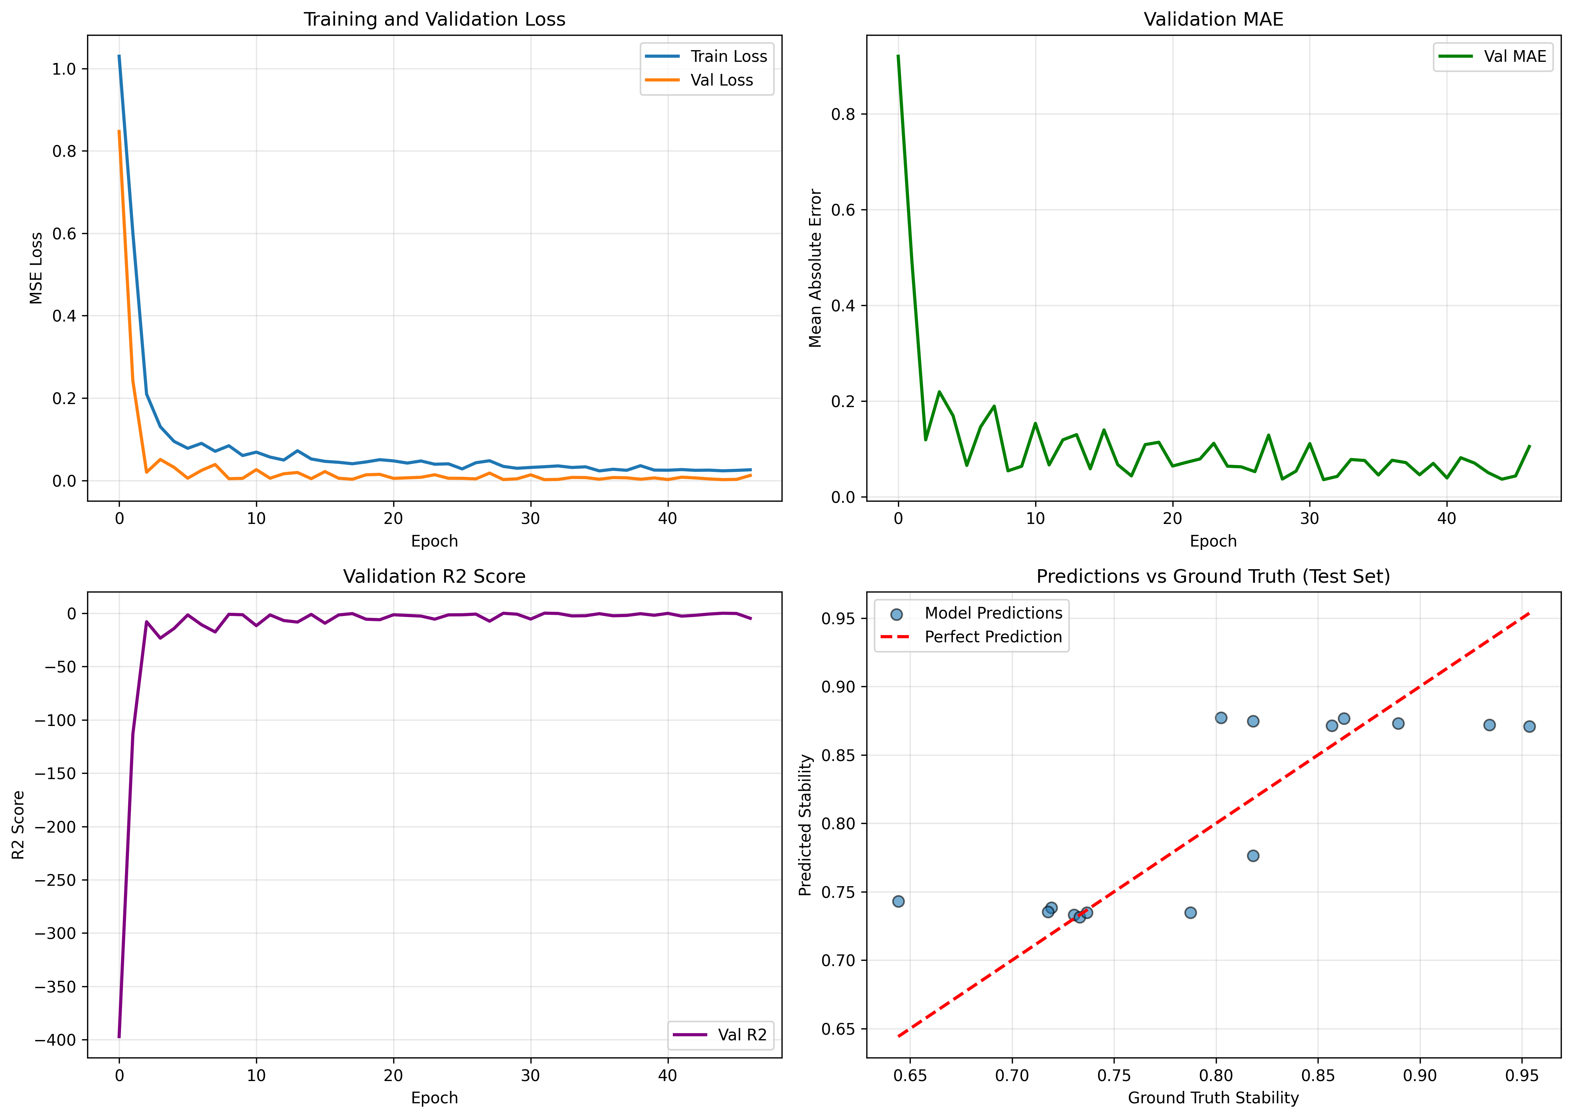
Training Visualization
Notes:
📊 Four Key Plots Generated:
1. Loss Curves: Train vs validation loss
→ Shows convergence and overfitting patterns
2. MAE Progression: Validation mean absolute error
→ Steady decrease indicates learning
3. R² Score: Validation goodness of fit
→ Increases toward 1.0 (excellent fit)
4. Predictions vs Ground Truth: Scatter plot
→ Points near diagonal = accurate predictions
📁 All plots saved to: results/training_results.png

Slide 10
What the Model Learned
1. Message Passing:
The model captures the main stability trend from graph structure and bond quality
2. Prediction Range:
Predictions are strongest in the mid-range
3. Remaining Limitations:
Model still underpredicts some high-stability samples and overpredicts the lowest-stability sample
4. Key Takeaway:
This shows why scatter plots are necessary alongside scalar metrics

Slide 11
Connection to Research
Mock Project Characteristics:
• Synthetic cubic lattices
• Random atom types
• Arbitrary stability labels
• 100 samples
Real Project Characteristics:
• Real crystal structures (ICSD, Materials Project)
• DFT-computed properties
• Actual material strength measurements
• Thousands of samples
Notes:
Core concepts, techniques, and pipeline directly transfer
Data Representation:
✓ Graph representation
✓ Node features
✓ Edge features
✓ Batch processing
Model Architecture:
✓ GCN layers
✓ Message passing
✓ Global pooling
✓ MLP head
Training Methodology:
✓ Data splitting
✓ Validation strategy
✓ Early stopping
✓ Hyperparameter tuning
Evaluation:
✓ Multi-metric evaluation
✓ Error analysis
✓ Visualization
✓ Interpretation

Slide 12
Next Steps
Review and understand the code in legacy codebase (so far)
Try generating different lattice types with random asperities in Abaqus

