Slide 1
PILARPREP
Turn customer discovery
into reusable project context.
ONE CUSTOMER STORY
Prepare
Refine
Approve
Handoff
AI-assisted preparation for sales, Solutions Architects, and delivery teams — built on AWS.
From pre-meeting signal
to shared delivery memory
AWS GenAI Hackathon • Live demo
Notes:
0:00–0:45. Open with the outcome: PilarPrep prevents customer context from being lost between sales, architecture, and delivery.
Do not start with AWS services. Start with the handoff problem and promise to show the full loop live.

Slide 2
THE GAP
02
The customer story breaks at every handoff.
01
02
03
Sales discovery
SA preparation
Delivery handoff
→
→
Business urgency, stakeholders, and commitments live in scattered notes.
Architects rebuild context and translate business language into technical questions.
New owners inherit summaries without assumptions, decisions, or unresolved risks.
THE RESULT
Repeated discovery. Contradictory assumptions. Slower decisions. A weaker customer experience.
Notes:
0:45–1:45. Explain that the expensive part is not note-taking; it is reinterpretation at every transition.
Use a short example: sales hears 'move faster,' the SA hears 'modernize,' and delivery receives neither the success metric nor the decision owner.

Slide 3
THE PRODUCT
03
Two connected loops keep the story intact.
LOOP 1 • BEFORE THE MEETING
LOOP 2 • AFTER THE MEETING
Create a customer-ready brief
Turn the packet into project memory
1
Capture context
1
Capture outcomes
2
Generate tailored briefs
2
Build the team handoff
3
Refine one brief at a time
3
Track decisions and risks
4
Approve the packet
4
Catch up by role
Notes:
1:45–2:30. This is the whole product in one slide.
Loop 1 makes the meeting better. Loop 2 makes the project better. Approval is the boundary that turns draft content into governed context.

Slide 4
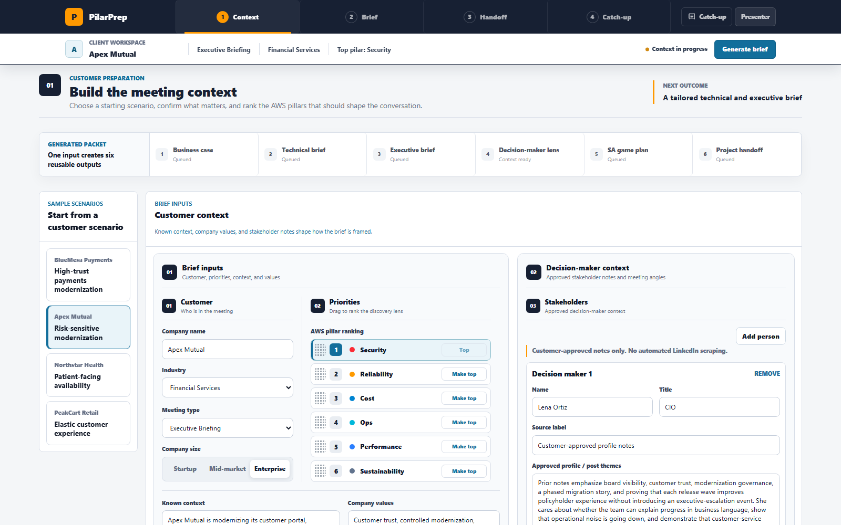
LIVE DEMO
04
PeakCart Retail: protect peak season without slowing growth.
CUSTOMER SCENARIO
Already on AWS.
Four-times traffic ahead.
Checkout latency and payment degradation
Inconsistent load-test evidence and ownership
Executive concern about cost and customer impact
Walk the live workflow now
Notes:
2:30–8:30. Switch to the live application.
Demo: select PeakCart, show ranked pillars and decision-makers, generate, review the business case and technical brief, apply feedback to one tab, show changed/clean copy, approve, then open the handoff and catch-up experience.
Keep the demo focused on decisions and workflow, not every field.
[Sources]
- PilarPrep live application: https://pilarprep.app/
[/Sources]

Slide 5
WHAT THE DEMO PROVES
05
One packet serves the meeting — and the work after it.
01
02
03
Business case
Technical brief
Executive brief
Restates urgency, outcomes, scope, and success measures.
Surfaces assumptions, architecture questions, risks, and AWS rationale.
Frames decisions and value without technical overload.
04
05
06
Objections
Meeting plan
Team handoff
Prepares evidence-based responses for likely blockers.
Gives the SA a practical talk track and closeout checklist.
Carries decisions, owners, risks, and next steps forward.
Targeted refinement regenerates the selected brief from authoritative facts — without silently rewriting the rest of the packet.
Notes:
8:30–10:00. Summarize what judges just saw.
Call out the refinement contract: complete regeneration of the active brief, contradiction checks, non-target tabs preserved, approval invalidated on change, and a clean/marked-up toggle.

Slide 6
AFTER APPROVAL
06
The packet becomes a governed project starting point.
1
2
3
Approved packet
Agent handoff
Role-aware catch-up
Customer context, briefs, decision-maker lens
Outcomes, owners, risks, assumptions, next steps
Sales, SA, delivery, or executive view
Catch-up is read-only. Handoff is the governed write path.
New people can answer “what happened, what matters, and what is next?” without restarting discovery.
Notes:
10:00–11:30. Explain the difference between handoff and catch-up.
Handoff deliberately writes approved project state. Catch-up reads the latest approved packet and project state, then tailors the explanation to the user's role.

Slide 7










AWS ARCHITECTURE
07
One durable pipeline. Two governed AI paths.
EXPERIENCE + ACCESS
DURABLE JOB PIPELINE
GOVERNED AI + DATA
CloudFront
API Gateway
Jobs Lambda
SQS + DLQ
Bedrock Nova
AgentCore
HTTPS + WAF
IAM / SigV4 jobs API
Validate + enqueue
Pointer-only messages
Generate + refine
Handoff + catch-up
Private S3
BRIEFS
FOLLOW-ON
React build via OAC
AI Worker
Tool Lambda
Unified action router
Governed reads / writes
Cognito
Temporary AWS credentials
DynamoDB
Artifact S3
CloudWatch
Jobs + state + pointers
Latest JSON + DOCX
Logs, metrics, alarms
Notes:
11:30–13:00. Explain left to right.
1) CloudFront serves a React app from a private S3 origin. Cognito supplies temporary credentials and the browser signs API requests with SigV4.
2) The Jobs Lambda validates scope, writes a job and input pointer, and queues a small SQS message. One worker handles every action; retries and DLQ make long AI calls durable.
3) Bedrock Nova generates and refines briefs. AgentCore handles the stateful follow-on experience through governed tools. One DynamoDB table holds jobs, project state, approval metadata, and latest pointers; S3 holds latest JSON and DOCX artifacts.
4) CloudWatch provides logs, metrics, and alarms across the path.
[Sources]
- AWS Architecture Icons: https://aws.amazon.com/architecture/icons/
- Repository: docs/infrastructure-configuration-breakdown.md
- Repository: docs/unified-jobs-architecture.md
[/Sources]

Slide 8
WHY THIS WINS
08
Built like a workload — not a prompt demo.
1
SECURE BY DEFAULT
Private S3 origins, HTTPS, WAF, IAM/SigV4, Bedrock Guardrails.
2
DURABLE AI WORK
SQS retries and a DLQ absorb variable model latency without blocking the UI.
3
GOVERNED STATE
One DynamoDB table scopes jobs, approvals, project memory, and latest pointers.
4
COST DISCIPLINE
Serverless, on-demand resources and configurable Nova models keep idle cost near zero.
Demo access is intentionally broad; production adds enterprise identity, tenant claims, durable approval audit, and retention controls.
Notes:
13:00–14:15. This slide answers 'is it real?'
Be transparent: the public hackathon demo uses unauthenticated Cognito identities with scoped IAM permissions. The production roadmap replaces this with workforce identity and tenant-bound authorization.
Avoid quoting exact token prices. Say the main variable cost is model input/output tokens and verify current pricing before the presentation.
[Sources]
- Repository: docs/infrastructure-configuration-breakdown.md
- AWS pricing should be verified before presentation: https://aws.amazon.com/bedrock/pricing/
[/Sources]

Slide 9
PILARPREP
Every customer conversation
becomes reusable context.
Better meetings today. Cleaner handoffs tomorrow. Faster confidence for everyone who joins later.
Tailored AI briefs
Governed project handoff
Role-aware catch-up
pilarprep.app
Questions
Notes:
14:15–15:00. Close on the transformation, not the technology.
Suggested final line: 'PilarPrep turns one customer conversation into context the whole team can trust — before the meeting, after the meeting, and when the next person joins.'
Pause. Invite questions.
[Sources]
- PilarPrep: https://pilarprep.app/
[/Sources]

