Slide 1
Incremental Static Regeneration
There is a need to update only those pages which need a change without having to rebuild the entire app
Incremental Static Regeneration (ISR)
With ISR, Next.js allows you to update static pages after you’ve built your application
You can statically generate individual pages without needing to rebuild the entire site, effectively solving the issue of dealing with stale data
How?
In the getStaticProps function, apart from the props key, we can specify a revalidate key
The value of revalidate is the number of seconds after which a page re-generation can occur

Slide 2
Incremental Static Regeneration
For example, if you set a revalidate time of 60, all visitors will see the same generated version of your site for one minute.
The only way to invalidate the cache is from someone visiting that page after the minute had passed.

Slide 3
On-demand Incremental Static Regeneration
Enter On-demand ISR. Now You can now manually purge the Next.js cache for specific page on-demand.
This is accomplished in Next.js by by using the function unstable_revalidate(), allowing you to revalidate individual pages that use getStaticProps.
This makes it easier to update your site when:
* Content from your headless CMS is created or updated
* Ecommerce metadata changes (price, description, category, reviews, etc.)

Slide 4
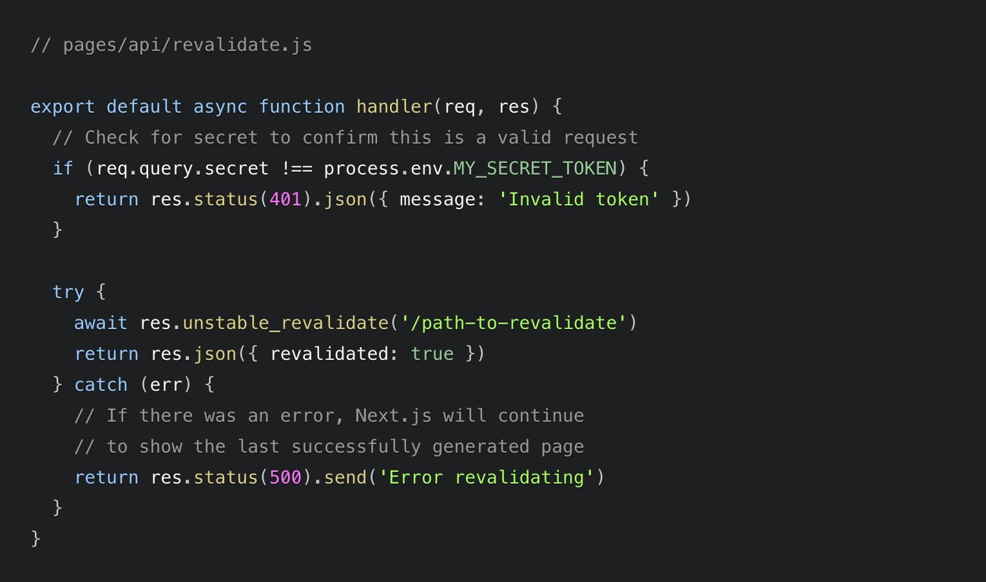
On-demand Incremental Static Regeneration

Slide 5
On-demand Incremental Static Regeneration
Inside getStaticProps, you do not need to specify revalidate to use on-demand revalidation.
If revalidate is omitted, Next.js will use the default value of false (no revalidation) and only revalidate the page on-demand when unstable_revalidate() is called.
On some platforms, on-demand revalidation propagates globally in ~300ms when pushing pages to the edge.

