Slide 1
AIVANCITY / PRACTICAL MACHINE LEARNING
Gas Turbine NOx
Emission Prediction
A PyTorch neural network for estimating same-hour nitrogen oxide concentrations
PRESENTED BY
PROFESSOR
Aadarshkumar Desai
Burak Civitcioglu
MSc in Data Engineering and Cloud Computing
36,733 hourly observations • 9 sensor inputs • PyTorch + Streamlit
UCI Gas Turbine CO and NOx Emission Data Set | 2011–2015
1 / 7
Notes:
SPEAKER NOTES — REHEARSAL ONLY
Introduce yourself and identify Professor Burak Civitcioglu and the Practical Machine Learning subject. Explain: this project estimates the concentration of NOx emitted by a gas turbine using nine measurements collected during the same hour. NOx is a pollutant generated during combustion. The dataset comes from UCI and includes 36,733 observations spanning 2011–2015. This is regression, not future forecasting. Transition to the chronological train/validation/test split on the next slide.

Slide 2
GAS TURBINE NOx • PYTORCH REGRESSION
Real data, split by year
One gas turbine in Turkey • UCI repository • measurements from 2011–2015
TRAIN
VALIDATION
TEST
15,039
7,152
14,542
2011–2012
2013
2014–2015
Inputs: 9 ambient/operating measurements (AT, AP, AH, AFDP, GTEP, TIT, TAT, TEY, CDP). Target: NOX (mg/m³).
UCI Gas Turbine Emissions | Validation: 2013 • Test: 2014–2015
2 / 7
Notes:
SPEAKER NOTES — REHEARSAL ONLY
Describe origin and scale. Explain the nine sensor abbreviations are temperatures, pressures, humidity and energy yield; CO is excluded. The chronological split avoids randomly mixing adjacent hours from different years. Training computes scaling means and standard deviations; validation selects hyperparameters; test years remain held out for final reporting. Cite UCI dataset 551.

Slide 3
GAS TURBINE NOx • PYTORCH REGRESSION
A small network trained from scratch
9 inputs
→
32 neurons
ReLU
→
16 neurons
ReLU
→
1 output
NOx
Training
MSE loss + Adam optimizer
Generalization
Validate every epoch; early stopping
865 trainable parameters • batch size 256 • input and target standardization from training data only
UCI Gas Turbine Emissions | Validation: 2013 • Test: 2014–2015
3 / 7
Notes:
SPEAKER NOTES — REHEARSAL ONLY
Explain Linear as weighted sums plus biases, ReLU as setting negative activations to zero, and the scalar output as an unconstrained regression estimate. Describe one batch: zero_grad, forward, MSE, backward, optimizer.step. No pretrained network is used. Parameter total: 9×32+32=320; 32×16+16=528; 16×1+1=17; total 865.

Slide 4
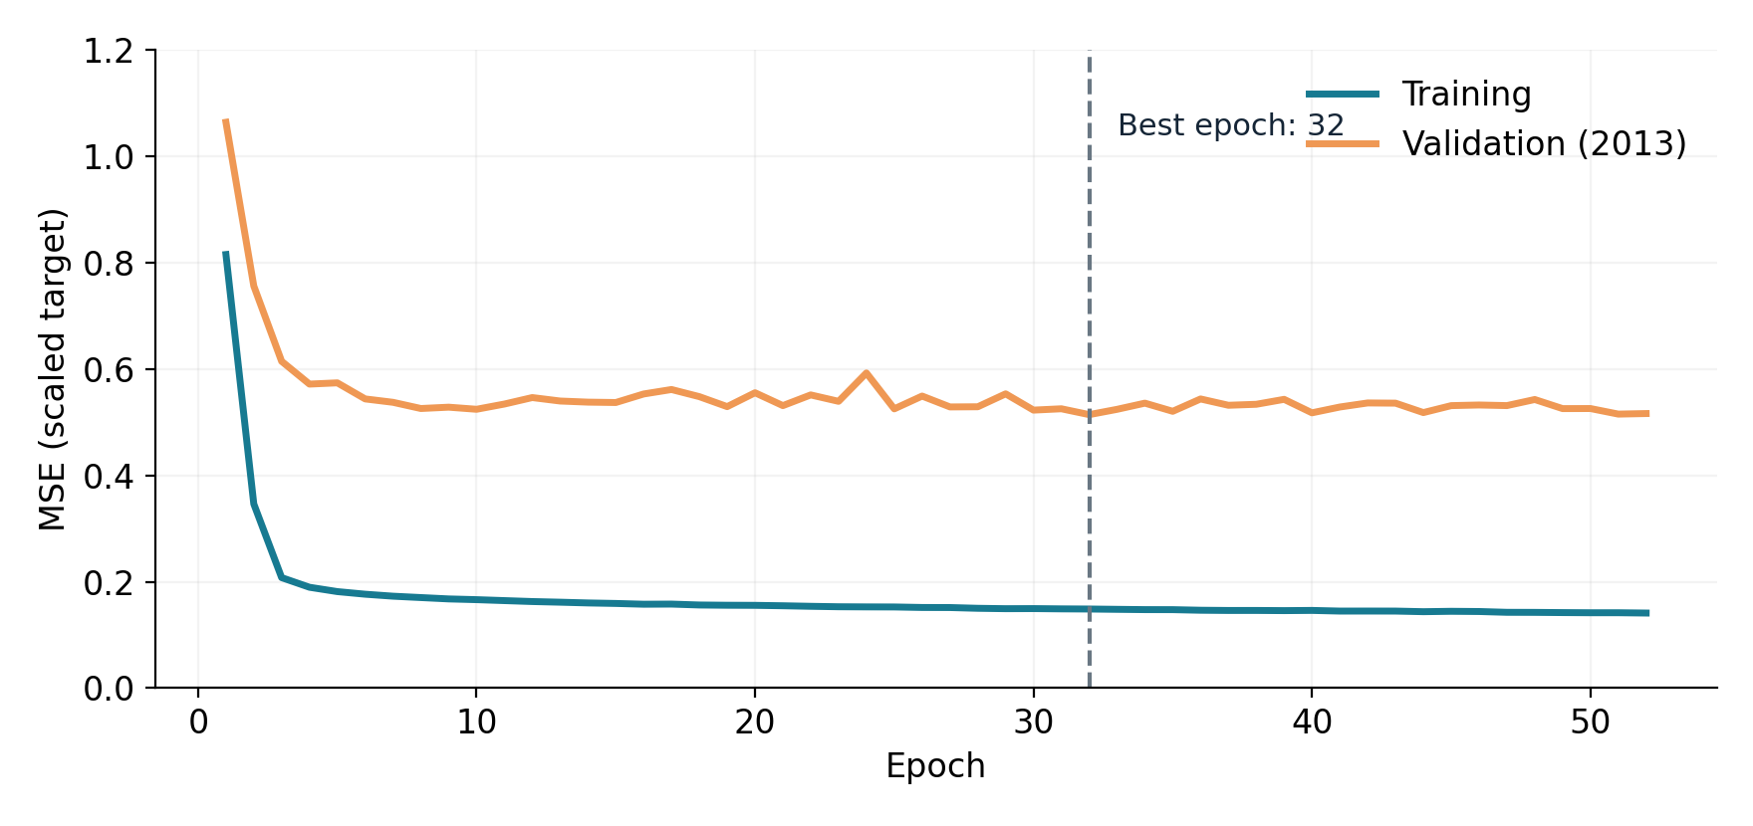
GAS TURBINE NOx • PYTORCH REGRESSION
Validation chooses the best checkpoint
Learning rates tested
0.001 • 0.0003
Selected checkpoint
Epoch 32
Validation RMSE: 7.507 mg/m³
Stop after 20 epochs without validation improvement (maximum: 120 per trial).
UCI Gas Turbine Emissions | Validation: 2013 • Test: 2014–2015
4 / 7
Notes:
SPEAKER NOTES — REHEARSAL ONLY
Two learning rates are tried from the same seed. Validation set is 2013 only. The line chart plots MSE on a STANDARDIZED target; the 7.507 RMSE is on real mg/m³ units, so numbers are on different scales. The minimum validation loss is at epoch 32; training ran to epoch 52 before early stopping. The best epoch weights, not the last epoch, are saved.

Slide 5
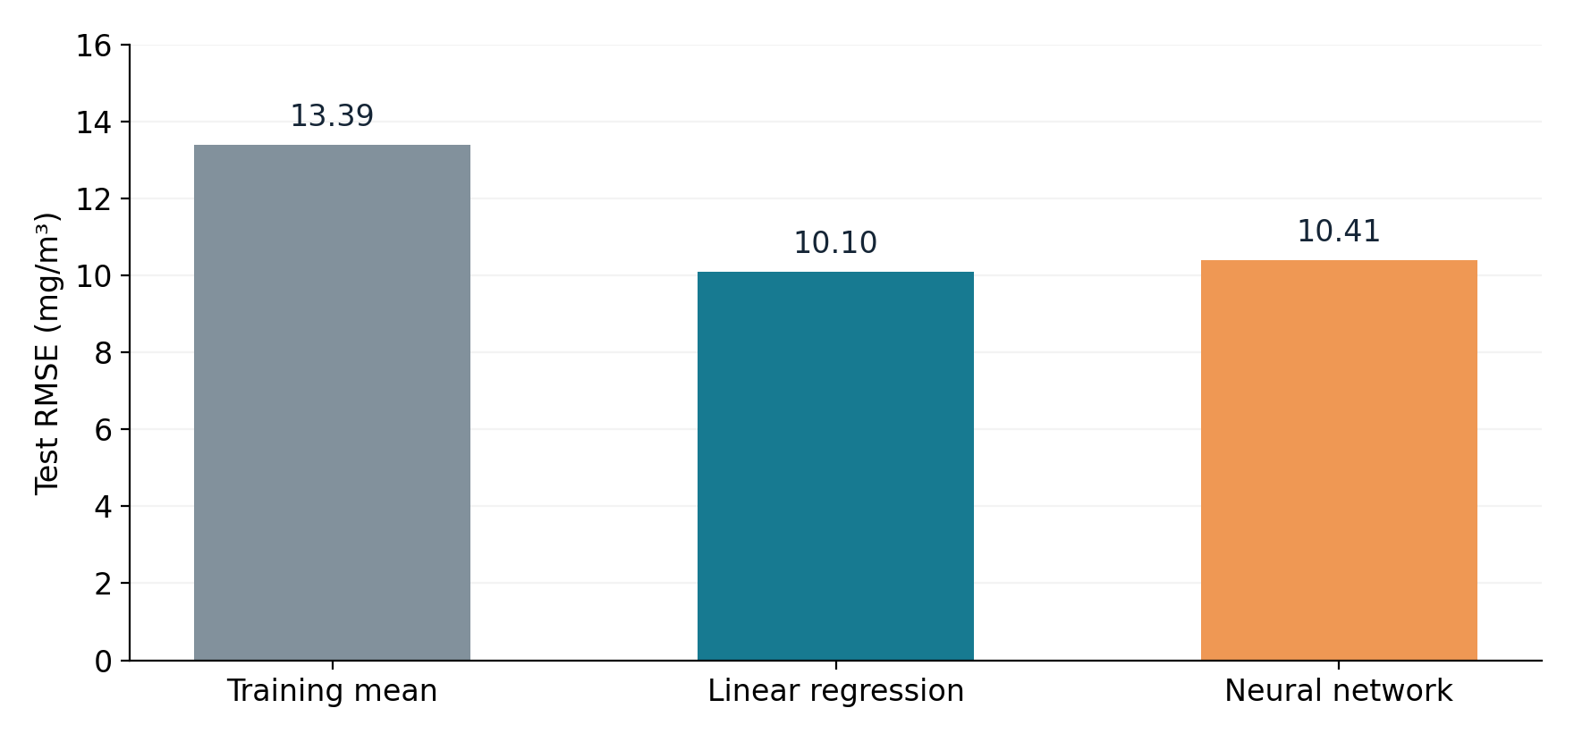
GAS TURBINE NOx • PYTORCH REGRESSION
Test result: the simpler baseline wins
Neural network
MAE 9.073
RMSE 10.407
R² 0.032
All metrics on 14,542 test rows
Finding: the neural network improves on the constant predictor, but linear regression has lower test error.
UCI Gas Turbine Emissions | Validation: 2013 • Test: 2014–2015
5 / 7
Notes:
SPEAKER NOTES — REHEARSAL ONLY
Clarify that test set is 2014–2015 and was not used for selecting learning rate or epoch. RMSE is typical error on a scale that penalizes large errors; lower is better. MAE is average absolute error. R² near zero means limited variance explained. Explicitly acknowledge that linear regression is superior here. Do not claim the neural network is the best model.

Slide 6
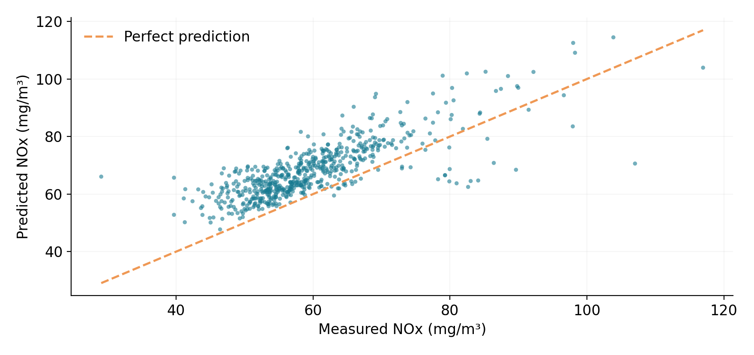
GAS TURBINE NOx • PYTORCH REGRESSION
Why the test result matters
Error by test year
2014
RMSE 9.14
2015
RMSE 11.51
Each dot is one observation from a displayed sample; the diagonal indicates an exact prediction.
UCI Gas Turbine Emissions | Validation: 2013 • Test: 2014–2015
6 / 7
Notes:
SPEAKER NOTES — REHEARSAL ONLY
Explain x-axis actual and y-axis predicted concentration. Dots on diagonal are perfect; distance from diagonal is error. Graph uses a display sample, not all 14,542 test rows; metrics use all rows. Performance worsens in 2015. Temporal drift is possible but not proven. One turbine and no explicit timestamps limit conclusions.

Slide 7
GAS TURBINE NOx • PYTORCH REGRESSION
Live demo, limitations, and takeaway
LIVE STREAMLIT DEMO
LIMITATIONS
1. Choose a saved example
2. Change one of the nine sensors
3. Select Estimate NOx
4. Show prediction in mg/m³
5. Try a batch CSV
• One gas turbine (2011–2015)
• Weak generalization in 2015
• Better linear baseline
• No calibrated uncertainty
• Not a control recommendation
Takeaway: an end-to-end, reproducible PyTorch experiment with an honest held-out evaluation.
UCI Gas Turbine Emissions | Validation: 2013 • Test: 2014–2015
7 / 7
Notes:
SPEAKER NOTES — REHEARSAL ONLY
Open Streamlit already running on the laptop. Select a preset, alter a sensor value, and show estimated NOx. Demonstrate CSV tab if time. Stress model.pt loads with eval/inference_mode and does not retrain at app startup. Give the limitations and close with reproducibility and integrity of evaluation. Be ready to explain any code line; never use speaker notes during defence if disallowed.

