Slide 1
What Are Word Vectors ?

Slide 2
Agenda
What are word vectors
Simple Application of Word Vectors
Word Vector With Cooccurrence Matrix
Dimensionality Reduction with PCA
Visualize Word Vectors with PCA
Calculate the similarity between words

Slide 3
What Are Word Vectors
You already know word vectors…..

Slide 4
Simple Application of Word Vectors
You have three books…..
Book on Economics
Book on Data Science
Book on Film Production
Y-axis : Count of word ‘Entertain’
 | “data” | “entertain”
Economics
Data Science
Film Production
X-axis : Count of word ‘data’

Slide 5
Word Vector With Cooccurrence Matrix
[“I like deep learning”, “I like nlp”, “I enjoy flying”
N_gram: 2 | I | like | enjoy | deep | learning | nlp | flying
I |  | 2 | 1 | 0 | 0 | 0 | 0
like | 2
enjoy | 1
deep | 0
learning | 0
nlp | 0
flyig | 0

Slide 6

Dimensionality Reduction with PCA
The Shadow Example … From 3D to 2D

Slide 7
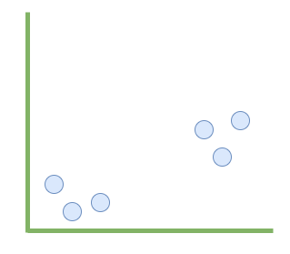
Dimensionality Reduction with PCA
Principal Components Analysis
feature1 | feature2 | feature3 | feature4 | feature5
Feature_1
Ask the algorithm to create two PCAs…..
PCA1 | PCA2
Feature_0

Slide 8
Word Vector With Cooccurrence Matrix
Original Data
PCA / Reduced Data
N_gram: 1 | I | like | enjoy | deep | learning | nlp | flying
I |  | 2 | 1 | 0 | 0 | 0 | 0
like | 2
enjoy | 1
deep | 0
learning | 0
nlp | 0
flyig | 0
 | PCA 1 | PCA 2
I | 0.51 | 3.58
like | 2.36 | 4.59
enjoy | 0.89 | -2.69
deep | 3.85 | -4.01
learning | -2.3 | 2.94
nlp | 1.9 | 6.27
flyig | -2.1 | -0.78

Slide 9
Simple Application of Word Vectors
Euclidian Distance
Cosign Distance
Like, enjoy , love
PCA 2
PCA 1

Slide 10
Simple Application of Word Vectors
Let’s go coding ……….

