Slide 1
Word Vectors.. Part 2

Slide 2
Agenda
Word Embedding
Skip Gram
Continuous BOW
Neural Nets
Word Embeddings with Neural Nets
Applications
Code

Slide 3
Word Embeddings
You have three books…..
Book on Economics
Book on Data Science
Book on Film Production
Y-axis : Count of word ‘Entertain’
 | “data” | “entertain”
Economics
Data Science
Film Production
X-axis : Count of word ‘data’

Slide 4
Word Embeddings
You have four words from a corpus…..
Cat
Dog
poverty
education
Y-axis : Intangible
Y-axis : Count of word ‘Entertain’
Money
Death
X-axis : tangible
X-axis : Count of word ‘data’
So how do we learn these embeddings ….?

Slide 5
Word Embeddings
Do you see the difference between what we saw earlier ?
You have four words from a corpus…..
Cat
Dog
poverty
education
Y-axis : Intangible
Y-axis : Count of word ‘Entertain’
Money
Death
X-axis : tangible
X-axis : Count of word ‘data’
So how do we learn these embeddings ….?

Slide 6
Word Embeddings
Word Embedding are generated from the context !
[["He", "is", "the", 'king'],["The", "king", 'is', 'royal'],["She", "is", "the", "queen"]]
How do we learn the context ?
We learn by predicting… just like regression …
We take a word, and predict the words before and after it - Skip Gram Learning
We take surrounding words, and predict the word between them – Continuous BOW

Slide 7
Word Embeddings
[["He", "is", "the", 'king'],["The", "king", 'is', 'royal'],["She", "is", "the", "queen"]]
Skip Gram Learning
Skip Gram Learning

Slide 8
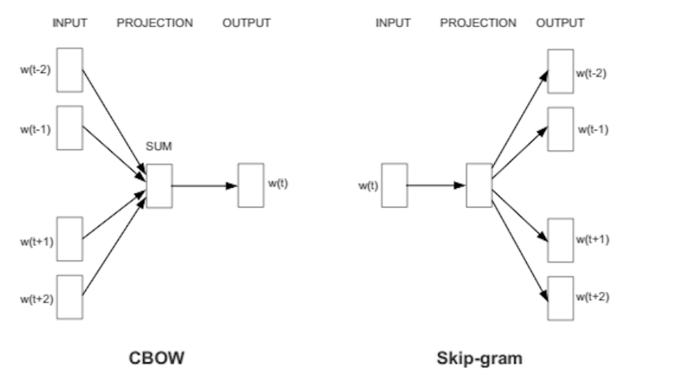
Word Embeddings

Slide 9
Word Embeddings
[["He", "is", "the", 'king'],["The", "king", 'is', 'royal'],["She", "is", "the", "queen"]]
Skip Gram Learning
works well with a small amount of the training data, represents well even rare words or phrases.
CBOW Learning
several times faster to train than the skip-gram, slightly better accuracy for the frequent words.

Slide 10
Neural Nets
Input Layer
Hidden Layer
Output Layer

Slide 11
Word Embeddings with Neural Nets
[["He", "is", "the", 'king'],["The", "king", 'is', 'royal'],["She", "is", "the", "queen"]]
Skip Gram Example
Ow long is context (window size) = 2
Input Layer
Hidden Layer
Output Layer
['he', 'is'],
['he', 'the’],
['is', 'he'],
['is', 'the'],
['is', 'king’],
['the', 'he'],
['the', 'is'],
['the', 'king’],

Slide 12
Word Embeddings with gensim
Lest go coding !

