Slide 1
NLP With Big Data

Slide 2
Agenda
Pillars of Big Data
Why Big Data is a Problem ?
Vertical and Horizontal Scaling
What is Multiprocessing
Spark & Databrick
How to use Spark For Free
Spark Coding Structure
Spark DataFrame Vs Koals
Contentment Analysis with Spark

Slide 3
What Makes the Data Big ?
There are 4 Pillars of big data
Volume: the size and amounts of big data that companies manage and analyze
Variety: the diversity and range of different data types,
Velocity: the speed at which companies receive, store and manage data
Veracity: the quality and the availability of the data

Slide 4
Why Big Data is a Problem ?
Ignoring Variety & Veracity….
Volume and Velocity will increase the data, sometime even by seconds ….
But the resources remain the same !

Slide 5
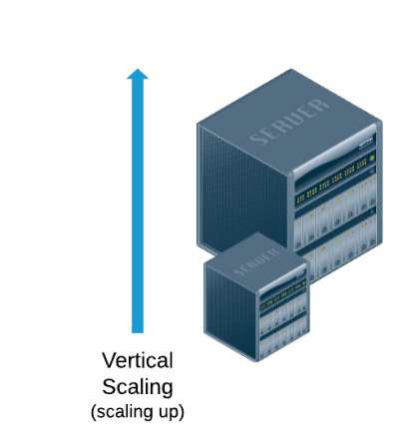
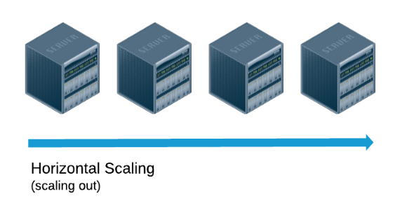
Vertical and Horizontal Scaling
What is the solution ?
Vertical Scaling
Horizontal Scaling

Slide 6
What is Multiprocessing ?
Horizontal Scaling
Array =[2,3,4,5]
F(x) = Square
Your computer “cores” can also do distribute computing

Slide 7
What is Spark
Spark is an engine / framework that applies multiprocessing on network
of computers
Apache Spark is itself free (open source)
But underlying resources are not ….
We can create a free one, at Databrick Community
https://community.cloud.databricks.com/login.html

Slide 8
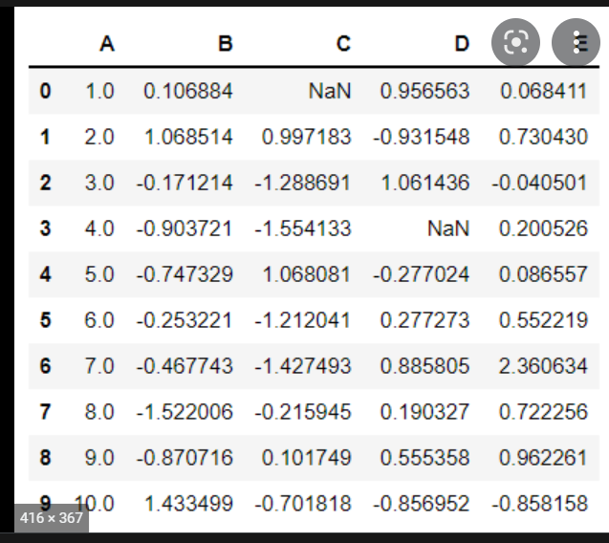
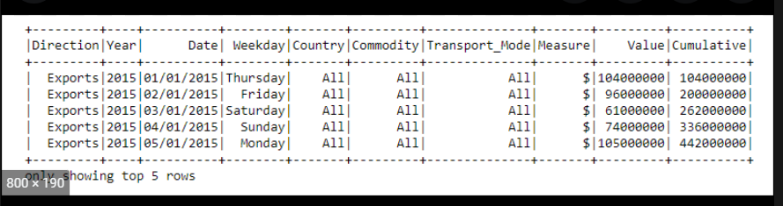
Spark Data Frames Vs Koalas
In distributed computing things are different
e.g. you do not want to run a “for loop”
Koalas Data Frame
Spark Data Frame
We will use Koalas as far as we CAN

Slide 9
Spark Coding Structure
Spark has its own Machine Learning Library, MLlib
Here is how things generally work
1. Feature Building Blocks
2. Vector Assembler
3. Model
5. Fit & Transform
4 .Pipeline

Slide 10
Let us start coding !

