Slide 1
BDM 2053
Big Data Algorithms and Statistics

Slide 2
Course Objectives
Discuss regression and its types.
Discuss unsupervised learning.
Discuss clustering using k-means and hierarchical clustering techniques.
Discuss deep learning.

Slide 3
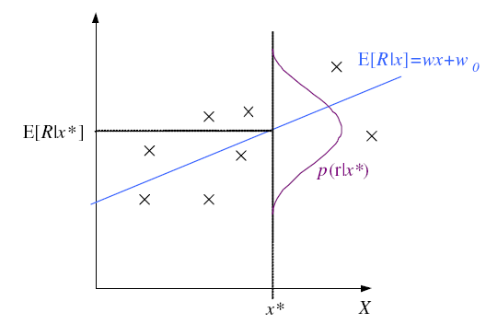
Regression

Slide 4
Regression: From LogL to Error

Slide 5
Linear Regression

Slide 6
Polynomial Regression

Slide 7
Other Error Measures

Slide 8
Bias and Variance
noise
squared error
bias
variance

Slide 9
Estimating Bias and Variance
M samples X_{i}={x^{t}_{i} , r^{t}_{i}}, i=1,...,M
are used to fit g_{i} (x), i =1,...,M

Slide 10
Bias/Variance Dilemma
Example: g_{i}(x)=2 has no variance and high bias
g_{i}(x)= _{∑t} r^{t}_{i}/N has lower bias with variance
As we increase complexity,
bias decreases (a better fit to data) and
variance increases (fit varies more with data)
Bias/Variance dilemma: (Geman et al., 1992)

Slide 11
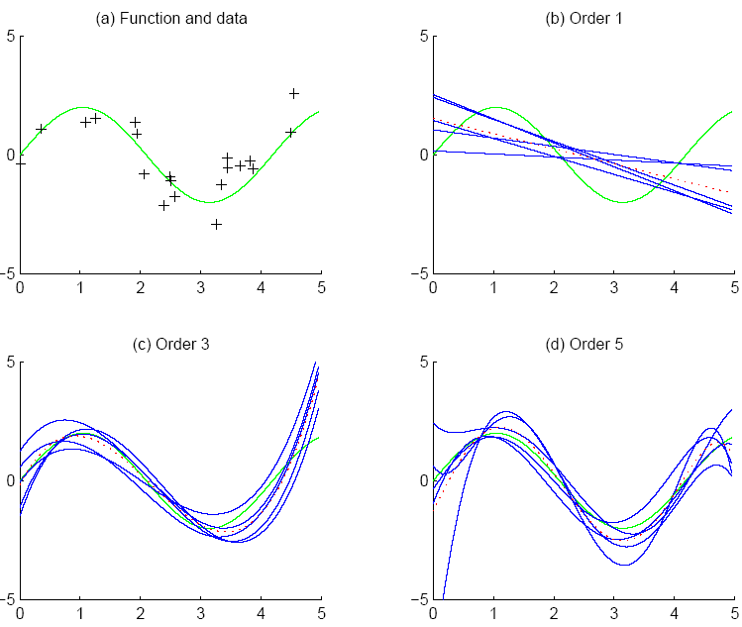
f
f
bias
g_{i}
g
variance

Slide 12
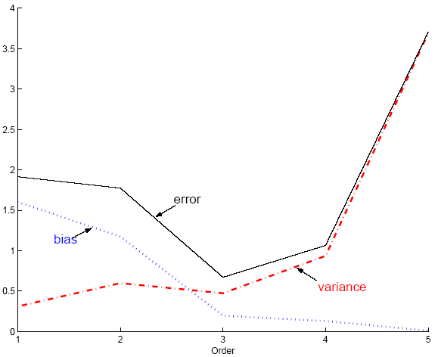
Polynomial Regression
Best fit “min error”

Slide 13
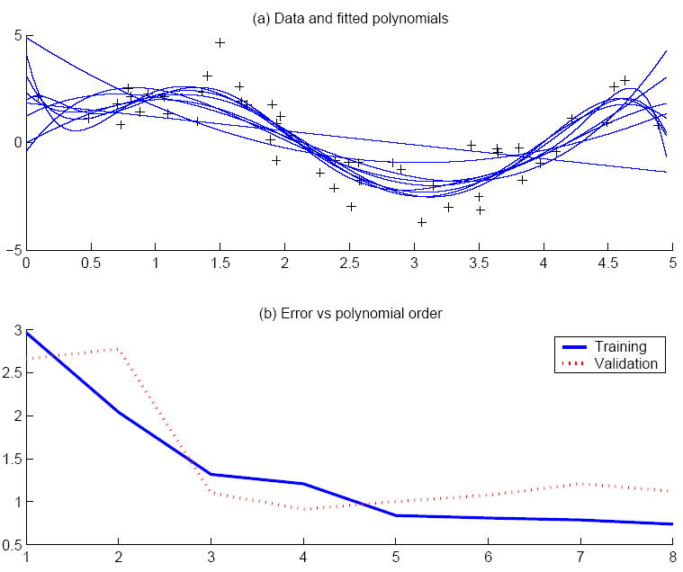
Best fit, “elbow”

Slide 14
Model Selection
Cross-validation: Measure generalization accuracy by testing on data unused during training
Regularization: Penalize complex models
E’=error on data + λ model complexity
Akaike’s information criterion (AIC), Bayesian information criterion (BIC)
Minimum description length (MDL): Kolmogorov complexity, shortest description of data
Structural risk minimization (SRM)

Slide 15
Bayesian Model Selection
Prior on models, p(model)
Regularization, when prior favors simpler models
Bayes, MAP of the posterior, p(model|data)
Average over a number of models with high posterior (voting, ensembles: Chapter 15)

Slide 16
Classes vs. Clusters
Supervised: X = { x^{t} ,r^{t} }_{t}
Classes C_{i} i=1,...,K
where p ( x | C_{i}) ~ N ( μ_{i} , ∑_{i} )
Φ = {P (C_{i} ), μ_{i} , ∑_{i} }^{K}_{i=1}
Unsupervised : X = { x^{t} }_{t}
Clusters G_{i} i=1,...,k
where p ( x | G_{i}) ~ N ( μ_{i} , ∑_{i} )
Φ = {P ( G_{i} ), μ_{i} , ∑_{i} }^{k}_{i=1}
Labels, r ^{t}_{i} ?

Slide 17
k-Means Clustering
Find k reference vectors (prototypes/codebook vectors/codewords) which best represent data
Reference vectors, m_{j}, j =1,...,k
Use nearest (most similar) reference:
Reconstruction error

Slide 18
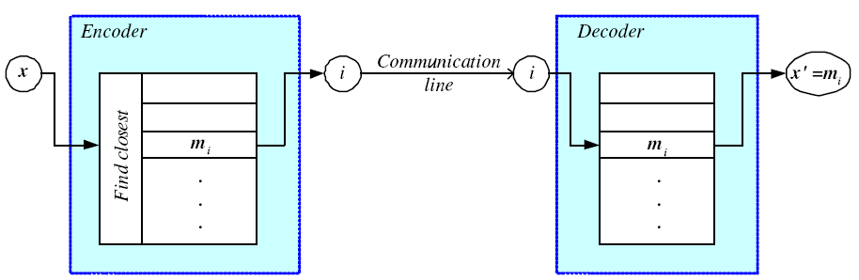
Encoding/Decoding

Slide 19
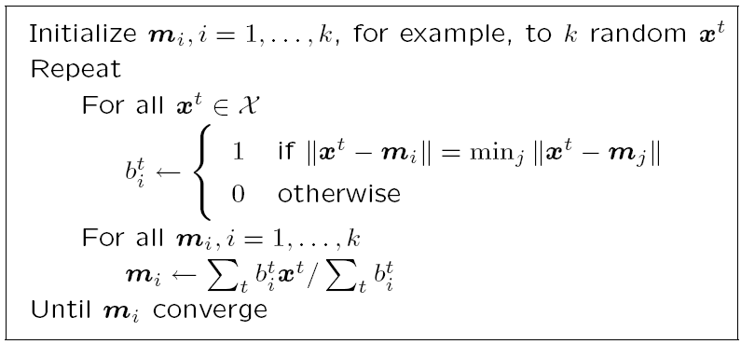
k-means Clustering

Slide 20
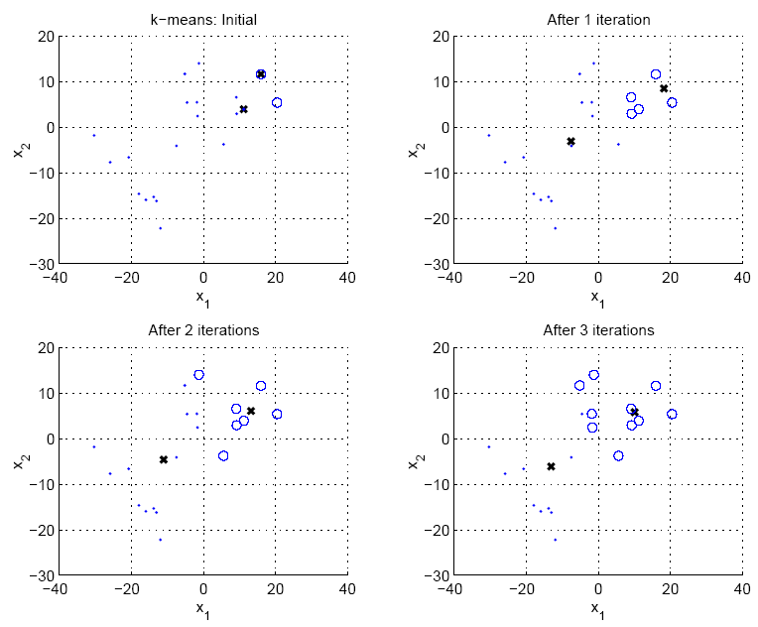

Slide 21
Expectation-Maximization (EM)
Log likelihood with a mixture model
Assume hidden variables z, which when known, make optimization much simpler
Complete likelihood, L_{c}(Φ |X,Z), in terms of x and z
Incomplete likelihood, L(Φ |X), in terms of x

Slide 22
E- and M-steps
Iterate the two steps
E-step: Estimate z given X and current Φ
M-step: Find new Φ’ given z, X, and old Φ.
An increase in Q increases incomplete likelihood

Slide 23
EM in Gaussian Mixtures
z^{t}_{i} = 1 if x^{t} belongs to G_{i}, 0 otherwise (labels r ^{t}_{i} of supervised learning); assume p(x|G_{i})~N(μ_{i},∑_{i})
E-step:
M-step:
Use estimated labels in place of unknown labels

Slide 24
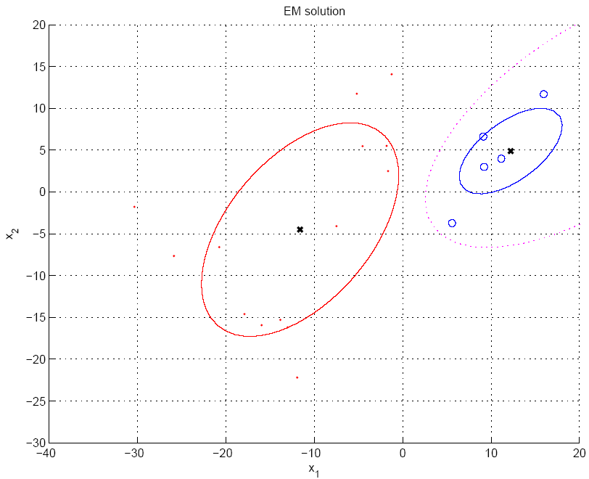
P(G₁|x)=h₁=0.5

Slide 25
Mixtures of Latent Variable Models
Regularize clusters
Assume shared/diagonal covariance matrices
Use PCA/FA to decrease dimensionality: Mixtures of PCA/FA
Can use EM to learn V_{i} (Ghahramani and Hinton, 1997; Tipping and Bishop, 1999)

Slide 26
After Clustering
Dimensionality reduction methods find correlations between features and group features
Clustering methods find similarities between instances and group instances
Allows knowledge extraction through
number of clusters,
prior probabilities,
cluster parameters, i.e., center, range of features.
Example: CRM, customer segmentation

Slide 27
Clustering as Preprocessing
Estimated group labels h_{j} (soft) or b_{j} (hard) may be seen as the dimensions of a new k dimensional space, where we can then learn our discriminant or regressor.
Local representation (only one b_{j} is 1, all others are 0; only few h_{j} are nonzero) vs
Distributed representation (After PCA; all z_{j} are nonzero)

Slide 28
Mixture of Mixtures
In classification, the input comes from a mixture of classes (supervised).
If each class is also a mixture, e.g., of Gaussians, (unsupervised), we have a mixture of mixtures:

Slide 29
Hierarchical Clustering
Cluster based on similarities/distances
Distance measure between instances x^{r} and x^{s}
Minkowski (L_{p}) (Euclidean for p = 2)
City-block distance

Slide 30
Agglomerative Clustering
Start with N groups each with one instance and merge two closest groups at each iteration
Distance between two groups G_{i} and G_{j}:
Single-link:
Complete-link:
Average-link, centroid

Slide 31
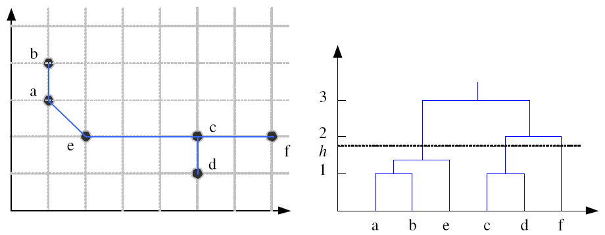
Example: Single-Link Clustering
Dendrogram

Slide 32
Choosing k
Defined by the application, e.g., image quantization
Plot data (after PCA) and check for clusters
Incremental (leader-cluster) algorithm: Add one at a time until “elbow” (reconstruction error/log likelihood/intergroup distances)
Manual check for meaning

Slide 33
Why Unsupervised Learning?
Unsupervised machine learning finds all kind of unknown patterns in data.
Unsupervised methods help you to find features which can be useful for categorization.
It is taken place in real time, so all the input data to be analyzed and labeled in the presence of learners.
It is easier to get unlabeled data from a computer than labeled data, which needs manual intervention.

Slide 34
Unsupervised learning is a machine learning technique, where you do not need to supervise the model.
Unsupervised machine learning helps you to finds all kind of unknown patterns in data.
Clustering and Association are two types of Unsupervised learning.
Four types of clustering methods are 1) Exclusive 2) Agglomerative 3) Overlapping 4) Probabilistic.
Important clustering types are: 1)Hierarchical clustering 2) K-means clustering 3) K-NN 4) Principal Component Analysis 5) Singular Value Decomposition 6) Independent Component Analysis.
Association rules allow you to establish associations amongst data objects inside large databases.
In Supervised learning, Algorithms are trained using labeled data while in Unsupervised learning Algorithms are used against data which is not labeled.
Anomaly detection can discover important data points in your dataset which is useful for finding fraudulent transactions.
The biggest drawback of Unsupervised learning is that you cannot get precise information regarding data sorting.

Slide 35
Deep Learning
Deep learning is a computer software that mimics the network of neurons in a brain. It is a subset of machine learning and is called deep learning because it makes use of deep neural networks. The machine uses different layers to learn from the data. The depth of the model is represented by the number of layers in the model. Deep learning is the new state of the art in term of AI. In deep learning, the learning phase is done through a neural network. A neural network is an architecture where the layers are stacked on top of each other

Slide 36
Deep Learning Process
In deep learning, the learning phase is done through a neural network. A neural network is an architecture where the layers are stacked on top of each other.
Consider the same image example above. The training set would be fed to a neural network
Each input goes into a neuron and is multiplied by a weight. The result of the multiplication flows to the next layer and become the input. This process is repeated for each layer of the network. The final layer is named the output layer; it provides an actual value for the regression task and a probability of each class for the classification task. The neural network uses a mathematical algorithm to update the weights of all the neurons. The neural network is fully trained when the value of the weights gives an output close to the reality. For instance, a well-trained neural network can recognize the object on a picture with higher accuracy than the traditional neural net.

Slide 37
Summary
Artificial intelligence is imparting a cognitive ability to a machine. Comparing AI vs Machine Learning, early AI systems used pattern matching and expert systems.
The idea behind machine learning is that the machine can learn without human intervention. The machine needs to find a way to learn how to solve a task given the data.
Deep learning is the breakthrough in the field of artificial intelligence. When there is enough data to train on, deep learning achieves impressive results, especially for image recognition and text translation. The main reason is the feature extraction is done automatically in the different layers of the network.

