Slide 1
BDM 2053
Big Data Algorithms and Statistics

Slide 2
Course Objectives
A Game for you!
What is Decision Tree?
How to build Decision Tree
Random Forest
Classifications

Slide 3
Review of Classification
Given a set of attributes (X1,X2, …, Xn) of an object, predict its label/class (C) based on training examples
Three types of attributes:
Numerical/continuous: Domain is ordered and can be represented on the real line (e.g., age, income)
(0.3, 0.4, 0. 5, …)
Ordinal: Domain is ordered, but absolute differences between values is unknown (e.g., preference scale, severity of an injury)
Grade: (A, B, C, D)
Nominal or categorical: Domain is a finite set without any natural ordering (e.g., occupation, marital status, race)
Color: (red, blue, yellow)

Slide 4

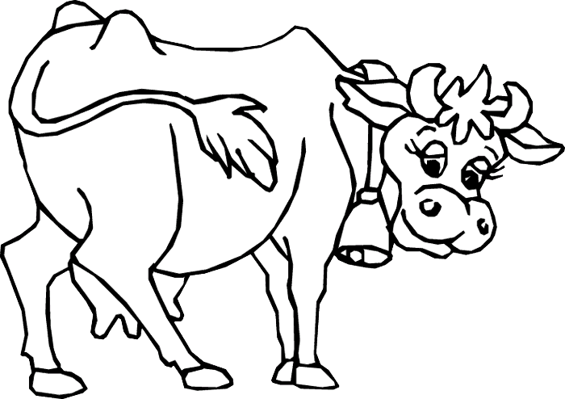
Game of Guessing Animal
I write down an animal name on a paper (e.g. cow)
You are expected to inquire on the attributes of the animal to guess the animal name. Only Yes/No questions can be asked. (e.g. 4 legs?)
The winner is the one who get the answer with the minimal No. of questions.
The tricky part what questions should u ask?

Slide 5
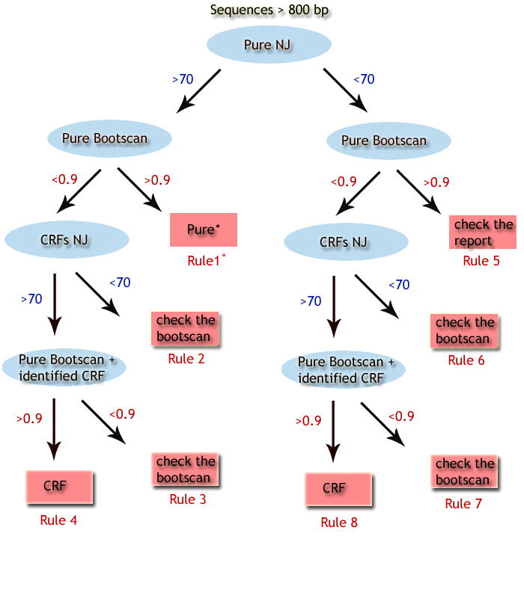
What is Decision Tree?
REGA HIV-1 Subtying Decision Tree Classifier

Slide 6
What is Decision Tree?
They do classification: predict a categorical output from categorical and/or real inputs
Decision trees are the single most popular data mining tool
Easy to understand
Easy to implement
Easy to use
Computationally cheap
Mature, Easy-to-use software package freely available
NO programming needed!

Slide 7
What is Decision Tree?
Extremely popular method
Credit risk assessment
Medical diagnosis
Market analysis
Bioinformatics
Chemistry
A literature search in pubmed.org retrieves 6906 papers related to decision trees!
Good at dealing with symbolic feature

Slide 8
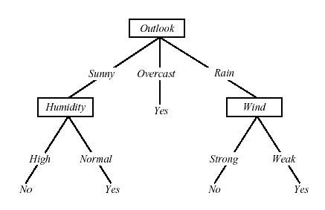
Decision Tree Representation
Classify instances by sorting them down the tree from the root to some leaf node
Each branch corresponds to attribute value
Each internal node has a splitting predicate
Each leaf node assigns a classification

Slide 9
Internal Nodes
Each internal node has an associated splitting predicate. Most common are binary predicates. Example predicates:
Age <= 20
Profession in {student, teacher}
5000*Age + 3*Salary – 10000 > 0

Slide 10
Internal Nodes: Splitting Predicates
Binary Univariate splits:
Numerical or ordered X: X <= c, c in dom(X)
Categorical X: X in A, A subset dom(X)
Binary Multivariate splits:
Linear combination split on numerical variables: Σ a_{i}X_{i} <= c
k-ary (k>2) splits analogous

Slide 11
Building Decision Tree Classifiers for DELL to Predict if a customer would buy a computer
Training Data

Slide 12
Output: A Decision Tree for “buys_computer”
age?
<=30
overcast
>40
31..40
student?
yes
credit rating?
no
yes
excellent
fair
no
yes
no
yes
Homogeneous: All labels of the instances are YES
Majority Voting 4/5

Slide 13
TDIDT Algorithm
Also known as ID3 (Quinlan)
To construct decision tree T from learning set S:
If all examples in S belong to some class C Then make leaf labeled C
Otherwise
select the “most informative” attribute A
partition S according to A’s values
recursively construct subtrees T1, T2, ..., for the subsets of S

Slide 14
Algorithm for Decision Tree Induction
Basic algorithm (a greedy algorithm)
Tree is constructed in a top-down recursive divide-and-conquer manner
At start, all the training examples are at the root
Attributes are categorical (if continuous-valued, they are discretized in advance)
Examples are partitioned recursively based on selected attributes
Test attributes are selected on the basis of a heuristic or statistical measure (e.g., information gain)
Conditions for stopping partitioning
All samples for a given node belong to the same class
There are no remaining attributes for further partitioning – majority voting is employed for classifying the leaf
There are no samples left

Slide 15
Design Issues of Decision Trees
Which decision tree is the best?
Which attributes to check first? How to split?
How to decide the split values of real-value attributes (e.g. age)?
When to stop splitting?
How to evaluate decision trees?
age?
<=30
overcast
31..40
>40
student?
yes
credit rating?
no
yes
excellent
fair
no
yes
no
yes

Slide 16
Which Decision Tree is the Best?
Occam’s razor: (year 1320)
Prefer the simplest hypothesis that fits the data.
The principle states that the explanation of any phenomenon should make as few assumptions as possible, eliminating those that make no difference in the observable predictions of the explanatory hypothesis or theory
Albert Einstein: Make everything as simple as possible, but not simpler.
Why?
It’s a philosophical problem.
Simple explanation/classifiers are more robust
Simple classifiers are more understandable

Slide 17
How To Build a Simple Decision Tree?: Attribute Selection
Intuitively (as in the game):
We want to reduce the search space (ambiguity) ASAP by asking each question
Scientifically:
Test attributes that gain most information.
Remember: The splitting process of decision tree stops only when the labels of all instances in a node becomes pure (homogeneous) except other special cases.

Slide 18
How To Build a Simple Decision Tree
Objective: Shorter trees are preferred over larger Trees
Idea: want attributes that classifies examples well. The best attribute is selected.
Select attribute which partitions the learning set into subsets as “pure” as possible
How well an attribute alone classifies the training data?

Slide 19
Other Attribute Selection Measures
CHAID: a popular decision tree algorithm, measure based on χ² test for independence
C-SEP: performs better than info. gain and gini index in certain cases
G-statistics: has a close approximation to χ² distribution
MDL (Minimal Description Length) principle (i.e., the simplest solution is preferred):
The best tree as the one that requires the fewest # of bits to both (1) encode the tree, and (2) encode the exceptions to the tree
Multivariate splits (partition based on multiple variable combinations)
CART: finds multivariate splits based on a linear comb. of attrs.
Which attribute selection measure is the best?
Most give good results, none is significantly superior than others

Slide 20
Random Forest
random forest is a classifier that consists of many decision trees and outputs the class that is the mode of the classes output by individual trees
For many data sets, it produces a highly accurate classifier.
It handles a very large number of input variables.
It estimates the importance of variables in determining classification.
It generates an internal unbiased estimate of the generalization error as the forest building progresses.
It includes a good method for estimating missing data and maintains accuracy when a large proportion of the data are missing.
It provides an experimental way to detect variable interactions.
It can balance error in class population unbalanced data sets.
It computes proximities between cases, useful for clustering, detecting outliers, and (by scaling) visualizing the data.
Using the above, it can be extended to unlabeled data, leading to unsupervised clustering, outlier detection and data views.
Learning is fast.

Slide 21
Issues in Decision Tree
Overfiting
Tree Pruning
Cross-validation
Model Evaluation
Advanced Decision Tree
C4.5 Software Package

Slide 22
Summary: Advantages of Decision Trees
Simple to understand and interpret. People are able to understand decision tree models after a brief explanation.
Have value even with little hard data. Important insights can be generated based on experts describing a situation (its alternatives, probabilities, and costs) and their preferences for outcomes.
Use a white box model. If a given result is provided by a model, the explanation for the result is easily replicated by simple math.
Can be combined with other decision techniques.

