Slide 1
BDM 2053
Big Data Algorithms and Statistics

Slide 2
Course Objectives
Neural Network Learning
Self-Organizing Maps
Origins
Algorithm
Examples

Slide 3
Learning Time: sequential learning
Course Objectives
Applications:
Sequence recognition: Speech recognition
Sequence reproduction: Time-series prediction
Sequence association
Network architectures
Time-delay networks (Waibel et al., 1989)
Recurrent networks (Rumelhart et al., 1986)

Slide 4
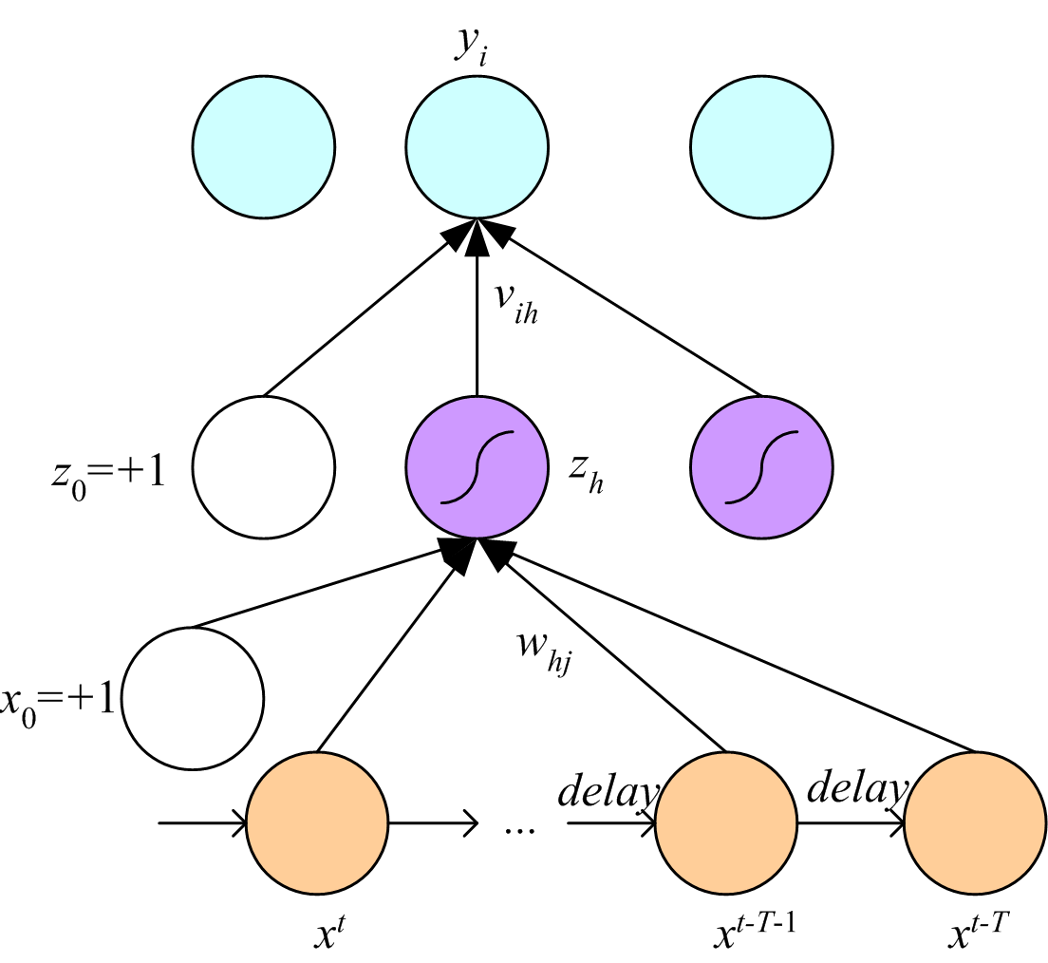
Time-Delay Neural Networks

Slide 5
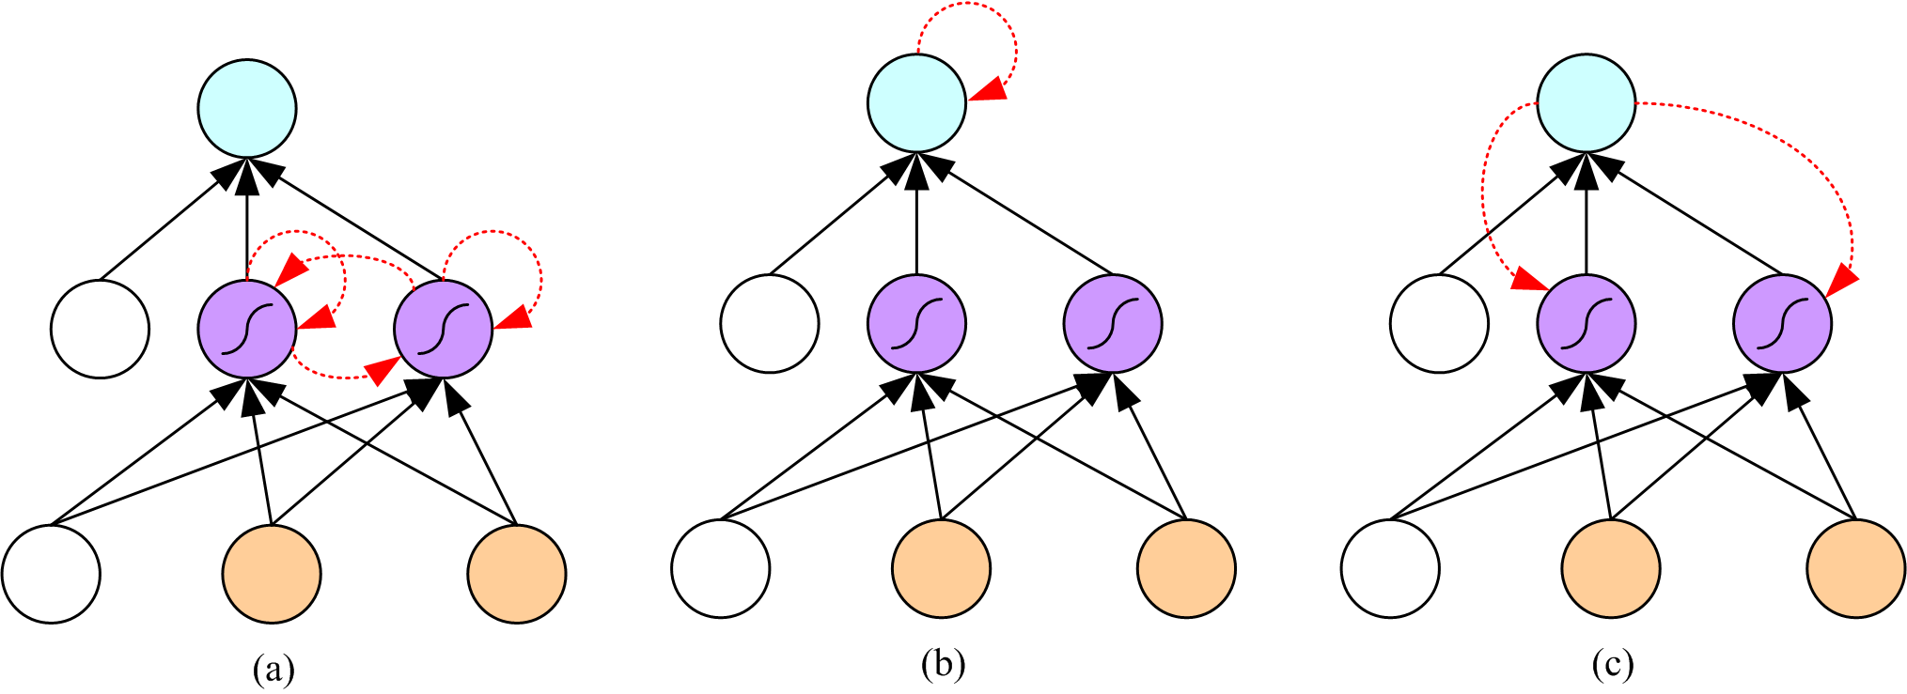
Recurrent Networks

Slide 6
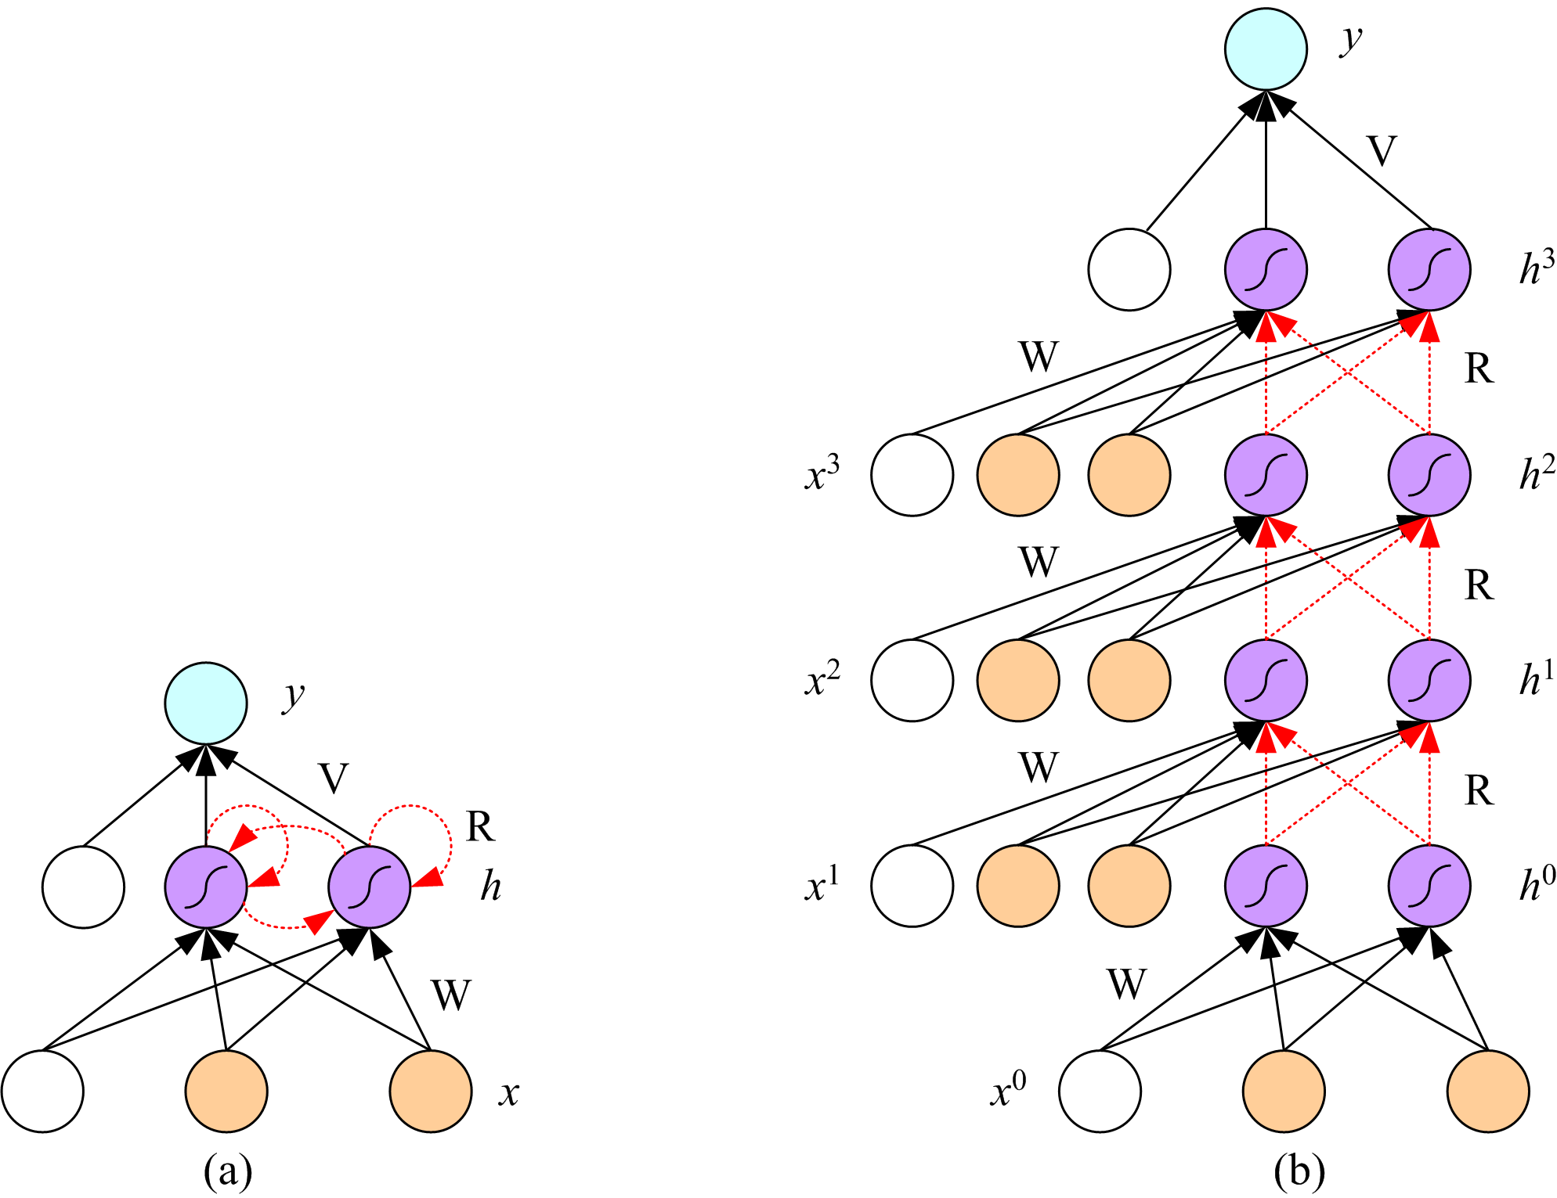
Unfolding in Time

Slide 7
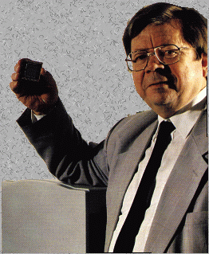
Self-Organizing Maps : Origins
Self-Organizing Maps
Ideas first introduced by C. von der Malsburg (1973), developed and refined by T. Kohonen (1982)
Neural network algorithm using unsupervised competitive learning
Primarily used for organization and visualization of complex data
Biological basis: ‘brain maps’
Teuvo Kohonen

Slide 8
Self-Organizing Maps
SOM - Architecture
Lattice of neurons (‘nodes’) accepts and responds to set of input signals
Responses compared; ‘winning’ neuron selected from lattice
Selected neuron activated together with ‘neighbourhood’ neurons
Adaptive process changes weights to more closely resemble inputs
j
2d array of neurons
w_{j1}
w_{j2}
w_{j3}
w_{jn}
Weighted synapses
x₁
x₂
x₃
...
x_{n}
Set of input signals
(connected to all neurons in lattice)

Slide 9
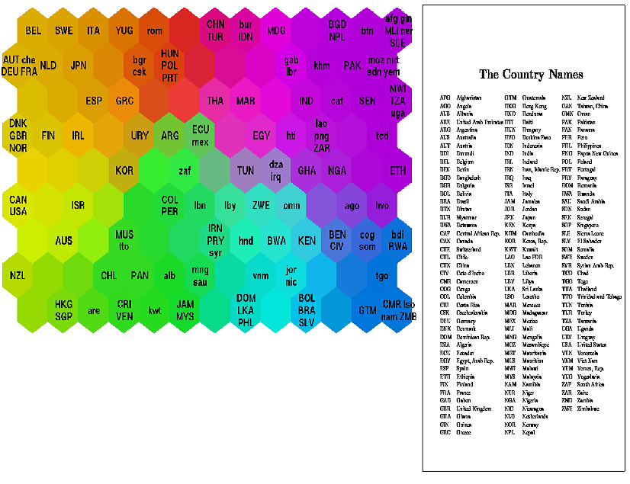
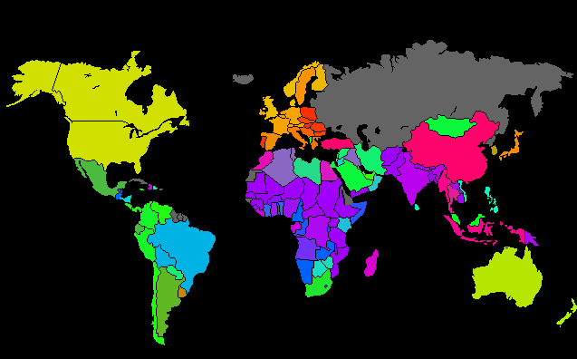
Self-Organizing Maps
SOM – Result Example
Classifying World Poverty
‘Poverty map’ based on 39 indicators from World Bank statistics (1992)

Slide 10
Self-Organizing Maps
SOM – Algorithm Overview
Randomly initialise all weights
Select input vector x = [x₁, x₂, x₃, … , x_{n}]
Compare x with weights w_{j} for each neuron j to determine winner
Update winner so that it becomes more like x, together with the winner’s neighbours
Adjust parameters: learning rate & ‘neighbourhood function’
Repeat from (2) until the map has converged (i.e. no noticeable changes in the weights) or pre-defined no. of training cycles have passed

Slide 11
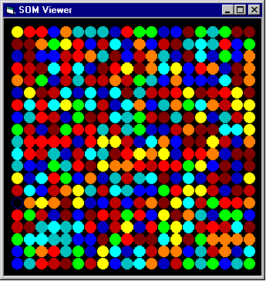
Initialisation
(i)Randomly initialise the weight vectors w_{j} for all nodes j

Slide 12
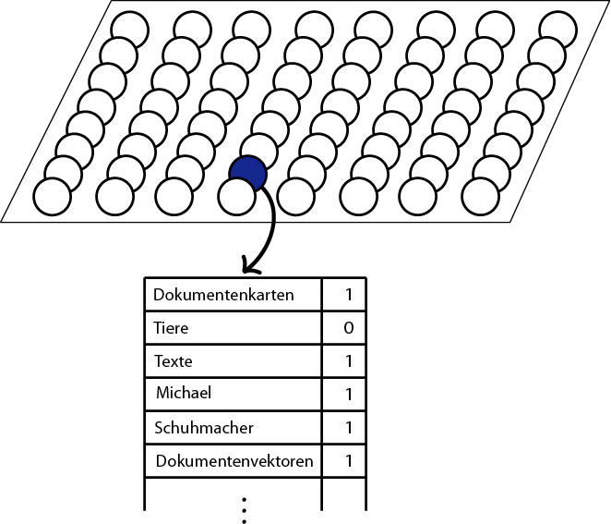
Input vector
In computer texts are shown as a frequency distribution of one word.
A Text Example:
Self-organizing maps (SOMs) are a data visualization technique invented by Professor Teuvo Kohonen which reduce the dimensions of data through the use of self-organizing neural networks. The problem that data visualization attempts to solve is that humans simply cannot visualize high dimensional data as is so technique are created to help us understand this high dimensional data.
Region
(ii) Choose an input vector x from the training set
Self-organizing
2
maps
1
data
4
visualization
2
technique
2
Professor
1
invented
1
Teuvo Kohonen
1
dimensions
1
...
Zebra
0

Slide 13

Finding a Winner
(iii) Find the best-matching neuron w(x), usually the neuron whose weight vector has smallest Euclidean distance from the input vector x
The winning node is that which is in some sense ‘closest’ to the input vector
‘Euclidean distance’ is the straight line distance between the data points, if they were plotted on a (multi-dimensional) graph
Euclidean distance between two vectors a and b, a = (a₁,a₂,…,a_{n}), b = (b₁,b₂,…b_{n}), is calculated as:
Euclidean distance

Slide 14
Weight Update
SOM Weight Update Equation
w_{j}(t +1) = w_{j}(t) + μ(t) λ_{ω(x)}(j,t) [x - w_{j}(t)]
“The weights of every node are updated at each cycle by adding
Current learning rate × Degree of neighbourhood with respect to winner × Difference between current weights and input vector
to the current weights”
Example of μ(t) Example of λ_{ω(x)}(j,t)
L. rate
No. of cycles
x-axis shows distance from winning node
y-axis shows ‘degree of neighbourhood’ (max. 1)

Slide 15
Example: Self-Organizing Maps
The animals should be ordered by a neural networks.
And the animals will be described with their attributes(size, living space).
e.g. Mouse = (0/0)
Size: Living space: small=0 medium=1 big=2 Land=0 Water=1 Air=2
Mouse
Lion
Horse
Shark
Dove
Size
small
medium
big
big
small
Living space
Land
Land
Land
Water
Air
(0/0)
(1/0)
(2/0)
(2/1)
(0/2)

Slide 16
Example: Self-Organizing Maps
This training will be very often repeated. In the best case the animals should be at close quarters ordered by similarest attribute.
(0.75/0.6875)
(0.1875/1.25)
Dove
(1.125/1.625)
(1.375/0.5)
(1/0.875)
(1.5/0)
Hourse
(1.625/1)
Shark
(1/0.75)
Lion
(0.75/0)
Mouse
Land animals

Slide 17
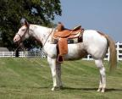

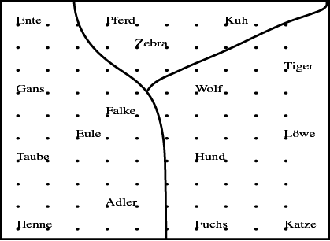

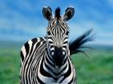


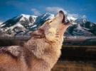







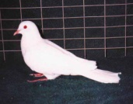

Example: Self-Organizing Maps
A grouping according to similarity has
emerged
peaceful
Animal names and their attributes
is
has
likes
to
birds
hunters
[Teuvo Kohonen 2001] Self-Organizing Maps; Springer;

Slide 18
Conclusion
Advantages
SOM is Algorithm that projects high-dimensional data onto a two-dimensional map.
The projection preserves the topology of the data so that similar data items will be mapped to nearby locations on the map.
SOM still have many practical applications in pattern recognition, speech analysis, industrial and medical diagnostics, data mining
Disadvantages
Large quantity of good quality representative training data required
No generally accepted measure of ‘quality’ of a SOM
e.g. Average quantization error (how well the data is classified)

Slide 19
Discussion topics
What is the main purpose of the SOM?
Do you know any example systems with SOM Algorithm?

Slide 20
References
[Witten and Frank (1999)] Witten, I.H. and Frank, Eibe. Data Mining: Practical Machine Learning Tools and Techniques with Java Implementations. Morgan Kaufmann Publishers, San Francisco, CA, USA. 1999
[Kohonen (1982)] Teuvo Kohonen. Self-organized formation of topologically correct feature maps. Biol. Cybernetics, volume 43, 59-62
[Kohonen (1995)] Teuvo Kohonen. Self-Organizing Maps. Springer, Berlin, Germany
[Vesanto (1999)] SOM-Based Data Visualization Methods, Intelligent Data
Analysis, 3:111-26
[Kohonen et al (1996)] T. Kohonen, J. Hynninen, J. Kangas, and J. Laaksonen, "SOM
PAK: The Self-Organizing Map program package, " Report
A31, Helsinki University of Technology, Laboratory of
Computer and Information Science, Jan. 1996
[Vesanto et al (1999)] J. Vesanto, J. Himberg, E. Alhoniemi, J Parhankangas. Self-
Organizing Map in Matlab: the SOM Toolbox. In Proceedings
of the Matlab DSP Conference 1999, Espoo, Finland, pp. 35-40, 1999.
[Wong and Bergeron (1997)] Pak Chung Wong and R. Daniel Bergeron. 30 Years of Multidimensional Multivariate Visualization. In Gregory M.
Nielson, Hans Hagan, and Heinrich Muller, editors, Scientific
Visualization - Overviews, Methodologies and Techniques, pages 3-33, Los Alamitos, CA, 1997. IEEE Computer Society Press.
[Honkela (1997)] T. Honkela, Self-Organizing Maps in Natural Language
Processing, PhD Thesis, Helsinki, University of Technology,
Espoo, Finland
[SVG wiki] http://en.wikipedia.org/wiki/Scalable_Vector_Graphics
[Jost Schatzmann (2003)] Final Year Individual Project Report Using Self-Organizing Maps to Visualize Clusters and Trends in Multidimensional Datasets
Imperial college London 19 June 2003

