Slide 1
BDM 2053
Big Data Algorithms and Statistics

Slide 2
Course Objectives
Artificial neurons and perceptrons.
Artificial neural net (ANN).
ANN's strengths and limitations.
role of large data sets in making artificial intelligence a desired technology.
Making the data ready for AI-based models.
How can AI be used for Natural Language Processing ?
Choose an algorithm to support the statistical model and AI approach.
Combine algorithms to improve the accuracy of the statistical model.

Slide 3
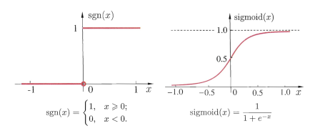
Artificial Neuron
Artificial neuron, also called linear threshold unit (LTU), by McCulloch and Pitts, 1943: with one or more numeric inputs, it produces a weighted sum of them, applies an activation function, and outputs the result.
Common activation functions: step function and sigmoid function.

Slide 4
Perceptrons
A perceptron, by Rosenblatt in 1957, is composed of two layers of neurons: an input layer consisting of special passing through neurons and an output layer of LTU’s.
The bias neuron is added for the completeness of linearity.
Rosenblatt proved that, if training examples are linearly separable, a perceptron always can be learned to correctly classify all training examples

Slide 5
Multi-Layer Perceptrons
A Multi-Layer Perceptrons (MLP) is composed of one passthrough input layer, one or more layers of LTU’s, called hidden layer, and one final layer of LTUs, called output layer.
Again, every layer except the output layer includes a bias neuron and is fully connected to the next layer.
When an MLP has two or more hidden layers, it is called a deep neural network (DNN).

Slide 6
Artificial Neural Networks
Computational models inspired by the human brain: –
– Massively parallel, distributed system, made up of simple processing units (neurons)
– Synaptic connection strengths among neurons are used to store the acquired knowledge.
– Knowledge is acquired by the network from its environment through a learning process

Slide 7
Properties of ANNs
Learning from examples – labeled or unlabeled
Adaptivity – changing the connection strengths to learn things
Non-linearity – the non-linear activation functions are essential
Fault tolerance – if one of the neurons or connections is damaged, the whole network still works quite well
Thus, they might be better alternatives than classical solutions for problems characterised by:
– high dimensionality, noisy, imprecise or imperfect data;
– a lack of a clearly stated mathematical solution or algorithm .

Slide 8
Advantages of ANN
Storing information on the entire network
Ability to work with incomplete knowledge
Having fault tolerance
Having a distributed memory
Gradual corruption
Ability to make machine learning
Parallel processing capability

Slide 9
Disadvantages of ANN
Hardware dependence
Unexplained behavior of the network
Determination of proper network structure
Difficulty of showing the problem to the network
The duration of the network is unknown

Slide 10
Relationship between AI and Big Data
Big data and artificial intelligence have a synergistic relationship.
AI requires a massive scale of data to learn and improve decision-making processes.
Big data analytics leverages AI for better data analysis.

Slide 11
Relationship between AI and Big Data
Can improve business performance and efficiency by:
Anticipating and capitalizing on emerging industry and market trends.
Analyzing consumer behavior and automating customer segmentation
Personalizing and optimizing the performance of digital marketing campaigns
Using intelligent decision support systems fueled by big data, AI, and predictive analytics

Slide 12
Understanding Data Processing
Data Processing is the task of converting data from a given form to a much more usable and desired form.
Collection
- How to collect data for machine learning if you don’t have any
Preparation
- Articulate the problem early
- Establish data collection mechanisms and Check your data quality
- Data Warehouses and ETL
- Data Lakes
Format data to make it consistent, Reduce data

Slide 13
Understanding Data Processing
Input
Processing
- Join transactional and attribute data
- Rescale data
- Discretize data
Output
Storage

Slide 14
Natural Language Processing
NLP is an interdisciplinary field that uses computational methods to:
Investigate the properties of written human language and model the cognitive mechanisms underlying the understanding and production of written language.
Develop novel practical applications involving the intelligent processing of written human language by computer.
Examples of NLP are virtual assistants like Google Assist, Siri, and Alexa.
Another well-known application of NLP is chatbots.

Slide 15
Natural Language Processing
Natural Language Processing (NLP) is the part of AI that studies how machines interact with human language
NLP and machine learning are both subsets of AI.
AI-powered chatbots, for example, use NLP to interpret what users say and what they intend to do, and machine learning to automatically deliver more accurate responses by learning from past interactions.

Slide 16
NLP Techniques
Syntactic Analysis
Semantic Analysis
Combined with machine learning algorithms, NLP creates systems that learn to perform tasks on their own and get better through experience.

Slide 17
Statistical Modelling
Statistical modelling is a method of mathematically approximating the world.
Statistical algorithms create a statistical model of the input data, which is in most cases represented as a probabilistic or prefix tree data structure.
A statistical model will have sampling, probability spaces, assumptions and diagnostics etc, to make inferences.

Slide 18
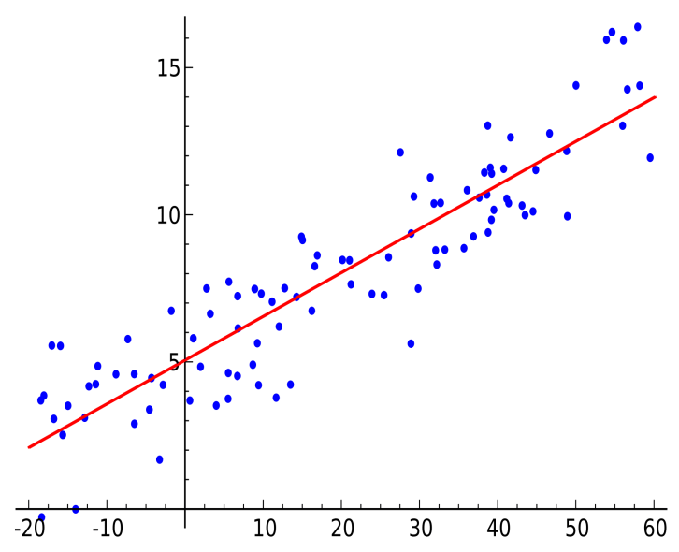
Linear regression
Linear regression is a statistical modelling technique, which attempts to model the relationship between an explanatory variable and a dependent variable by fitting the observed data points on a linear equation.
A linear regression is used if there is relationship or significant association between the variables.
A linear regression line has equation in the following form:
Y = a + b X
Where, X = explanatory variable and
Y = dependent variable.
b = slope of the line
a = intercept

Slide 19
Ensembling Models
Simple Averaging/ Weighted Method:
This method of ensembling just takes the average of two models
if we combine these two algorithms we would get a pretty decent outcome and our accuracy would definitely increase. This is the idea behind an average model which a very basic case of ensembling.

Slide 20
Types of Ensembling:
Boosting:
- Boosting refers to a group of algorithms that utilize weighted averages to make weak learners into stronger learners.
Bootstrap Aggregation (Bagging):
- Bootstrap refers to random sampling with replacement. Bootstrap allows us to better understand the bias and the variance with the dataset. Bootstrap involves random sampling of small subset of data from the dataset.

Slide 21
THANK YOU

