Slide 1
BDM 2053
Big Data Algorithms and Statistics

Slide 2
Learning Objectives
Tableau – Introduction to Tableau
How to ready the data for Tableau Analytics
Tableau Interface
Creating a Worksheet

Slide 3
What is Tableau
Tableau is a data visualization tool that lets us analyze virtually any type of structured data and produce highly interactive and attractive graphs, dashboards, and reports in minutes.
Tableau makes it easier to create powerful, visual information that communicates what is important better than a spreadsheet or text table. Tableau has advanced capabilities for more technical users, but it dramatically lowers the bar for creating dashboards and performing analytical analysis for non-technical analysts and information consumers.

Slide 4
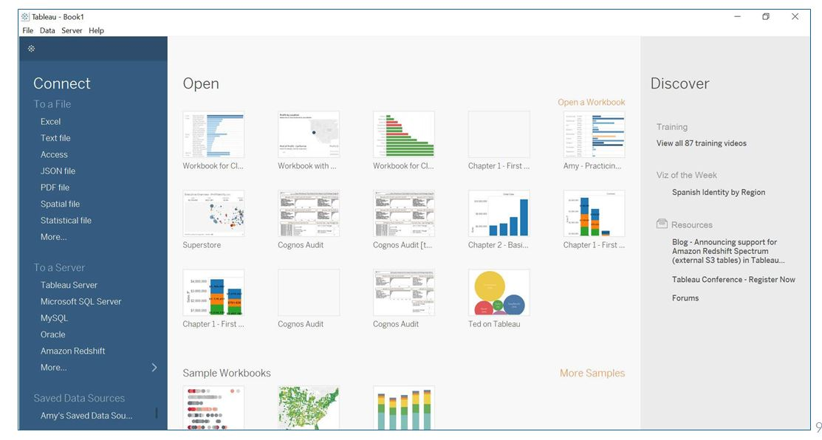
Getting Your Data Ready
Choose a connection or an existing workbook from the Tableau Welcome Page.
Note: Upon installing Tableau, check your local drive for My Tableau Repository

Slide 5
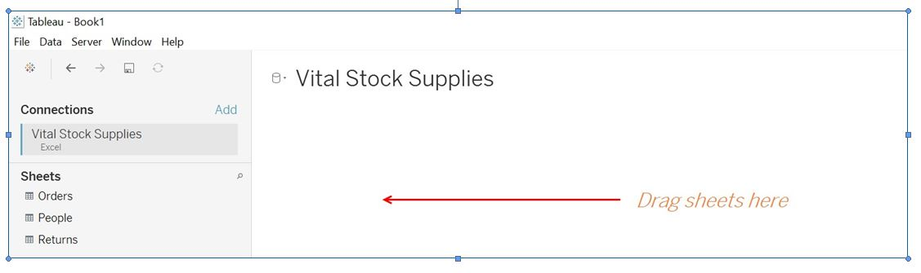
Once you choose your data source, you (and it) are brought to the Data Source Page where you can format your metadata.
Sheets on the left navigation pane behave like tables in a database.

Slide 6
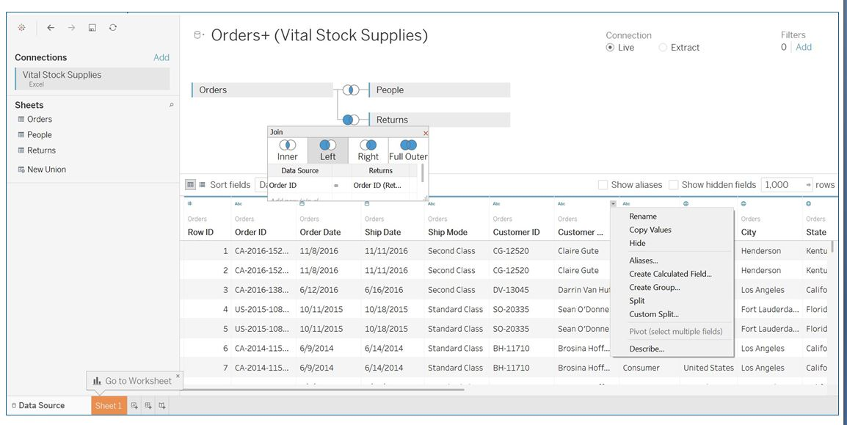

Slide 7
Splitting
 String fields can be split into multiple fields for easier analysis
 Automatic or custom split options
 Aliasing
Roles (time, ship date/order date)
Binning (high/low sales)
 Renaming
 Data types
 Geographic roles
 Calculated fields
 Pivoting
 Data interpreter
Helps clean up data

Slide 8
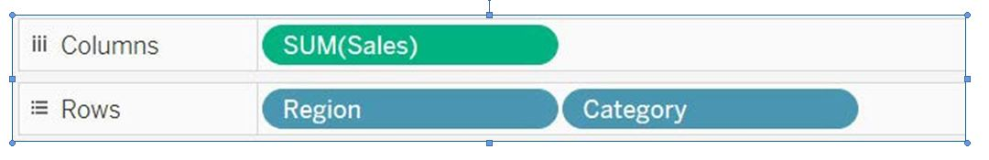
THE INTERFACE
Work in workbooks which contain worksheets, dashboards, and stories
 Worksheets are also known as Views of your data
 We drag and drop fields from the data source onto Shelves
 Rows, Columns, Filters …
 Items that appear on shelves are called Pills
 If the Pill is blue, it is a Dimension
 If the Pill is green, it is a Measure

Slide 9
When you bring your data into Tableau, it automatically places the fields into one of two categories. Dimensions or Measures.
Dimensions are fields that organize your data into categories (or buckets).
Individual dimension values are called Members
Usually Non-numerical and provide critical, contextual meaning to a Measure.
Who, what, when, where, why
 Measures return numeric values for “measuring“ different dimensions.
Usually aggregated (sum, average, min, max, etc.)
Things you can do math on that are generally meaningless without context

Slide 10
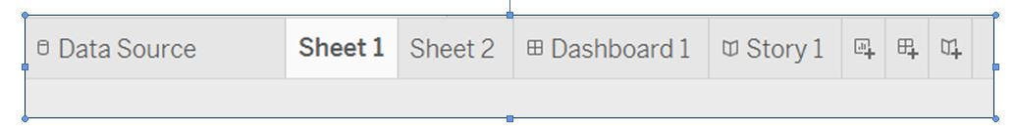
Change between data source, worksheets, and dashboards using the tabs at the bottom
 You can also add new worksheets, dashboards, or story boards using the “new” buttons.

Slide 11
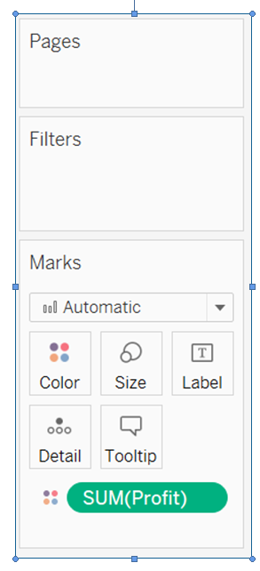

Slide 12
Once you’ve connected to data and evaluated available dimensions and measures in the Data pane, you’ll need to decide where to drag desired dimensions and measures. You may choose to drag directly onto the visualization or onto a particular shelf or card.
The most common shelves are the Columns and Rows. Dragging dimensions and measures to these determines the layout of your visualization.
Use cards to navigate pages, filters, and marks on a worksheet.
The Page shelf acts as a modified Filters shelf allowing you to page through values.
The Filters shelf allows you to narrow data down.
The Marks card allows you to customize the display of the ‘marks’ that make up your chart.

Slide 13
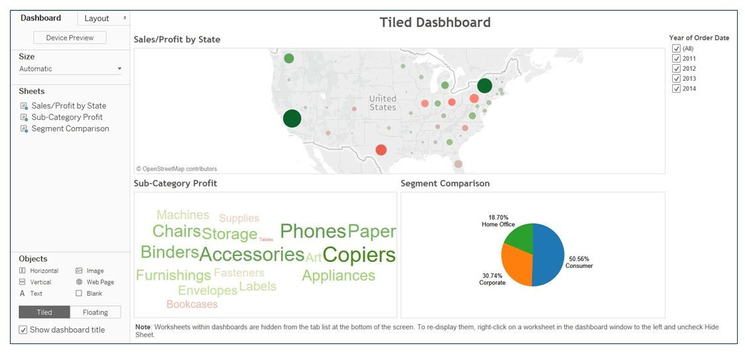
Use dashboards to organize and interact with multiple worksheets

Slide 14
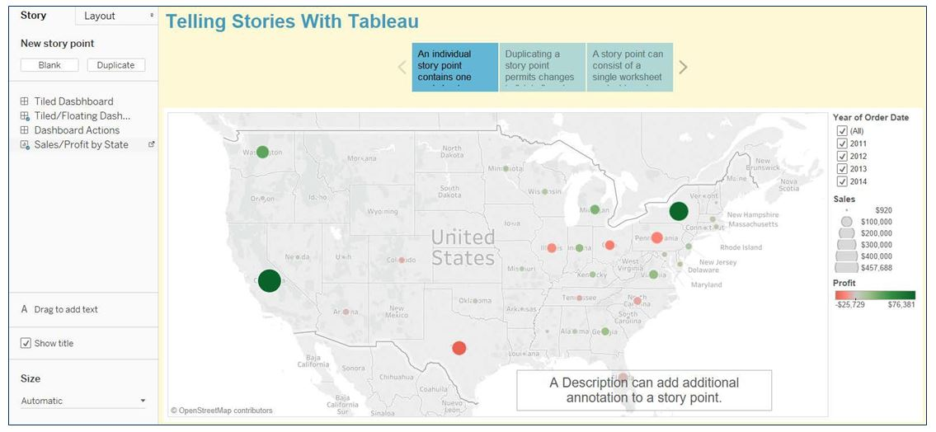
Use stories to combine elements and create directed, interactive analysis

Slide 15
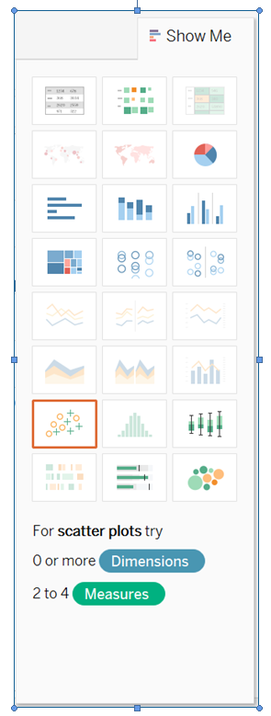

Slide 16
Once you’ve connected to data and evaluated available dimensions and measures in the Data pane, you’ll need to decide where to drag desired dimensions and measures. You may choose to drag directly onto the visualization or onto a particular shelf or card.
The most common shelves are the Columns and Rows. Dragging dimensions and measures to these determines the layout of your visualization.
Use cards to navigate pages, filters, and marks on a worksheet.
The Page shelf acts as a modified Filters shelf allowing you to page through values.
The Filters shelf allows you to narrow data down.
The Marks card allows you to customize the display of the ‘marks’ that make up your chart.

Slide 17
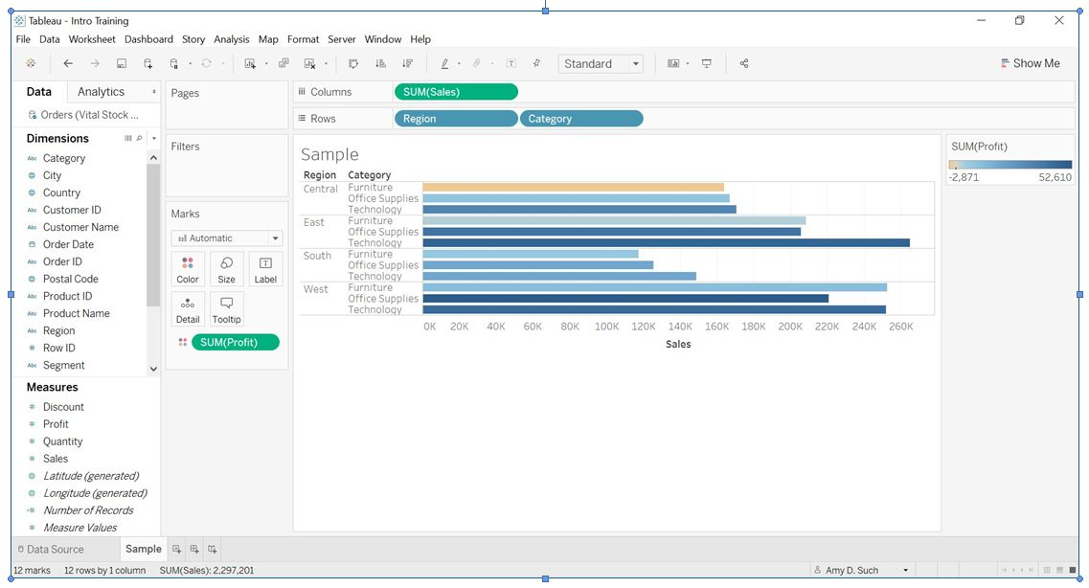
Add Dimensions and/or Measures from the Data pane to the Shelves and Cards to create visualizations.

Slide 18
Creating Your First Worksheet
Open Tableau, connect to data, build a basic visualization to show Sales for each Sub-Category broken down by Order Date Year vs. Category. Use color show sum of Profit.
Open Tableau.
Connect to Excel.
Navigate to Excel Data Source per class instructions Typically under this path:
My Tableau Repository > Datasources > 10.x > en_US-US > Vital Stock Supplies.xls
Click Open.
This is the Data Source screen. Here, we will add sheets from the Excel file to act as the fields for our visualization.
Under Sheets, drag Orders to where it says “Drag sheets here”. Our data appears in the bottom pane.
In the bottom portion of the left pane, under the Go to Worksheet prompt, click Sheet.
In the left pane, within the Data tab, under Dimensions, drag Order Date to the Columns shelf and Category and Sub-Category to the Rows shelf.
Under Measures, find and drag Sales to the Columns shelf and Profit to the Color mark on the Marks card.
Double-click the bottom of the worksheet and rename it to Bar Chart.

Slide 19
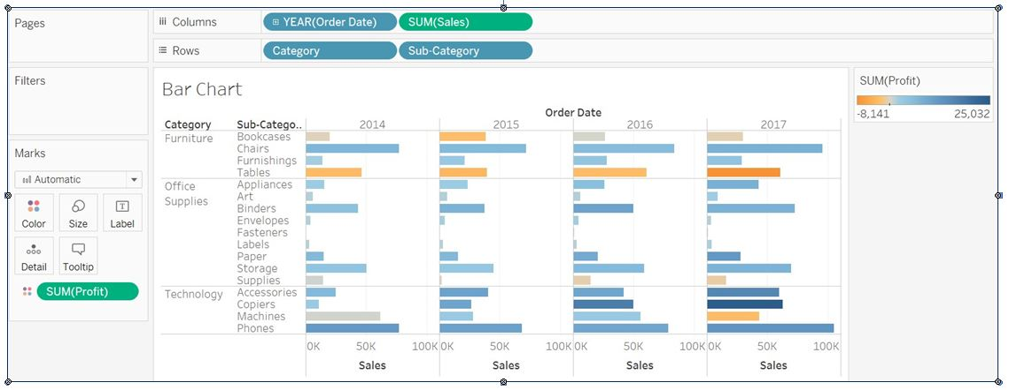
Outcome

Slide 20
Thank you

