Slide 1
BDM 2053
Big Data Algorithms and Statistics

Slide 2
Course Objectives
Describe machine learning.
Explore classification using various machine learning algorithms such as support vector machines (SVM), Bayesian networks, decision trees, random forests etc.
Discuss regression and its types.

Slide 3
Learning a Class from Examples
Class C of a “family car”
Prediction: Is car x a family car?
Knowledge extraction: What do people expect from a family car?
Output:
Positive (+) and negative (–) examples
Input representation:
x₁: price, x₂ : engine power

Slide 4
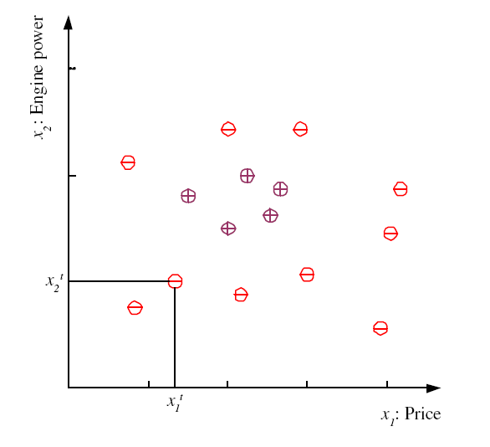
Training set X

Slide 5
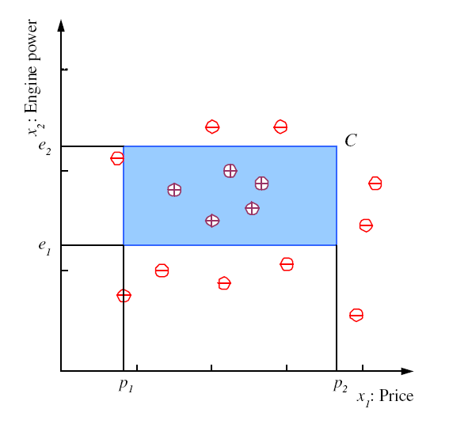
Class C

Slide 6
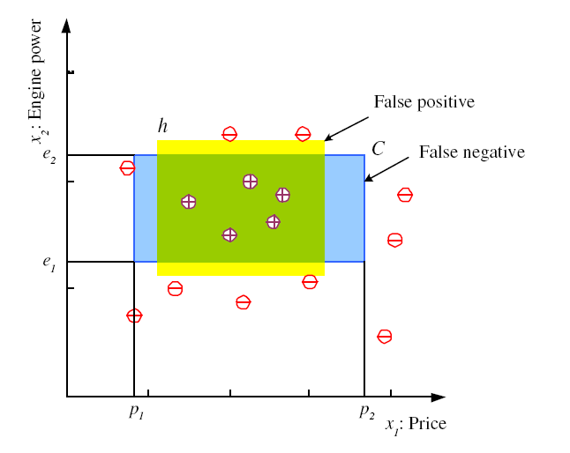
Hypothesis class H
Error of h on H

Slide 7
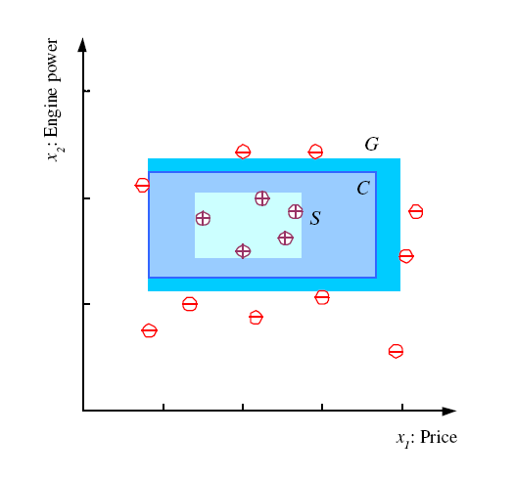
S, G, and the Version Space
most specific hypothesis, S
most general hypothesis, G
h ∈ H, between S and G is
consistent and make up the
version space
(Mitchell, 1997)

Slide 8
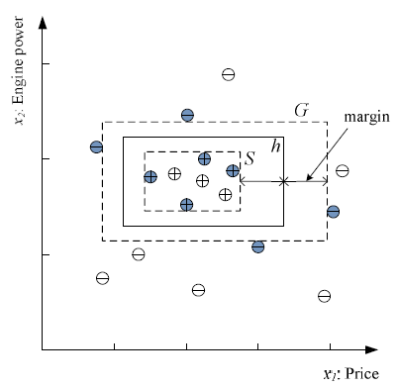
Margin
Choose h with largest margin

Slide 9
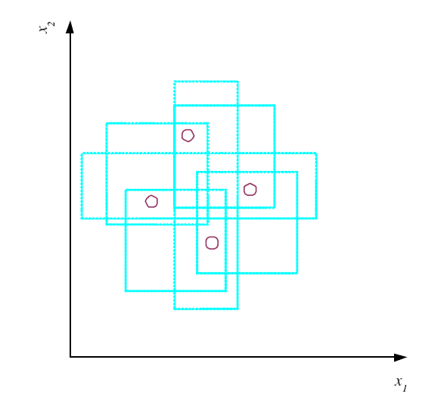
VC Dimension
N points can be labeled in 2^{N} ways as +/–
H shatters N if there
exists h Î H consistent
for any of these:
VC(H ) = N
An axis-aligned rectangle shatters 4 points only !

Slide 10
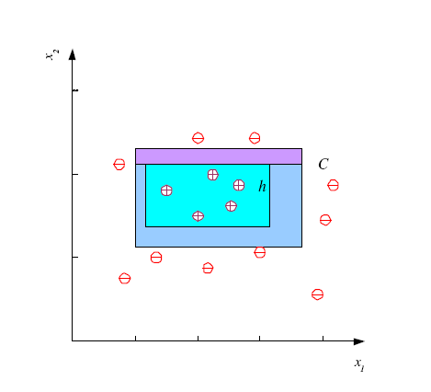
Probably Approximately Correct (PAC) Learning
How many training examples N should we have, such that with probability at least 1 ‒ δ, h has error at most ε ?
(Blumer et al., 1989)
Each strip is at most ε/4
Pr that we miss a strip 1‒ ε/4
Pr that N instances miss a strip (1 ‒ ε/4)^{N}
Pr that N instances miss 4 strips 4(1 ‒ ε/4)^{N}
4(1 ‒ ε/4)^{N} ≤ δ and (1 ‒ x)≤exp( ‒ x)
4exp(‒ εN/4) ≤ δ and N ≥ (4/ε)log(4/δ)

Slide 11
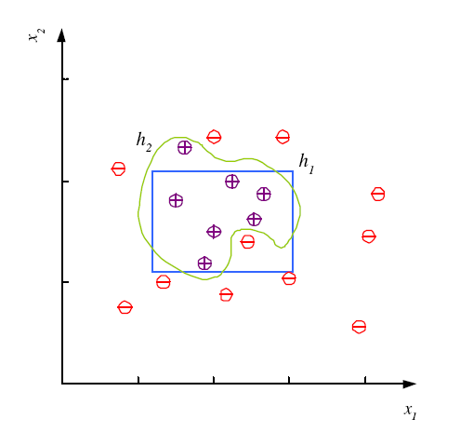
Noise and Model Complexity
Use the simpler one because
Simpler to use
(lower computational
complexity)
Easier to train (lower
space complexity)
Easier to explain
(more interpretable)
Generalizes better (lower
variance - Occam’s razor)

Slide 12
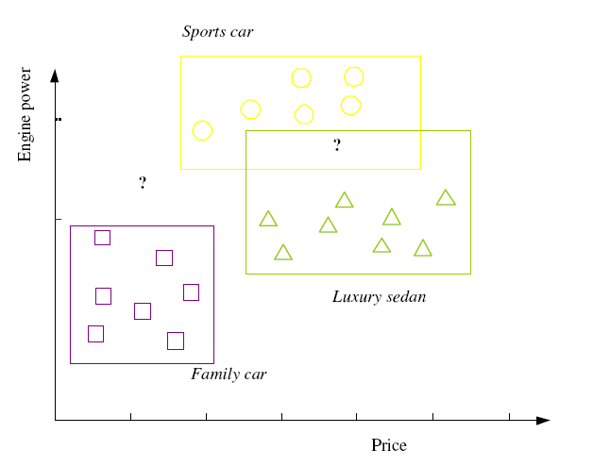

Multiple Classes, C_{i} i=1,...,K
Train hypotheses
h_{i}(x), i =1,...,K:

Slide 13
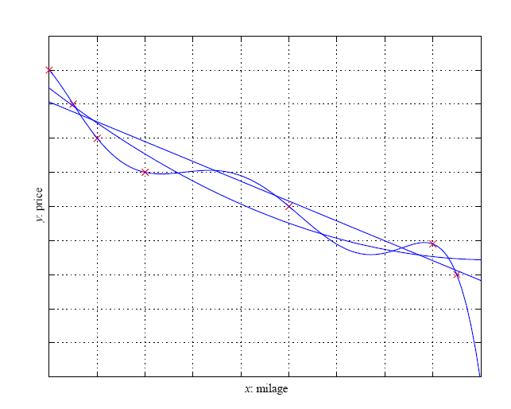
Regression

Slide 14
Model Selection & Generalization
Learning is an ill-posed problem; data is not sufficient to find a unique solution
The need for inductive bias, assumptions about H
Generalization: How well a model performs on new data
Overfitting: H more complex than C or f
Underfitting: H less complex than C or f

Slide 15
Triple Trade-Off
There is a trade-off between three factors (Dietterich, 2003):
Complexity of H, c (H),
Training set size, N,
Generalization error, E, on new data
As N­, E¯
As c (H)­, first E¯ and then E­

Slide 16
Cross-Validation
To estimate generalization error, we need data unseen during training. We split the data as
Training set (50%)
Validation set (25%)
Test (publication) set (25%)
Resampling when there is few data

Slide 17
Dimensions of a Supervised Learner
Model:
Loss function:
Optimization procedure:

Slide 18
Outline
Discriminant Function
Learning Association Rules
Naïve Bayes Classifier
Example: Play Tennis
Relevant Issues
Conclusions

Slide 19
What is discriminant Function
For classification problem, for each class, define a function such that we choose Ci if

Slide 20
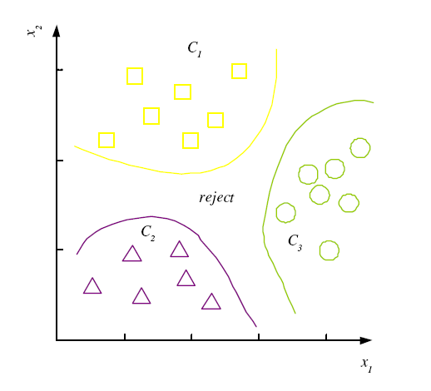
Discriminant Functions
K decision regions R₁,...,R_{K}

Slide 21
K=2 Classes
Dichotomizer (K=2) vs Polychotomizer (K>2)
g(x) = g₁(x) – g₂(x)
Log odds:

Slide 22
Problem: Association Rule Mining
INPUT
A set of transactions
Objective:
Given a set of transactions D, generate all association rules that have support and confidence greater than the user-specified minimum support and minimum confidence.
Minimize computation time by pruning.
Constraints:
Items should be in lexicographical order
Association Rules
{Diaper} → {Beer},
{Milk, Bread} → {Eggs, Coke},
{Beer, Bread} → {Milk},
Real World Applications
NCR (Terradata) does ARM for more than 20 large retail organizations including Walmart.
Used for pattern discovery in biological DBs.

Slide 23
Association Rules
Association rule: X → Y
Support (X → Y):
Confidence (X → Y):
Apriori algorithm (Agrawal et al., 1996)

Slide 24
Apriori Algorithm: Breadth First Search

Slide 25
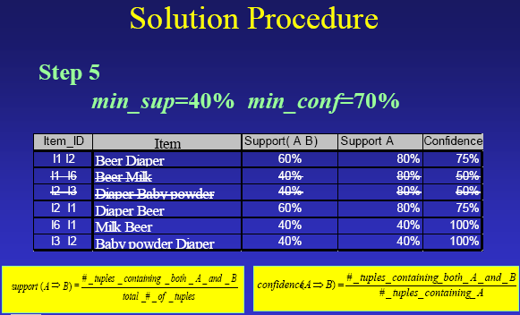
Apriori Algorithm Examples Problem Decomposition
If the minimum support is 50%, then {Shoes, Jacket} is the only 2- itemset that satisfies the minimum support.
If the minimum confidence is 50%, then the only two rules generated from this 2-itemset, that have confidence greater than 50%, are:
Shoes ⇒ Jacket Support=50%, Confidence=66%
Jacket ⇒ Shoes Support=50%, Confidence=100%

Slide 26
The Apriori Algorithm — Example
Min support =50%
Database D
L₁
C₁
Scan D
C₂
C₂
L₂
Scan D
C₃
Scan D
L₃

Slide 27
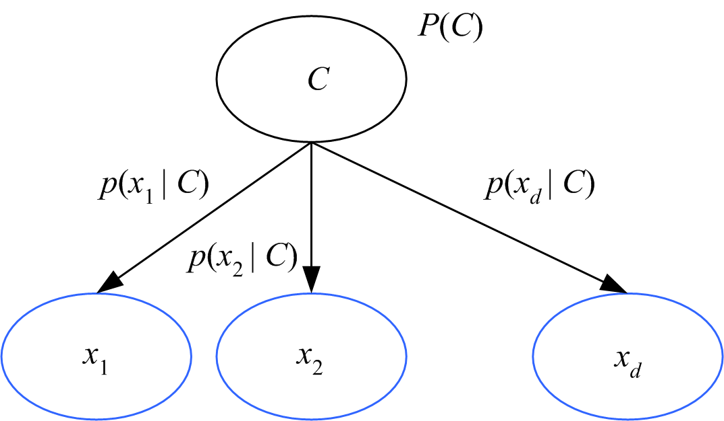
Naive Bayes’ Classifier
Given C, x_{j} are independent:
p(x|C) = p(x₁|C) p(x₂|C) ... p(x_{d}|C)

Slide 28
Background
There are three methods to establish a classifier
a) Model a classification rule directly
Examples: k-NN, decision trees, perceptron, SVM
b) Model the probability of class memberships given input data
Example: multi-layered perceptron with the cross-entropy cost
c) Make a probabilistic model of data within each class
Examples: naive Bayes, model based classifiers
a) and b) are examples of discriminative classification
c) is an example of generative classification
b) and c) are both examples of probabilistic classification

Slide 29
Probability Basics
Prior, conditional and joint probability
Prior probability:
Conditional probability:
Joint probability:
Relationship:
Independence:
Bayesian Rule

Slide 30
Probabilistic Classification
Establishing a probabilistic model for classification
Discriminative model
Generative model
MAP classification rule
MAP: Maximum A Posterior
Assign x to c* if
Generative classification with the MAP rule
Apply Bayesian rule to convert:

Slide 31
Naïve Bayes
Bayes classification
Difficulty: learning the joint probability
Naïve Bayes classification
Making the assumption that all input attributes are independent
MAP classification rule

Slide 32
Naïve Bayes
Naïve Bayes Algorithm (for discrete input attributes)
Learning Phase: Given a training set S,
Output: conditional probability tables; for elements
Test Phase: Given an unknown instance ,
Look up tables to assign the label c* to X’ if

Slide 33
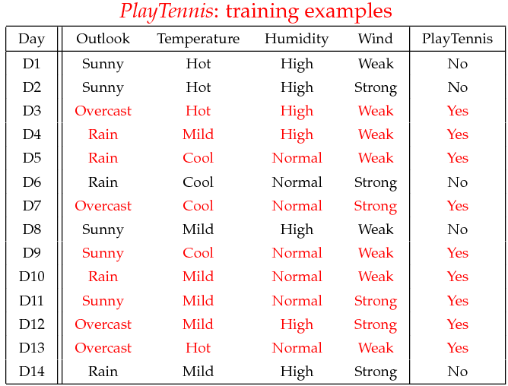
Example
Example: Play Tennis

Slide 34
Example
Learning Phase
Outlook | Play=Yes | Play=No
Sunny | 2/9 | 3/5
Overcast | 4/9 | 0/5
Rain | 3/9 | 2/5
Temperature | Play=Yes | Play=No
Hot | 2/9 | 2/5
Mild | 4/9 | 2/5
Cool | 3/9 | 1/5
Humidity | Play=Yes | Play=No
High | 3/9 | 4/5
Normal | 6/9 | 1/5
Wind | Play=Yes | Play=No
Strong | 3/9 | 3/5
Weak | 6/9 | 2/5
P(Play=Yes) = 9/14
P(Play=No) = 5/14

Slide 35
Example
Test Phase
Given a new instance,
x’=(Outlook=Sunny, Temperature=Cool, Humidity=High, Wind=Strong)
Look up tables
MAP rule
P(Outlook=Sunny|Play=Yes) = 2/9
P(Temperature=Cool|Play=Yes) = 3/9
P(Huminity=High|Play=Yes) = 3/9
P(Wind=Strong|Play=Yes) = 3/9
P(Play=Yes) = 9/14
P(Outlook=Sunny|Play=No) = 3/5
P(Temperature=Cool|Play==No) = 1/5
P(Huminity=High|Play=No) = 4/5
P(Wind=Strong|Play=No) = 3/5
P(Play=No) = 5/14
P(Yes|x’): [P(Sunny|Yes)P(Cool|Yes)P(High|Yes)P(Strong|Yes)]P(Play=Yes) = 0.0053
P(No|x’): [P(Sunny|No) P(Cool|No)P(High|No)P(Strong|No)]P(Play=No) = 0.0206
Given the fact P(Yes|x’) < P(No|x’), we label x’ to be “No”.

Slide 36
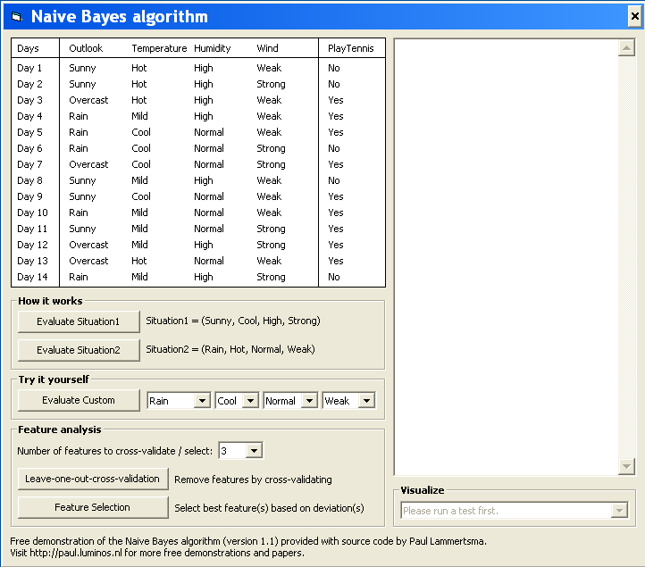
Example
Test Phase
Given a new instance,
x’=(Outlook=Sunny, Temperature=Cool, Humidity=High, Wind=Strong)
Look up tables
MAP rule
P(Outlook=Sunny|Play=Yes) = 2/9
P(Temperature=Cool|Play=Yes) = 3/9
P(Huminity=High|Play=Yes) = 3/9
P(Wind=Strong|Play=Yes) = 3/9
P(Play=Yes) = 9/14
P(Outlook=Sunny|Play=No) = 3/5
P(Temperature=Cool|Play==No) = 1/5
P(Huminity=High|Play=No) = 4/5
P(Wind=Strong|Play=No) = 3/5
P(Play=No) = 5/14
P(Yes|x’): [P(Sunny|Yes)P(Cool|Yes)P(High|Yes)P(Strong|Yes)]P(Play=Yes) = 0.0053
P(No|x’): [P(Sunny|No) P(Cool|No)P(High|No)P(Strong|No)]P(Play=No) = 0.0206
Given the fact P(Yes|x’) < P(No|x’), we label x’ to be “No”.

Slide 37
Relevant Issues
Violation of Independence Assumption
For many real world tasks,
Nevertheless, naïve Bayes works surprisingly well anyway!
Zero conditional probability Problem
If no example contains the attribute value
In this circumstance, during test
For a remedy, conditional probabilities estimated with

Slide 38
Relevant Issues
Continuous-valued Input Attributes
Numberless values for an attribute
Conditional probability modeled with the normal distribution
Learning Phase:
Output: normal distributions and
Test Phase:
Calculate conditional probabilities with all the normal distributions
Apply the MAP rule to make a decision

Slide 39
Conclusions
Naïve Bayes based on the independence assumption
Training is very easy and fast; just requiring considering each attribute in each class separately
Test is straightforward; just looking up tables or calculating conditional probabilities with normal distributions
A popular generative model
Performance competitive to most of state-of-the-art classifiers even in presence of violating independence assumption
Many successful applications, e.g., spam mail filtering
Apart from classification, naïve Bayes can do more…

