Slide 1
BDM 2053
Big Data Algorithms and Statistics

Slide 2
Course Objectives
Discuss statistical analysis and measures of central tendency (mean, median, mode).
Describe statistical concepts of dispersion, i.e. variance, standard deviation and Inter Quartile
Range (IQR).
Explore frequency table and histogram.

Slide 3
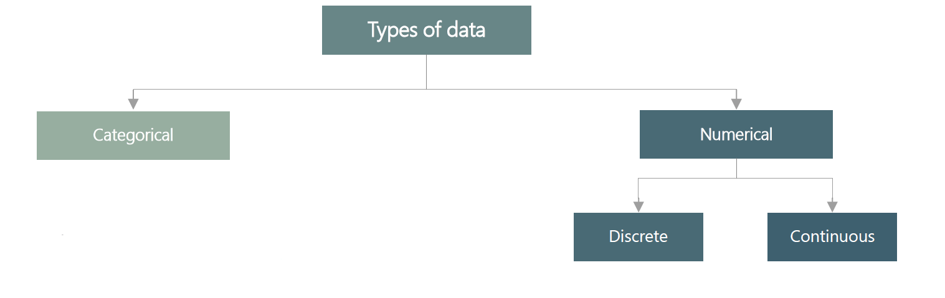
Types of data

Slide 4
Types of data
Categorical data represents groups or categories.
Examples:
1. Car brands: Audi, BMW and Mercedes.
2. Answers to yes/no questions: yes and no
Numerical data represents numbers It is divided into two groups discrete and continuous. Discrete data can be usually counted in a finite matter, while continuous is infinite and impossible to count
Examples
Discrete: #children you want to have, SAT score
Continuous: weight, height

Slide 5
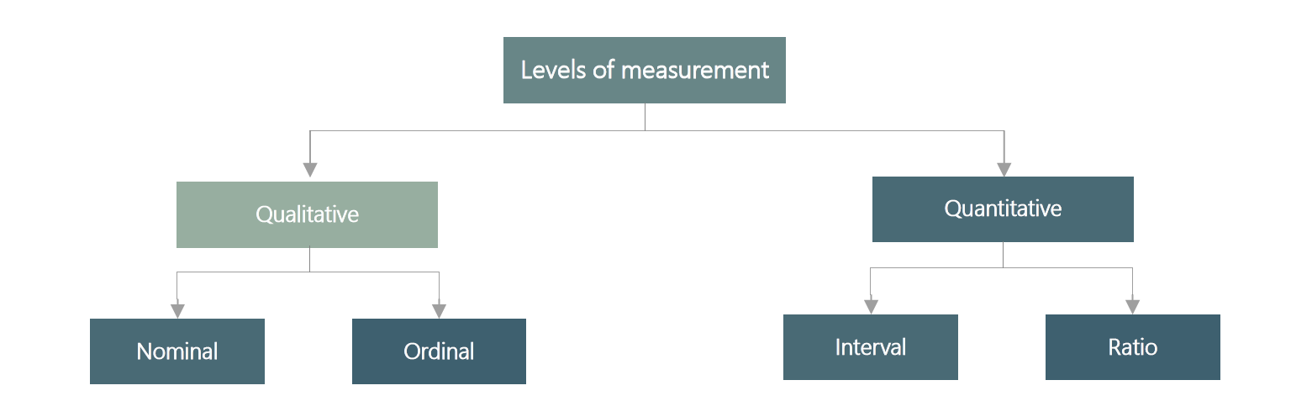
Levels of measurement

Slide 6
Levels of measurement
There are two qualitative levels nominal and ordinal. The nominal level represents categories that cannot be put in any order, while ordinal represents categories that can be ordered
Examples:
Nominal: four seasons ( spring, summer, autumn)
Ordinal: rating your meal ( unappetizing, neutral, tasty, and delicious)
There are two quantitative levels interval and ratio. They both represent “ however, ratios have a true zero, while intervals don’t.
Examples:
Interval: degrees Celsius and Fahrenheit
Ratio: degrees Kelvin, length

Slide 7
Mean
The mean is the most widely spread measure of central tendency. It is the simple average of the dataset.
Note: easily affected by outliers
The formula to calculate the mean is:
In Excel, the mean is calculated by:
=AVERAGE()

Slide 8
Median
the median is the midpoint of the ordered dataset. It is not as popular as the mean, but is often used in academia and data science. That is since it is not affected by outliers.
In an ordered dataset, the median is the number at position
If this position is not a whole number, it, the median is the simple average of the two numbers at positions closest to the calculated value.
In Excel, the median is calculated by:
=MEDIAN()

Slide 9
Mode
The mode is the value that occurs most often. A dataset can have 0 modes, 1 mode or multiple modes.
The mode is calculated simply by finding the value with the highest frequency.
In Excel, the mode is calculated by:
=MODE.SNGL() -> returns one mode
=MODE.MULT() -> returns an array with the modes. It is used when we have more than 1 mode.

Slide 10
Variance and standard deviation
Variance and standard deviation measure the dispersion of a set of data points around its mean value
There are different formulas for population and sample variance standard deviation This is due to the fact that the sample formulas are the unbiased estimators of the population formulas
Sample variance:=VAR.S()
Population variance:=VAR.P()
Sample standard deviation:=STDEV.S()
Population standard deviation:=STDEV.P()

Slide 11
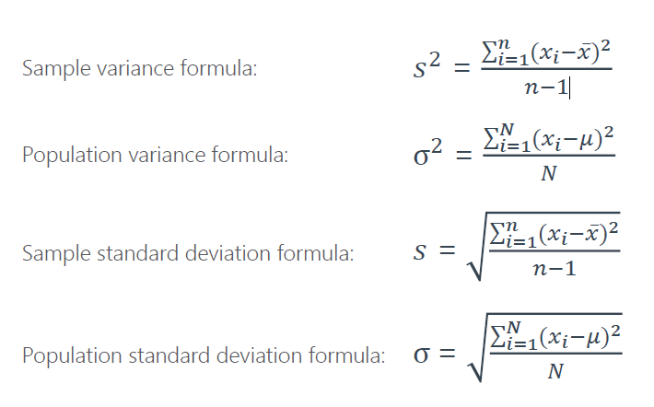
Variance and standard deviation

Slide 12
IQR

Slide 13
Covariance
Covariance is a measure of the joint variability of two variables
A positive covariance means that the two variables move together
A covariance of 0 means that the two variables are independent
A negative covariance means that the two variables move in opposite directions
Covariance can take on values from to This is a problem as it is very hard to put such numbers into perspective
InExcel,thecovarianceiscalculatedby:
Samplecovariance:=COVARIANCE.S()
Populationcovariance:=COVARIANCE.P()

Slide 14
Correlation
Correlation is a measure of the joint variability of two variables Unlike covariance, correlation could be thought of as a standardized measure It takes on values between 1 and 1 thus it is easy for us to interpret the result
A correlation of 1 known as perfect positive correlation, means that one variable is perfectly explained by the other
A correlation of 0 means that the variables are independent
A correlation of 1 known as perfect negative correlation, means that one variable is explaining the other one perfectly, but they move in opposite directions
InExcel,correlationiscalculatedby:
=CORREL()

Slide 15
Numerical variables. Frequency distribution table and histogram
Frequency distribution tables for numerical variables are different than the ones for categorical Usually, they are divided into intervals of equal (or unequal) length The tables show the interval, the absolute frequency and sometimes it is useful to also include the relative (and cumulative) frequencies.
The interval width is calculated using the following formula
𝐼𝑛𝑡𝑒𝑟𝑎𝑙𝑤𝑖𝑑𝑡ℎ=𝐿𝑎𝑟𝑔𝑒𝑠𝑡𝑛𝑢𝑚𝑏𝑒𝑟−𝑠𝑚𝑎𝑙𝑙𝑒𝑠𝑡𝑛𝑢𝑚𝑏𝑒𝑟/𝑁𝑢𝑚𝑏𝑒𝑟𝑜𝑓𝑑𝑒𝑠𝑖𝑟𝑒𝑑𝑖𝑛𝑡𝑒𝑟𝑣𝑎𝑙𝑠

Slide 16
Numerical variables. Frequency distribution table and histogram
1. Decide on the number of intervals you would like to use
2. Find the interval width (using a the formula above)
3. Start your 1 st interval at the lowest value in your dataset
4. Finish your 1 st interval at the lowest value the interval width start_interval_cell interval_width_cell
5. Start your 2 nd interval where the 1 st stops (that's a formula as well just make the starting cell of interval 2 the ending of interval 1
6. Continue in this way until you have created the desired number of intervals
7. Count the absolute frequencies using the following COUNTIF formula
=COUNTIF(dataset_range ,">=“&interval start) COUNTIF( dataset_range ,">“&interval end)
8. In order to calculate the relative frequencies, use the following formula absolute_frequency_cell number_of_observations
9. In order to calculate the cumulative frequencies
i. The first cumulative frequency is equal to the relative frequency
ii. Each consecutive cumulative frequency previous cumulative frequency the respective relative frequency
Note that all formulas could be found in the lesson Excel files and the solutions of the exercises provided with each lesson

Slide 17
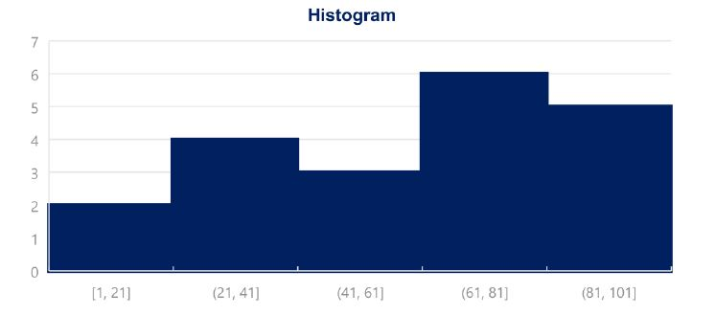
Histogram
Histograms are the one of the most common ways to represent numerical data Each bar has width equal to the width of the interval. The bars are touching as there is continuation between intervals where one ends the other begins.

Slide 18
Creating a histogram in Excel:
Creating a histogram in Excel:
1. Choose your data
2. Insert->Charts->Histogram
3. To change the number of bins(intervals):
1.Select the x-axis
2.Click Chart Tools->Format->Axis options
3.You can select the bin width(interval width),number of bins,etc.

Slide 19
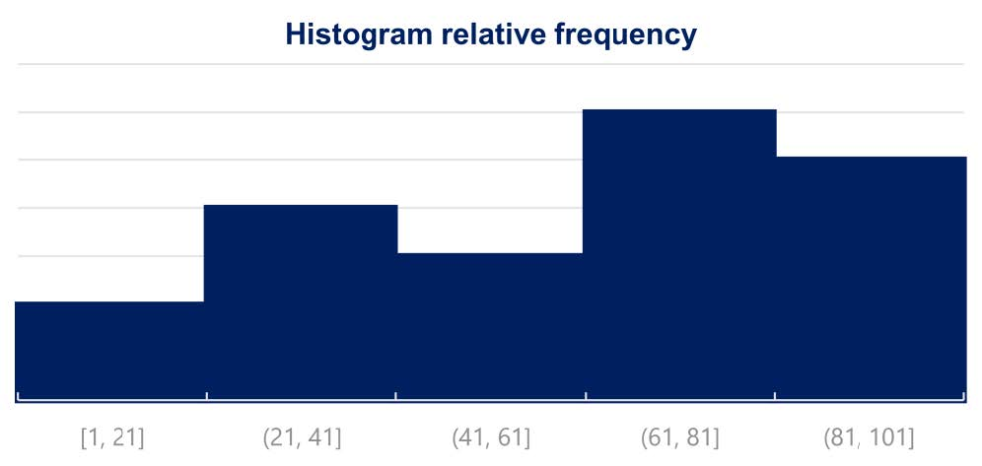
Histogram Relative Frequency

Slide 20
Thank you

