Slide 1
BDM 2053
Big Data Algorithms and Statistics

Slide 2
Course Objectives
Discuss various distributions (e.g. normal, binomial, Poisson etc.)
Explore the application of probability distributions in data science.
Discuss the concept of correlation in data science.
Discuss random sampling.

Slide 3
Bernoulli Distribution
A Bernoulli distribution has only two possible outcomes, namely 1 (success) and 0 (failure), and a single trial. So the random variable X which has a Bernoulli distribution can take value 1 with the probability of success, say p, and the value 0 with the probability of failure, say q or 1-p.
Here, the occurrence of a head denotes success, and the occurrence of a tail denotes failure. Probability of getting a head = 0.5 = Probability of getting a tail since there are only two possible outcomes.
The probability mass function is given by: p^{x}(1-p)^{1-x} where x € (0, 1). It can also be written as
The probabilities of success and failure need not be equally likely, like the result of a fight between me and Undertaker. He is pretty much certain to win. So in this case probability of my success is 0.15 while my failure is 0.85
Here, the probability of success(p) is not same as the probability of failure. So, the chart below shows the Bernoulli Distribution of our fight.

Slide 4
Here, the probability of success = 0.15 and probability of failure = 0.85. The expected value is exactly what it sounds. If I punch you, I may expect you to punch me back. Basically expected value of any distribution is the mean of the distribution. The expected value of a random variable X from a Bernoulli distribution is found as follows:
E(X) = 1*p + 0*(1-p) = p
The variance of a random variable from a bernoulli distribution is:
V(X) = E(X²) – [E(X)]² = p – p² = p(1-p)
There are many examples of Bernoulli distribution such as whether it’s going to rain tomorrow or not where rain denotes success and no rain denotes failure and Winning (success) or losing (failure) the game.

Slide 5
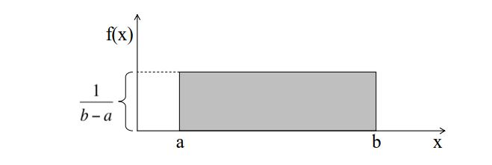
Uniform Distribution
When you roll a fair die, the outcomes are 1 to 6. The probabilities of getting these outcomes are equally likely and that is the basis of a uniform distribution. Unlike Bernoulli Distribution, all the n number of possible outcomes of a uniform distribution are equally likely.
A variable X is said to be uniformly distributed if the density function is:
The graph of a uniform distribution curve looks like

Slide 6

You can see that the shape of the Uniform distribution curve is rectangular, the reason why Uniform distribution is called rectangular distribution.
For a Uniform Distribution, a and b are the parameters.
The number of bouquets sold daily at a flower shop is uniformly distributed with a maximum of 40 and a minimum of 10.
Let’s try calculating the probability that the daily sales will fall between 15 and 30.
The probability that daily sales will fall between 15 and 30 is (30-15)*(1/(40-10)) = 0.5
Similarly, the probability that daily sales are greater than 20 is = 0.667
The mean and variance of X following a uniform distribution is:
Mean -> E(X) = (a+b)/2
Variance -> V(X) = (b-a)²/12
The standard uniform density has parameters a = 0 and b = 1, so the PDF for standard uniform density is given by:

Slide 7

Binomial Distribution
Let’s get back to cricket. Suppose that you won the toss today and this indicates a successful event. You toss again but you lost this time. If you win a toss today, this does not necessitate that you will win the toss tomorrow. Let’s assign a random variable, say X, to the number of times you won the toss. What can be the possible value of X? It can be any number depending on the number of times you tossed a coin.
There are only two possible outcomes. Head denoting success and tail denoting failure. Therefore, probability of getting a head = 0.5 and the probability of failure can be easily computed as: q = 1- p = 0.5.
A distribution where only two outcomes are possible, such as success or failure, gain or loss, win or lose and where the probability of success and failure is same for all the trials is called a Binomial Distribution.
The outcomes need not be equally likely. Remember the example of a fight between me and Undertaker? So, if the probability of success in an experiment is 0.2 then the probability of failure can be easily computed as q = 1 – 0.2 = 0.8.
Each trial is independent since the outcome of the previous toss doesn’t determine or affect the outcome of the current toss. An experiment with only two possible outcomes repeated n number of times is called binomial. The parameters of a binomial distribution are n and p where n is the total number of trials and p is the probability of success in each trial.
On the basis of the above explanation, the properties of a Binomial Distribution are
Each trial is independent.
There are only two possible outcomes in a trial- either a success or a failure.
A total number of n identical trials are conducted.
The probability of success and failure is same for all trials. (Trials are identical.)
The mathematical representation of binomial distribution is given by:

Slide 8
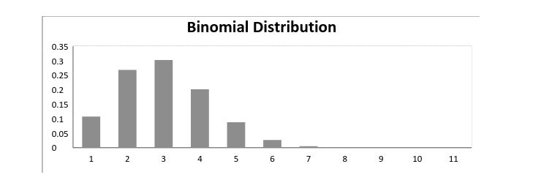
A binomial distribution graph where the probability of success does not equal the probability of failure looks like

Slide 9

Normal Distribution
Normal distribution represents the behavior of most of the situations in the universe (That is why it’s called a “normal” distribution. I guess!). The large sum of (small) random variables often turns out to be normally distributed, contributing to its widespread application. Any distribution is known as Normal distribution if it has the following characteristics:
The mean, median and mode of the distribution coincide.
The curve of the distribution is bell-shaped and symmetrical about the line x=μ.
The total area under the curve is 1.
Exactly half of the values are to the left of the center and the other half to the right.
A normal distribution is highly different from Binomial Distribution. However, if the number of trials approaches infinity then the shapes will be quite similar.
The PDF of a random variable X following a normal distribution is given by:

Slide 10
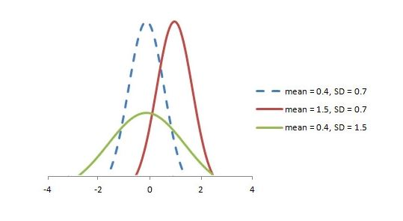
The mean and variance of a random variable X which is said to be normally distributed is given by:
Mean -> E(X) = µ
Variance -> Var(X) = σ^2
Here, µ (mean) and σ (standard deviation) are the parameters. The graph of a random variable X ~ N (µ, σ) is shown below.

Slide 11
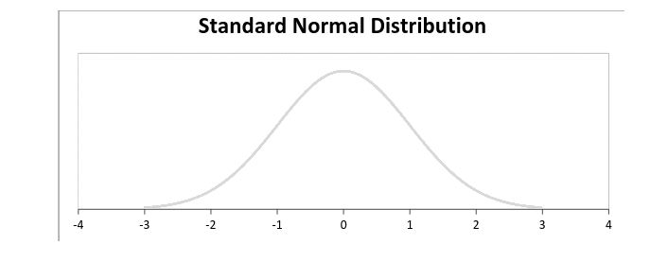
A standard normal distribution is defined as the distribution with mean 0 and standard deviation

Slide 12

Poisson Distribution
Suppose you work at a call center, approximately how many calls do you get in a day? It can be any number. Now, the entire number of calls at a call center in a day is modeled by Poisson distribution. Some more examples are
The number of emergency calls recorded at a hospital in a day.
The number of thefts reported in an area on a day.
The number of customers arriving at a salon in an hour.
The number of suicides reported in a particular city.
The number of printing errors at each page of the book.
You can now think of many examples following the same course. Poisson Distribution is applicable in situations where events occur at random points of time and space wherein our interest lies only in the number of occurrences of the event.
A distribution is called Poisson distribution when the following assumptions are valid:
1. Any successful event should not influence the outcome of another successful event. 2. The probability of success over a short interval must equal the probability of success over a longer interval. 3. The probability of success in an interval approaches zero as the interval becomes smaller.
Now, if any distribution validates the above assumptions then it is a Poisson distribution. Some notations used in Poisson distribution are:
λ is the rate at which an event occurs,
t is the length of a time interval,
And X is the number of events in that time interval.
Here, X is called a Poisson Random Variable and the probability distribution of X is called Poisson distribution.
Let µ denote the mean number of events in an interval of length t. Then, µ = λ*t.
The PMF of X following a Poisson distribution is given by:

Slide 13
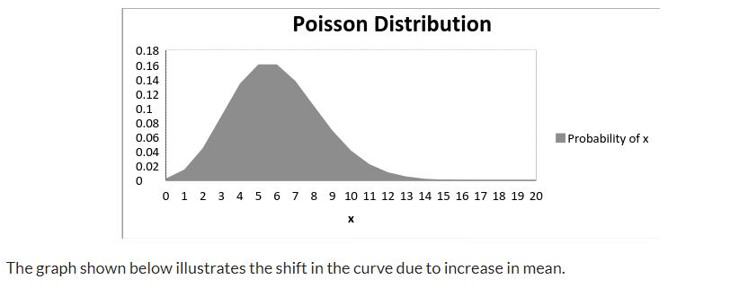
The mean µ is the parameter of this distribution. µ is also defined as the λ times length of that interval. The graph of a Poisson distribution is shown below:

Slide 14
Every single successful data science project revolves around finding accurate correlations between the input and target variables. However more than often, we oversee how crucial correlation analysis is. It is recommended to perform correlation analysis before and after data gathering and transformation phases of a data science project.

Slide 15
What Is Correlation?
Correlation is a statistical measure.
Correlation explains how one or more variables are related to each other. These variables can be input data features which have been used to forecast our target variable.
Two features (variables) can be positively correlated with each other. It means that when the value of one variable increases then the value of the other variable(s) also increases.

Slide 16
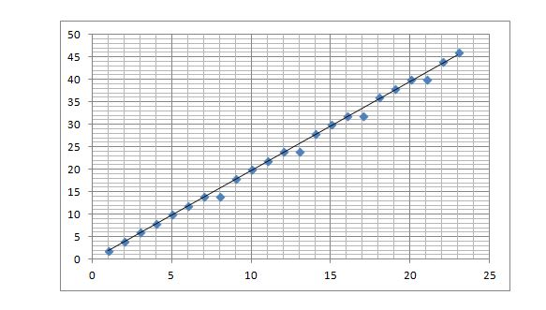
Example Of Strong Positive Correlation
The trend line has a positive gradient.
Two features (variables) can be negatively correlated with each other. This occurs when the value of one variable increases and the value of other variable(s) decreases.

Slide 17
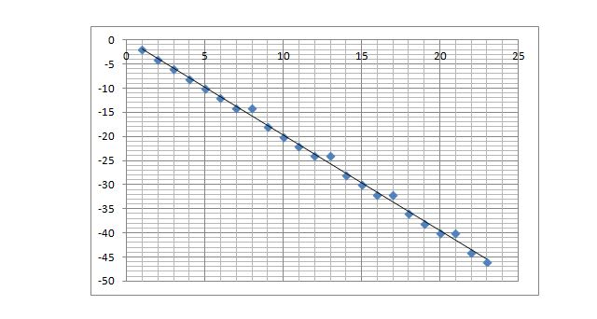
Example Of Strong Negative Correlation
Two features might not have any relationship with each other. This happens when the value of a variable is changed then the value of the other variable is not impacted.

Slide 18
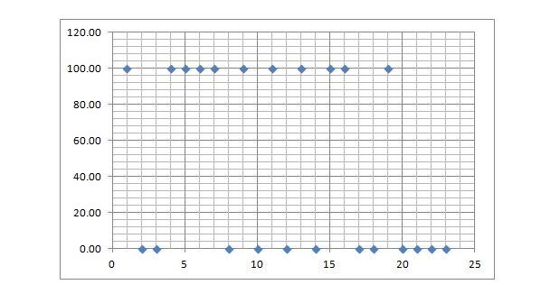
Example Of No Correlation

Slide 19
What is Random Sampling?
Random sampling, or probability sampling, is a sampling method that allows for the randomization of sample selection, i.e., each sample has the same probability as other samples to be selected to serve as a representation of an entire population.
Random sampling is considered one of the most popular and simple data collection methods in research fields (probability and statistics, mathematics, etc.). It allows for unbiased data collection, which lets studies arrive at unbiased conclusions.
Random sampling, also known as probability sampling, is a sampling method that allows for the randomization of sample selection.
It is essential to keep in mind that samples do not always produce an accurate representation of a population in its entirety; hence, any variations are referred to as sampling errors.
There are four primary, random (probability) sampling methods – simple random sampling, systematic sampling, stratified sampling, and cluster sampling.

Slide 20
Types of Random Sampling Methods
1. Simple random sampling
Simple random sampling is the randomized selection of a small segment of individuals or members from a whole population. It provides each individual or member of a population with an equal and fair probability of being chosen. The simple random sampling method is one of the most convenient and simple sample selection techniques.
2. Systematic sampling
Systematic sampling is the selection of specific individuals or members from an entire population. The selection often follows a predetermined interval (k). The systematic sampling method is comparable to the simple random sampling method; however, it is less complicated to conduct.
3. Stratified sampling
Stratified sampling, which includes the partitioning of a population into subclasses with notable distinctions and variances. The stratified sampling method is useful, as it allows the researcher to make more reliable and informed conclusions by confirming that each respective subclass has been adequately represented in the selected sample.
4. Cluster sampling
Cluster sampling, which, similar to the stratified sampling method, includes dividing a population into subclasses. Each of the subclasses should portray comparable characteristics to the entire selected sample. This method entails the random selection of a whole subclass, as opposed to the sampling of members from each subclass. This method is ideal for studies that involve widely spread populations.

Slide 21
Thank you

