Slide 1
BDM 2053
Big Data Algorithms and Statistics

Slide 2
Course Objectives
Discuss data science project evaluation.
Explore data science project deployment practices.
Choose appropriate statistical model to address business problem.
Combine statistical models to increase accuracy for machine learning, pattern recognition, and natural language processing.

Slide 3
Evaluation
It’s not necessary to understand the inner workings of a machine learning project, but you should understand whether the right things have been measured and whether the results are suited to the business problem. You need to know whether to believe what data scientists are telling you.
There are actually two closely related concerns under the rubric of evaluation:
Model evaluation is typically taught to data scientists and concerns the technical quality of a model: How well does the model perform? Can we trust the numbers? Are they statistically significant?
Project evaluation includes model evaluation, but also asks questions of the application context: Is the right problem being solved? Is the performance metric appropriate to the task? How are the data being provided and how is the model result used? Are the costs acceptable?

Slide 4
Both types are important not only to data scientists but also to managers and executives, who must evaluate project proposals and results. To managers I would say: It’s not necessary to understand the inner workings of a machine learning project, but you should understand whether the right things have been measured and whether the results are suited to the business problem. You need to know whether to believe what data scientists are telling you.
To this end, here I’ll evaluate a machine learning project report. I found this work described as a customer success story on a popular machine learning blog. The write-up was posted in early 2017, along with a related video presenting the results. Some aspects are confusing, as you’ll see, but I haven’t sought clarification from the authors because I wanted to critique it just as reported. This makes for a realistic case study: you often have to evaluate projects with missing or confusing details.
As you’ll see, we’ll uncover some common application mistakes that even professional data scientists can make.

Slide 5
The Problem
The problem is presented as this: A large insurance company wants to predict especially large insurance claims. Specifically, they divide their population into drivers who report an accident (7–10%), drivers who have no accidents (90–93%), and so-called large-loss drivers who report an accident involving damages of $10,000 or more (about 1% of their population). It is only the last group involved in large, expensive claims that they want to detect. They are facing a two-class problem, whose classes they call Large Loss and Non-Large Loss.
Readers acquainted with my prior posts may recall I’ve talked about how common unbalanced classes are in real-world machine learning problems. Indeed, here we see a 99:1 skew where the positive (Large-Loss) instances are outnumbered by the uninteresting negative instances by about two orders of magnitude. (By the way, this would be considered very skewed by ML research standards, though it’s on the lighter side by real-world standards.) Because of this skew, we have to be careful in evaluation.

Slide 6
The Approach
Their approach was fairly straightforward. They had a historical data sample of previous drivers’ records on which to train and test. They represented each driver’s record using 70 features, encompassing both categorical and numerical features, although only a few of these are shown.
They state that their client had previously used a Random Forest to solve this problem. A Random Forest is a well known and popular technique that builds an ensemble of decision trees to classify instances. They hope to do better using a deep learning neural network. Their network design looks like this:

Slide 7
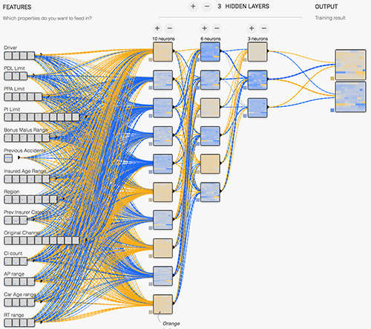

Slide 8
The model is a fully connected neural network with three hidden layers, with a ReLU as the activation function. They state that data from Google Compute Engine was used to train the model (implemented in TensorFlow), and Cloud Machine Learning Engine’s HyperTune feature was used to tune hyper parameters.
I have no reason to doubt their representation choices or network design, but one thing looks odd. Their output is two ReLU (rectifier) units, each emitting the network’s accuracy (technically: recall) on that class. I would’ve chosen a single Softmax unit representing the probability of Large Loss driver, from which I could get a ROC or Precision-Recall curve. I could then threshold the output to get any achievable performance on the curve. (I explain the advantages of scoring over hard classification in this post.)

Slide 9
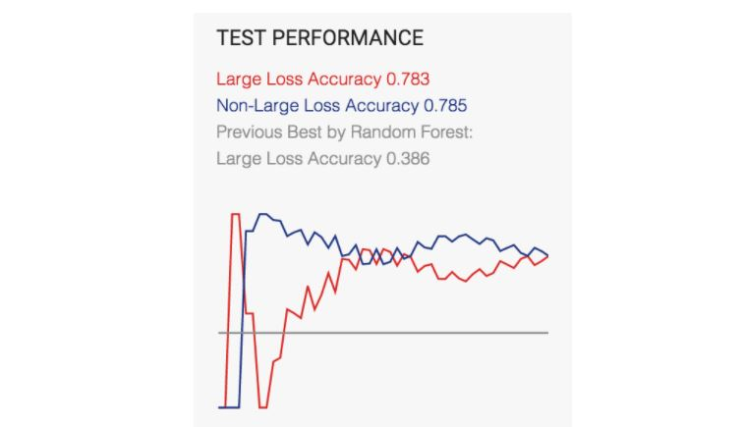
The Results
Their method of presenting test results is confusing. At the very outset, they report 78% accuracy—which is odd, both because accuracy is an uninformative measure for this skewed domain and because simply always saying Non-Large Loss should yield 99% accuracy. These two points are not unrelated.
But further down they show this as their end result:

Slide 10
The graph is missing x and y markings, so it’s hard to get much out of the curves. The only information is at the top. They are reporting two accuracies, one for each class. This changes things—they’re not using composite classification accuracy (the common meaning of “accuracy”) but the recall on each class. We can calculate some of the information to evaluate their system. Is it enough?
The Large Loss accuracy (recognition rate) is 0.78. By convention, the rare class is usually positive, so this means the True Positive (TP) rate is 0.78, and the False Negative rate (1 – True Positive rate) is 0.22. The Non-Large Loss recognition rate is 0.79, so the True Negative rate is 0.79 and the False Positive (FP) rate is 0.21.
What they had previously reported as Random Forest Accuracy is 0.39. Now we realize that this value is really the single-class recognition rate on the Large Loss class, so it is the Random Forest’s True Positive rate. They don’t report a False Positive rate (or True Negative rate, from which we could have calculated it). That’s a problem.
That concludes their report.

Slide 11
Critique
The first criticism is fairly obvious. They report only a single run of training and testing, so regardless of any other issues we really have only a single result to work with. We should want multiple runs using cross-validation or bootstrap to provide an indication of variation. As it is, we have no confidence that these numbers are representative. Most Machine Learning courses introduce the student to basic model evaluation and emphasize the need for multiple evaluations to establish confidence regions.
So how good is their solution?
Bottom line: We don’t know. They haven’t given us enough information. Probably not as good as they think.
Here is an ROC curve illustrating the classifiers. Such diagrams allow us to see the performance as a trade-off between sensitivity and specificity (equivalently, between False Positives and True Positives).

Slide 12
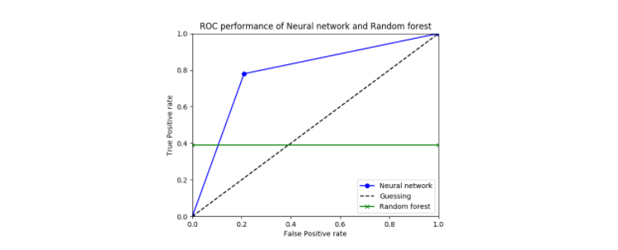

Slide 13
Evaluating the Solution as a Project
Stepping back from the technical details, we can critique this as a solution to a business problem. The “case” they’ve given us here doesn’t say anything really about what business problem they’re trying to solve. We can’t judge whether the solution is appropriate for solving it. The write-up simply states, “it’s important for adjusters to understand which clients are at higher risk for such cases in order to optimize the pricing of its policies“.
Ignoring their model’s poor performance, is this even a good approach? “Understanding” often includes understanding the predictors, not just the names and account numbers of the high-scoring drivers. Nothing is said about how this understanding is achieved. Though neural networks are extremely popular right now, deep learned neural networks are notorious for not being comprehensible. They may not have been the ideal choice for this problem.
Finally, nothing is said about how the solution would affect pricing, nor even what is important from the modeling to optimize pricing.
An important part about solving applications with machine learning is understanding how the model is going to be used in the context of the application (the larger process). This project simply showed a quick translation of a business problem into a two-class problem, then showed the technical details of the model and the results attained. Because the initial analysis of the insurance problem was superficial, we don’t even know what performance would be acceptable.

Slide 14
Productionizing Data Science Projects
First, we’ll consider what it means to productionize data science code. Data scientists, business analysts, and developers often work on their own laptop or desktop machines during the initial stages of the data science workflow. At some intermediate or later stages in their workflow, they want to encapsulate and deploy a portion or all of their analysis in the form of libraries, applications, dashboards, or API endpoints that other members of the data science team can leverage to further extend, disseminate, or collaborate on their results.
The process of productionizing data science assets can mean different workflows for different roles or organizations, and it depends on the asset that they want to productionize. Getting code ready for production usually involves code cleanup, profiling, optimization, testing, refactoring, and reorganizing the code into modular scripts or libraries that can be reused in other notebooks, models, or applications.
Once the code is ready for production, a number of new considerations must be made to ensure that the deployed projects and applications are robust, performant, reliably accessible, secure, and scalable, among other factors.
Let’s consider an example use case in the deployment stage of the data science workflow. A data scientist has created an end-to-end analysis in an interactive notebook environment that imports and cleans data, then classifies the data using various clustering algorithms. Now, they want to transform this analysis into a report for business analysts that gets updated daily, as well as an interactive web application for all of the users within their organization to interact with.
Another example use case for data science deployments is one that involves a data engineer who wants to transform a notebook used for exploratory analysis into a library that can be used by other data scientists and developers within the organization as well as a web application and REST API for data scientists to export and consume the post-processed, cleaned data in their own analyses. In the following section, we’ll explore the details of these data science deployment use cases, describe different types of data science assets, and describe how to deploy and scale data science projects beyond the scope of the original developer’s machine.

Slide 15
Deploying Data Science Projects
When starting an analysis from a Python script or Jupyter notebook, there are many different approaches that can be used to transform this code into an asset that can be leveraged and consumed by many different users and roles within a data science team. Depending on the desired output, different types of data science assets can include:
Reports that can be deployed as hosted, static notebooks
Code that can be encapsulated inside of a package and shared for reusability
Dashboards and applications that can be deployed and used across an organization
Machine learning models that can be embedded in web applications or queried via REST APIs

Slide 16
Considerations When Deploying Data Science Projects
The above sections provided some implementation-specific information and tools that can be used to deploy data science assets such as notebooks, dashboards, or interactive applications in different scenarios, including hosted notebook and dashboard servers, RESTful API frameworks, and process management. There are additional aspects that should be considered when deploying any type of data science asset or project within your organization.
When defining a process for data scientists and users to productionize and deploy their own custom applications, notebooks, or dashboards within your organization, you’ll also want to consider the general production details described in the following sections to ensure that the deployed applications and compute infrastructure are robust, stable, secure, and scalable, among other considerations.

Slide 17
Provisioning Compute Resources
Before you deploy your data science project, you’ll need to reserve and allocate compute resources from a cloud-based provider (Amazon AWS, Google Cloud Platform, or Microsoft Azure) or one or more bare-metal machines within your organization that will act as deployment servers.
Depending on factors such as the computational resources (CPU, memory, disk) required for your applications, number of concurrent users, and expected number of deployed applications, your use case might require one or more deployment servers in a cluster.
Once you’ve identified compute resources for your use case, you’ll need to install and configure the production environments on the machines, including system-wide configuration, user management, network and security settings, and the system libraries required for your applications. Some enterprise-grade configuration management tools that we commonly use to manage deployment servers and machines within cluster environments include Fabric, Salt, Ansible, Chef, and Puppet.

Slide 18
Managing Dependencies and Environments
When you deploy a data science application, you’ll want to ensure that it’s running in an environment that has the appropriate version of Python, R, and libraries that your application depends on, including numerical, visualization, machine learning, and other data science packages and their corresponding C/C++/Fortran/etc. libraries.
This problem is easy to solve using Anaconda with multiple conda environments, which are separate from the system/framework installation of Python on your deployment servers and can be used to manage as many Python and R environments and package versions as your applications need. Conda Kapsel is a newer project in the conda ecosystem that allows you to define, manage, and run reproducible, executable projects and their dependencies, including conda environments, data files, and services.
Containerization and virtualization management layers such as Docker or Vagrant can also optionally be used with Anaconda to improve the portability of your application in various environments. Anaconda makes this aspect of data science deployment easy by integrating with various cloud providers, containerization, and virtualization technologies.

Slide 19
Scheduling Regular Execution of Jobs
After you deploy your data science project, you might want to incorporate scheduled execution intervals for a notebook, dashboard, or model so that the end-users will always be viewing the most up-to-date information that incorporates the latest data and code changes.
This can be accomplished via a Cron job scheduler or via workflow/pipeline managers such as Apache Airflow (incubating) or Luigi. Using these tools, you can configure your data science application to run at regular intervals every few minutes, hours, or days to perform tasks such as data ingestion, data cleaning, updated model runs, data visualization, and saving output data.

Slide 20
ML vs NLP and Using Machine Learning on Natural Language Sentences
Let’s return to the sentence, “Billy hit the ball over the house.” Taken separately, the three types of information would return:
Semantic information: person – act of striking an object with another object – spherical play item – place people live
Syntax information: subject – action – direct object – indirect object
Context information: this sentence is about a child playing with a ball
These aren’t very helpful by themselves. They indicate a vague idea of what the sentence is about, but full understanding requires the successful combination of all three components.
This analysis can be accomplished in a number of ways, through machine learning models or by inputting rules for a computer to follow when analyzing text. Alone, however, these methods don’t work so well.
Machine learning models are great at recognizing entities and overall sentiment for a document, but they struggle to extract themes and topics, and they’re not very good at matching sentiment to individual entities or themes.

Slide 21
Alternatively, you can teach your system to identify the basic rules and patterns of language. In many languages, a proper noun followed by the word “street” probably denotes a street name. Similarly, a number followed by a proper noun followed by the word “street” is probably a street address. And people’s names usually follow generalized two- or three-word formulas of proper nouns and nouns.
Unfortunately, recording and implementing language rules takes a lot of time. What’s more, NLP rules can’t keep up with the evolution of language. The Internet has butchered traditional conventions of the English language. And no static NLP codebase can possibly encompass every inconsistency and meme-ified misspelling on social media.

Slide 22
Very early text mining systems were entirely based on rules and patterns. Over time, as natural language processing and machine learning techniques have evolved, an increasing number of companies offer products that rely exclusively on machine learning. But as we just explained, both approaches have major drawbacks.
That’s why at Lexalytics, we utilize a hybrid approach. We’ve trained a range of supervised and unsupervised models that work in tandem with rules and patterns that we’ve been refining for over a decade.

Slide 23
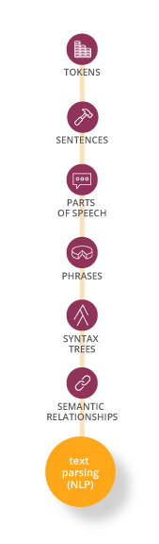
Hybrid Machine Learning Systems for NLP
Our text analysis functions are based on patterns and rules. Each time we add a new language, we begin by coding in the patterns and rules that the language follows. Then our supervised and unsupervised machine learning models keep those rules in mind when developing their classifiers. We apply variations on this system for low-, mid-, and high-level text functions.

Slide 24
Low-level text functions are the initial processes through which you run any text input. These functions are the first step in turning unstructured text into structured data. They form the base layer of information that our mid-level functions draw on. Mid-level text analytics functions involve extracting the real content of a document of text. This means who is speaking, what they are saying, and what they are talking about.
The high-level function of sentiment analysis is the last step, determining and applying sentiment on the entity, theme, and document levels.

Slide 25
Low-Level
Tokenization: ML + Rules
PoS Tagging: Machine Learning
Chunking: Rules
Sentence Boundaries: ML + Rules
Syntax Analysis: ML + Rules
Mid-Level
Entities: ML + Rules to determine “Who, What, Where”
Themes: Rules “What’s the buzz?”
Topics: ML + Rules “About this?”
Summaries: Rules “Make it short”
Intentions: ML + Rules “What are you going to do?”
Intentions uses the syntax matrix to extract the intender, intendee, and intent
We use ML to train models for the different types of intent
We use rules to whitelist or blacklist certain words
Multilayered approach to get you the best accuracy
High-Level
Apply Sentiment: ML + Rules “How do you feel about that?”
You can see how this system pans out in the chart below:

Slide 26
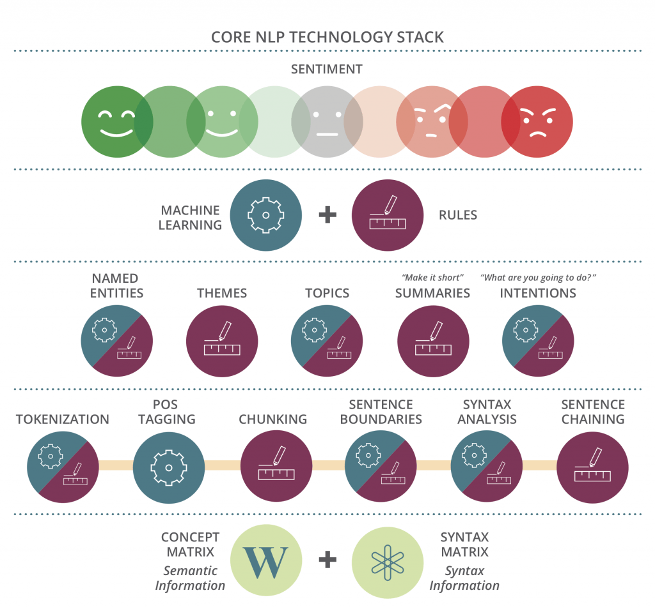

Slide 27
Summary
Language is messy and complex. Meaning varies from speaker to speaker and listener to listener. Machine learning can be a good solution for analyzing text data. In fact, it’s vital – purely rules-based text analytics is a dead-end. But it’s not enough to use a single type of machine learning model. Certain aspects of machine learning are very subjective. You need to tune or train your system to match your perspective.
In short:
The best way to do machine learning for NLP is a hybrid approach: many types of machine learning working in tandem with pure NLP code.

Slide 28
Thank You

