Slide 1
BDM 2053
Big Data Algorithms and Statistics

Slide 2
Course Objectives
What is Big Data
Big Data Introduction
Big Data Architectures
Big Data Store service
Big Data Processing Service
Big Data Eco Systems

Slide 3
BIG DATA
HADOOP & ECO-SYSTEMS

Slide 4
Big Data – 3 Vs
Volume
“Internet Scale”
Terabytes (240, trillion), 220 DVDs (4.7GB)
Petabytes (250, quadrillion), 1,000 1TB drives
Velocity
From batch to real-time
real-time streaming as it happens
micro-batches
batch and scheduled
Variety
Multitude of data formats:
Semi-structured: csv files, clickstreams, log files.
Unstructured data: audio, video, clinical notes, free form text, email, machine data.

Slide 5
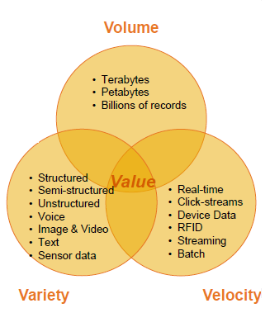
Big Data – 3 Vs
Volume:
Bytes, KB, MB, GB, TB, PB, EB
Velocity:
Batch, Real Time, Streaming
Variety:
Structured (Tables), Semi-Structured (Xml, JSON, Log), Un-Structured (Audio, Video, Images)

Slide 6
Hadoop came from the Google File System paper published in October 2003
Doug Cutting ‘s Apache Nutch project moved to the new Hadoop subproject in January 2006.
Doug Cutting named this project as Hadoop after his son's toy elephant, who was working at Yahoo! at the time.
The initial code of Nutch consisted of 5k lines of code for NDFS and 6k lines of code for Map Reduce.
Hadoop consists of the Hadoop Common package (HDFS, Map Reduce), contains the necessary Java ARchive (JAR) files and scripts needed to start Hadoop.

Slide 7
Hadoop Milestones
Year | Month | Event
2003 | October | Google File System paper released
2006 | January | Hadoop is born from Nutch 197
2006 | February | Hadoop is named after Cutting's son's yellow plush toy
2006 | April | Hadoop 0.1.0 released
2006 | April | Hadoop sorts 1.8 TB on 188 nodes in 47.9 hours
2008 | April | Hadoop world record fastest system to sort a terabyte of data. Running on a 910-node cluster, Hadoop sorted one terabyte in 209 seconds
2008 | May | Hadoop wins TeraByte Sort (World Record sortbenchmark.org)
2008 | October | Loading 10 TB/day in Yahoo clusters
2008 | October | Cloudera, Hadoop distributor is founded
2009 | April | Hadoop sorts a petabyte
2009 | July | MapR, Hadoop distributor founded

Slide 8
Year | Month | Event
2009 | July | HDFS now a separate subproject
2009 | July | Map Reduce now a separate subproject
2010 | June | Yahoo 4,000 nodes/70 petabytes
2012 | January | Hadoop community moves to separate from Map Reduce and replace with YARN
2012 | November | Apache Hadoop 1.0 Available
2013 | March | YARN deployed in production at Yahoo
2014 | February | Apache Hadoop 2.3 Available
2014 | February | Apache Spark top Level Apache Project
2014 | June | San Jose Hadoop Summit (3,200 attendees)
2014 | August | Apache Hadoop 2.5 Available
2015 | June | Apache Hadoop 2.7 Available
2016 | September | Apache Hadoop 3.0.0-alpha1 available
2017 | January | Apache Hadoop 3.0.0-alpha2 available

Slide 9
NOSQL, HADOOP, HADOOP-ECO-SYSTEMS
1. NOSQL:
HBASE, Cassandra, Mongo DB, Big Table, Hyper Table, Couch DB.
2. HADOOP:
HDFS, Map Reduce
3. HADOOP ECO-SYSTEMS:
Hive, Pig, Sqoop, Flume, Oozie, Zookeeper, Phoenix, Spark, Scala, Kafka, SBT.
Hadoop: Open Source from Apache
HDFS: Hadoop Distributed File System.
Map Reduce: Functional Programming Language written in Java

Slide 10
Hadoop Roles
Administration:
Development: (Programming, Non-Programming)
Programming: Java, R, Python, Ruby, .NET
Non-Programming: Main Frames, Data Warehousing, SQL, Scripting Languages.
File System:
Windows: NTFS, FAT, FAT32
Linux: EXT3, EXT4
Distributed File System:
More Than one machine connected through a Network

Slide 11
FS VS DFS VS HDFS:
FS:
Storing the Large Amount of Data
Processing the Large Amount of Data
Data Loss ( Power, Network, H/W, S/W Failures)
Meta Data Limitations
Vertical Scaling
DFS:
No Automatic Split
Labeling Like Part1, Part2, Part3,.. Under Metadata

Slide 12
Vendor Distributions
1. Cloudera
2. Horton Works
3. MapR
4. Amazon EMR, EC2
5. Google
6. IBM
7. Intel
8. HP
9. EMC2
10. Microsoft
11. VMWare ….

Slide 13
Hadoop 1.X Architecture
Hadoop’s Architecture is a Master-Slave Architecture
Hadoop Automatically handles Splits, Replicas and Metadata
Hadoop 1.x Architectural Components:
1. Name Node
2. Data Node
3. Secondary Name Node
4. Job Tracker
5. Task Tracker

Slide 14
Hadoop 1.x Architecture Components
Component | Process Name | RPC Port | Http Port | Comments
HDFS | Name Node | 8020 | 50070 | Metadata Storage
HDFS | Data Node | - | 50075 | Actual Data Storage
HDFS | Secondary Name Node | - | 50090 | Backup Name Node
Map Reduce | Job Tracker | 8021 | 50030 | Assigning Jobs to Task Tracker
Map Reduce | Task Tracker | - | 50060 | Executing Jobs

Slide 15
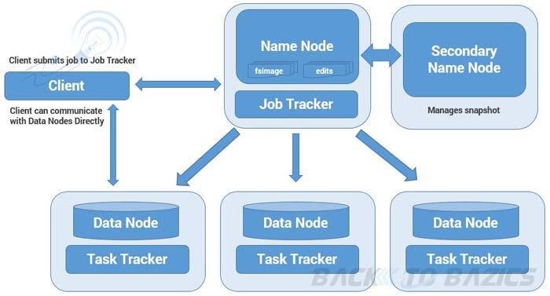
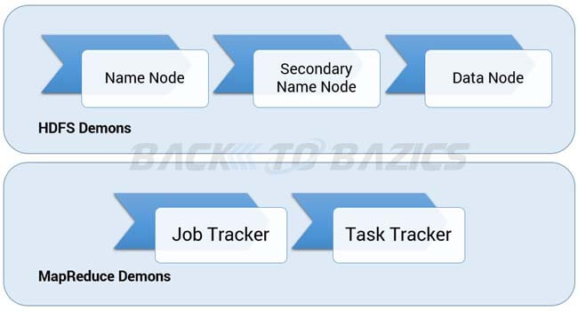
Hadoop 1.X Architecture

Slide 16
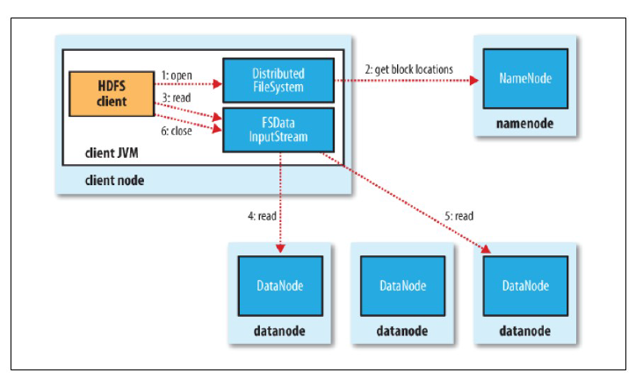
A client reading data from HDFS

Slide 17
A client writing data to HDFS

Slide 18
Rack Awareness

Slide 19
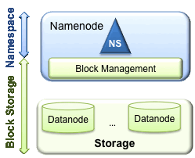
HDFS Federation

Slide 20
HDFS Layers
HDFS has two main layers:
Namespace
Consists of directories, files and blocks.
It supports all the namespace related file system operations such as create, delete, modify and list files and directories.
Block Storage Service, which has two parts:
Block Management (performed in the Namenode)
Storage

Slide 21
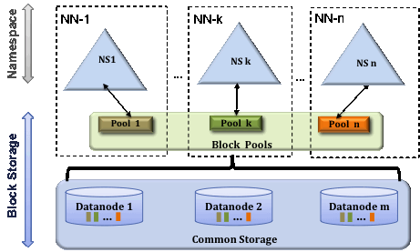
Multiple Namenodes

Slide 22
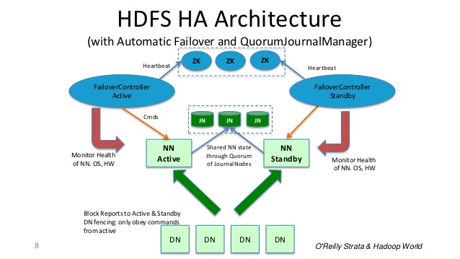
NN High Availability with QJM

Slide 23
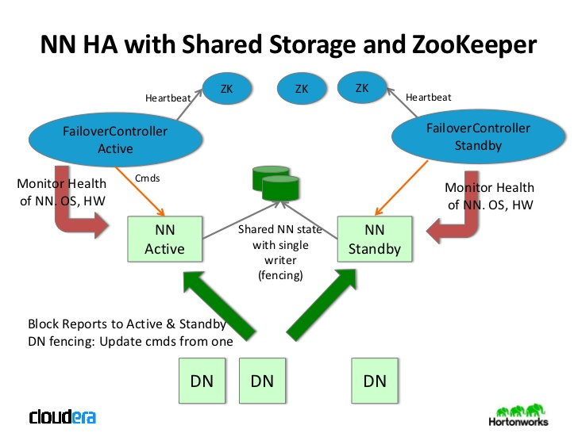
NN High Availability with NFS

Slide 24
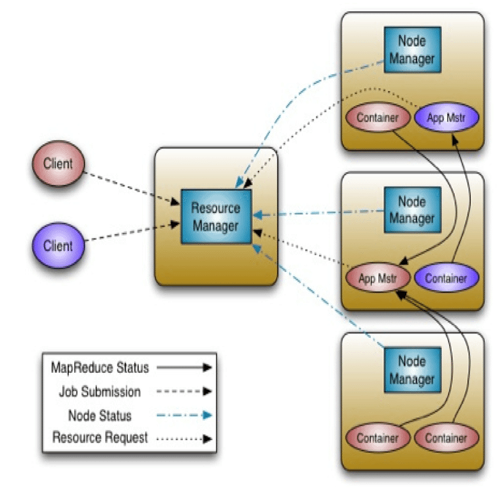
Hadoop 2.X Architecture

Slide 25
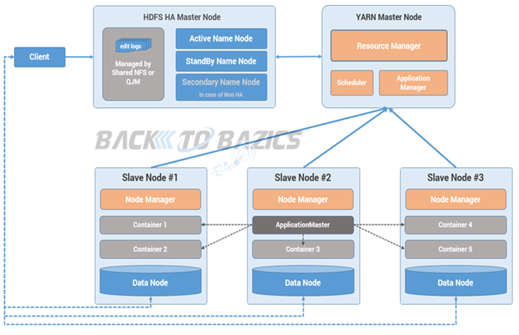
YARN Architecture

Slide 26
How Hadoop Runs a Map Reduce job

Slide 27
Questions?

Slide 28
Thank You

