Slide 1
2022F-T3 BDM 3053 – Infonomics 01 (DSMM Group 1) Chapter – 01 Why Monetize Information?
Group – A
Priti Bhale(C0835691)
Greeshma (C0834358)
Roshan(C0831342)

Slide 2
Agenda
1. Introduction
1.1 Monetizing Information as an Assets.
1.2 Possibilities of Monetizing Information.
1.3 Myths of Monetizing Information.
1.4 Economic Alternatives for Information
1.5 Direct Monetarization vs Indirect Monetarization. What to choose?
1.6 Identify External Opportunities
1.7 Information Unique Characteristics.

Slide 3
Learning Outcomes:
In this chapter we are mainly focusing on what is Infonomics and how will it help to monetize, merge and manage the information.
Monetizing the information as an Asset is the key parameter of the Chapter.
Basically, it’s all about the information that is around us, and how we actually turn that information useful for all business forms.
We will also focus on the unique characteristics of how information could be relevant, complete, and understandable.
Direct and Indirect methods o how the information can be monetized are seen in these chapters.
We are also going to witness how big companies such as Citigroup have tackled the problems and managed to get their two weeks’ work done in just two months.
By the end of the chapter, we are going to learn how to deal with the myths about monetizing the information and learn about its unique characteristics.

Slide 4
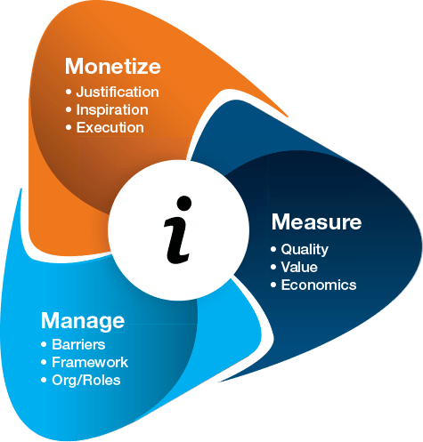
What is Infonomics..?
Infonomics is the economics of information. It is the study that offers a structure for companies to manage, monetize and value knowledge as a real asset.
Part 1: Monetizing Information as an Asset

Slide 5
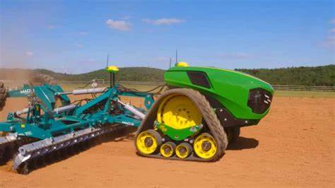
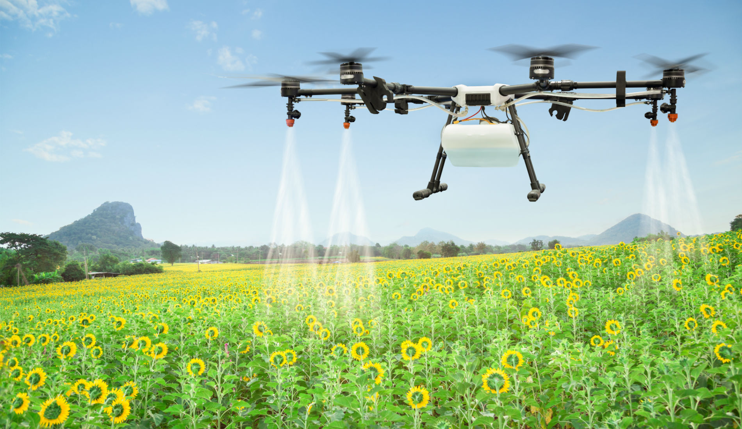
Why Monetize Information
Ian Pigott runs a diversified farming business near Harpenden also has an autonomous 11-ton John Deere tractor which is guided by the Information that comes from the satellite about the Samples of Plants, soil erosion, pesticides, and also sends all the information to the farmer’s tablet sitting in his chair.
Just by sitting in his office, Pigott can manage the entire operations on the farm. Similarly, other farms are also operated by drones for the underground water supply, flooding, etc.., this kind of machines have made life easy. But the actual point is are these companies really concerned about crop growth?
Companies such as John Deere and Caterpillar are just capturing the data from these activities and are using it for their own beneficiary and are improvising the equipment for the next generation’s use. Ultimately, fertilizers companies like Monsanto and Archer Daniels Midland are in turn using this information to improve their agricultural products.

Slide 6
Possibilities of Monetizing Information
Once we have all the information with us and the information is properly monetized we have a lot of benefits from it such as:
Operational Efficiency can be improved
The quality and production of sales can be increased
We can have a good business relationship with customers
The development of the product can also be improved.
Each of the possibilities mentioned above has an individual and distinguishable benefit where the information can be monetized, managed, and measured. By any chance, if any of these are not given importance for sure we are losing our money.

Slide 7
Myths of Monetizing Information.
There are certain myths or unaware facts about monetizing the information such as:
One must sell the information in exchange for cash
One must be in the business in order to monetize the information
It would only be great if we share the information with our friends and family.
In order to avoid these kinds of myths, we need to be aware of why monetizing information is not only an idea but also a way to achieve success.

Slide 8
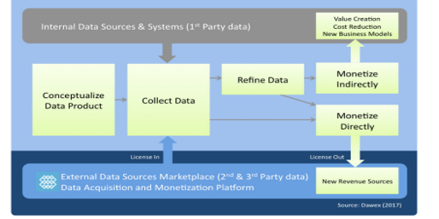
Economic Alternatives for Information
Direct Monetarization:
charge money for their products, via subscription, e-commerce, virtual items, etc.
small, focused group of customers.
Pros: make money as you go
Cons: Direct cash transactions highly visible on income.
Indirect Monetarization:
Indirect monetizers don't charge money to use their product and in fact, often give their product away for free or use the information to generate insights that give more opportunities to business
reduce costs
improve productivity
reduce risks
develop new products

Slide 9
Direct Monetarization vs Indirect Monetarization. What to choose?
People often misinterprets that Direct Monetarization is easy→ Direct Profit
Indirect Monetarization: offers more opportunities to expand the business
Advantages for Indirectly Monetarizing Information
It’s too valuable to sell your data
Improve your business, and create completely new services and business models based on the data you get from your products or services.
Example:
Citigroup added $9 billion in market capitalization and a dividend increase of 500 percent.
Machine intelligence technology correlating and analyzing 2,600 macroeconomic variables with revenue streams from dozens of business units with the help of Ayasdi (it helps the companies recognize and analyze their own data and develop insights)
Using this information to demonstrably reduce risk and improve compliance, Citigroup had added billions in market value.

Slide 10
Example: 2
Belk is monetizing information to measurably optimize merchandising, marketing, and real estate investments. It analyzes data from its millions of customers across thirteen different databases, along with census, ethnicity, and population migration data.
The company has developed models to analyze customers by spend level, purchase history, and other dimensions to identify and target high-value multichannel customers.
It also optimized assortment plans and store format, and improved store opening and closing decisions it has almost doubled the number of online and in-store customers.
Conclusion : Indirect Monetarizing is broader than those for monetizing it directly.
Think beyond your data: Citigroup and Belk have made used data coming from different sources: n, such as open data, syndicated data, social media data, and others.

Slide 11
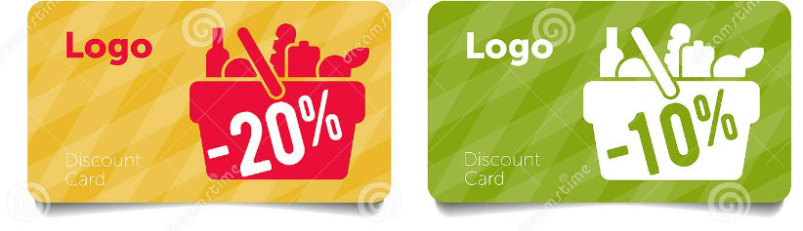
Uncover Your Hidden Treasures Example:
Government organizations in the U.S. are prohibited from selling data outright due to the Freedom of Information Act
The City of Chicago compiles data on vacant buildings for various reasons including compliance, public safety, and taxation.
Makes available to real estate developers can identify prime locations to consider for renovation
Helps the city, the developers, and for the city residents.
Think broader than just cash for the information Loyalty Cards in Grocery Stores:
Give discounts to customers in return of their information
“Loyalty-based discount” is secret retail code for “free stuff in exchange for information about you and your purchase.
Provide access to customer’s data, shopping patterns which helps in increasing sales
They can track the information of the customer from the patterns of and can make use of it to identify the behavior of the customer

Slide 12
Information Unique Characteristics
1. Understandable
Since the information has already been condensed, it must be grasped by the recipient in order for him to quickly interpret it. He must be able to interpret any acronyms, shorthand notations, or acronyms that may be present in the data.
2. Relevant
Generally information is considered to be good if and only if it is relevant. This means that it should be pertinent and meaningful to the decision maker and should be in his area of responsibility.
3. Complete
Information should be containing all the necessary facts that will be needed for the decision maker to satisfactorily solve the problem at hand using such information.
As we know that information cannot always be complete, every reasonable effort should be made
in order to obtain it.

Slide 13
4. Endless copies
As information cannot be depleted when consumed for better or worse information can be easily replicable. We can make an endless copies of it for various indefinite purposes, again without affecting the original. Thanks to the technology such as punch cards, floppy disks, pen drives, hard drives and now internet, information can be duplicated and can be available to the multiple parties with effortless use.
5. A history of transferability
As we know how simple it is to transfer information is related to its ability to be replicated. Transporting it and making copies are undoubtedly linked but different things. In the time Information was dense before electronic data. The writing was found on stone tablets, paper and wood follow. Additionally, several forms of tacit knowledge were Orally "transported“.
6. New Business Models and Profitability
These days the long term value of the IT doesn’t lies in the features and functions of a proposed technology or solution, but in the value of the information that the technology uses.

Slide 14
Conclusion
So far we have seen what is Infonomics and Monetizing the Information.
In the coming Chapters we are going to learn about the other two parts which are Measure and Managing the information.
We have also seen some examples in this chapter for a better understanding of Monetizing Information.
We can conclude from the chapter that we need to value the information as an Asset.

Slide 15
Summary
In this chapter we learned about Infonomics and how it is helping to monetize, merge and manage information.
Various alternatives monetarizing the information with the advantages and disadvantages
This chapter mainly focuses on the value information has in terms of various business perspectives and why it should be considered an asset.
The unique advantageous characteristics of the information are also described.

Slide 16
References:
https://www.linkedin.com/pulse/direct-indirect-data-monetization-question-didier-navez/
www.gartner.com/document/3267517
http://www.busmanagement.com/issue-9/perfect-package/
https://nibmehub.com/opac-service/pdf/read/Infonomics%20_%20how%20to%20monetize-%20manage%20and%20measure%20information%20as%20an%20asset%20for%20competitive%20advantage.pdf

Slide 17
THANK YOU

