Slide 1
Quantifying & Accounting for Information Assets
Group – K
Kamaldeep Kaur Dhami
Meet AnilKumal Patel

Slide 2
Agenda
Information Assets
Why Measure Information Asset
Measuring the Value of Information
Objective Data Quality Metrics
Subjective Data Quality Metrics
Information Asset Valuation Models
Understanding and Closing Information Value Gaps
Combining Information Valuation Models
Conclusion

Slide 3
Learning outcome
Better understanding of Information Assets and the reason why should we measure the information models
Understanding Data Quality Metrics Objective & Subjective
Overview of Valuation Models both Fundamental and Financial valuation approaches.
Understanding and Closing Information Value Gaps
Combining Valuation Models

Slide 4

Information Assets
In financial accounting, an asset is defined as any resource controlled or owned by an economic entity or a business.
An Information Asset can be described as data or information which is of value to the organization, including information like patient records, customer information or intellectual property etc.
These assets can exist in physical form (on paper, CDs, or other media) or electronically (stored in files, personal computers or databases.

Slide 5
Why Measure Information Assets?
On 9/11 in addition to the tragic loss of life & property, there was one more kind of loss – “The Loss of corporate Information assets.”
The terrorist attack of 2001 happened before the cloud-based or offsite backups data storage had become mainstream.
Weeks & Months following 9/11, we heard from the businesses in the twin tower who lost their data & were struggling to recreate it.
Just like other organizations suffering from loss of property, some of these companies filed claims with their insurers for the value of information assets they lost.
On the other hand the insurers denied these claims, arguing that information was not considered property, not even that they updated their CGL (commercial general liability) policy by inserting – “ electronic data is not Tangible Property”.
Imagine if some of the companies had accurate and detailed inventories of their information assets or had formal, and audited valuations placed on them their claims would have had to be taken more seriously and likely would have been upheld by the courts.

Slide 6
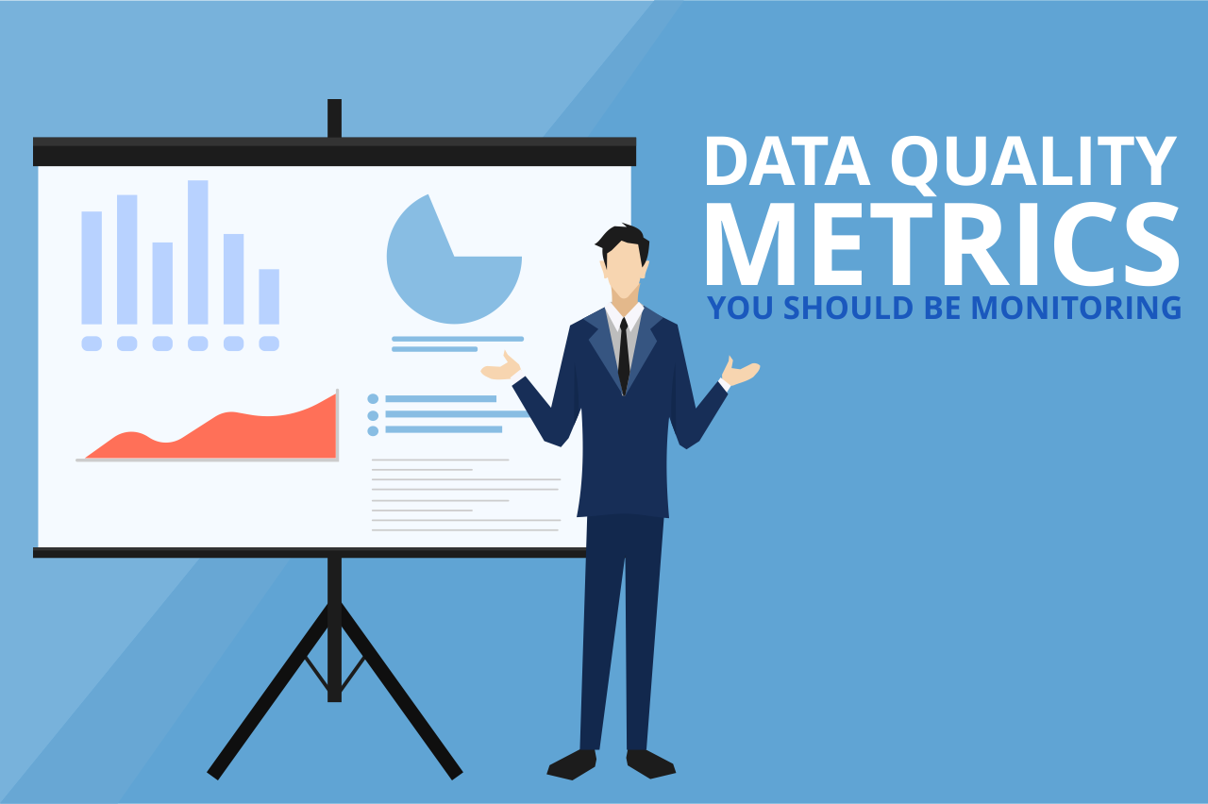
Measuring the value of Information
ASSESSING DATA QUALITY – As information becomes an important asset to organizations in regards to transformation & performance, its quality characteristics are a paramount concern to IT & business leaders.
Poor Data Quality has a detrimental effect on innovation, business performance, and competitiveness. Particularly in the realm of Big Data where orders of magnitude increase in volume, variety, and velocity of information, the issues, and their economic impact are greatly amplified.
Gartner data quality expert Ted Friedman has identified many Data Quality (DQ) indicators, which include both objective and subjective dimensions.

Slide 7
Objective Data Quality Metrics
Validity: It defines how well the non-missing data accurately represents reality, irrespective of format or precision.
Completeness: The percentage of instances of the data recorded v/s the total data available.
Integrity: The correctness and existence of links from and to a record, and the legitimacy of relationships among the attribute values within a record.
Consistency: the number of different formats, structures, or forms data takes when stored in various datasets.
Uniqueness: the percentage of duplicate forms of data instances which exist and identifying them. (for e.g. “CompanyName” v/s “CompanyName Inc.” v/s “CompanyName Incorporated” v/s “CNI”.
Precision: the degree of exactitude of a value.
Timeliness: The probability that a local data record reflects its original source at any given time.
Accessibility: number of businesses that can benefit from data and are able to retrieve it.

Slide 8
Subjective Data Quality Metrics
Existence: the degree to which the business objects, ideas, and events of importance are represented in corporate information assets.
Scarcity: the probability that other organizations also have the same data. Scarcer data is likely to have greater business benefits than commonplace data.
Relevancy: the number of businesses that could use or benefit from the data. Higher relevancy is an indicator of business usefulness.
Usability: the degree to which the data is helpful in performing a business function.
Interpretability: the degree to which the data have a unique meaning and are easy to understand.
Believability: the degree to which the data is trusted.
Objectivity: the degree to which the source of data is believed to be impartial.

Slide 9
Information Asset Valuation Models
To assist organizations in putting infonomics principles into practice we can use various methods to compute the value of an information asset. These include both Fundamental and Financial valuation approaches.
The fundamental models consider the quality-related aspect of information while the financial models measure value in monetary terms by adapting accepted methods for valuing traditional assets.

Slide 10
Fundamental Valuation Models
Intrinsic Value of Information (IVI)
The intrinsic value of information is its presumptive benefit that enables broad comparisons across information classes regardless of how the information may currently be being used.
This method can be useful to prioritize information-related investments among different information sources or initiatives.
For example, the intrinsic value of information (IVI) is particularly useful to guide data quality or security-related efforts and investments.

Slide 11
Business Value of Information (BVI)
This method considers the utility of an information asset to actual business usage.
This method is handy to get a quick take on information’s potential real-world benefit.
For example, when there are competing business priorities, this model can be used to align information-related priorities with them.
Performance Value of Information (PVI)
This approach looks at the realized (or estimated) impact of an information asset on a business objective that is represented as key performance indicators (KPIs).
The PVI yields hard, empirical measurements that are an excellent predictor or proxy for financial measures.

Slide 12
Financial Valuation Models
Cost Value of Information (CVI)
This method simply assesses an information asset as the financial expense required to generate, capture, or collect it.
This method is preferred when there is no active market for the information asset and its contribution to revenue cannot be determined adequately.
The CVI is the best means of estimating information replacement cost and negative business impact if lost, stolen, or damaged.
Market Value of Information (MVI)
This method looks at the potential or actual financial value of an information asset in an open marketplace.
Typically, data monetization is transacted among trading partners in return for cash, goods, or services, or other considerations such as preferential contract terms and conditions.

Slide 13
Economic Value of Information (EVI)
This method generates the net financial value of an information asset by applying the traditional income approach for asset valuation, then subtracting the information’s associated lifecycle expenses.
The EVI is an empirical analysis of the contribution of information to the top and bottom lines.
The EVI, however, requires a live experiment and the ability to estimate information supply chain costs.
Many traditional business leaders are still uncomfortable with the contemporary concept of experimenting with revenue-producing processes.

Slide 14
Understanding and Closing Information Value Gaps
Enterprises repeatedly fall into the trap of getting diminishing returns from buying and applying more complex and leading-edge IT to the same narrow sets of data, rather than doing simpler things with the data that has the highest value gap. It’s like a farmer who buys new equipment, hires more workers, and drenches a certain crop with fertilizer and water when other crops have greater growth and profitability potential.
Determining the value of any information asset using the cost approach (CVI) can offer a baseline, nominal, and conservative value of the information regardless of how it is or could be used.
Since the late 1980s, accountants have allowed for the value of an asset to be recorded as representing its “probable future economic benefits.” This means that a currently unutilized asset may have a formal measurable value.
It also means that any asset has three degrees of value:
A realized value based on the economic benefits it is currently delivering,
A probable value based on its intended uses, and
A mostly theoretical potential value if it were to be optimally applied.

Slide 15
These three degrees of value also give us a way to apply the Gartner Information Value Models to identify value gaps: the information performance gap and the information vision gap:
Information Performance Gap—The difference between the realized value of an information asset and its probable value.
Information Vision Gap—The difference between probable and potential information valuations.

Slide 16
Combining Information Valuation Models
The individual valuation models are useful by themselves, and each model excels at looking at value through a particular lens. By combining the strength of each model, we can identify and close information value gaps.
Prioritize Information Management Investments
You can use IVI to identify information assets with low intrinsic value and high potential business relevance and prioritize data quality improvement efforts on those assets.
Identify New Revenue Opportunities
By assessing the MVI of information you’re utilizing internally, you may find opportunities for external monetization in the form of new information products, discounts, or bartered goods. In M&A scenarios, knowing the MVI of your internal data can also open doors to information-savvy buyers who would gladly pay a premium for your valuable data assets.

Slide 17
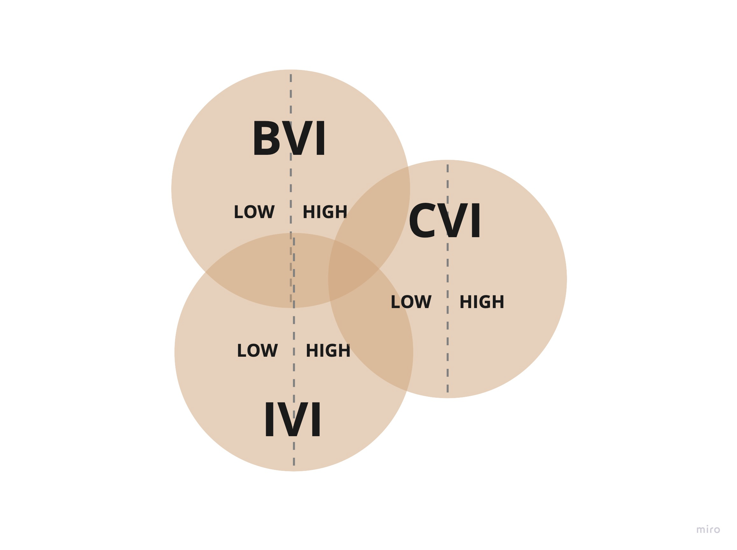
Determine the Marketability of Information Assets
Sometimes, MVI alone is not enough to determine the marketability of information assets because it fails to consider the quality and cost of managing the asset. We can combine IVI, external BVI, and CVI to identify marketable assets and take these variables into consideration.

Slide 18
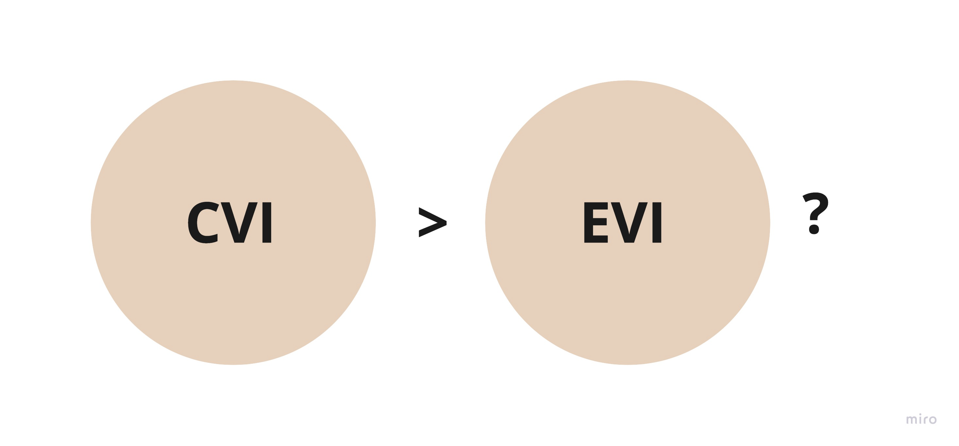
Validate the Benefits of Information Governance
By tracking the increase in KPIs through the improvement of data quality, you can demonstrate the effectiveness of information governance practices. For example, you can link better data documentation to an increased usage of your data lake.
Accelerate Innovation and Digital Transformation
Your business can ideate ways to extract more economic value from that data with high business relevance but unrealized economic potential. Often, this can act as a driving force behind digital transformation initiatives.
Defensible Disposal of Information
You can use the CVI and EVI to make a strong case for disposing of information that costs more to manage than the value it provides.

Slide 19
Conclusion
Even practicable—if not perfect—models for measuring information’s value in various ways cannot convey enough about information’s behavior as an asset.
Quantifying an information asset’s potential or probable or actual value provides us with useful indicators to prove or justify ways to improve how we manage and monetize it.
But such models fall short of telling us how information behaves or how we can bend its behavior to our benefit.
For this, we must turn to the field of economics. Although designed for traditional goods and services and human behavior, economic principles and models can be applied to information assets as well—with some tweaking.

Slide 20
Reference
www.irmi.com/articles/expert-commentary/the-2001-iso-cgl-revision.
R. McCarney, J. Warner, S. Iliffe, R. van Haselen, M. Griffin, and P. Fisher, “The Hawthorne Effect: A Randomised, Controlled Trial,” BMC Med Res Methodol, Volume 7, 2007, p. 30. doi:10.1186/1471-2288-7-30.
Paul Adams, interview with author, 17 December 2016.
A Gartner Consulting project.
The Fourth MIT Information Quality Industry Symposium, 14–16 July 2010. Data as an Asset: Balancing the Data Ecosystem.

Slide 21

Thank you

