Slide 1
2022F-T3 BDM 3053 – Infonomics 01 (DSMM Group 1) Chapter – 12 Adapting Economic Principles For Information
Group – L
Bibek Shah Shankhar(C0835648)
Tika Thapa (C0832724)

Slide 2
Agenda
1.1 Applying Economic Concepts to Information.
1.2 Supply And Demand of Information.
1.3 Information Pricing And Elasticity.
1.4 Marginal Utility Of Information.
1.5 Opportunity Cost Of Information Choices.
1.6 Production Possibilities of Information.
1.7 Improving Information Yield.

Slide 3
Learning Outcomes:-
How the principle of supply and demand operates differently with information than with other assets.
How to understand and apply the forces of information pricing and elasticity.
How understanding the marginal utility of information for both human and technology-based consumers of information should drive business and architecture decisions.
How the opportunity costs of certain information assets must be factored into selecting and publishing them. The frontier affects information related behavior and investments.
How to use Gartner’s information yield curve to conceptually integrate the concepts of information monetization, management, and measurement for improved information-related and business strategies.

Slide 4
Applying Economic Concepts to Information
While economists are concerned about the economics of information, CDOs, CIOs, and enterprise architects in particular should be concerned with infonomics. It's not a part of their line of work and never has been, formally.
Certainly, architects base their design choices on the facts at their availability, volume, speed, and diversity, and may unintentionally consider different economic informational cost, marginal utility, and supply and demand variables.
We’ll explore only those which have the greatest relevance in information assets, and that require some reformulation to guide information producers and consumers such as CDOs, CIOs, and enterprise-, application-, and data architects.

Slide 6
Supply And Demand of Information
Information is an unstable resource. It is representational of some other thing or activity, does not deplete when used, may be employed concurrently, costs relatively little to store or transmit, and can quickly change or vanish.
The most fundamental economic premise is supply and demand. Demand is the amount of anything that a person is willing to buy at a specific price, whereas supply is the amount of that item that is actually accessible.
Executives, business leaders, and architects must understand how the pricing equilibrium differs for information compared traditional services and products. It is based on a more comprehensive function of information costs, workable uses, and market saturation rather than balancing supply and demand.
Information buyers shouldn't assume being able to purchase it for only a small price increase. And information providers must consider how diminishing market saturation will affect the amount of purchasers at any price point (and vice versa), as well as how this would affect their identifiable income stream.

Slide 7
Information Pricing And Elasticity
Organizations are increasingly buying information rather than producing it, whether directly through data brokers or social media aggregators or indirectly via the exchange of commodities or services.
However, the way an information unit's price fluctuates in reaction to other factors (i.e., its elasticity)—primarily the supply and demand of information—may be just as significant as—or perhaps more important than—fixing a price for it.
The amount a supplier (publisher, producer) of an information asset supplies in response to a change in price is measured by the price elasticity of information supply. However, given that data is intrinsically reproducible,
why would a supplier, such as a book publisher or data broker, limits the supply even with downward pressure on prices? Simple: to stop the price from falling below zero, producing little or lossmaking earnings.

Slide 8
On the other side, the demand elasticity of information says that a consumer of information would look for another (substitute) source at a certain price threshold .
Enterprise initiatives to discover and curate information sources may thus be crucial for negotiating the price of existing licensed or bartered information sources and for enhancing the usability of information.
Additionally, the growth of information sources and their availability forces information providers to stand out by offering more comprehensive information sets, better quality, or other services like analytics or integration.

Slide 9
The Marginal Utility Of Information
The value of information influences its availability, demand, and price. Utility is a generic measure of happiness or pleasure according to economists .This should not be confused with value, which compares advantages and costs.
The additional satisfaction received by consuming one more unit of an item or service is known as marginal utility. It helps economists and marketers predict how much or how much more of a product a consumer will purchase or consume.

Slide 10
Positive Marginal Utility Vs Negative Marginal Utility
When a customer consumes an additional unit of an item or service, their overall utility improves (for instance, when a child receives a second doll outfit), this is known as positive marginal utility.
In contrast, negative marginal utility occurs when consuming an extra unit reduces the overall benefit (for example, when consuming an extra scoop of ice cream makes you feel sick).

Slide 11
Architecting For Optimized Information Utility
There are three fundamental ways to design systems that can prevent the adverse effects brought on by streams of similar data:
Transmit only distinct data if it is produced and filtered by the publisher. IoT devices, for example, might only send updates when their state changes.
Transmit only differential data, which includes the delta between subsequent data points. Examples include the aptly named differential backups, and also accelerometer sensors and water leak detectors.
Produce and transmit only derivative data. Examples include publishing a revision to a previously published book or article, or applying different algorithms to a piece of information in order to craft uniquely differentiated messages for particular customers.

Slide 12
Opportunity Cost of Information Choices
If you chose one alternative over another, then the cost of choosing that alternative is an opportunity cost. For example, choosing public transportation to travel to a particular destination by foregoing the option of traveling in one's own car is a good example of opportunity cost, because you end up saving money which needs to be spent on fuel. In the sphere of infonomics, this constitutes selecting one information source over another.
It’s the job of the CDO to ensure that opportunity costs for information and analytics are understood and employed to drive related strategies
CDOs, business leaders, and enterprise architects must be aware of potential unintended consequences (or externalities in economic parlance) when planning to shift to new information sources or analytic methods

Slide 13
The Production Possibilities of Information
defines the set of possible combinations of goods and services a society can produce given the resources available.
Sometimes the inhibitor to improving the production or quality of information, or to implementing more advanced analytic capabilities, is due to its internal information production possibility frontier.
several ways to overcome information-related production possibility frontiers.
-> Embed information-related activities into other activities to soften their impact on resources.
-> Automate information-related activities, or other activities, to free resources.
->Use ROI modeling to justify additional resources, thereby expanding the production possibility frontier outward.

Slide 14
Improving Information Yield
Ultimately, each of these economic factors influence—or should influence—how and when you make information-related investments.
For an organization, or more specifically its CDO, to gauge the appropriate level of investment to understand the information-related investment information yield curve comes into the picture.
The information yield curve brings together, conceptually, the concepts of information monetization, management, and measurement. As we all know, information asset management (IAM) involves numerous moving parts.

Slide 15
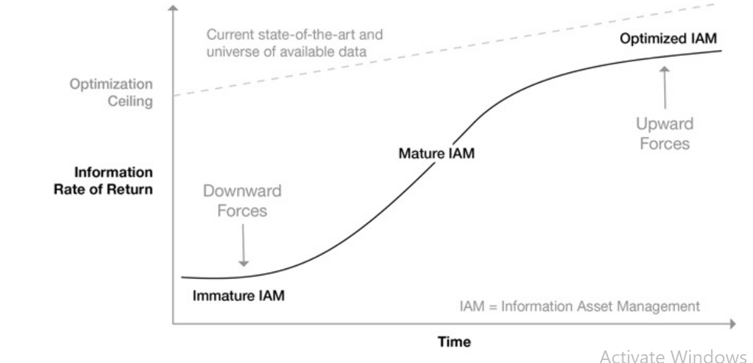
low-maturity organizations will see accelerating improvements in the rate of return on their information assets from information-related investments, while high-maturity organizations will see decelerating rates of return as they approach an optimization ceiling.

Slide 16
Summary
In this chapter we learned about how we can apply Economics concepts to information.
The Supply and Demand of Information
Price elasticity. Elasticity helps us understand how much a change in price will affect market behaviors.
The concept of marginal utility is used by economists to determine how much of an item consumers are willing to purchase.
Opportunity Cost of Information Choices, Production Possibilities of Information, Improving Information Yield

Slide 17
References:
https://nibmehub.com/opac-service/pdf/read/Infonomics%20_%20how%20to%20monetize-%20manage%20and%20measure%20information%20as%20an%20asset%20for%20competitive%20advantage.pdf

Slide 18
THANK YOU

