Slide 1
Chapter 3
Methods for Monetizing Information

Slide 2
Agenda
Steps to Monetizing Information
What Information Monetization Success looks like
References

Slide 3
Steps to Monetizing Information
There are several steps, if followed correctly, would lead to the substantial rewards in the field of tasks for monetizing information as an asset.
Identify and compare potential sources of both direct and indirect information commercialization.
Analyze the viability of your ideas for monetizing information..
Choose, implement, and modify high-value information monetization strategies.from other companies, particularly those in different industries.
Check the viability of your ideas for monetizing information and Information should be prepared and packaged for monetization.

Slide 4
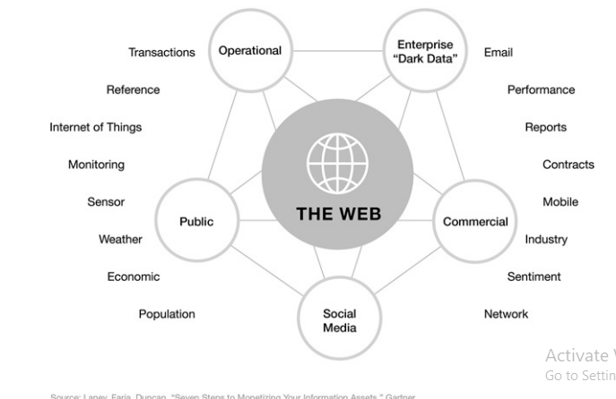
Steps to Monetizing Information
Types of Information
Figure 3.1 Information Asset Inventory

Slide 5
Steps to Monetizing Information
Few skills are mandatory by any product managers:-
Thinking big
Identifying and understanding customers.
Evolving
Measuring and communicating
Being Experimental.
Currently, XO Communications examines 500 unique consumer data points characteristics including call habits, late or unpaid bills, and other crucial signs. Customer attrition was cut by 47 percent after just four months of deployment by XO. %, safeguarding $15 million in revenue

Slide 6
Steps to Monetizing Information
Types of data which could play an integral role in the monetization:-
Operation Data
Dark Data
Commercial Data
Public Data
Social Media Data
When you directly monetize information, you must choose how much of the information will be enhanced through integration, analytics, or reporting, as well as how and to whom the information will be made available.
The goal of indirect monetization is company optimization. It comprises utilising data internally to enhance a procedure or item in a way that yields quantifiable benefits, such income growth or cost savings.

Slide 7
Steps to Monetizing Information
Evaluate Alternatives for Both Direct and Indirect Monetization
Direct Data Monetization
Bartering/Trading with information
Information-enhanced products or services
Selling raw data through brokers
Offering data/report subscriptions

Slide 8
Steps to Monetizing Information
Indirect Data Monetization
Using data to improve efficiencies
Using data to develop new products, markets
Using data to build and solidify partner relationships
Branded indices

Slide 9
Steps to Monetizing Information
Adapt High value monetization from other industries
Understanding, evaluating, and adapting what other organizations are doing, especially outside your own industry, can jump-start your monetization efforts.
Public case studies, professional organizations and industry conferences can all be sources of inspiration, new ideas, and new thinking about monetizing information.
Example: Gartner, Los Angeles Police Department

Slide 10
Steps to Monetizing Information
Test Ideas for Feasibility
Ideas for monetizing information have to be realistic. So put them to the test using this feasibility checklist
Practical – is the idea utilitarian, or merely interesting/cool? Is it usable?
Marketable – Would the idea have sufficiently broad appeal, internally or externally?
Scalable – Can the idea be developed and implemented to the extent required or intended?
Manageable – Do you have the skills to oversee the development and implementation of the idea?
Technological – Do you have the tools, information and skills to develop and rollout the idea?

Slide 11
Steps to Monetizing Information
Economical – Will the idea require too much investment or generate sufficient return on investment?
Legal – Does the idea conform to local laws where it will be used or implemented?
Ethical – Will the idea be something that has potential for customer/user/public backlash?
Ecological – Will the idea cause undue impact on the environment?

Slide 12
Steps to Monetizing Information
Prepare Data for Monetization Use
How are you going to gather the information, and from where? Then, what are you going to do to enhance its utility and potential economic value?
At the most basic level, many of these are tasks with which most information management organizations are familiar
Aggregation
Integration
Supplementation
Analytics
Cleansing
De-Identifying

Slide 13
Steps to Monetizing Information
Establish and Cultivate the Market for the Information Product
Packaging
Productizing
Marketplace platform
Licencing
Access/Distribution

Slide 14
What Information Monetization Success looks like
Goals to achieve Monetization Success
Gains in revenue, cost savings, or risk minimization
Ideally, we can determine whether we were successful in monetizing information when, regardless of how it was used, we can link the knowledge to a measurable economic gain. Once more, some of these benefits might be direct.

Slide 15
What Information Monetization Success looks like
Financial Attribution
The net value of the information assets utilized individually can be calculated as you measure the financial gains made. The worth of the information for any given usage must be taken into account. Usually, these will involve labor and computational resources.

Slide 16
What Information Monetization Success looks like
Productization
We might have informationalized a product or productized some information from the standpoint of our offering. In the former, information is sometimes made available to others as raw data, sometimes as information that has been summarized, and occasionally as interpreted insights. In the latter, information is used to improve an existing product or service's usability, performance, marketability, or other aspects.

Slide 17
What Information Monetization Success looks like
Management Information Improvement
The better management of information—from its data governance and data quality to its storage and protection—is a frequent, nearly always positive outcome of information monetization efforts. Attitudes toward and attention to the care and feeding of any particular information asset will greatly improve once your firm understands and conveys the economic benefits.

Slide 18
What Information Monetization Success looks like
Market Reaction
As with any advancement or innovation in a business model, anticipate responses or imitations from rivals. Even if you are merely licensing aggregate point-of-sale (POS) data free of personally identifiable information (PII), some rivals may try to cast doubt on your company's honesty. Others can swiftly follow suit, possibly depreciating the market data you have been the sole possessor of. Your monetization strategy might be expanded by rivals, who might form joint ventures or brand-new, external businesses that are exempt from the same industry compliance rules. These actions are already being taken by several businesses in highly regulated sectors like banking and insurance.

Slide 19
References
“Our Business,” Westpac.com, accessed 12 August 2016, www.westpac.com.au/about-westpac/westpacgroup/company-overview/our-businesses/.
“Our Strategy and Vision,” Westpac.com, accessed 12 August 2016, www.westpac.com.au/aboutwestpac/westpac-group/company-overview/our-strategy-vision/.
Stuart Corner, “Westpac Using Big Data to Woo Customers with Offers Made to Measure,” The Sydney Morning Herald, 04 March 2014, www.smh.com.au/it-pro/business-it/westpac-using-big-data-to-woocustomers-with-offers-made-to-measure-20140303-hvfx5.html.
Corner, “Westpac.”
Lynda Partner, “4 Factors for Digital Transformation Success,” Pythian.com, 12 July 2016, www.pythian.com/blog/4-factors-digital-transformation-success/.
Partner, “4 Factors.”

