Slide 1
Chapter 4
Analytics: The Engine of
Information Monetization
Group D:
Anirudh Siddula (C0830486)
Milanjeet Kaur (C0829899)
Venkata Sai Manikanta Ponakala (C0833772)

Slide 2
Agenda
What is Advanced Analytics
How is it different from Business Intelligence(BI)
What are the advantages of Advanced Analytics
Monetization of Big data with Advanced Analytics.
Case studies on Advanced Analytics in various fields.

Slide 3
Learning outcome
Importance of Advanced Analytics.
Limitations of Business Intelligence.
Big Data and its use cases with Advanced Analytics.
Decision making with Advanced Analytics.
Infomatics and its use in healthcare, financial, biology, manufacturing, and retail.
Produce valuation presentations for executives, business stakeholders, and decision makers.

Slide 4
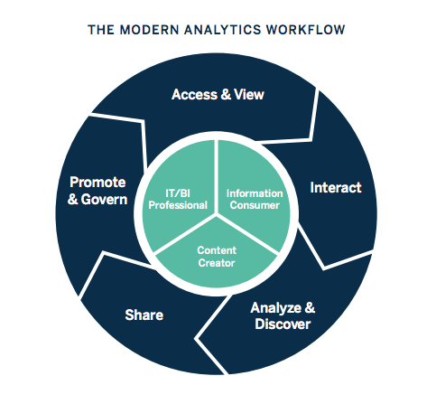
Business Intelligence
What is Business Intelligence
Business intelligence (BI) uses business analytics, data mining, data visualization, and data tools to help organizations make better data-driven decisions.[1]

Slide 5
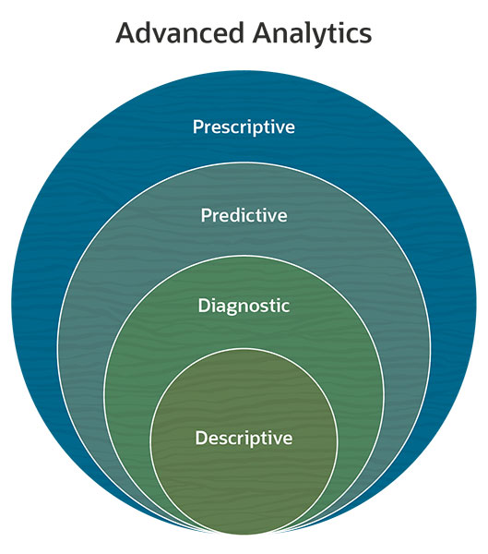
Advanced Analytics
What is Advanced Analytics ?
Advanced analytics uses sophisticated, automated methods to assess data, revealing correlations and relationships and extracting predictive information. Data mining, which sorts large quantities of diverse data into clean, usable data is the key for Advanced Analytics.[2]
Descriptive Analytics - What happened ?
Diagnostic Analytics - Why did it happen ?
Predictive Analytics - What will happen ?
Prescriptive Analytics - How can we make it happen ?

Slide 6
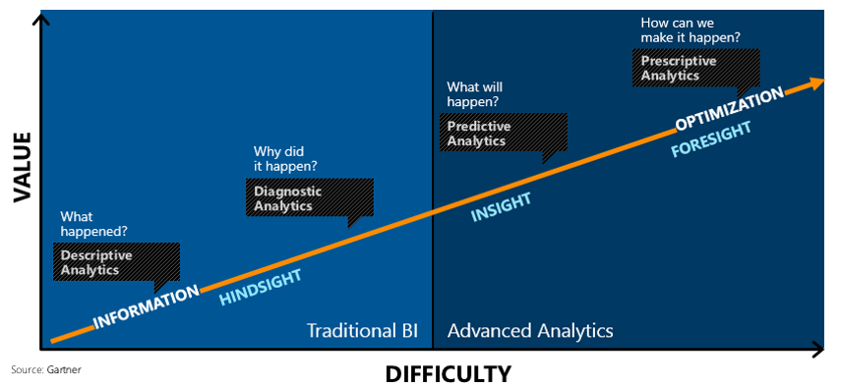
Advanced Analytics
How are Business Intelligence and Advanced Analytics related ?
More advanced analytic capabilities which generate actionable insights, predictions, or explicit recommendations leading to economic improvements.

Slide 7
Big V’s of Advanced Analytics:
Volume
Variety
Velocity
Veracity
Value

Slide 8

Case Study – I Monetizing on Increased Volume of Information
Mobilink cellular service:
Leading cellular Provider of Islamabad.
Increased subscriber range.
Monetize on cellular data/information of customers.
Base decisions on top of Advanced analytics made possible by SAP InfiniteInsight
Promotions and campaigns inclined towards more usage.
Predictive modeling to increase customer retention by 380 Percent!

Slide 9


Case Study – II Monetizing on Increased Variety of Information
Coca-Cola:
Minute Maid acquisition by Coca –Cola.
Customer dissatisfaction about the consistency.
Revenue analytics similar to Delta airlines to maximize its revenue per mile.
Black Book methodology.

Slide 10
Advantages of Advanced Analytics
Improved and Actionable decision making.
Embracing complexity, unexpected Activity and changing conditions.
Optimizing Business Process.
Automating Governance, Risk and Compliance.
Enhancing Scenario Planning.
Identify Monetizable Insights.
Understanding Unstructured Information.
Identifying Faint Signals.
Evolving to Insight and Foresight.
Instigating Innovation.

Slide 11
Conclusion
When a business is evolving and times are changing, businesses should truly consider the power of Advanced Analytics.
It not only provides quicker insights for better decision making but also be consistent at making predictions and prescriptions.

Slide 12
Summary
Advanced Analytics tends to give out more monetization value to organizations.
They are complex to build and model.
The predictions and decisions made using advanced analytics are better than decisions made out of Business Intelligence tools and reports.

Slide 13
References
[1] - https://www.tableau.com/learn/articles/business-intelligence
[2] - https://www.netsuite.com/portal/resource/articles/erp/advanced-analytics.shtml
Reference Book: Infonomics by Douglas B. Laney. Gartner, Inc.
https://nibmehub.com/opac-service/pdf/read/Infonomics%20_%20how%20to%20monetize-%20manage-%20and%20measure%20information%20as%20an%20asset%20for%20competitive%20advantage.pdf

