Slide 1
Information Management Maturity and Principles
Presented By,
GROUP E
Sreya
Palwinder
Tania

Slide 2
Agenda
Discuss about:
Information Management,
EIM Maturity Model
Various Levels of Information Maturity
Impediments to Maturity
Barriers to Information Asset Management
Challenges

Slide 3
Learning outcome
CONTENTS COURSE OUTLINE
Information Management
EIM Maturity Model
Levels of Information Maturity
Impediments in Maturity
Barriers to Information Asset Management
Generally Accepted Information Principles
Conclusion
Summary
Reference
Summarize valuation approaches used in informatics and its related disciplines: information theory, information economics, macroeconomics, intellectual capital, intangible asset valuation, asset management, and Generally Accepted Accounting Principles (GAAP) Science.

Slide 4
What Is Information Management?
Information management is the entire range of technical, operational, and social functions of a system that is used to handle information.
Individuals, social networks of individuals, organizations, businesses, and governments all engage in some form of information management.

Slide 5
The Information Management Maturity Model
Enterprise information management (EIM) is defined as the optimization, storage and processing of data within an enterprise through the combined power of business intelligence or analytics and content management.
An EIM maturity model enables organizations to identify at what stage of maturity they've reached and what actions to take to reach the next level.

Slide 6
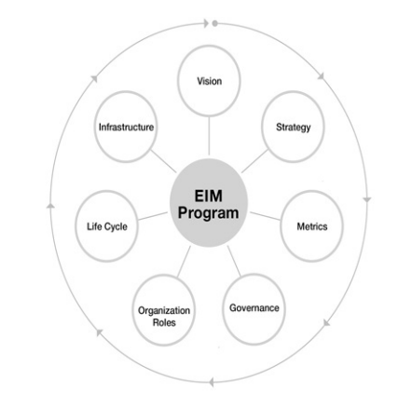
EIM Model
Gartner’s EIM maturity model
7 essential building blocks for EIM maturity
Vision
Strategy
Metrics
Governance
Organization Roles
Life Cycle
Infrastructure

Slide 7
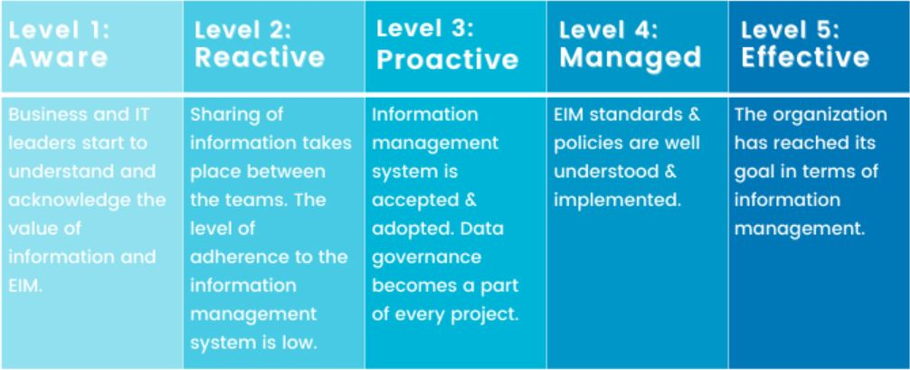
Levels of Information Maturity
Level 1 organizations (in lower 10%, aware of key issues and challenges)
Level 2 organizations (approximately 30%, operate in a reactive application-centric mode)
Level 3 organizations (approximate 40%, more proactive)
Level 4 organizations (approximately 15%, managing and leveraging information)
Level 5 organizations (fewer than 5%, typically model organizations, optimized aspects)

Slide 8
Impediments in Maturity
According to the Gartner EIM Maturity workshop, the challenges expressed by participants are :
Vision Challenges
Strategic Challenges
Information Metrics Challenges
Governance Challenges
People Related Challenges
Infrastructure Challenges

Slide 9
Vision Challenges Strategy Challenges
Information is managed independently,
no sharing of data.
Data accessible only to owner and heirs.
Disagreement in ownership and
credibility of data.
Poor information management.
Information seen as disposable.
Control of IT over information management.
Overplanning and lack of implementation.
Information hoarding.
Lack of Vision to form a strategy.
Ignorance to existing information.
More focus on technology
Insufficient Funding.

Slide 10
Information Metrics Challenges Governance Challenges
Subjective goals and measures.
Goal Tracking is rarely done.
Cost-benefit, ROI metrics, prioritization
are rarely included in IT projects.
Data quality is not measured.
Failure in measuring information value,
cost and risk.
Lack of required officials in handling data.
Ad hoc data quality efforts are favored.
Information hoarding.
Information sprawl.
Improper monitoring of policies.
Lack of sponsorship.
Lack of information inventory.

Slide 11
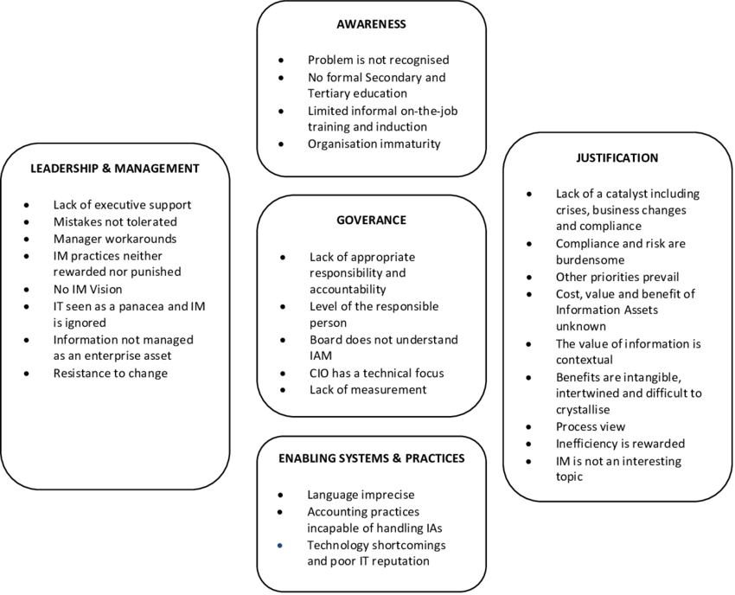
Barriers to Information Asset Management
The challenges to manage information as an asset are:
Awareness
Leadership and Management
Business Governance
Enabling Systems and Practices
Justification

Slide 12
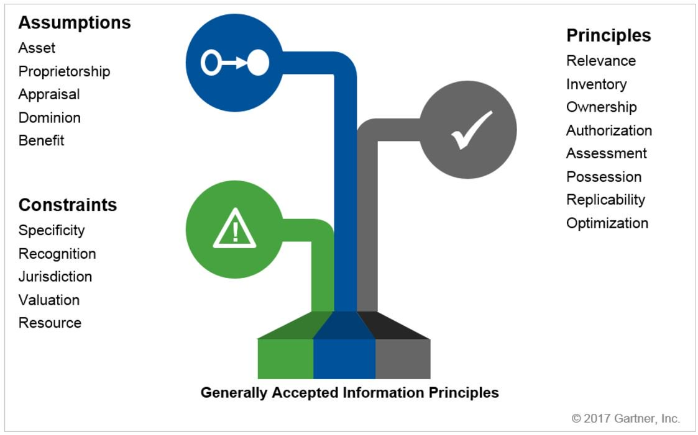
Generally Accepted Information Principles
The principles are based on assumptions and constraints.
The assumptions are :
Asset Assumption
Proprietorship Assumption
Appraisal Assumption
Dominion Assumption
Benefit Assumption

Slide 13
Generally Accepted Information Principles
The constraints restrict how the principles are followed:
Specificity Constraint
Recognition Constraint
Jurisdiction Constraint
Valuation Constraint
Resource Constraint

Slide 14
Generally Accepted Information Principles
The principles dictate how information assets should be managed:
Relevance Principle
Inventory Principle
Ownership Principle
Authorization Principle
Assessment Principle
Possession Principle
Replicability Principle
Optimization Principle

Slide 15
Conclusion
New digital transformation plans are required as a result of the tremendous waves of disruption that today's businesses are facing, including a scattered workforce, cybersecurity concerns, altering customer expectations, and changes in international regulations.
For business transformation, recent work must be seamless, automatic, networked, affordable, and accessible. Information Management uses technology to power and secure daily operations while connecting professionals with clients.

Slide 16

Summary
In a nutshell,
EIM software allows enterprises to handle both structured and unstructured data across business activities, derive commercial insights, and encrypt that data while fulfilling regulatory standards.
Information management strategies use software and other technologies that are intended to help enterprises get the most out of their data in order to increase productivity, encourage transparency, and allow business insights.

Slide 17
Reference
Infonomics: How to Monetize, Manage, and Measure Information as an Asset for Competitive Advantage
DOUGLAS B. LANEY Gartner, Inc.
https://www.sciencedirect.com/topics/computer-science/information-management
https://www.hyland.com/en/resources/terminology/enterprise-information-management
https://solutions.opentext.com/information-advantage

