Slide 1
Chapter 6
Information Supply Chains and Ecosystems
Group F :
Ganesh Chaulagain(C0838561)
Hukamdeep Singh (c0834020)
Jyoti Shukla(817905)

Slide 2
Agenda
Discussing Supply Chain Scenarios (Push & Pull)​
Metrics for information Supply chain​
New Supply chain model for information Assets ​
Working in the real information ecosystem ​
Adapting Classic Ecosystem Entities Concepts​
Information as a second language​

Slide 3
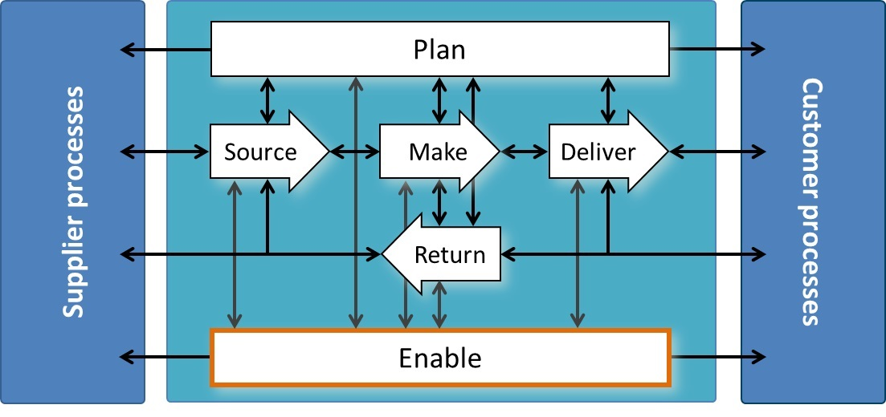
Applying the SCOR Model to the information Supply Chain

Slide 4
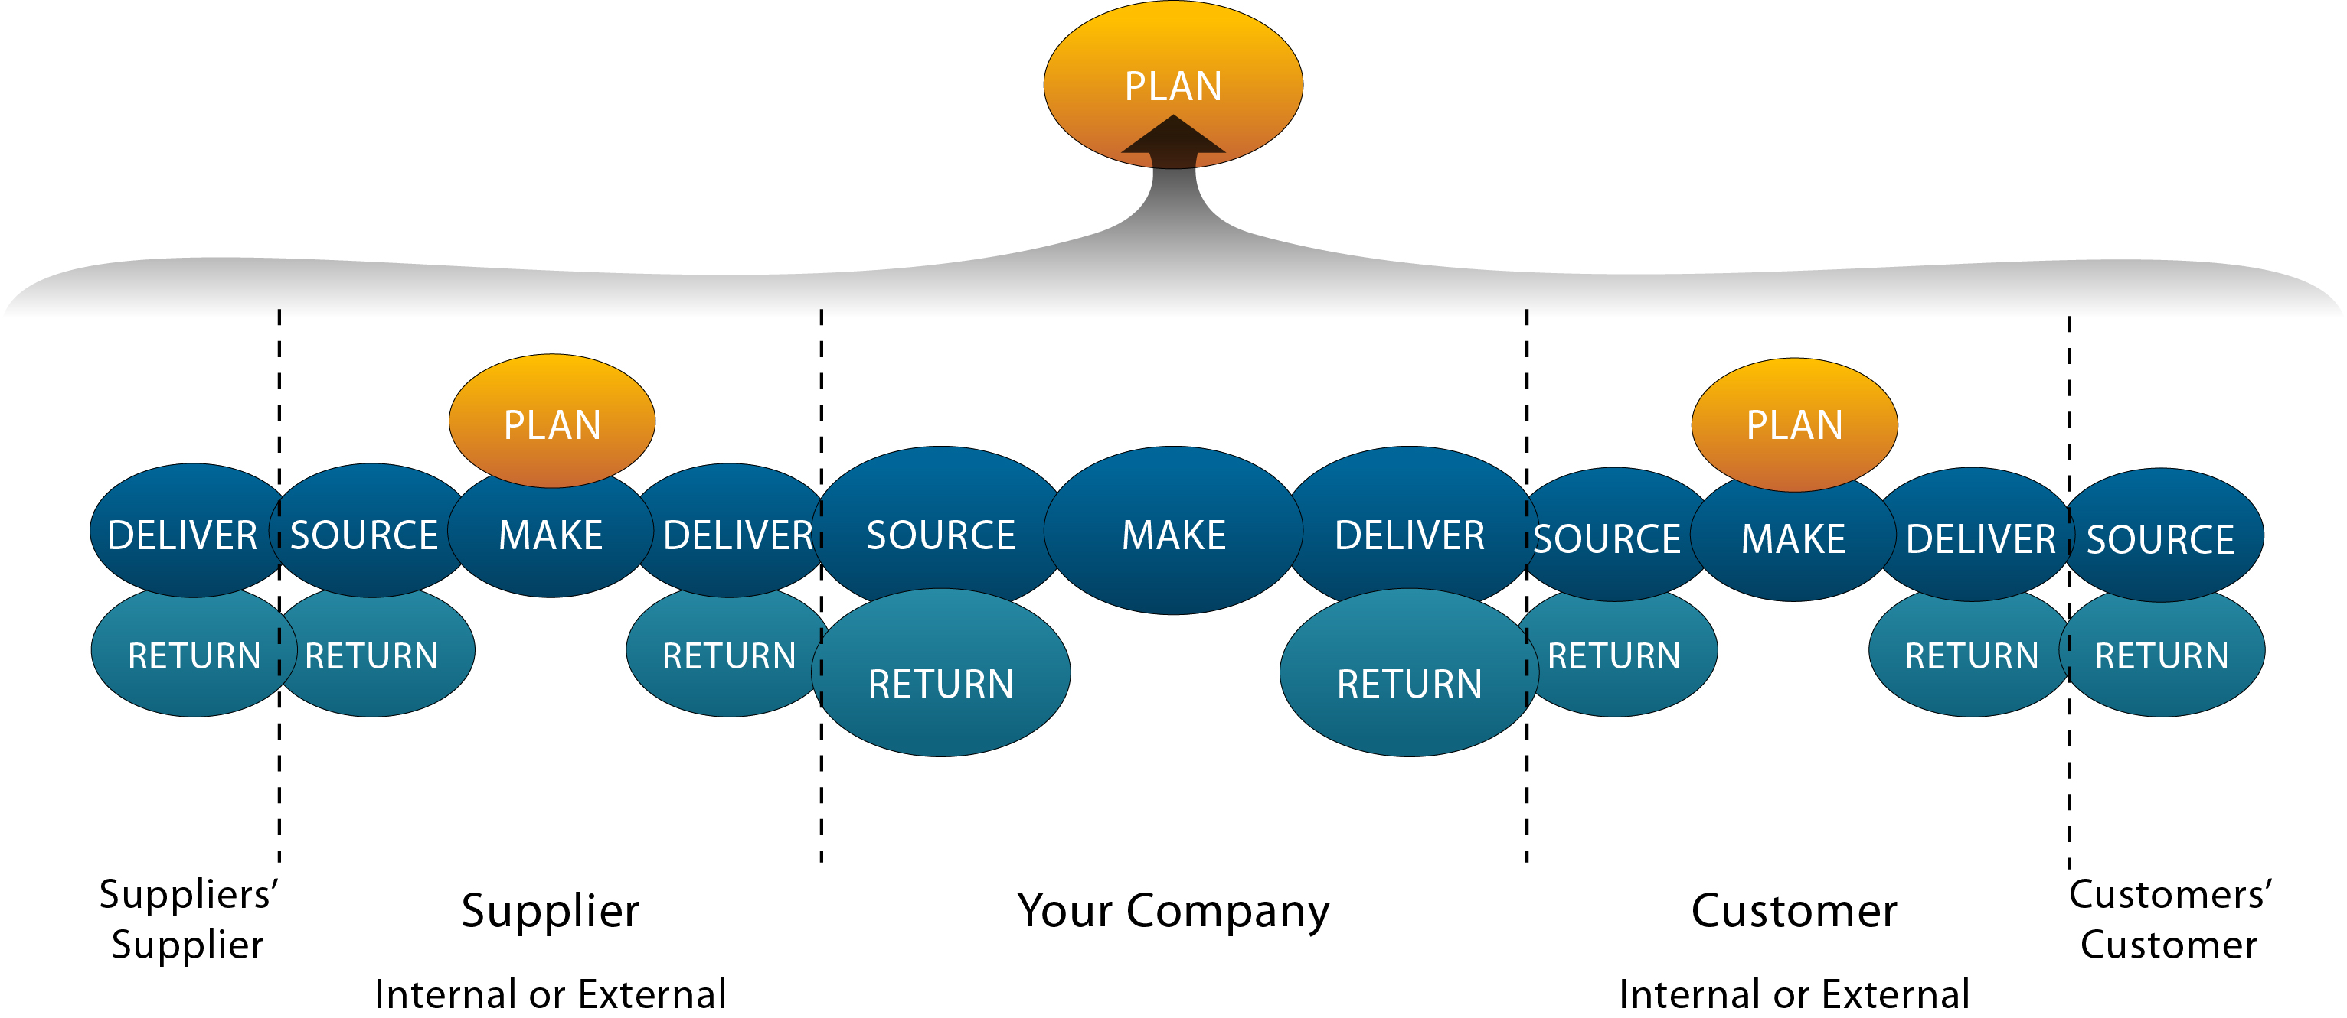

Slide 5
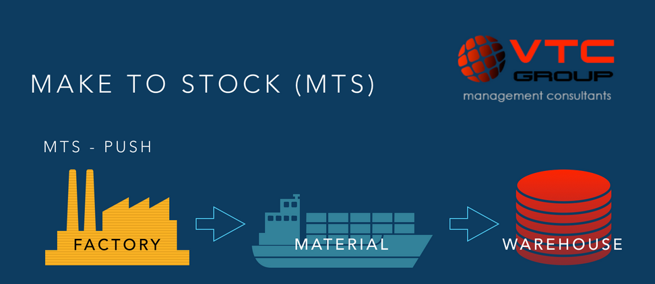
Information Supply Chain Scenarios
"make-to-stock"

Slide 6
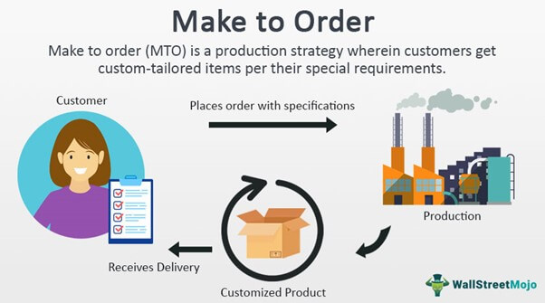
Information Supply Chain Scenarios
"make-to-order"

Slide 7
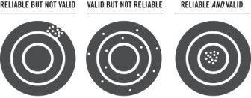

Metrics for the Information Supply Chain
SCOR model have around 200 key indicators for performance
Reliability : Query/update performance, Data quality
Responsiveness: Info accessibility, request turnaround time, User satisfaction survey

Slide 8


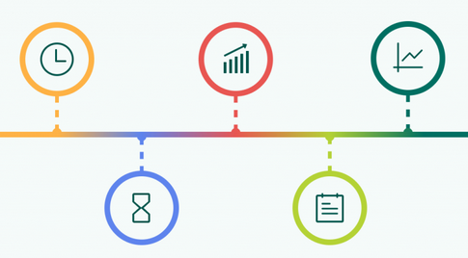
Metrics for the Information Supply Chain
Agility: Linked data, metadata, and master data measures, Ease of integration
Costs : Data acquisition cost Data management costs, Data delivery costs
Asset Management Efficiency (Assets): Information timeliness, Actual usage

Slide 9
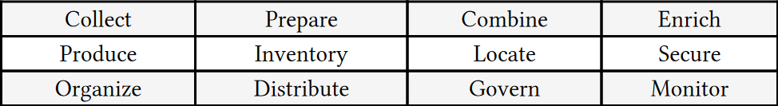
A New Supply Chain Model for Information Assets
Supply Side of assets:
Demand side of assets:

Slide 10
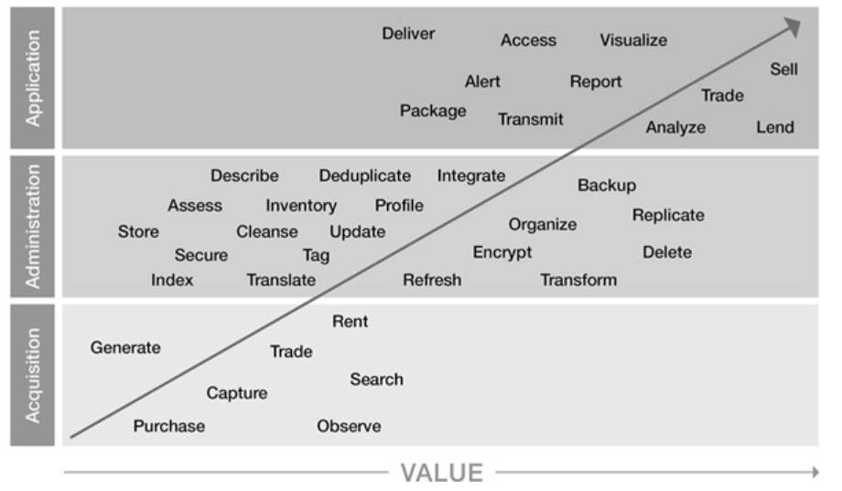
A New Supply Chain Model for Information Assets

Slide 11
Real Information Ecosystem

Slide 12
As per biological definition of an ecosystem, it is a group of living things that includes both the elements of their habitat such as air, water, sun and soil as well as living things.
Therefore, in the field of information technology as well, the ecosystem is any system or network where components interact and are connected, such as in a business and this flow of information becomes even more important as businesses turn to ecosystems to fuel their digital growth.

Slide 13
ROLES OF INFORMATION IN AN INFORMATION ECOSYSTEMS.

Slide 14
We can consider information as an energy resource or resource. For instance, its like an oil of the 21st century or also can be considered as information is like a water because these information fuels business process and business themselves.
The most common way to think about information within an ecosystem context is as an organism itself.
One could argue that information germinates or is born, survives and thrives, replicates, combines and evolves.
It is affected by climate and topography, and sometimes even decomposes and is recycled.

Slide 15
STEPS TO PREPARE FOR A REAL INFORMATION ECOSYSTEM
There may be ways to modify the variety of conventional biological ecosystem theories in order to better explain the world of information and some of them are briefed below:

Slide 16
Ecosystem Entities:
Actors such as organisms' organic matters and nutrients, and energy is named for biology whereas we can consider metaphor of information as energy in information ecosystem.
Ecosystem Features:
Like their counterpart, information ecosystems involve networks of interactions among information “organisms” and with their environment. It may not be natural to think of information as interacting, but that’s just what happens during lookups, searches, integration, query updates, and reporting.
Ecosystem processes:
The types of processes within the biological ecosystem include energy flows, nutrient cycling, and the movement of matter.
These sub-processes enable the main functions of decomposition, reproduction, and growth.

Slide 17
Similarly, altering information can occur via filtering it, cleansing it, or applying algorithms to it and thereby rendering it more consumable
Ecosystem Influences:
In the biological world, disturbances may include falling trees or rocks, wildfires, insect invasions, volcanic eruptions, or tsunamis.
Using a concept known as “threat modeling” we can imagine and should prepare for similar kinds of disturbances to our information ecosystems such as security breaches, natural disasters, new competitors, or business collapses
Ecosystem Management:
Many biological ecosystems are managed to ensure the ongoing optimal production of organisms for ultimate consumption (e.g., eating, viewing, playing, commuting, etc.).
Similarly, information ecosystems are managed to ensure the ongoing optimal production of information consumed by businesses and individuals

Slide 18
Lessons from Sustainability

Slide 19
Definition
When an ecosystem is healthy, scientists say it is in balance or sustainable. Since we want our information ecosystems to be sustainable and thrive, let’s take a look at how we might incorporate the principles of sustainability or conservation. What was originally known as the “three Rs” of Reduce, Reuse, and Recycle recently have been expanded into “five Rs” which also include Refuse and Repurpose.

Slide 20
Refuse
Refusing an asset is the surest way to prevent any expenses or risks associated with it.
Doing so incurs not only excess storage costs, but also unnecessary costs up and down the information lifecycle such as planning, design,architecture, data integration, backup/recovery, governance, and security.
bulking up a database with extraneous data can impact operational,analytic, and business performance.
refusing information can be a difficult decision, especially in this age of untold opportunities for monetization and decreasing storage expense. But in many cases, information you don’t collect today will be licensable from a partner or data broker when you need it

Slide 21
Reduce (If you can’t refuse it, try to reduce it)
Reducing the use of an asset is about minimizing—rather than eliminating—the expenses associated with it
Information architects and data modelers have struggled with this conundrum daily since the introduction of the relational database: how to balance performance versus storage.
Customer relationship management (CRM), enterprise resource planning (ERP), and other application architects wrangle with decisions over whether to include or exclude certain fields from the application’s data model.
Information professionals need to have the ability, authority, and economic models to push back.
Information management professionals should be attuned to reducing the information generated or collected, and reducing the information moved and presented

Slide 22
Reuse(Especially if you cannot reduce it, reuse it.)
Reusing an asset is simply to use it again for the same purpose, whatever that purpose is. Fortunately, such is the nature of information.
It is non-depletable. No matter how much you use it, it doesn’t get used up.this is one of the characteristics that makes information highly monetizable.
Reuse may not be a primary consideration in information ecosystem design, as reusability is a key characteristic of information. However, if you find certain information isn’t being reused, such as in the case of “dark data,” it may be time to reduce it.

Slide 23
Repurpose(Repurpose on purpose.)
Repurposing an asset involves sharing it and enabling it to be used for different reasons. An Uber or Lyft driver’s automobile is a prime example.
Information’s non-depletability enables its extreme reuse, information’s non-rivalry characteristic enables its extreme repurposing. More than just being able to share an asset or resource, non-rivalry.
In addition to reference data such as metadata and master data, most repurposing of information tends to be in the form of repurposing operational data for analytics. Or in the case of content it may involve simultaneously sharing on the web, an intranet, broadcast media, or signage.

Slide 24
Recycle(No use for it? Recycle it.)
Recycling involves breaking down an asset to create a new one. Or in our previous ecosystem terminology: decomposing it to provide the building blocks for a new organism.
With transactional or other structured information (portions of a dataset),fields may be parsed and recombined to create new datasets.
With transactional or other structured information (portions of a dataset),fields may be parsed and recombined to create new datasets.
Often recycling will involve sharing “decomposed” information with others (even outside the organization) so that they may benefit from creating new information assets from it.

Slide 25
Remove(Can’t reduce, reuse, repurpose, or recycle it? Remove it)
In addition to the “five Rs” of classic sustainability and conservation, there’s a sixth “R” specific to non-physical assets such as information: removal.
The removal or dumping of physical assets is a last resort, and not much in the realm of sustainability. But with non-physical or intangible assets, removing unneeded ones is easy and doesn’t harm your or anyone else’s information ecosystem. But it can help with lessening personnel, storage, processing costs, and risks.
However, when the actual deletion of information may not be allowable due to regulatory compliance reasons, consider moving the data into an offline archive.Technically, the simple deletion of information may not always be so simple.Within an information ecosystem, many different kinds of information are linked through other information. Therefore, simply deleting some unused information can cause data integrity problems.

Slide 26
Information as a Second Language
All of these metaphors for information we’ve devised over the years are not meant to be clever. Rather they’re to help information management professionals,IT professionals, business people, and executives communicate about information more effectively using familiar, non-threatening terminology and frameworks.
To consolidate all of these challenges and potential solutions related to“speaking data” within an organization and among business partners, Gartner analyst Valerie Logan recently has introduced the concept of “information as a second language” (ISL). No surprise, ISL parallels the kind of challenges and training afforded to non-native speakers in the U.S. under the moniker “English as a Second Language” (ESL). Logan’s ISL idea is a fantastic one and still being developed.

Slide 27
Conclusion
Information is Crucial because it provides the framework on which managers make choices and supply chain processes carry out transactions, information is essential to supply chain performance and just like healthful ecosystems are essential for people, animals, and plants,informations are also equally important in fueling the businesses and business process in the present world.

Slide 28
Reference
Infonomics: How to Monetize, Manage, and Measure Information
In fact, he did. In the book The Art of War Sun Tzu is quoted as saying: “The general who wins the battle makes many calculations in his temple before the battle is fought. The general who loses makes but few calculations beforehand.”
Andy Roswell-Jones, Jan-martin Lowendahl, Chris Howard, and Tomas Nielsen, “The 2017 CIO Agenda: Seize the Digital Ecosystem Opportunity,” Gartner, 14 October, 2016, www.gartner.com/document/3478517.
https://icatalog.dau.edu/mobile/CLL037/DAU_Supply_Chain_Atlas/010103/010103000060.html
Infonomics: How to Monetize, Manage, and Measure Information as an Asset by Douglas B. Laney
https://www.wallstreetmojo.com/make-to-order/
https://www.vtc-group.com/single-post/2017/09/11/mtomts-strategies-make-to-ordermake-to-stock
omics: How to Monetize, Manage, and

