Slide 1
Chapter 7
Leveraging Information Asset Management Standards and Approaches
GROUP-G
Sagar Dahiya
Vindhya Teegapuram
Sujit khatiwada

Slide 2
Agenda
What is an Asset?
Information Asset and it’s importance.
Standard and Non-Standard Information Asset Management Standards.
Balance Sheet Assets and Other major Proto-Assets

Slide 3
Course learning outcome
Defend infomatics and its use
1.1 Summarize valuation approaches used in infomatics and its related disciplines:
information theory, information economics, intellectual capital, intangible asset, asset management.

Slide 4
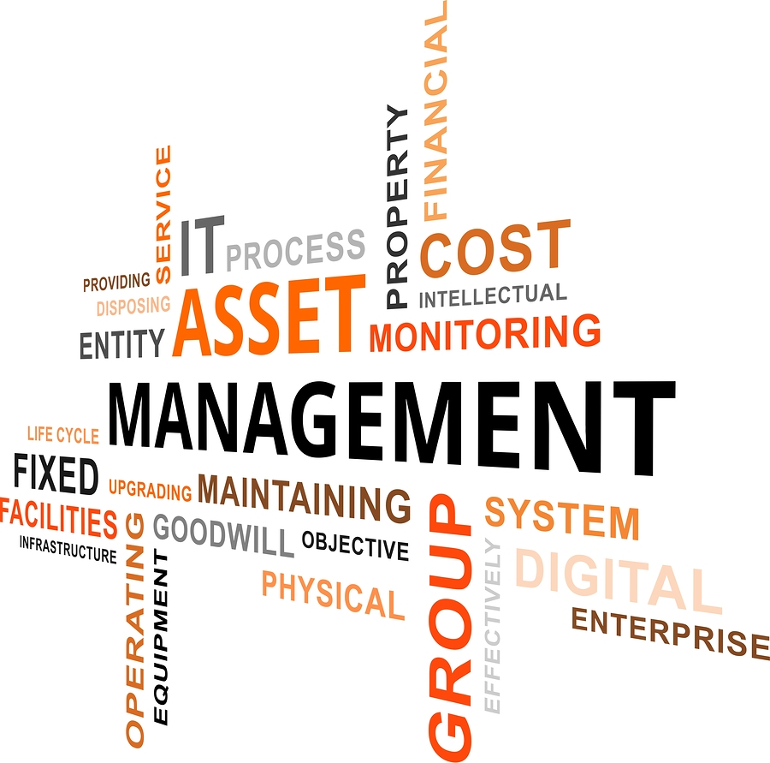
Information Asset Management

Slide 5
What is an Asset?
Something that has potential or actual value to an organization
Can have present or future value
Nature of Assets:
Human Assets (Behavior, knowledge and competence of workforce)
Financial Assets
Information Assets (Good quality data and information)
Intangible Assets (Organizations reputation and image)
Physical Assets (Plants, machinery, building and property)

Slide 6
Information Asset and it’s importance
It is a body of information, defined and managed as a single unit so it can be understood, shared, protected and exploited efficiently.
Why is this important:
A managed IM program supports compliance in all our fields of practice
Focus on Risk Mitigation and High Value Records
Information Protection & Security
Access and Privacy
Compliance Monitoring

Slide 7
Non-Standard Information Management Standards
Many associations, collaborative open standards groups, and professional services organizations and industry have succeeded to create their own information management-related methodologies or other tools.
These are:
Capability Maturity Model Integration (CMMI),
Data Management Association International (DAMA),
Enterprise Data Management (EDM) Council,
Cicero Group, MIKE2.0, Accenture, Deloitte, IBM and others.
Most of these tend to be lacking in adoption, completeness, integration, and/or usability, so we need standards.

Slide 8
IT Asset Management Standards
The major parts of this ITAM standard are detailed below.
ISO 19770–1 is a process defining best practices for software asset management (SAM) in an organization,
ISO 19770–2 is an XML standard for inventorying and identifying what software is deployed on a given device,
ISO 19770–3 is a schema describing the entitlements and rights associated with a software license, including how to measure the license and entitlement consumption, and
ISO 19770–4 is a standard for reporting on resource utilization.
ISO/IEC 19770-5 provides the overview and vocabulary.

Slide 9
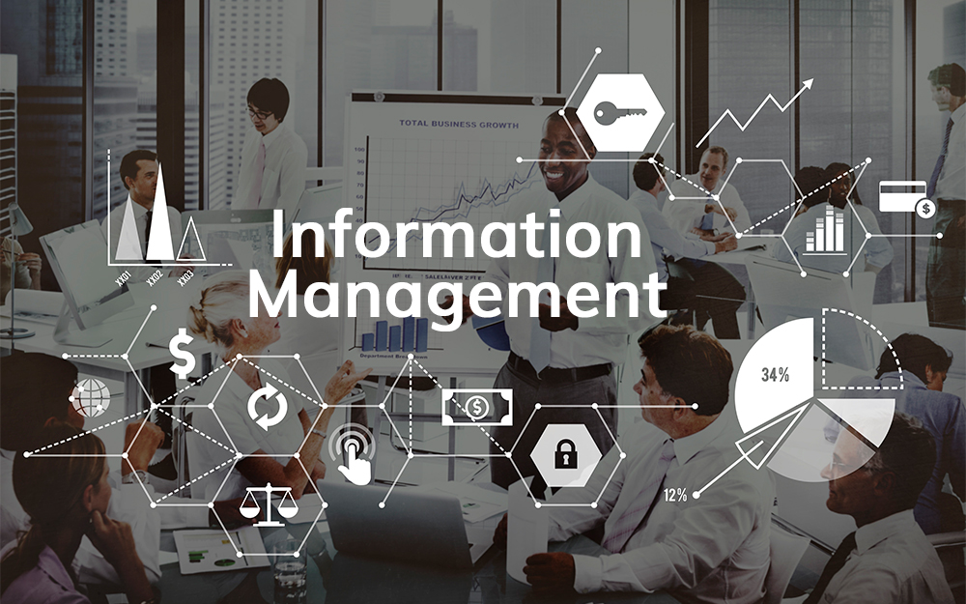

Slide 10
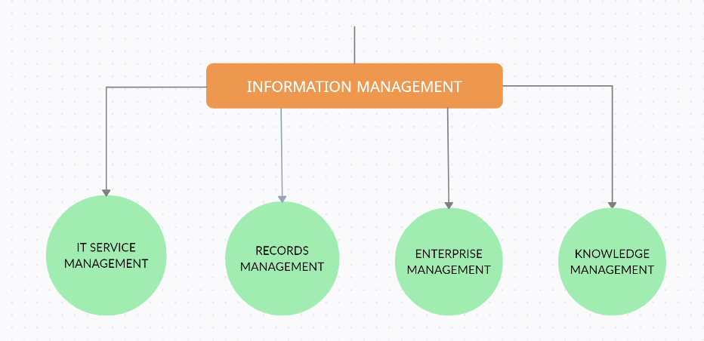
What is Information Management?
Information, as we know it today, includes both electronic and physical information. Information management (IM) is the process of gathering, organizing, and distributing information from one or more sources to one or more audiences.
Below is a picture with few components of IM which will be discussed in this presentation

Slide 11
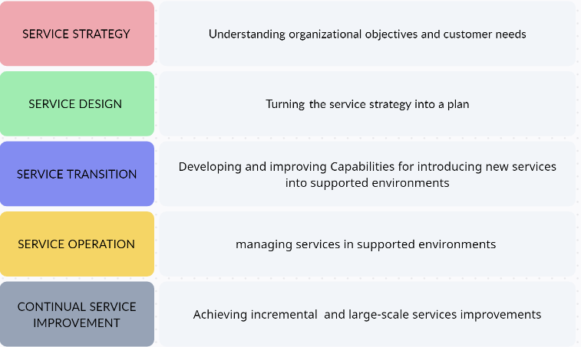
IT Service Management (ITSM):
A set of processes, procedures and other tools known as the Information Technology Infrastructure Library (ITIL) is the prevailing standard for IT service management.
1. ITIL Service Strategy
2. ITIL Service Design
3. ITIL Service Transition
4. ITIL Service Operation
5. ITIL Continual Service Improvement

Slide 12
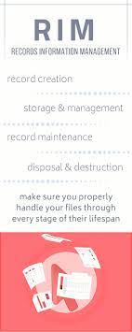
Records Information Management (RIM):
Explained about the current ISO standard for RIM, ISO 15489-1:2016 which defines records as “Information created , received , and maintained as an evidence and information by an organization or person, in pursuance of legal obligations or in the transaction of business.”
This ISO standard describes concepts and principles relating to :
1.Records,Metadata for records, and record systems,
2.Policies, assigned responsibilities,
3. Processing for creating ,capturing and managing records.
NOTE: RIM standards also introduces some concepts which are well documented in Data Governance programs, such as a “defensible solution”-one which can be supported with clearly documented policies, processes, and procedures.

Slide 13
Enterprise Content Management (ECM):
ECM is a discipline for “the strategies, methods and tools used to capture, manage, store, preserve, and deliver content and documents related to organizational processes.”
There are some unique concepts and focused areas which might incorporate into the overall information management approach include:
Specifications concerning the capture or entry and validation of content,
Storing content in an optimal format/structure,
Content classification, Content findability, searchability, and discovery,
Digital rights and digital signatures

Slide 14
Knowledge Management (KM):
Information leaders, such as Chief Data Officers(CDOs), would be wise to take advantage of a lot of what KM has to offer in terms of:
Adapting and dealing with new and exceptional situations in establishing a vision for EIM, including scenario planning,
Developing, communicating, and sharing an EIM vision to transmit an “information culture,”
Collaborating across other areas of the organization, including IT, business, finance, legal, etc.,
Developing, implementing, and improving repeatable, experience-based information asset management methods

Slide 15
Balance Sheet Assets and Other major Proto-Assets
Let's move on from the information and IT industries now and explore asset management concepts in other contexts.
Physical Asset Management
Financial Asset Management
Human Capital Management
Other Intangible Assets

Slide 16
Physical Asset Management
It is a methodical strategy for more effective asset management.
Aims to extend the useful life of assets and maintain their quality of equipment, vehicles, machinery, chillers, HVAC, and other assets.

Slide 17
Physical Asset Management Standard
PAS 55 (Publicly Available Specification - the basis for ISO 55001)
Asset Management Standard
It applies to any company where physical assets are essential to the operation,
particularly those in the transportation, mining, and energy sectors.
It provides answers to five key questions:
What resources do you possess?
chance of suffering an asset-related catastrophe?
aware of the state of your assets currently?
how much does corrective maintenance cost as opposed to preventive maintenance?
should a specific asset be repaired or replaced?

Slide 18
Financial Asset Management
The business of managing money to achieve clients' financial goals.
A financial asset is a liquid asset with value derived from a legal claim to ownership or a contractual right.
It include, among other things, cash, investments in stocks, bonds, mutual funds, and bank deposits.
Goal: Increase value while mitigating risk

Slide 19
Financial Asset Management Roles
Fiduciary Responsibility
A person who intentionally accepts the duty to behave in the best interest and for the profit of another party whose assets they are managing is known.
The obligations of a fiduciary are both moral and legal.
Fiduciary idea of a true “information fiduciary” (or “trustee”) could help elevate the status of information assets and their caretakers
Chief Financial Officer
Senior executive responsible for managing the financial actions of a company.
Report to the board on information asset and analyze indicators and available information.
Investment and decisions to leverage company's information

Slide 20
Human Capital Management (HCM)
Procedures used by an organization to hire, manage, develop, and maximize workers in order to raise their worth to the business (HCM).
People are not assets because we can no longer be owned.
But still discipline of human capital has emerged to manage us as if we were assets.
People Capability Maturity Model (P-CMM)
“a tool to help you successfully address the critical people issues in your organization and guides organizations in improving their processes for managing and developing their workforce”

Slide 21
Intangible Assets
A company's intangible assets do not appear on the balance sheet and do not have a documented book value.
These ideas manifest not in tangible things like hardware or equipment,
things you can’t hold in your hand,
Includes knowledge, designs, patents, processes, trademarks, domains, copyrights, trade, secrets, and even brand.
Intellectual property (IP), is recognized as formal assets and property.
Software exists for tracking and valuing and licensing IP, but a comprehensive, standardized approach does not exist.

Slide 22
Conclusion
These industry-standard methodologies, capability models, and standards and checklists offer tremendous new precepts for how to manage information.
Information is no longer treated as a byproduct or new artifact of business, but rather a vital asset.
Information, like many other sorts of organizational assets, can have a short lifecycle and might degrade with time.

Slide 23
Summary
It may be difficult to manage any kind of asset and managing information assets is no exception.
The expansion of information, the demands on your organization, and the constantly shifting requirements necessitate a novel strategy for your company's very survival.
Management processes needs to ensure the data is accurate and up to date, as well as meeting each standard.
The process of managing asset information starts at the time an asset is originally generated, during the conceptual stage (lust), and can occasionally last well past retirement (dust).

Slide 24
Reference
https://www.gov.nl.ca/apsim/files/Information-Asset-Management.pdf
https://www.aiim.org/what-is-information-management
https://nibmehub.com/opac-service/pdf/read/Infonomics _ how to monetize- manage- and measure information as an asset for competitive advantage.pdf

